Slide 1

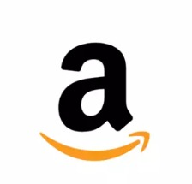
ICT LAB PRESENTATION
Presented By:
Talha Ayyaz
Muhammad Saqib
Hamza Khan
Abdullah Usman

Slide 2
Outlines:
Introduction
Industry
Timeline
Target Market
Three Pillars
    Sellers
    Customers
    Developers
Conclusion

Slide 3
Introduction
Amazon is a multinational technology company that focuses on e-commerce, cloud computing, online advertising, digital streaming, and artificial intelligence. It was founded by Jeff Bezos in 1994 and is headquartered in Seattle, Washington and Arlington County, Virginia. Amazon is one of the most valuable and influential companies in the world, with over 1.3 billion customers and a market capitalization of over 1.6 trillion dollars.

Slide 4
The Industry
Amazon is a part of the “e-commerce” Industry
The industry has grown about 10% or more each year for the past 15 years.
In the recent years, online shopping has become so easy with so many devices such as Mobiles phones, Tablets, Laptops.
Amazon is seen as being one of the world’s largest online retailer.

Slide 5
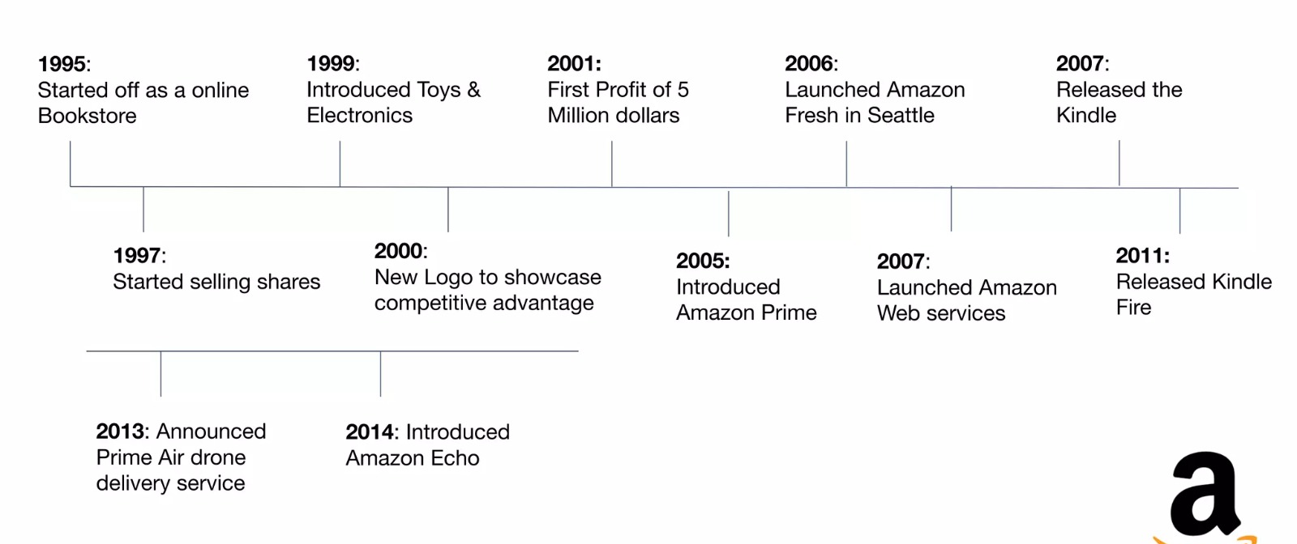
Timeline

Slide 6


Slide 7
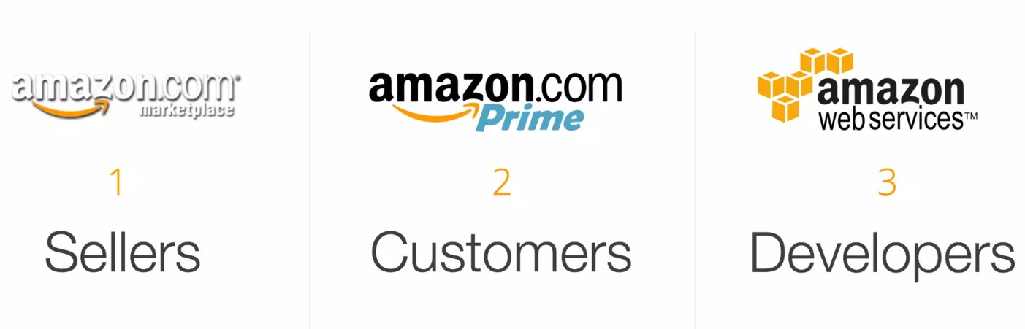
Three Pillars

Slide 8
Sellers
700,000 Unique Brands
  350 Million Products
Extend Reach for small business
  Increase Online Presence
  Accounts for 1:3 Online Transactions
Amazon Needs Sellers
  Offer Education, Training, & Exclusive Tools
  Inventory Management

Slide 9
Customers
Always Day One
  Innovation & Customer Obsession
Ideal Target
  Early Adopters
  New Parents
Amazon Prime
  Free 2-Day Shipping
  Exclusive Access to Benefits

Slide 10
Developers

Slide 11
Conclusion
In conclusion, we can say, Amazon is a multinational e-commerce company that offers a wide range of products and services, such as books, electronics, clothing, groceries, cloud computing, streaming, and more. It is the most valuable and influential companies in the world, with over 1.3 billion customers and a market capitalization of over 1.6 trillion dollars. Furthermore, it is also known for its innovation and leadership in areas such as artificial intelligence, robotics, voice assistants, and space exploration. Amazon's vision is to be Earth's best employer and Earth's safest place to work.

Slide 12
Any Question?

Slide 13
References
Amazon (company) - Wikipedia. https://en.wikipedia.org/wiki/Amazon_%28company%29
Amazon.com. Spend less. Smile more. https://www.amazon.com/
Amazon.com: Welcome to Amazon. https://us.amazon.com/b?node=17867753011
Amazon.fr : livres, DVD, jeux vidéo, musique, high-tech, informatique. https://www.amazon.fr/.

