Slide 1

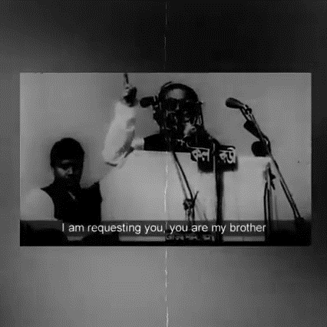
Jinnah: The real Breaker of East Pakistan
Submitted by: Muhammad Saqib
Date: Nov 14, 2023

Slide 2
Outlines
Introduction
Why Jinnah: The real Breaker of East Pakistan?
  Historical Facts
  Jinnah Speech
  Language Riots
Other causes behind the Fall of Dhaka
  Sheikh Mujeeb's Six Points
Conclusion

Slide 3
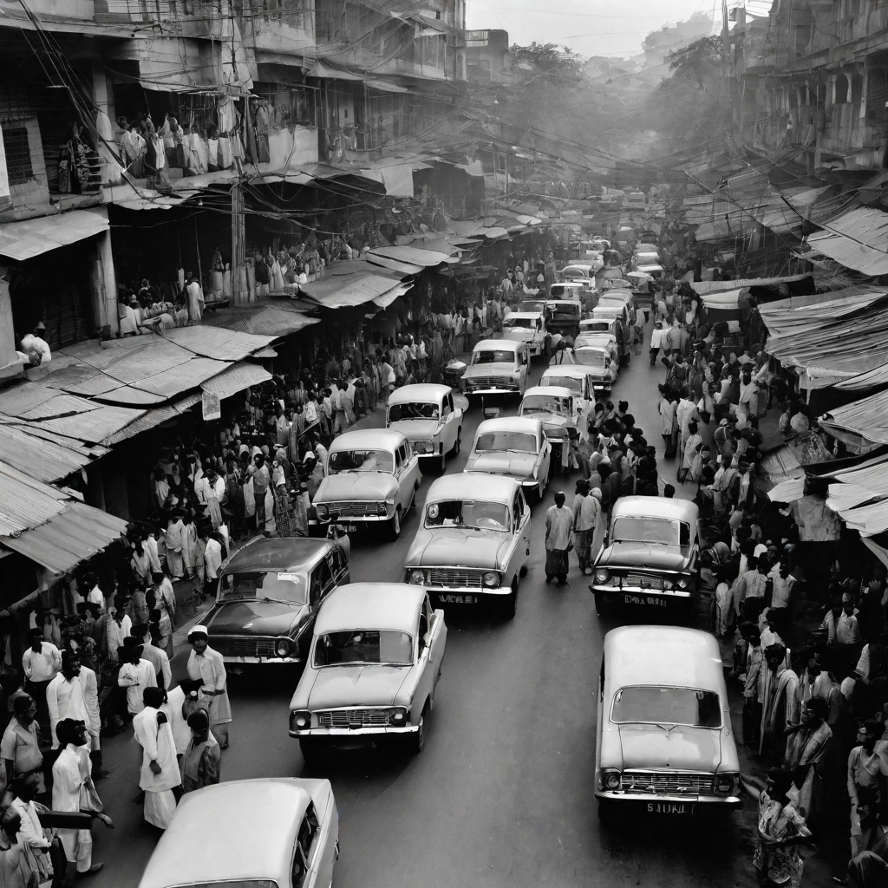

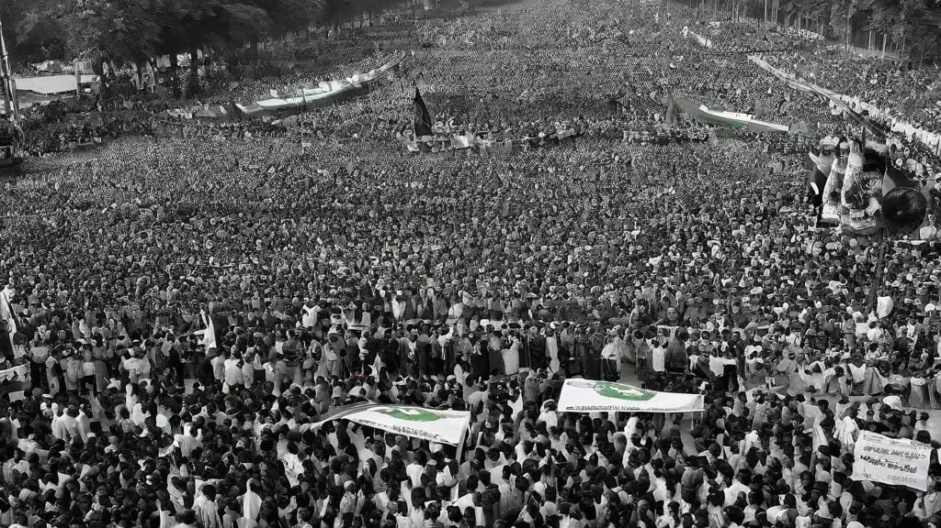
Why Jinnah: The real Breaker of East Pakistan?
Historical Facts
Jinnah Speech
Language Riots
Causes behind the Partition
A huge distance between East & West Pakistan
An unnatural state since the beginning even separated by borders
Jinnah Policies and beginning of independence
21st March 1948, Jinnah addressed to the people of Dhaka
And declared Urdu as a National Language
Mass agitation during speech
No constitution
Seeds of hatred were sown
Language riots started in 1952
During this, Awami Muslim League emerged later named Awami League in 1955
It emerged since language issue
Notes:
Discuss other factors behind the fall of Dhaka:
Shift of Money
Population Distribution
Ayub Era
Mujeeb’s Six Points (Next Slide)
Elections of 1971

Slide 4
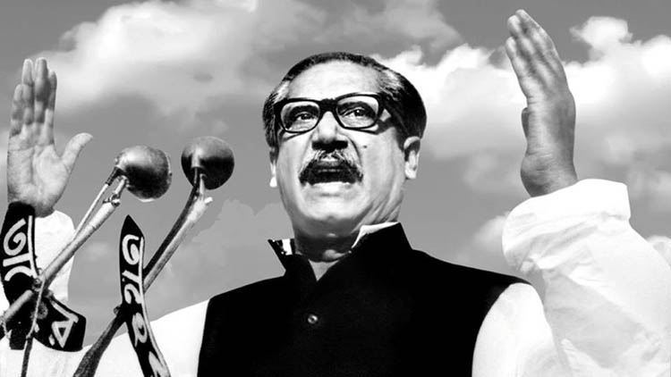






Sheikh Mujeeb’s Six Points
Sheikh Mujeeb's Six Points
Federal Parliamentary System
Limited Federal Governments
Separate Currencies
Limited federal taxation
Separate trade
Separate troops
Notes:
“A concise History of Pakistan” by Muhammad Reza Kazmi
Emerge of Muslim Nationalism
West Pakistan’s stance on Mujeeb’s six points
Other factors

Slide 5
Conclusion
Conclusion:
To conclude my topic - Jinnah: The real breaker of East Pakistan, I can say that;
  There were several reasons behind the fall of Dhaka but start of these occurs from Jinnah’s address at Dhaka which compel us to say that yes, he was the man who sow the seeds of hated by declaring Urdu as the national language even though there was no need to do that because we had no proper constitution.
  However, this was not the sole reason because there were other reasons also which were discussed earlier and we go through them one by one, but initializations was done by Jinnah that’s why we are calling him as a real breaker of East Pakistan.
Notes:
Military role
Bajwa stance on Fall of Dhaka [Former Army Chief]

