Slide 1
CS-105 Problem Solving and Programming
Lecture 3-4

Slide 2
Data
Constants and Variables
  Data used in problem solving
Constants
  A constant is a specific alphabetical and/or numerical value that never changes during the processing of all the instructions in the solution
  Constants can be any type of data – numeric, alphabetical, etc.
  In many programming languages and applications constants can be named

Slide 3
Data
Constants
  In this case, the constant is given a location in memory and a name
  Once the constant is given a value, it cannot be changed during the execution of the program, e.g., the value of PI.
  The only way to change the value of a constant is to change the program.
  Many name conventions stipulate that named constants be given names containing ALL CAPITAL LETTERS in order to easily distinguish them from variables

Slide 4
Variables
The value of a variable may change during processing
In many languages variables are called identifiers since the name identifies what the value represents
The programmer uses variable name as a reference name for a specific value of the variable
The computer sets up a specific memory location to hold the value of each variable name found in the program

Slide 5
Variables
The variable name should be consistent with what the value of the variable represents
Rules for naming the variables:
Name the variable according to what it represents
Do not use spaces in the variable names
Start a variable name with a letter
Do not use hyphens or special symbols except underscore
Be consistent when using upper and lowercase letters

Slide 6
Variables
Rules for naming the variables:
Use the exact variable name when referencing that variable in any part of the program
Use the exact variable name when referencing that variable in any part of the program
Use the naming conventions specified by the organization where you work, e.g. all uppercase letters for constants and first uppercase letter for every word used in variable name

Slide 7
Data Types
The data the computer uses are of many different types
Computer must be told about the data type of each variable or constant
Numeric Data
Includes all types of numbers. The subtypes of numeric data type are Integer and Real
Integers are whole numbers
Real numbers or floating point numbers are whole numbers plus decimal parts

Slide 8
Data Types
Numeric Data
  A real number can be represented in scientific notation such as 2.5E5 or 3.2E-3. No commas are used.
Character Data
  The character data set consists of all single digit numbers, letters and special characters, available to the computer – placed within quotation marks.
  An uppercase letter is considered different from a lowercase letter.

Slide 9
Data Types
Character Data
When more than one character is put together, the computer considers this item as a string.
Character and string data are compared and arranged in alphabetical order.
The computer gives each character a number (ASCII Codes). The numbers are compared to see which is larger and are then arranged in ascending order.
Upper case letters are given a smaller value than a lowercase letter

Slide 10
Data Types
Logical Data
Consists of only two values – true and false
They are used in making yes-or-no decisions
For example, to check the credit record

Slide 11
Operators
The computer has to be told how to process data.
This task is accomplished through the use of operators in high level languages
Operators are data connectors within expressions and equations
The type of operator used in problem solving are mathematical, relational, and logical.
The operand and the resultant are two concepts related to the operator

Slide 12
Operators
Operands are the data that the operator connects and processes.
The resultant is the answer that results when the operation is completed. For example 5 + 7
Mathematical Operators:
+, -, /, *, MOD
Relational Operators:
<, >, ==, !=, <=, >=
Operands of relational operators can either be numeric or character, however, they must be of the same type.

Slide 13
Operators
The resultant of relational operation is of logical data type (i.e. either True or False).
Logical Operators:
AND, OR, NOT
Logical operators are used to connect relational expressions and to perform operations on logical data.

Slide 14
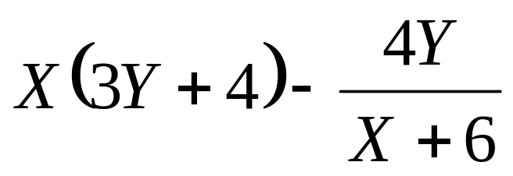
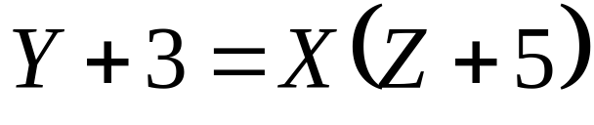
Setting up Numeric Expressions and Mathematical Equations
Numeric Expression
  There must be an operator between variables and / or constants
Mathematical Expression
  The programmer must modify the equation so that it is in the form of an assignment instruction

Slide 15
Operator Precedence
  ()
  Function calls
  NOT, Unary –
  /, *, MOD
  +, –
  <, <=, >, >=
  ==, !=
  AND
  OR
  =

Slide 16
Evaluating a Mathematical Expression
      5 * (X + Y) – 4 * Y / (Z + 6)
1
4
2
3
5
6

Slide 17
Evaluating a Relational Expression
      X – 4 > Y
1
2

Slide 18
Evaluating a Logical Expression
      NOT (A < B) AND (C OR D)
1
2
3
4

Slide 19
Developing a Logical Expression
Problem: A large department store has its own charge card. The policy for a customer to charge an item is that the customer must have a valid charge card and either a balance of >= Rs.1000/- or a charge of < Rs. 500/-.

Slide 20
Functions
Small set of instructions that perform specific tasks and return values.
Are used as part of instructions in a solution. They are basic tasks that are used repeatedly in a problem solving process.
Are used to shorten problem solving time and improve readability of the solution
Each language / application has built-in functions in it. Most languages allow programmers to write their own functions

Slide 21
Functions
Are used as function_name(data).
Functions use data for processing. Data are listed as part of the function and are called parameters.
Examples:
  Sqrt(N), Abs(-3), Power(x, y), Random(), Integer(4.67), Min(7, 4), Round(N, n1)

