Slide 1
Artificial Intelligence
Lecture # 10

Slide 2
Learning objectives
To enable students to
  Understand how gradients are calculated through the chain rule
  Understand backpropagation

Slide 3
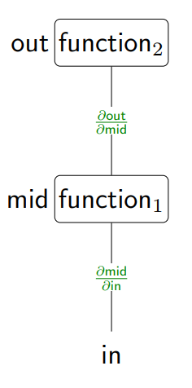

Composing functions

Slide 4
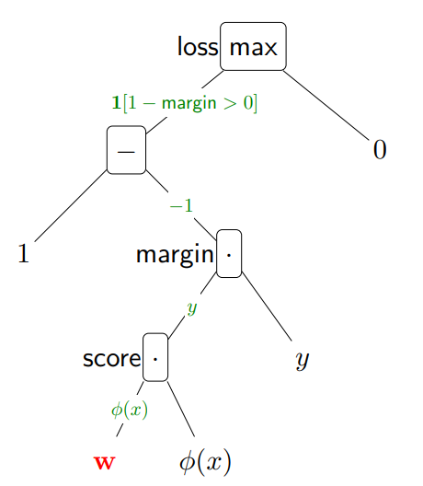

Consider the hinge loss
To compute the gradient

Slide 5
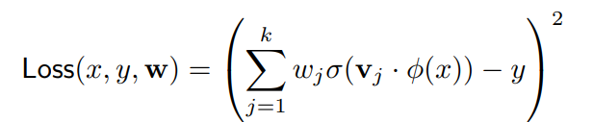
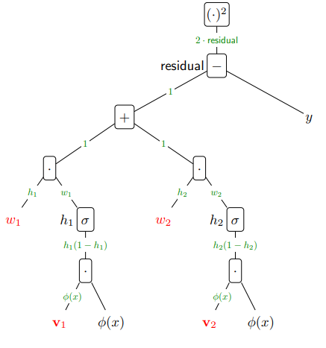
Neural networks

Slide 6
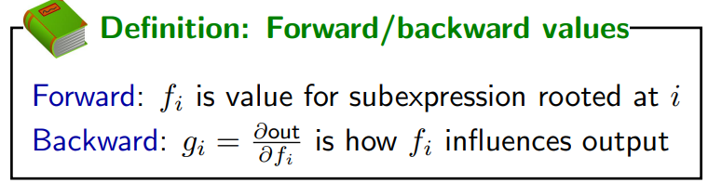

Slide 7
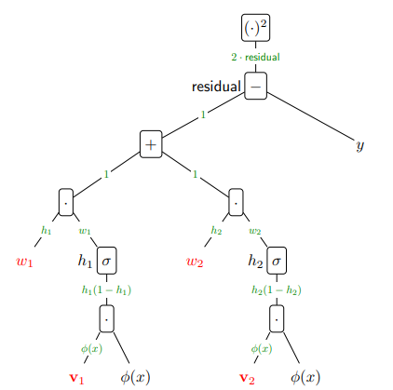
Backpropagation

Slide 8
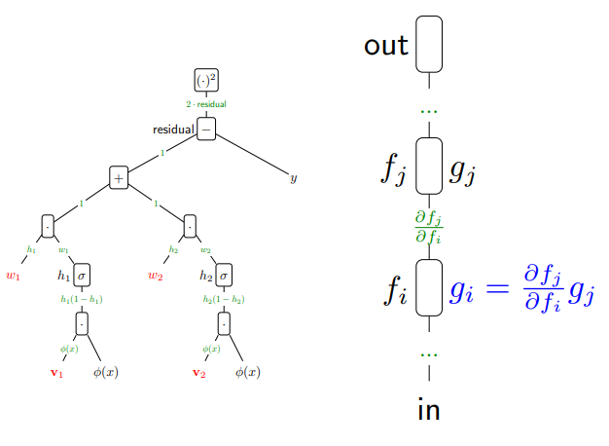
Back propagation

Slide 9
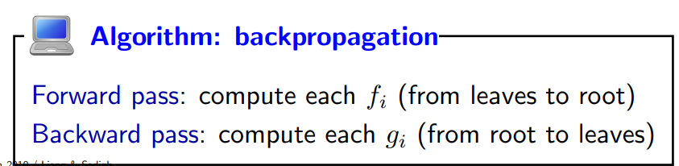

Slide 10
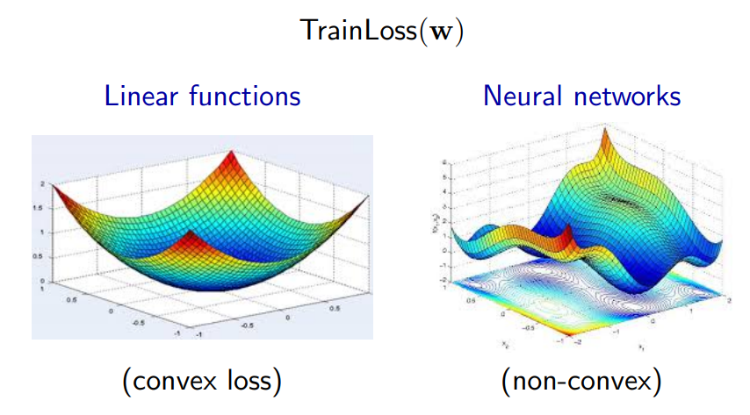
Optimization in Neural Networks
Optimization of neural networks is generally hard

