Slide 1
Artificial Intelligence
Lecture # 11

Slide 2
Learning objectives
To enable students to
  Apply backpropagation on examples
  Understand nearest neighbor classification

Slide 3
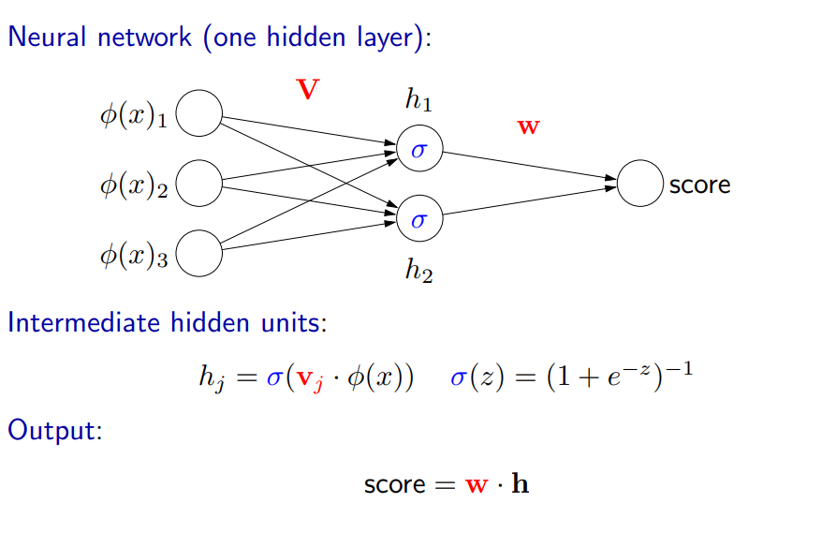

Slide 4
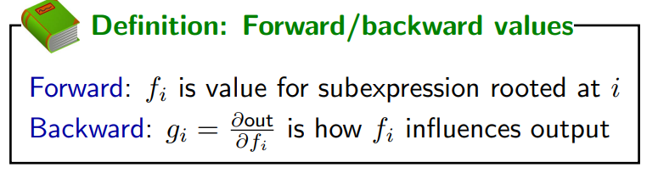

Slide 5
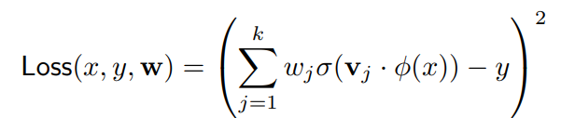
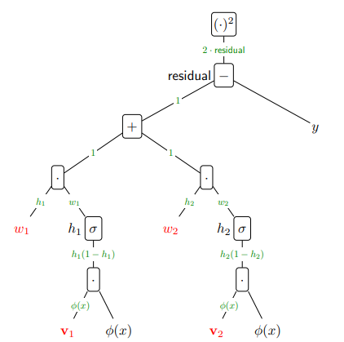
Backpropagation

Slide 6
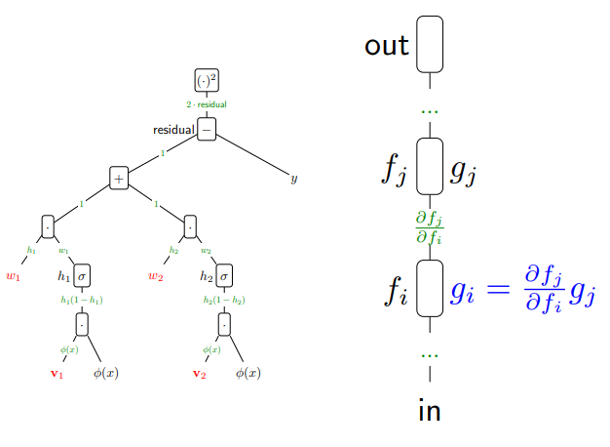
Back propagation

Slide 7
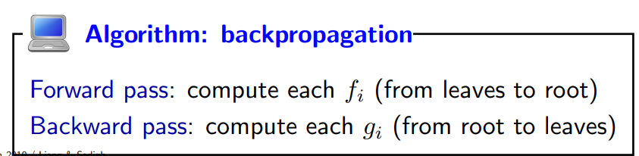

Slide 8
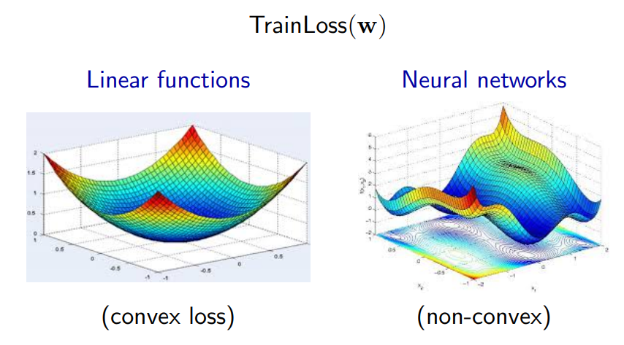
Optimization in Neural Networks
Optimization of neural networks is generally hard

Slide 9
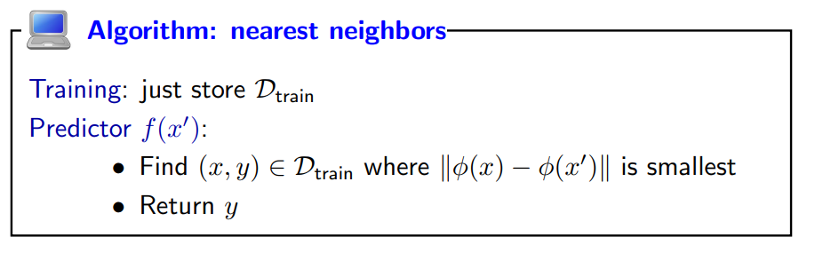
Nearest Neighbours
Simple
Choice of similarity/distance measure

Slide 10
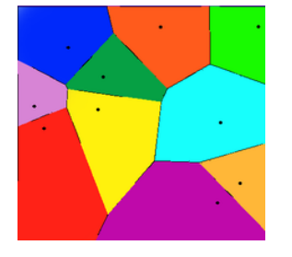
Decision boundary

Slide 11
Summary of learners
Linear predictors: combine raw features
  prediction is fast
  easy to learn
  weak use of features
Neural networks: combine learned features
  prediction is fast
  hard to learn
  powerful use of features
Nearest neighbors: predict according to similar examples
  prediction is slow
  easy to learn
  powerful use of features

Slide 12
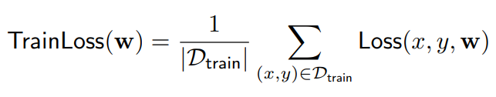
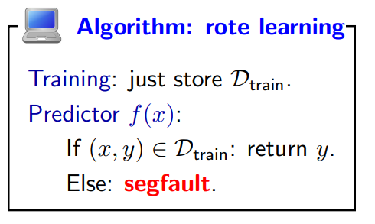
Training error
Is this a good objective?
This algorithm minimizes the training error (zero)

Slide 13
Generalization
Uptil now, the average training loss has been taken as the objective function
The true goal is to minimize error on unseen future examples
We need to avoid overfitting and we need to generalize
Through overfitting, we may end up fitting noise in the data

Slide 14
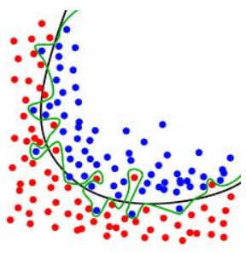
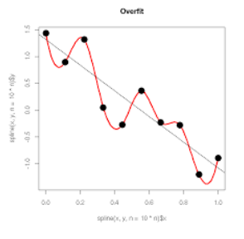
Overfitting
  Classification Regression

Slide 15
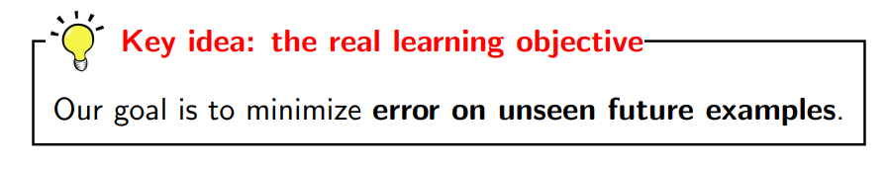
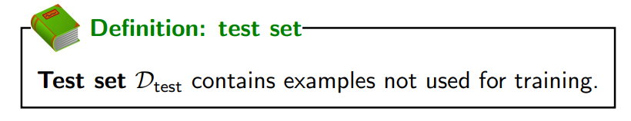
Since the unseen future examples are not available

Slide 16
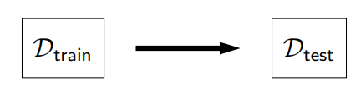
An algorithm generalizes well when it is trained on the training data but evaluated on the test data to give acceptable results

