Slide 1
Artificial Intelligence
Lecture # 12

Slide 2
Learning objectives
To enable students to
  Understand generalization and types of errors
  Understand strategies to reduce error

Slide 3
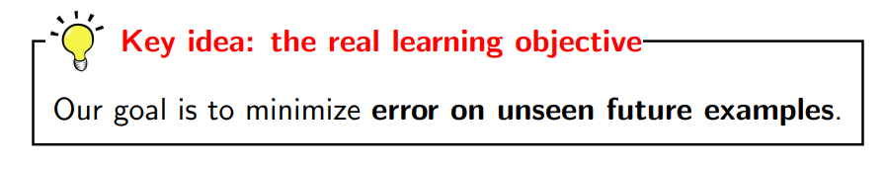
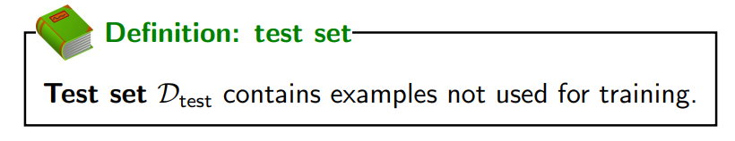
Since the unseen future examples are not available

Slide 4
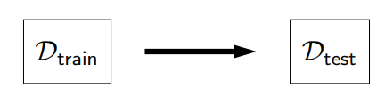
An algorithm generalizes well when it is trained on the training data but evaluated on the test data to give acceptable results

Slide 5
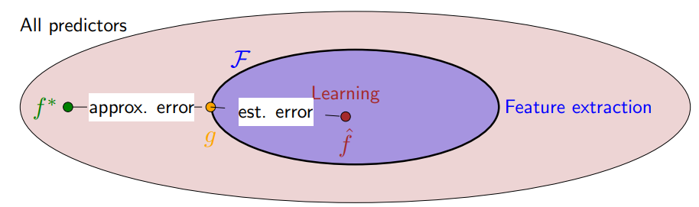
Approximation and estimation error
How far are we from f*, a predictor that predicts everything perfectly
Approximation error: how good is the hypothesis class?
Estimation error: how good is the learned predictor relative to the potential of the hypothesis class?

Slide 6

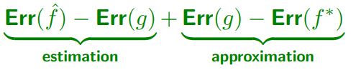
The learning framework consists of
  choosing a hypothesis class F (by defining the feature extractor)
  choosing a particular predictor f from F
Larger hypothesis classes have lower approximation error
Let g ∈ F be the best predictor in the hypothesis class in the sense of minimizing test error
How good the predictor f returned by the learning algorithm wrt best in the hypothesis class
Larger hypothesis classes have higher estimation error

Slide 7
Hypothesis class size
As the hypothesis class size increases:
  Approximation error decreases
    taking min over larger set
  Estimation error increases
    harder to estimate something more complex
Recall
To control the size of the hypothesis class, control the number of possible values of w that the learning algorithm can choose from

Slide 8

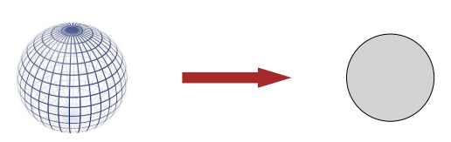
Strategy 1: dimensionality
Reduce d, the dimensionality

Slide 9
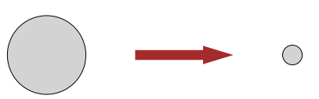
Strategy 2: norm
Reduce the norm ||w||

Slide 10

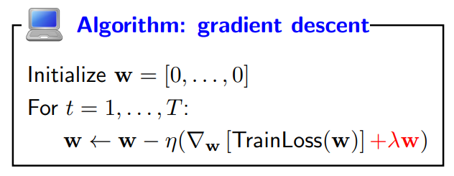
Controlling the norm
Objective (regularized)
This form of regularization is known as L₂ regularization

Slide 11
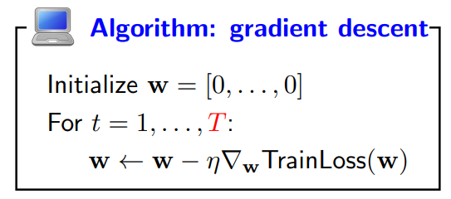
Controlling the norm
Early stopping

Slide 12
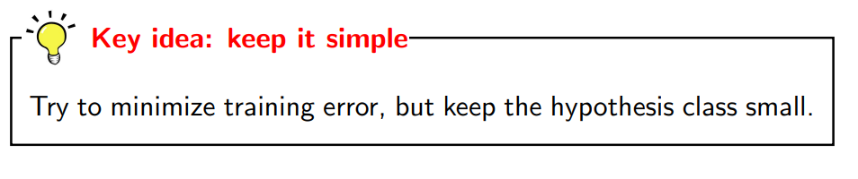

Slide 13
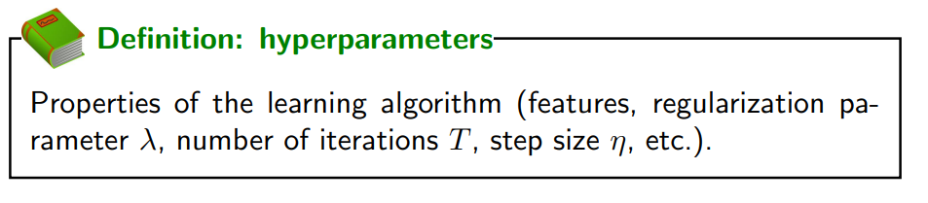
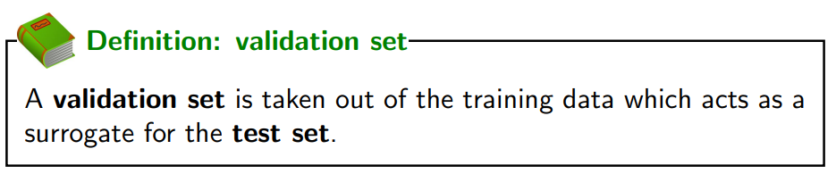
Hyperparameters
How to choose hyperparameters?
Usually10-50% of the test set
K-Fold validation

