Slide 1
Artificial Intelligence
Lecture # 14

Slide 2
Learning objectives
To enable students to
  Carry out k-means clustering
  Understand basic idea of hierarchical clustering
  Understand binary similarity measures

Slide 3
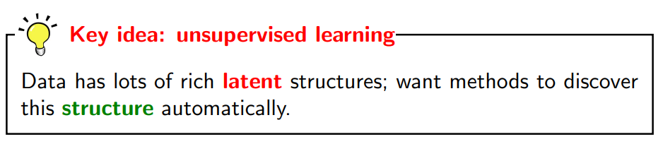
Unsupervised learning
D_{train} only contains inputs x

Slide 4
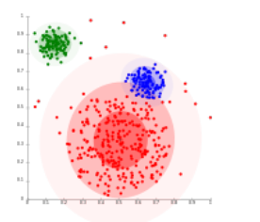
Clustering

Slide 5
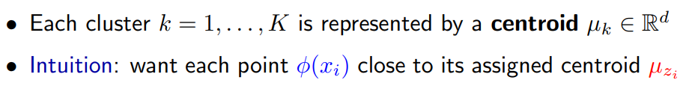
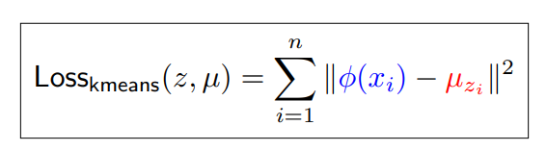
K-Means clustering
Objective function

Slide 6
Suppose that the data mining task is to cluster points with (x, y) representing location) into three clusters, where the points are:
A1 (2,10), A2 (2,5), A3(8,4), B1(5,8), B2 (7,5), B3 (6,4), C1(1,2), C2(4,9)
The distance function is Euclidean distance. Suppose initially we assign A1, B1, and C1 as the center of each cluster, respectively. Use the k-means algorithm to show the final three clusters

Slide 7
Comments on the K-Means Method
Strength: Efficient: O(tkn), where n is # objects, k is # clusters, and t is # iterations. Normally, k, t << n.
Comment: Often terminates at a local optimal.
Weakness
  Applicable only to objects in a continuous n-dimensional space
  Need to specify k, the number of clusters, in advance (there are ways to automatically determine the best k (see Hastie et al., 2009)
  Sensitive to noisy data and outliers
  Not suitable to discover clusters with non-convex shapes

Slide 8
Hierarchical Clustering
Use distance matrix as clustering criteria. This method does not require the number of clusters k as an input, but needs a termination condition
Step 0
Step 1
Step 2
Step 3
Step 4
agglomerative
(AGNES)
a
a b
b
a b c d e
c
c d e
d
d e
e
divisive
(DIANA)
Step 4
Step 3
Step 2
Step 1
Step 0

Slide 9
Dendrogram: Shows How Clusters are Merged
  Decompose data objects into a several levels of nested partitioning (tree of clusters), called a dendrogram
  A clustering of the data objects is obtained by cutting the dendrogram at the desired level, then each connected component forms a cluster

Slide 10
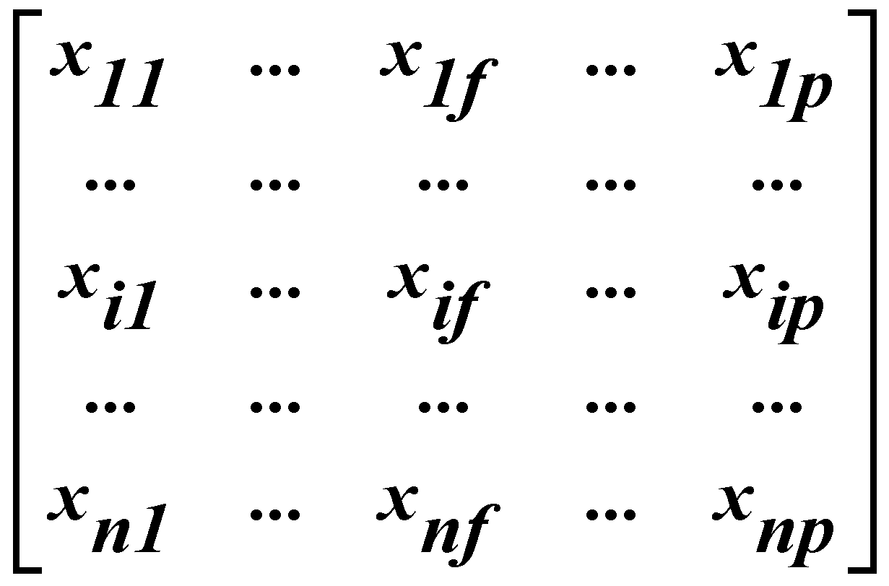
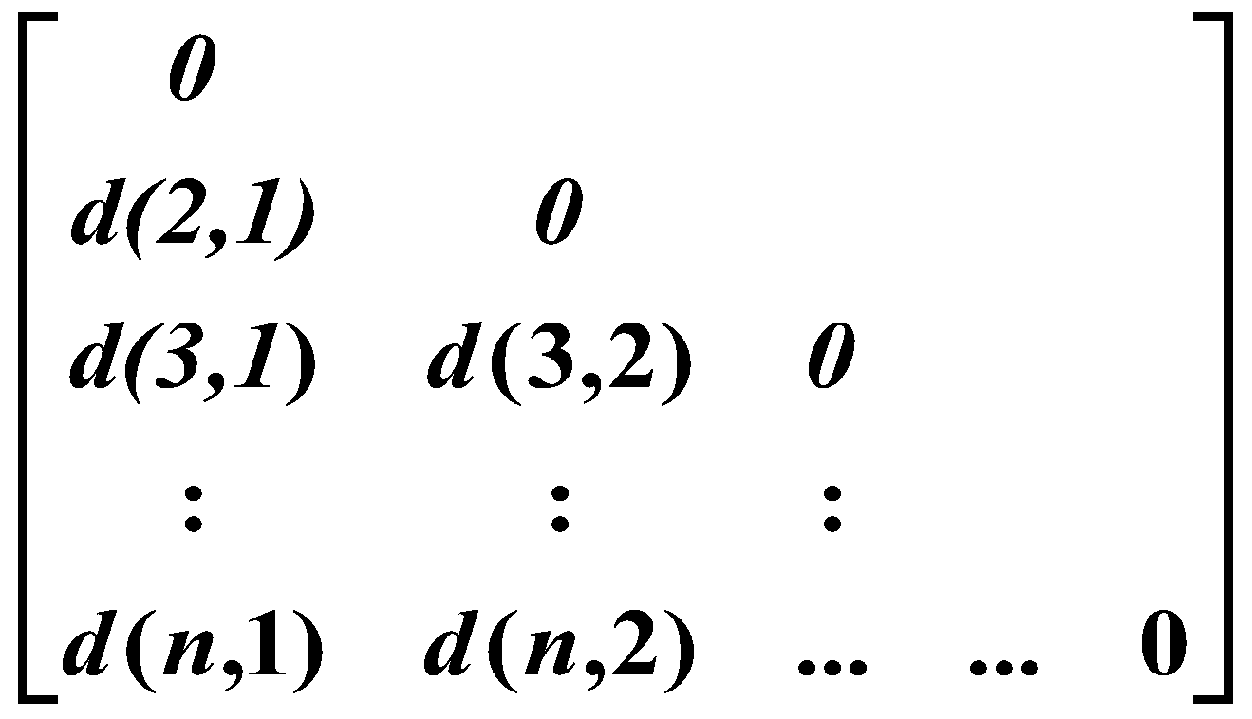
Data Matrix and Dissimilarity Matrix
Data matrix
  n data points with p dimensions
Dissimilarity matrix
  n data points, but registers only the distance
  A triangular matrix

Slide 11
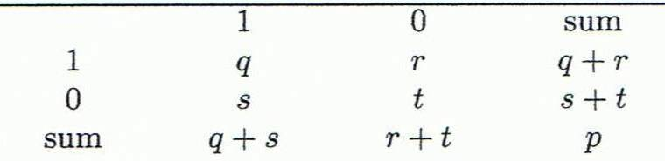
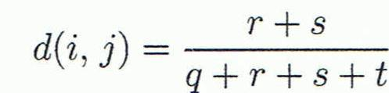
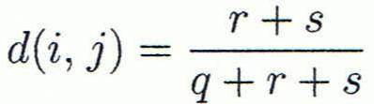

Proximity Measure for Binary Attributes
Object j
A contingency table for binary data
Distance measure for symmetric binary variables:
Distance measure for asymmetric binary variables:
Jaccard coefficient (similarity measure for asymmetric binary variables):
Object i

Slide 12
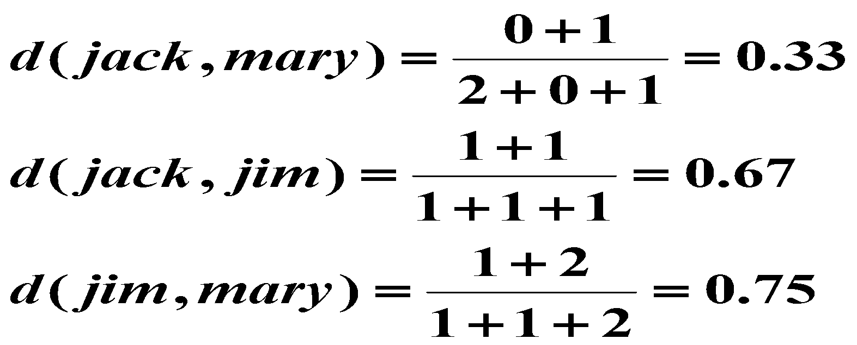
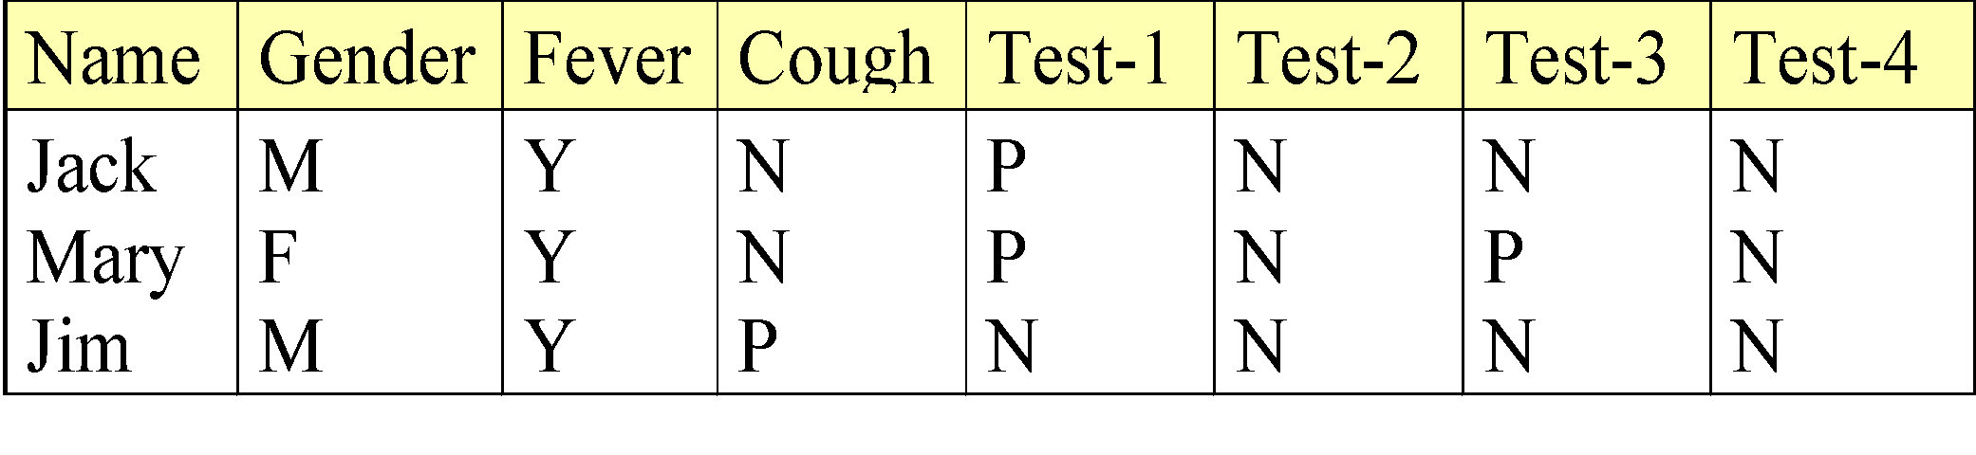
Dissimilarity between Binary Variables
Example
  Gender is a symmetric attribute
  The remaining attributes are asymmetric binary
  Let the values Y and P be 1, and the value N be 0

