Slide 1
Artificial Intelligence
Lecture # 15

Slide 2
Learning objectives
To enable students to
  Understand Euclidean distance measures
  Carry out hierarchical clustering
  Introduce Search-based models

Slide 3
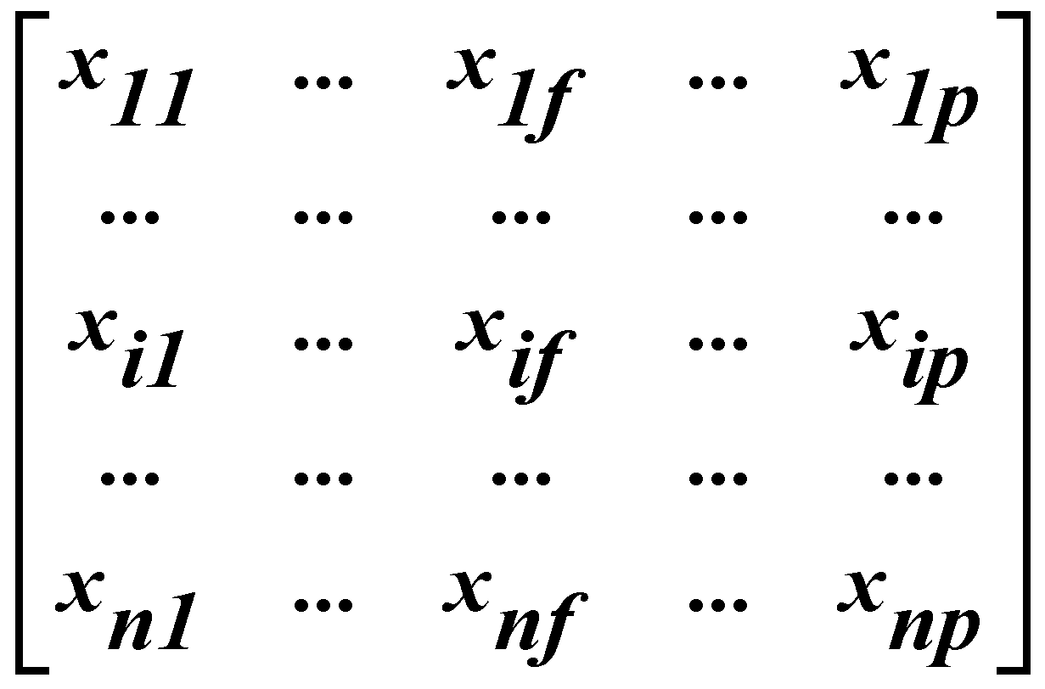
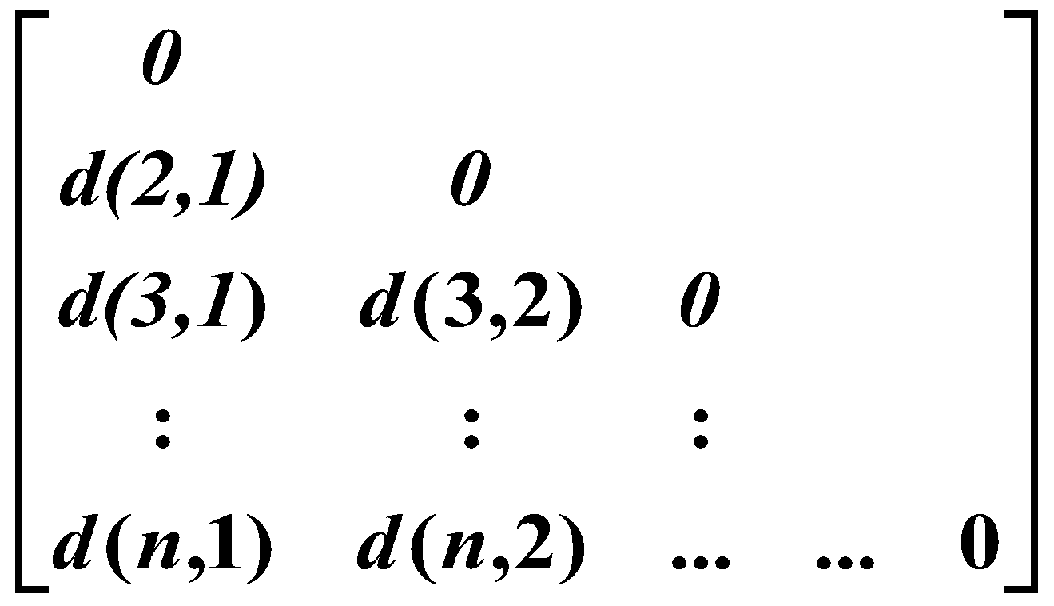
Data Matrix and Dissimilarity Matrix
Data matrix
  n data points with p dimensions
Dissimilarity matrix
  n data points, but registers only the distance
  A triangular matrix

Slide 4
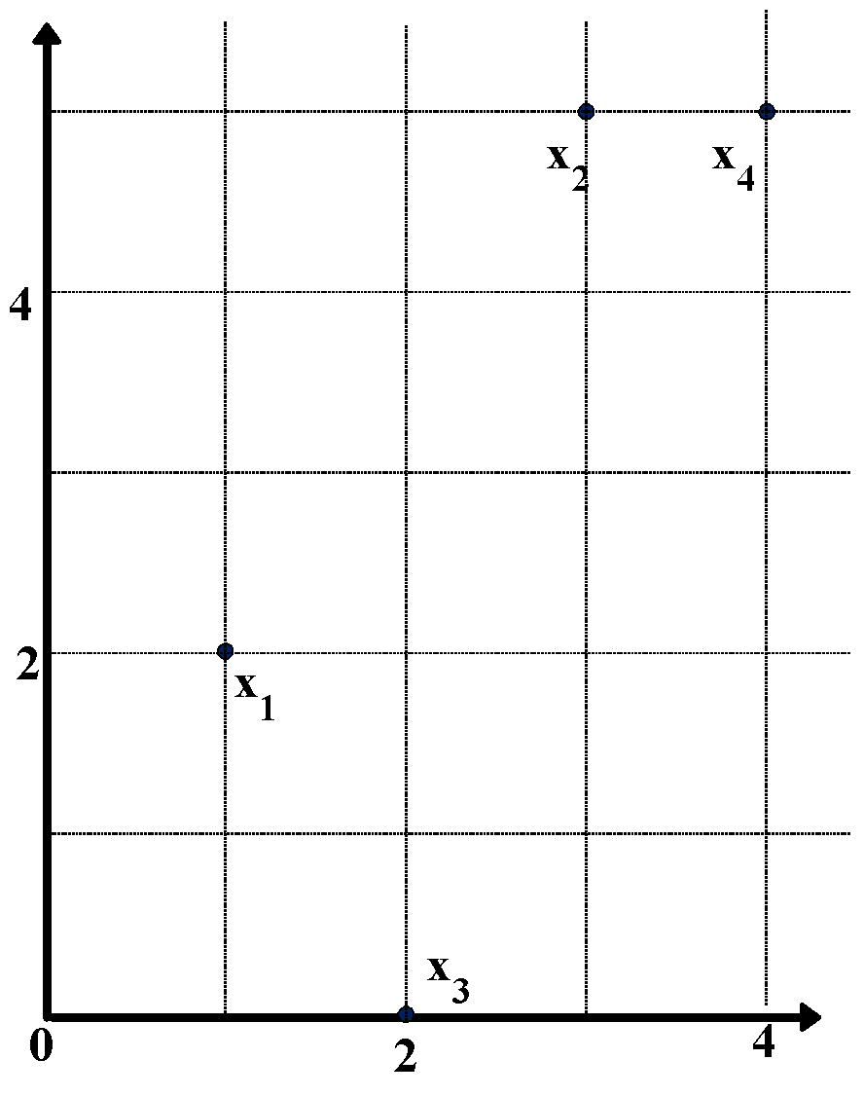
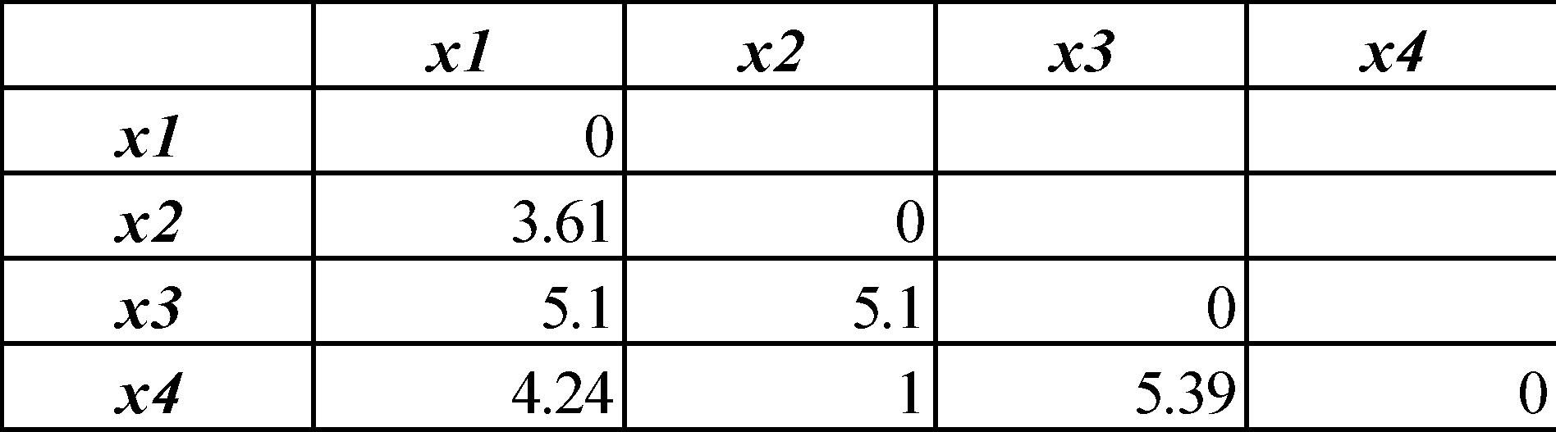
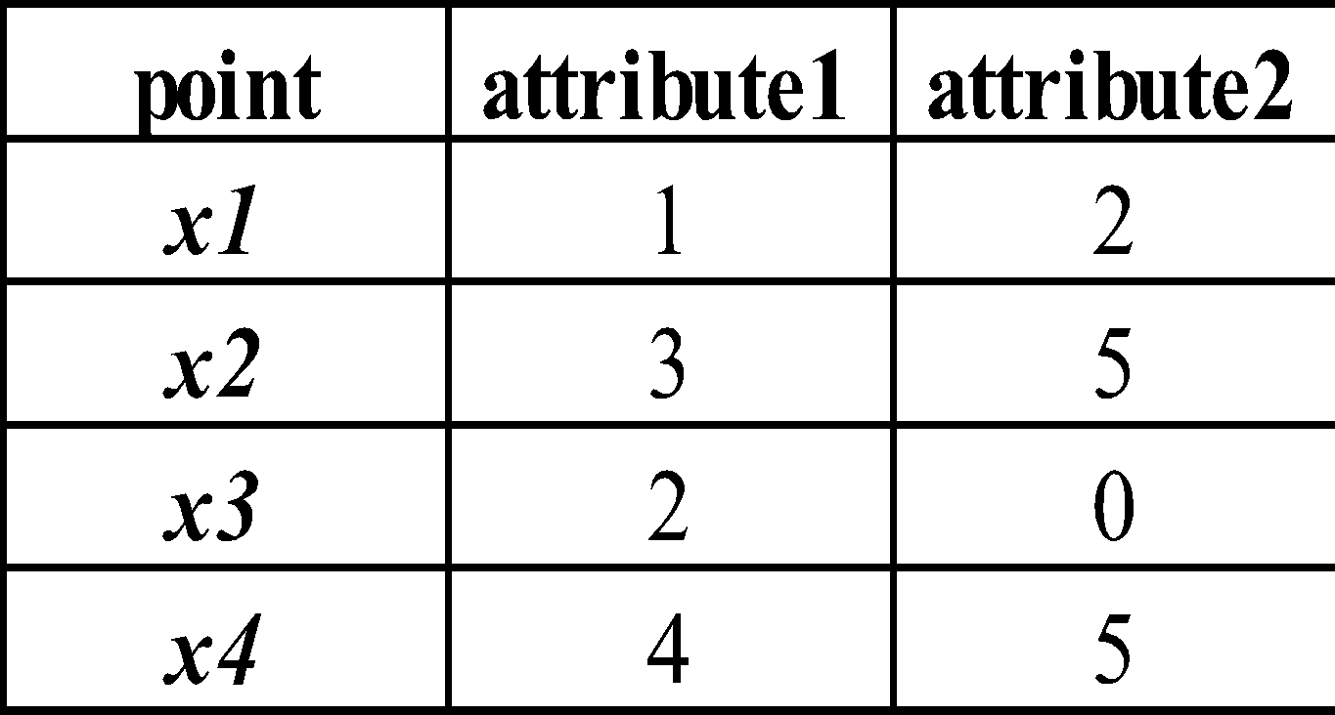
Data Matrix and Dissimilarity Matrix
Data Matrix
Dissimilarity Matrix
(with Euclidean Distance)

Slide 5
Distance on Numeric Data: Minkowski Distance
Minkowski distance: A popular distance measure
  where i = (x_{i1}, x_{i2}, …, x_{ip}) and j = (x_{j1}, x_{j2}, …, x_{jp}) are two p-dimensional data objects, and h is the order (the distance so defined is also called L-h norm)

Slide 6
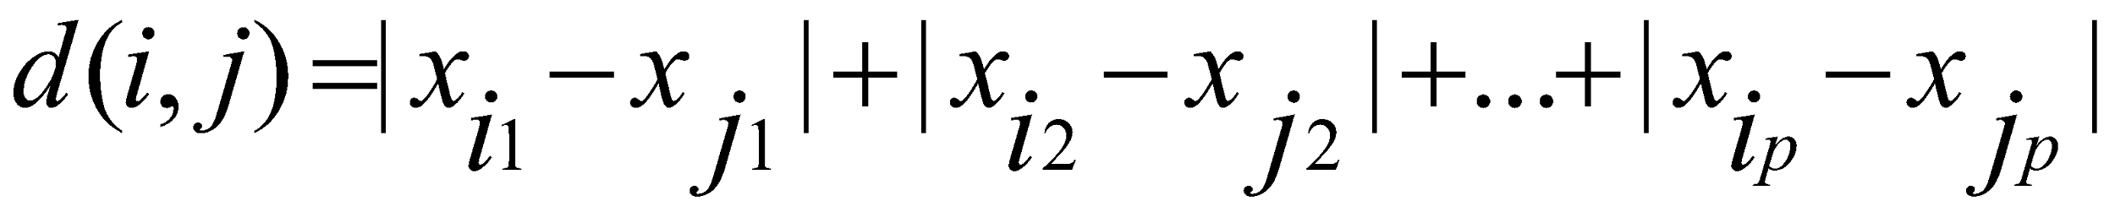
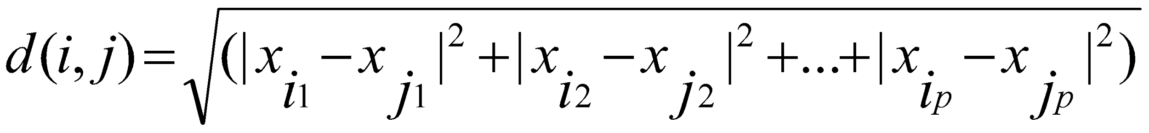
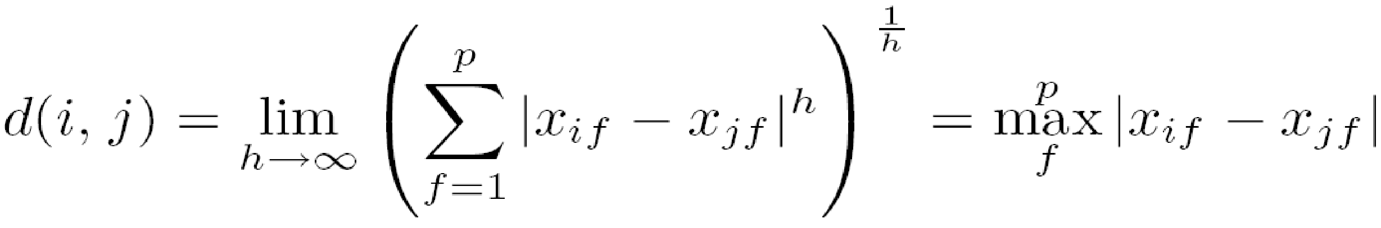
Special Cases of Minkowski Distance
h = 1: Manhattan (city block, L₁ norm) distance
  e.g., the Hamming distance: the number of bits that are different between two binary vectors
h = 2: (L₂ norm) Euclidean distance
h → ∞. “supremum” (L_{max} norm, L∞ norm) distance.
  This is the maximum difference between any component (attribute) of the vectors

Slide 7
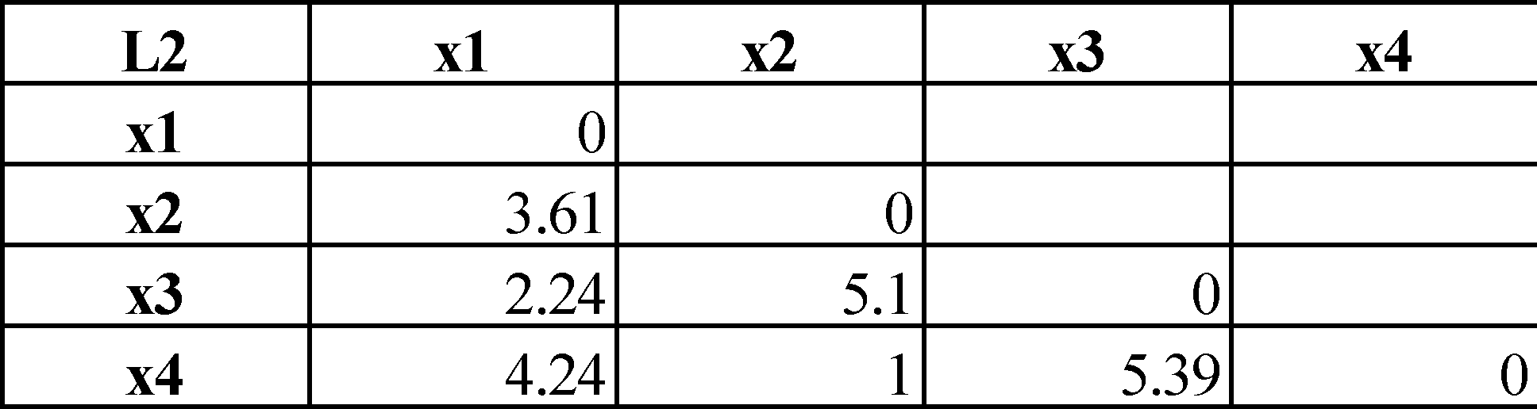
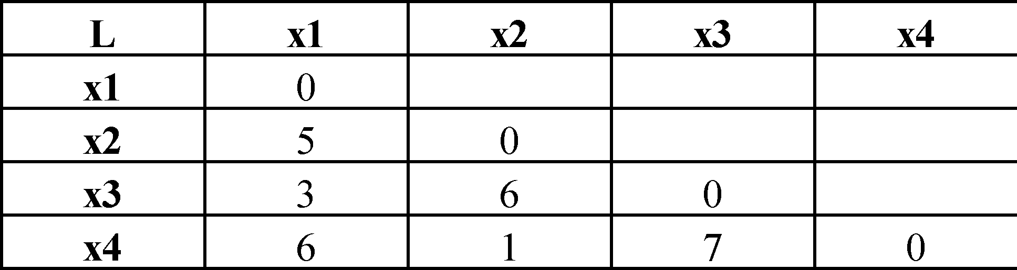
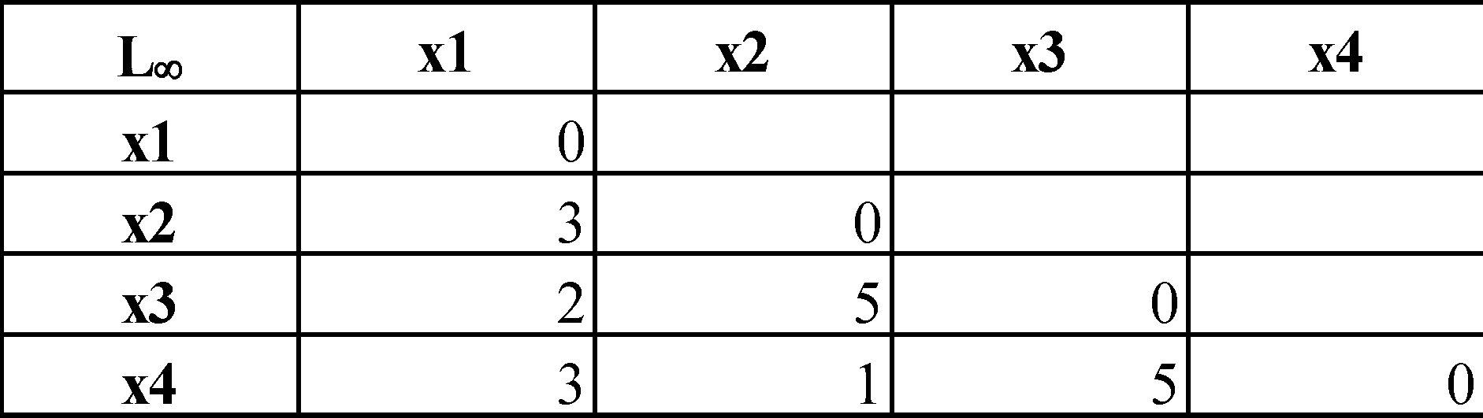
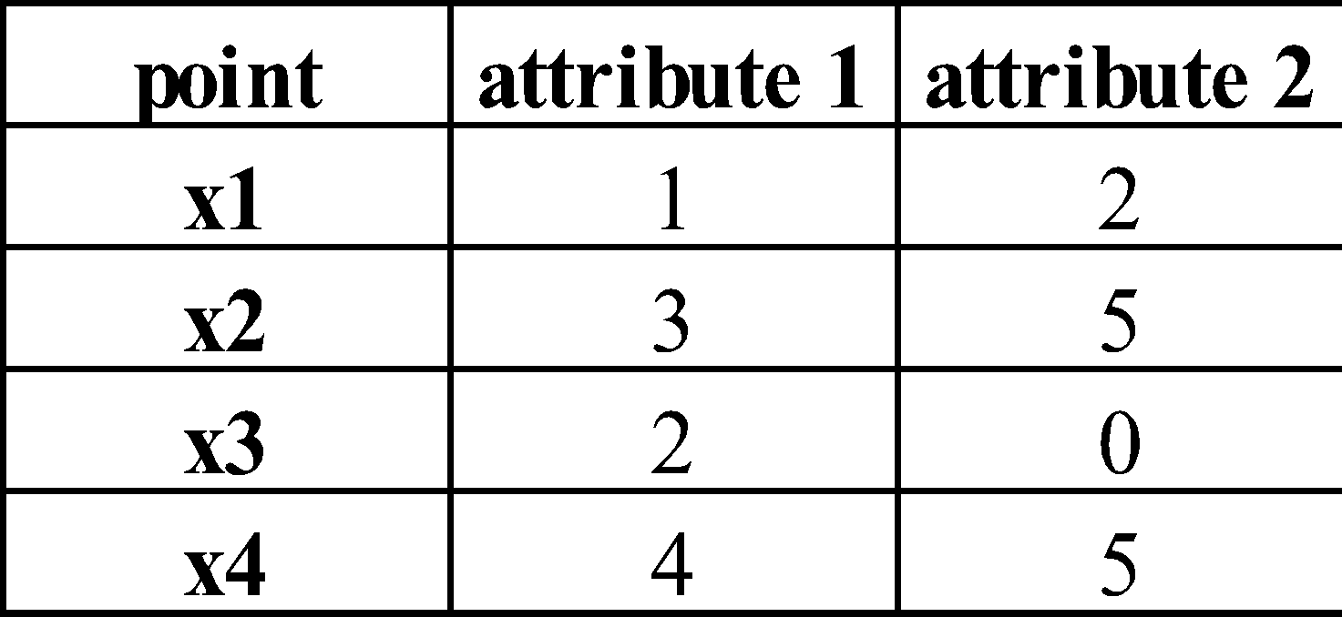
Minkowski Distance
Manhattan (L₁)
Euclidean (L₂)
Supremum

Slide 8
Distance between Clusters
Single link: Based on Minimum distance
Complete link: Based on Maximum distance
X
X
8
Notes:
8

Slide 9
Analysis of Hierarchical Clustering
Major weakness of agglomerative clustering methods
  Can never undo what was done previously
  Do not scale well: time complexity of at least O(n²), where n is the number of total objects

Slide 10
Search-based Models

Slide 11
Model types
Four types in order of increasing generality:
  Simple reflex models
  State-based models
  Variable-based models
  Logic-based models
  Machine learning
  Reflex State-based Variable Logic
  - Search-based - Constraint satisfaction
  - Markov decision - Bayesian networks
  - Adversarial

Slide 12
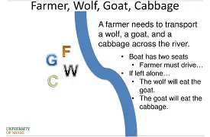
Farmer, Goat, Wolf, Cabbage Problem

Slide 13

Search-based models
Problem:
  Achieve a goal state
Task
  Find sequence of actions to reach a goal state

Slide 14
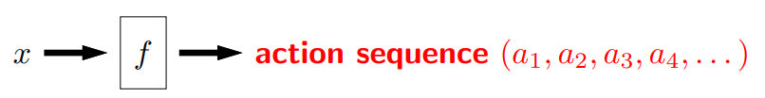
Search problem (state-based models)
Need to consider future consequences of an action
For each example, the key is to decompose the output solution into a sequence of primitive actions
We also need to think about how to evaluate different possible outputs

Slide 15
Applications
Finding the route from source to destination
Goal: Reach destination
Objective: fastest, shortest
Actions: turn right, go straight etc

Slide 16

Robot motion planning
Goal: Put sugar in tea
Objective: safest, fastest
Actions: rotate arm, rotate leg etc

