Slide 1
Artificial Intelligence
Lecture # 16
(Session 18)

Slide 2
Learning objectives
To enable students to
  Understand Search-based models

Slide 3
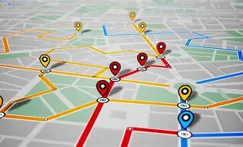
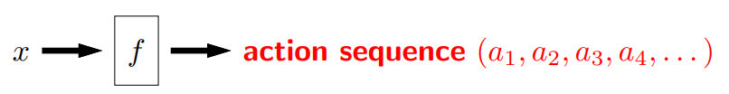
Search problem (state-based models)
Need to consider future consequences of an action
For each example, the key is to decompose the output solution into a sequence of primitive actions
We also need to think about how to evaluate different possible outputs

Slide 4
Paradigm

Slide 5
Model: defined by
  states (Initial (Start) state, Goal (Final) state)
  actions or successor function
  costs
A solution is a sequence of actions leading from the initial state to a goal state
Optimal solution has the lowest path cost among all solutions
Approach: Build a search tree - basically a ‘what if’ tree
Inference: Algorithms for search

Slide 6
Searching for Solutions
To solve the problems, we search through the state space
We may have a search graph, but for now we consider only a search tree
We usually do not build the search tree as a concrete data structure
The search tree is used merely to visualize the computation of the search algorithms and study the structure of the search problem

Slide 7
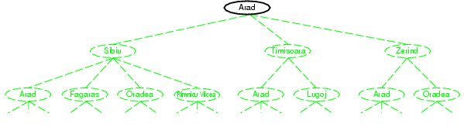
Tree search example
We start from a search node, and check whether it is goal state
It is not, so more states need to be considered by applying successor function to the current state, thereby generating new states

Slide 8
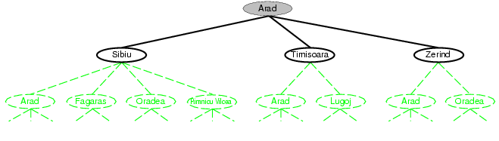
Tree search example

Slide 9
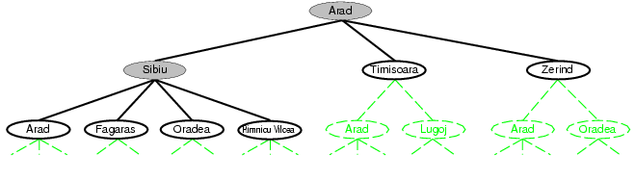
Tree search example
We continue
  Choose
  Test
  Expand
  Till no more states
Choice of which state to expand is determined by the search strategy

Slide 10
Measuring Search Strategy Performance
10
A search strategy is defined by picking the order of node expansion
Strategies are evaluated along the following dimensions:
  completeness: does it always find a solution if one exists?
  time complexity: number of nodes generated
  space complexity: maximum number of nodes in memory
  optimality: does it always find a least-cost solution?

Slide 11
Uninformed search strategies
11
Uninformed search strategies use only the information available in the problem definition. Do not know that one non-goal state is more promising than another
Breadth-first search
Depth-first search
Depth-limited search
Uniform-cost search
Iterative deepening search

Slide 12
Transportation example
Street with blocks numbered 1 to n.
Walking from s to s + 1 takes 1 minute
Taking a bus from s to 2s takes 2 minutes
How to travel from 1 to n in the least time?

Slide 13
Water Jug example
An unlimited supply of water, and a sink
Two unmarked jugs:
  a four liter jug
  a three liter jug
How to get two liters into the four liter jug, with no water in the three liter jug?

