Slide 1
Artificial Intelligence
Lecture # 17
Session#20
Session 19 was sessional
Session 18 was assignments checking

Slide 2
Learning objectives
To enable students to
  Understand Search-based strategies

Slide 3
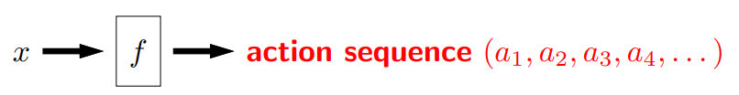

Search problem (state-based models)
Model: defined by
  states (Initial (Start) state, Goal (Final) state)
  actions or successor function
  costs
A solution is a sequence of actions leading from the initial state to a goal state, optimal solution has the lowest path cost among all solutions
Inference: Algorithms for search

Slide 4
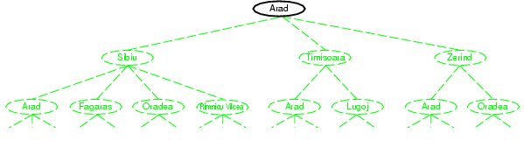
Tree search example
We start from a search node, and check whether it is goal state
It is not, so more states need to be considered by applying successor function to the current state, thereby generating new states

Slide 5
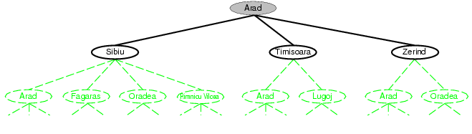
Tree search example

Slide 6
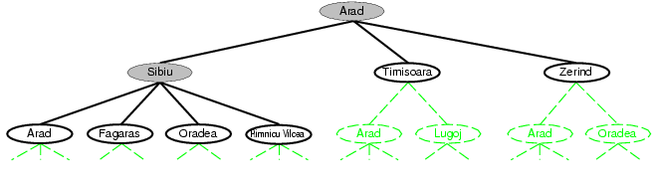
Tree search example
We continue
  Choose
  Test
  Expand
  Till no more states
Choice of which state to expand is determined by the search strategy

Slide 7
Measuring Search Strategy Performance
7
A search strategy is defined by picking the order of node expansion
Strategies are evaluated along the following dimensions:
  completeness: does it always find a solution if one exists?
  time complexity: number of nodes generated
  space complexity: maximum number of nodes in memory
  optimality: does it always find a least-cost solution?

Slide 8
Uninformed search strategies
8
Uninformed search strategies use only the information available in the problem definition. Do not know that one non-goal state is more promising than another
Breadth-first search
Depth-first search
Depth-limited search
Uniform-cost search
Iterative deepening search

Slide 9
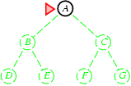
Breadth-first search
9
Expand shallowest unexpanded node
Implementation:
  fringe is a FIFO queue, i.e., new successors go at end

Slide 10
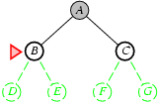
Breadth-first search
Expand shallowest unexpanded node
Implementation:
  fringe is a FIFO queue, i.e., new successors go at end
10

Slide 11
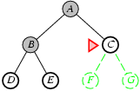
Breadth-first search
11
Expand shallowest unexpanded node
Implementation:
  fringe is a FIFO queue, i.e., new successors go at end

Slide 12
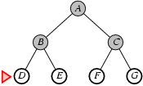
Breadth-first search
12
Expand shallowest unexpanded node
Implementation:
  fringe is a FIFO queue, i.e., new successors go at end

Slide 13
Breadth-first search
BFS(G, s)
for each vertex u V[G] –{s}
do color[u] ← white
d[u] ← ∞
π[u] ← NIL
color[s] ← gray
d[s] ← 0
π[s] ← NIL
Q ← Ø
ENQUEUE(Q,s)
While Q ≠ Ø
do u ← DEQUEUE(Q)
for each v Adj[u]
do if color[v] = white
then color[v] ← gray
d[v] ← d[u] + 1
π[v] ← u
ENQUEUE(Q,v)
color[u] ← BLACK

Slide 14
Breadth First Search
The results of BFS may depend on order in which the neighbours of a given tree are visited
The BFS tree may vary, but the distances d computed by the algorithm will not
Optimal for problems where all actions have the same cost

Slide 15
Analysis of Breadth First Search
The running time for BFS consists of following major components
  Ti =Initializing vertices T
  Tq =Queuing and Dequeuing
  Ts = Scanning Adjacency list
The Graph G(V,E) has |V| vertices and |E| edges. Each vertex is initialized once. Therefore, Ti = O(V)
The queuing and dequeuing operations take O(1) time, and each vertex is queued and dequeued once,
  Tq =O(V)

Slide 16
Analysis of Breadth First Search
The scanning of Adjacency list takes place for each vertex. In worst case all links are examined.
The total time is proportional to the number of edges scanned. Since |E| is the number of edges in G,
  Ts =O(E)
Thus running time is given by O(|V|+|E|)
  completeness: does it always find a solution if one exists?
  time complexity: number of nodes generated
  space complexity: maximum number of nodes in memory
  optimality: does it always find a least-cost solution?

Slide 17
Properties of breadth-first search
17
Consider
  b to be the branching factor
  d to be the solution depth
Complete?
  Yes (if b is finite)
Time?
  Number of nodes generated is 1+b+b²+b³+… +b^{d} = O(b^{d+1})
Space?
  O(b^{d}) (keeps every node in memory)
Optimal?
  Not necessarily since shallowest is not necessarily optimal
  Yes (if cost = 1 or uniform per step)
Space is the bigger problem (more than time)

Slide 18
Depth First Search
The Depth First Search (DFS) is one of the standard graph traversal methods
Each node is visited once only
The method proceeds by searching deeper in the graph wherever possible
Edges are discovered out of the most recently discovered vertex v that still has unexplored edges leaving it
When all of v’s edges have been explored, the search back tracks to explore edges leaving the vertex from which v was discovered

Slide 19
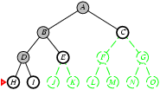
Depth-first search
19
Expand deepest unexpanded node
Implementation:
  fringe = LIFO queue, i.e., put successors at front

Slide 20
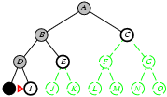
Depth-first search
20
Expand deepest unexpanded node

Slide 21
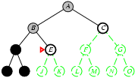
Depth-first search
21
Expand deepest unexpanded node
Implementation:
  fringe = LIFO queue, i.e., put successors at front

Slide 22
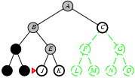
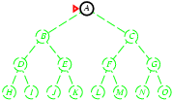
Depth-first search
22
Expand deepest unexpanded node
Implementation:
  fringe = LIFO queue, i.e., put successors at front

Slide 23
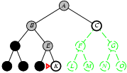
Depth-first search
23
Expand deepest unexpanded node
Implementation:
  fringe = LIFO queue, i.e., put successors at front

Slide 24
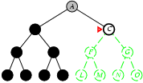
Depth-first search
24
Expand deepest unexpanded node
Implementation:
  fringe = LIFO queue, i.e., put successors at front

Slide 25
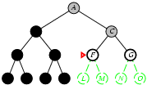
Depth-first search
25
Expand deepest unexpanded node
Implementation:
  fringe = LIFO queue, i.e., put successors at front

Slide 26
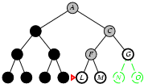
Depth-first search
26
Expand deepest unexpanded node

Slide 27
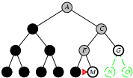
Depth-first search
27
Expand deepest unexpanded node

Slide 28
Depth First Search
DFS(G)
for each vertex u V[G]
do color[u] ← white
π[u] ← NIL
Time ← 0
for each vertex u V[G]
do if color[u] = white
then DFS-VISIT(u)
DFS-VISIT(u)
color[u] ← GRAY
time ← time + 1
D[u] ← time
for each v Adj[u]
do if color[v] = white
then π[v] ← u
DFS-VISIT(v)
color[u] ← BLACK
F[u] ← time ← time + 1

Slide 29
Depth First Search
The results of DFS may depend on order in which vertices are examined, and upon order in which the neighbours of a given vertex are visited
The Graph G(V,E) has |V| vertices and |E| edges. Each vertex is initialized once. Therefore, Ti =|V|
There is one call to DFS-VISIT for each vertex v, and loop in DFS Visit is executed |Adj[v]| times
The scanning of Adjacency list takes place for each vertex. The total time is proportional to the number of edges scanned. Since |E| is the number of edges in G, Ts = |E| because
Thus total running time is given by time O(|V|+|E|)

Slide 30
Properties of depth-first search
30
Complete?
  Yes, in finite spaces
Time?
  O(b^{m}): terrible if m (max depth) is much larger than d
Space?
  O(bm), i.e., linear space!
Optimal?
  No – returns the first tree it finds even if not optimal

Slide 31
Depth-limited search
31
= depth-first search with depth limit l
i.e., nodes at depth l are treated like they have no successors

Slide 32
Properties of depth-limited search
32
Solves the infinite path problem
Complete?
  What if we choose l < d
Time?
  O(b^{l})
Space?
  O(bl)
Optimal?
  No – What if l > d
Depth limits can be based on knowledge of the problem

Slide 33
Uniform-cost search (Djikstra’s Algorithm)
33
Expands node n with lowest path cost
Equivalent to breadth-first if
  step costs all equal

Slide 34
Dijkstra’s Algorithm
DIJKSTRA(G, w, s)
INITIALIZE-SINGLE-SOURCE(G, s)
S ← Ø
Q ← V[G]
While Q ≠ Ø
do u ← EXTRACT-MIN(Q)
S ← S U {u}
for each vertex v Adj[u]
do RELAX(u, v, w)

Slide 35
Initialization
INITIALIZE-SINGLE-SOURCE(G, s)
for each vertex v V[G]
do d[v] ← ∞
π[v] ← NIL
d[s] ← 0

Slide 36
Relaxation
The process of relaxing an edge (u,v) consists of testing whether it can improve the shortest path from s to v so far by going through u.
Relax(u,v,w)
if d[v] > d[u] + w(u,v)
then d[v] ← d[u] + w(u,v)
π[v] ← u

Slide 37
Dijkstra’s Algorithm - Analysis
Min-priority queue is maintained by calling 3 priority-queue operations:
  Insert – line 3
  Extract-min – line 5
  Decrease-key (implicit in relax) – line 8
There are a total of |E| decrease-key operations
Running time depends on how the min-priority queue is implemented
If implemented as a binary heap, then O(ElgV)
If implemented as a Fibonacci heap, then O(VlgV + E)

Slide 38
Uniform-cost search
38
Complete?
  Yes
Time?
  O(b^{ceiling(C*/ ε)}) where C* is the cost of the optimal solution, ^{ε} is least action cost
Space?
  O(b^{ceiling(C*/ ε)})
Optimal?
  Yes – nodes expanded in increasing order of path cost

Slide 39
Iterative Deepening Depth-First Search
39
A general strategy used in combination with depth-first search, that finds the best depth limit
Combines the benefits of BFS and DFS

Slide 40
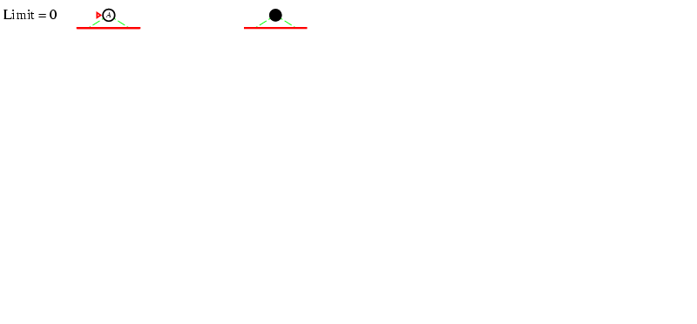
Iterative deepening search l =0
40

Slide 41
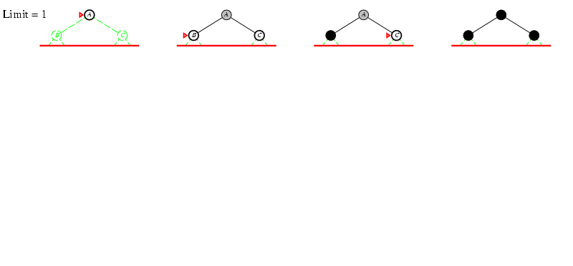
Iterative deepening search l =1
41

Slide 42
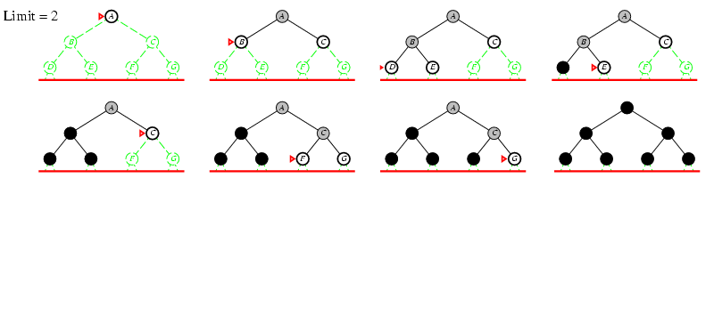
Iterative deepening search l =2
42

Slide 43
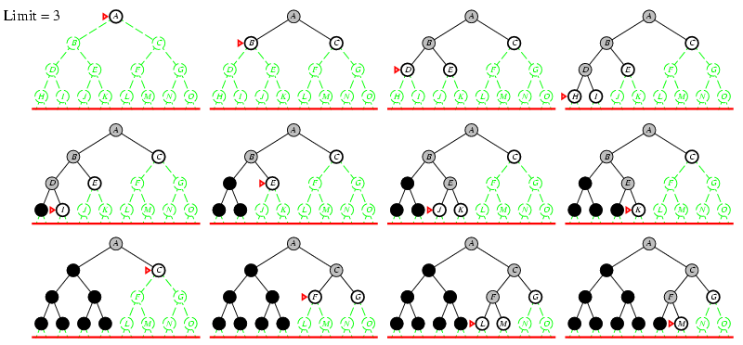
Iterative deepening search l =3
43

Slide 44
Properties of Iterative Deepening DFS
Like DFS
  Memory requirements are modest
  O(bd)
Like BFS
  Explores a layer completely before going to next layer
  Complete when branching factor is finite
  Optimal when step cost is uniform
44

Slide 45
Properties of Iterative Deepening DFS
45
Complete?
  Yes, if branching factor is finite
Time?
  d b¹ + (d-1)b² + … + b^{d} = O(b^{d})
Space?
  O(bd)
Optimal?
  Yes, for uniform costs e.g. = 1

Slide 46
Summary
Breadth-first search
  expands the shallowest nodes first; it is complete, optimal for unit action costs, but has exponential space complexity.
Uniform-cost search
  expands the node with lowest path cost, g(n), and is optimal for general action costs.
Depth-first search
  expands the deepest unexpanded node first. It is neither complete nor optimal, but has linear space complexity
Depth-limited search
  adds a depth bound.
Iterative deepening search
  calls depth-first search with increasing depth limits until a goal is found. Complete when full cycle checking is done, optimal for unit action costs, time complexity comparable to bfs, linear space complexity

