Slide 1
Artificial Intelligence
Lecture # 18
Session#21

Slide 2
Learning objectives
To enable students to
  Understand Informed Search-based strategies

Slide 3
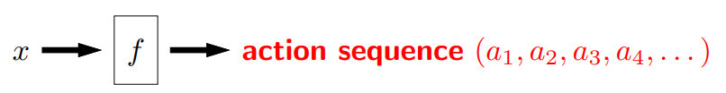

Search problem (state-based models)
Model: defined by
  states (Initial (Start) state, Goal (Final) state)
  actions or successor function
  costs
A solution is a sequence of actions leading from the initial state to a goal state, optimal solution has the lowest path cost among all solutions
Inference: Algorithms for search

Slide 4
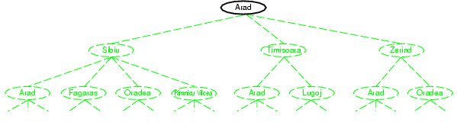
Tree search example
We start from a search node, and check whether it is goal state
It is not, so more states need to be considered by applying successor function to the current state, thereby generating new states

Slide 5
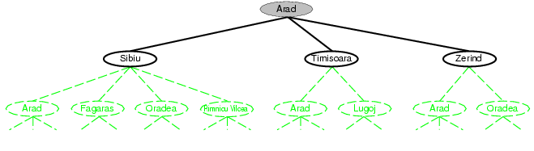
Tree search example

Slide 6
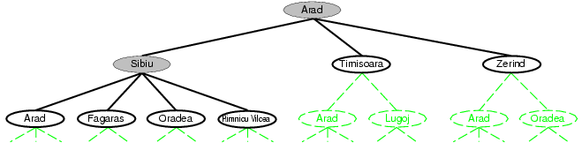
Tree search example
We continue
  Choose
  Test
  Expand
  Till no more states
Choice of which state to expand is determined by the search strategy

Slide 7
Informed Search Strategies
Informed search strategies use problem-specific knowledge and can find solutions more efficiently than uninformed search strategies.
General Approach
  A node is selected for expansion based on an evaluation function, f(n)
  Traditionally, the node with the lowest evaluation is selected for expansion, because the evaluation measures distance to the goal
7

Slide 8
Informed Search Strategies
  All we can do is choose the node that appears to be best according to the evaluation function
  Key component is a heuristic function denoted by h(n)
  h(n) = estimated cost of the cheapest path from node n to a goal node
  If n is the goal node, h(n)=0

Slide 9
Greedy Best-first Search
Tries to expand the node that is closest to the goal
Evaluation function f(n)
= h(n) (heuristic)
= estimate of cost from n to goal
e.g., h_{SLD}(n) = straight-line distance from n to Bucharest
9

Slide 10
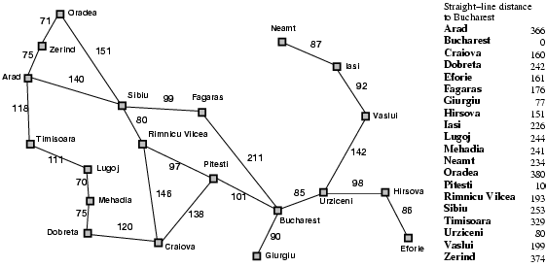
Reaching from Arad to Bucharest

Slide 11

Greedy best-first search example

Slide 12
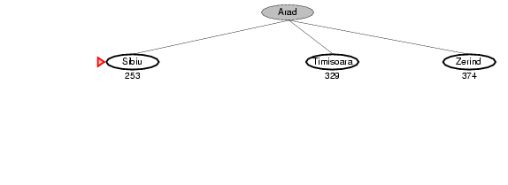
Greedy best-first search example

Slide 13
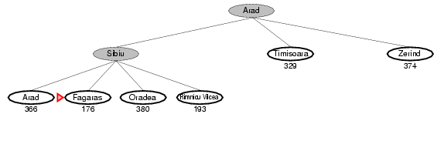
Greedy best-first search example

Slide 14
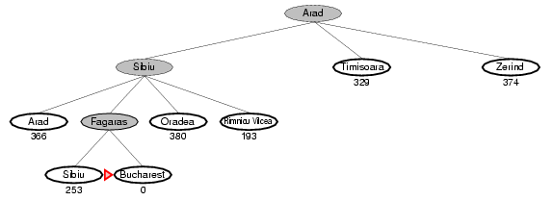
Greedy best-first search example

Slide 15
Optimal
  No
  The path via Sibiu and Fagaras to Bucharest is 32 kms longer than the path through Rimnicu Vilcea and Pitesti
Can get stuck in loops, e.g., Iasi -> Neamt -> Iasi -> Neamt
15

Slide 16
Properties of greedy best-first search
Resembles depth-first search, but will back up if it hits a dead end
Complete? Yes, in finite spaces
Time? O(b^{m})
Space? O(b^{m}) -- keeps all nodes in memory
Optimal? No

Slide 17
A* search
Evaluation function f(n) = g(n) + h(n)
  g(n) = cost so far to reach n
  h(n) = estimated cost from n to goal
  f(n) = estimated total cost of path through n to goal
A* search is complete. Provided that the heuristic function h(n) satisfies certain conditions, it is optimal
If h(n) is an admissible heuristic - that is, provided that h(n) never overestimates the cost to reach the goal
A simple example is the straight-line distance
17

Slide 18

A* search example

Slide 19
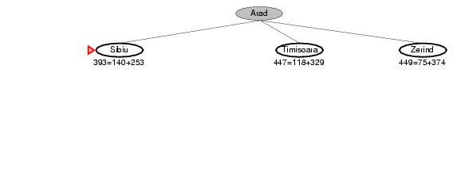
A* search example

Slide 20
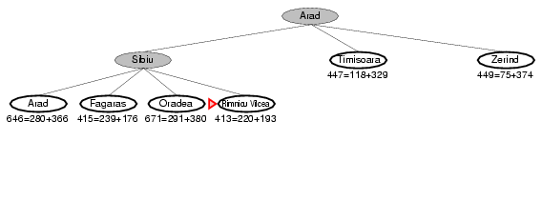
A* search example

Slide 21
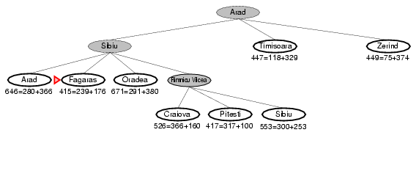
A* search example

Slide 22
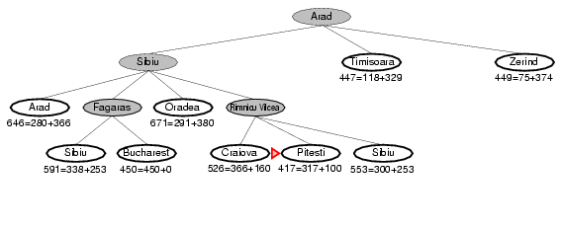
A* search example

Slide 23
A* search is complete. Provided that the heuristic function h(n) satisfies certain conditions, it is optimal
If h(n) is an admissible heuristic - that is, provided that h(n) never overestimates the cost to reach the goal
A simple example is the straight-line distance

Slide 24
Admissible heuristics
A heuristic h(n) is admissible if for every node n,
h(n) ≤ h*(n), where h*(n) is the true cost to reach the goal state from n
An admissible heuristic never overestimates the cost to reach the goal, i.e., it is optimistic
Example: h_{SLD}(n) (never overestimates the actual road distance)
Theorem: If h(n) is admissible, A* using TREE-SEARCH is optimal

Slide 25
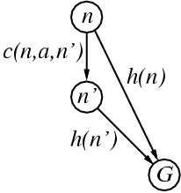
Consistent heuristics
A heuristic is consistent if for every node n, every successor n' of n generated by any action a,
h(n) ≤ c(n,a,n') + h(n')
Every consistent heuristic is admissible
Theorem: If h(n) is consistent, A* using GRAPH-SEARCH is optimal

Slide 26
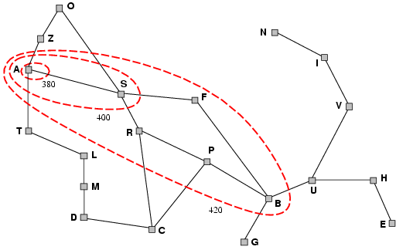
Optimality of A*
A* expands nodes in order of increasing f value
Gradually adds "f-contours" of nodes
Contour i has all nodes with f=f_{i}, where f_{i} < f_{i+1}

Slide 27
A* expands no nodes with f(n)> C*
i.e. a subtree is pruned below a certain point, without compromising optimality
Important in AI
27

Slide 28
Properties of A*
Complete? Yes (unless there are infinitely many nodes)
Time? Exponential
Space? Keeps all nodes in memory
Optimal? Yes

Slide 29
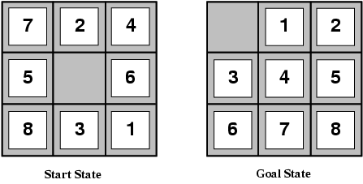
Admissible heuristics
E.g., for the 8-puzzle:
h₁(n) = number of misplaced tiles
h₂(n) = total Manhattan distance
(i.e., no. of squares from desired location of each tile)
h₁(S) = ?
h₂(S) = ?
Neither of these overestimates the true solution cost
8
3+1+2+2+2+3+3+2 = 18

Slide 30
Admissible heuristics
From the definitions of the two heuristics, for any node n, h2(n) >= h1(n).
We thus say that h2 dominates h1
Domination translates directly into efficiency
A* using h2 will never expand more nodes than A* using h1
Better to use a heuristic function with higher values, provided it does not overestimate
30

Slide 31
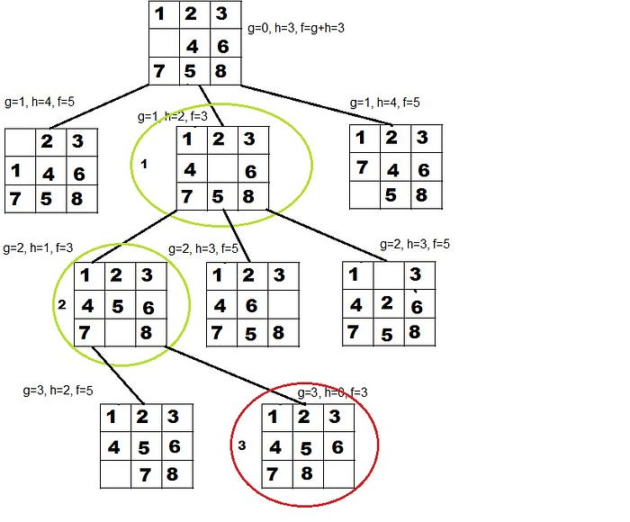

Slide 32
Dynamic Programming
Not an algorithm, but a technique like divide and conquer
Dynamic Programming is a technique typically applied for solving optimization problems
The dynamic programming method determines an optimal solution, that is, one which has the maximum or minimum cost

Slide 33
Dynamic Programming
The algorithm works by splitting a problem into a sequence of optimization sub problems
The sub problems are solved and then combined to obtain solution to the main problem
The dynamic programming approach seems to be similar to divide-and-conquer approach
However, unlike the divide-and-conquer method, the dynamic programming approach is applicable when the sub-problems are not independent i.e. dynamic programming splits the problem into overlapping sub problems.
Further, the optimal solutions to sub problems are stored into a table, which is used to build the final or global optimal solution.

Slide 34
Dynamic Programming
Development of a dynamic programming algorithm can be broken into a sequence of following steps:
  Characterize the structure of an optimal solution
  Recursively define the value of an optimal solution
  Compute the value of an optimal solution in a bottom-up fashion

Slide 35
Elements of Dynamic Programming
Optimal sub-structure
  An optimal solution to a problem contains optimal solutions to sub-problems
  Dynamic programming uses optimal sub-structure in a bottom-up manner
Overlapping sub-problems
  Space of sub-problems must be small
  Recursive algorithm visits same problem again and again
  Each sub-problem is solved once, solution is stored in table

Slide 36
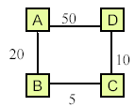
Optimal sub-structure
The principle of optimality holds in the case of problem of finding a shortest distance in a network, but it does not hold good for problem of finding the longest distance
Consider, for example, the network shown in the figure. The shortest distance A to D is A->B->C->D 35. Further, the shortest distance from A to C is A->B->C=25, and shortest distance from A to B is A->B=20. Thus, principle of optimality holds true for each of the sub paths of the shortest distance between A to D.
Now consider the longest distance from C to A. It is C->D->A=60. However, the sub path C->D=10 is not the longest distance, because the longest distance from C to D is C->B->A->D=75. Hence, the principle of optimality does not hold true.

Slide 37
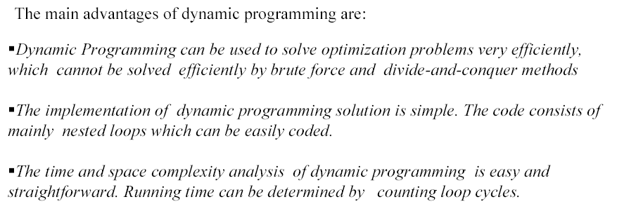
Dynamic Programming - Advantages

Slide 38
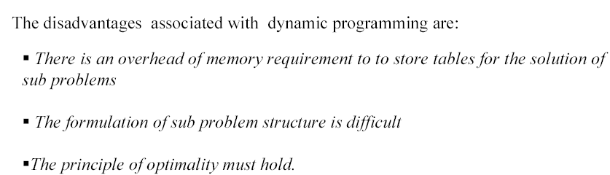
Dynamic Programming – Disadvantages

