Slide 1
Artificial Intelligence
Lecture # 19
Session#22

Slide 2
Learning objectives
To enable students to
  Understand consistent heuristics in Search-based strategies

Slide 3
Admissible heuristics
A heuristic h(n) is admissible if for every node n,
h(n) ≤ h*(n), where h*(n) is the true cost to reach the goal state from n
An admissible heuristic never overestimates the cost to reach the goal, i.e., it is optimistic
Example: h_{SLD}(n) (never overestimates the actual road distance)
Theorem: If h(n) is admissible, A* using TREE-SEARCH is optimal

Slide 4
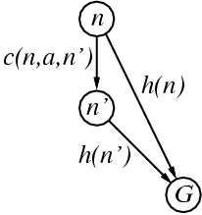
Consistent heuristics
A heuristic is consistent if for every node n, every successor n' of n generated by any action a,
h(n) ≤ c(n,a,n') + h(n')
Every consistent heuristic is admissible
Theorem: If h(n) is consistent, A* using GRAPH-SEARCH is optimal

Slide 5
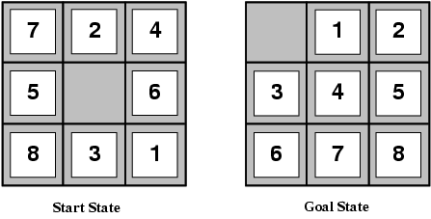
Admissible heuristics
E.g., for the 8-puzzle:
h₁(n) = number of misplaced tiles
h₂(n) = total Manhattan distance
(i.e., no. of squares from desired location of each tile)
h₁(S) = ?
h₂(S) = ?
Neither of these overestimates the true solution cost
8
3+1+2+2+2+3+3+2 = 18

Slide 6
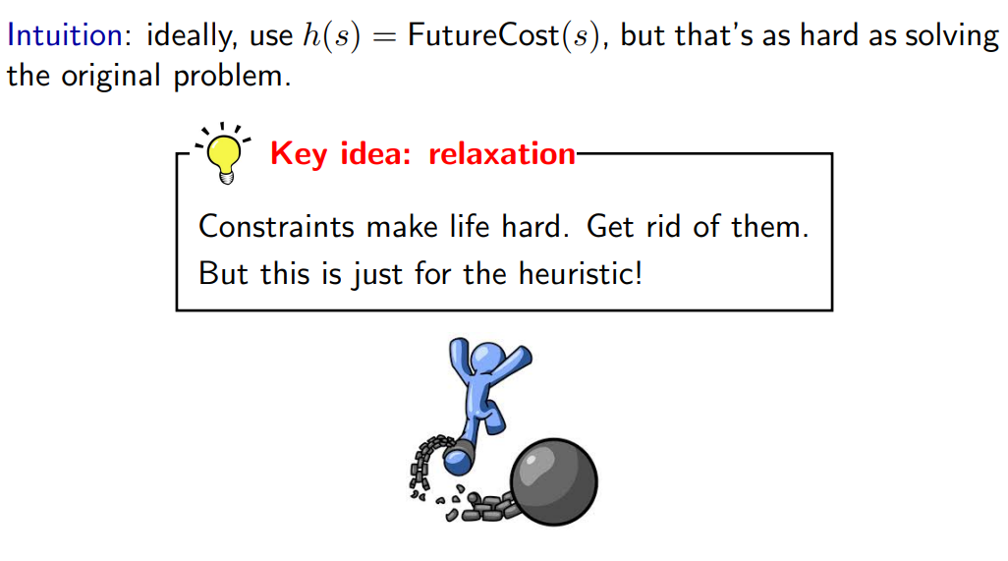
Relaxation

Slide 7
Relaxation
Instead of computing FutureCost(s) on the original problem, compute FutureCost(s) on an easier problem
Coming up with good heuristics is about modeling, not algorithms
We have to think carefully about our problem domain and see what kind of structure we can exploit in it

Slide 8
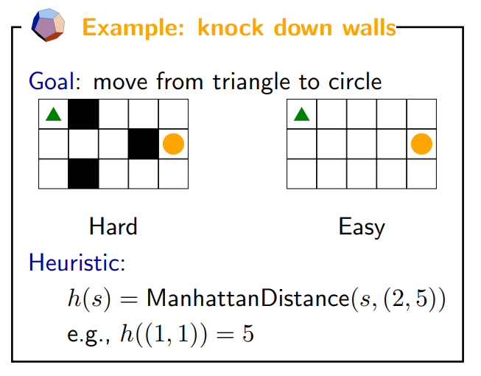
Closed form solution

Slide 9
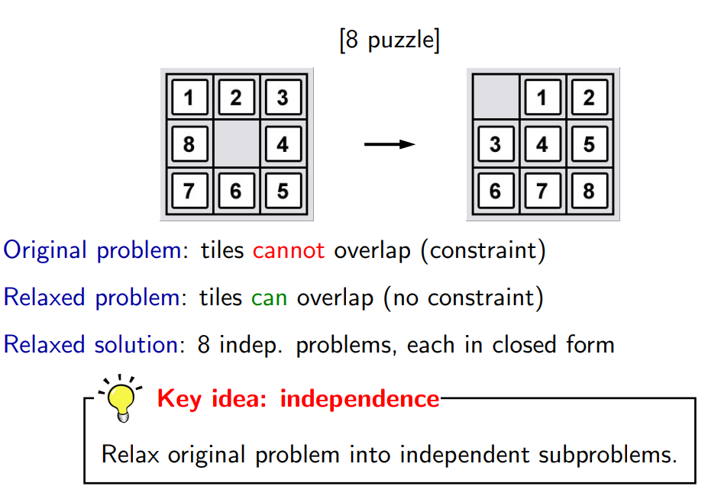
Independent sub-problems

Slide 10
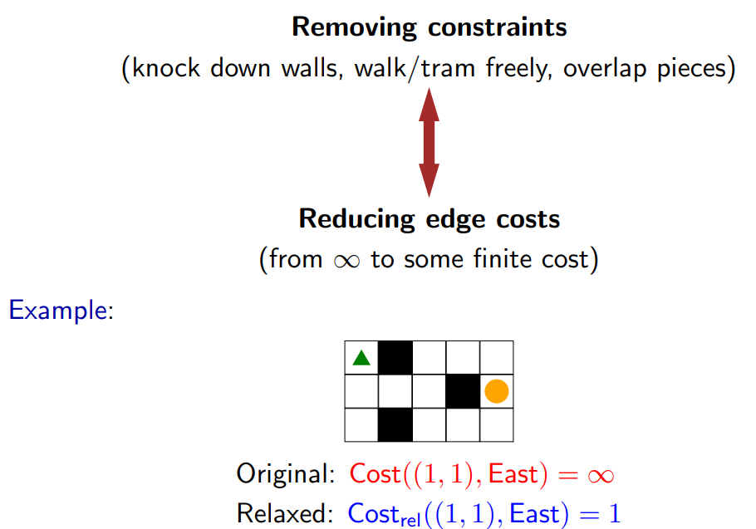
General Framework

Slide 11
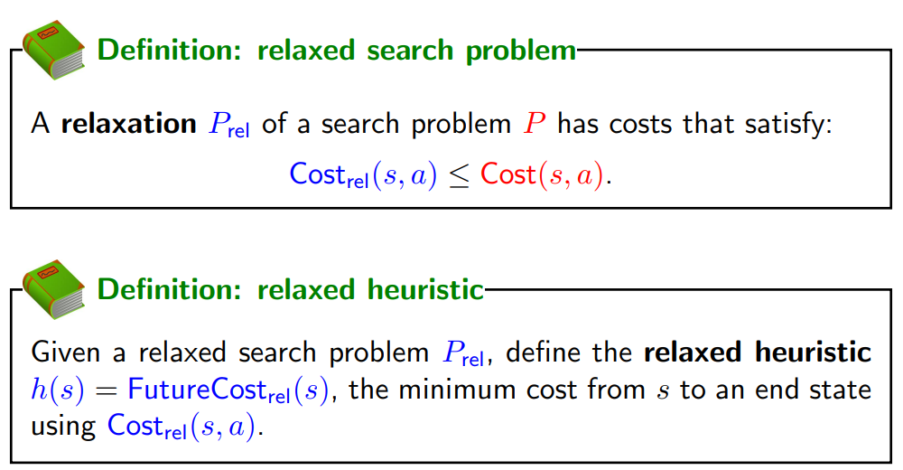

Slide 12
We define a relaxed search problem as one where the relaxed edge costs are no larger than the original edge costs
The relaxed heuristic is simply the future cost of the relaxed search problem, which by design should be efficiently computable
All of these relaxed problems are simply used to get the value of the heuristic h(s) to guide the full search
The actual solutions to these relaxed problems are not used

Slide 13
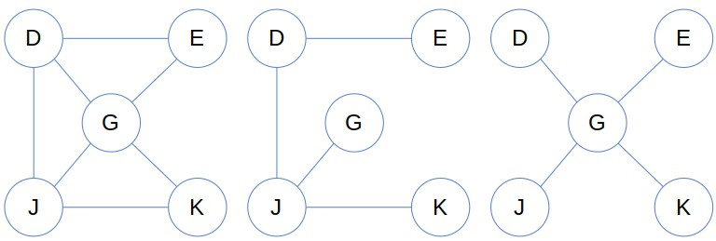
Removing constraints can be thought of as adding edges (you can go between pairs of states that you weren’t able to before)
Adding edges is equivalent to reducing the edge cost from infinity to something finite (the resulting edge cost)
The state-space graph of the relaxed problem is a super-graph of the original state relaxed problem space because the removal of restrictions creates added edges in the graph

Slide 14
The relaxed problem adds edges to the state-space graph
  any optimal solution in the original problem is, by definition, also a solution in the relaxed problem
The relaxed problem may have better solutions if the added edges provide shortcuts.
  The cost of an optimal solution to a relaxed problem is an admissible heuristic for the original problem.

Slide 15
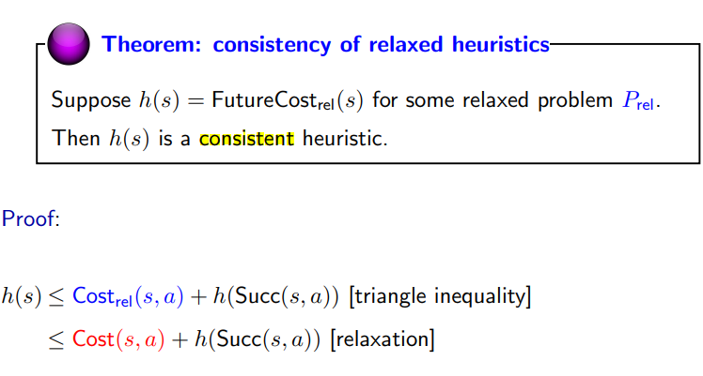
Consistency of Relaxed Heuristics

Slide 16
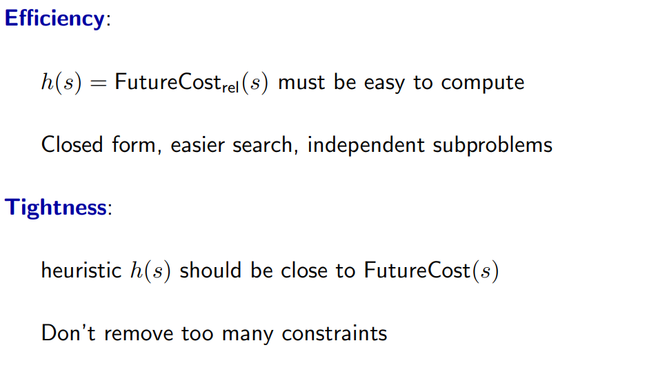
Tradeoff

Slide 17
Admissible heuristics
From the definitions of the two heuristics, for any node n, h2(n) >= h1(n).
We thus say that h2 dominates h1
Domination translates directly into efficiency
A* using h2 will never expand more nodes than A* using h1
Better to use a heuristic function with higher values, provided it does not overestimate
‹#›

Slide 18
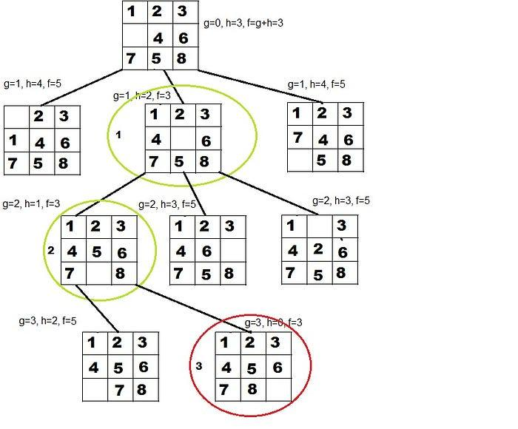

Slide 19
Dynamic Programming
Not an algorithm, but a technique like divide and conquer
Dynamic Programming is a technique typically applied for solving optimization problems
The dynamic programming method determines an optimal solution, that is, one which has the maximum or minimum cost

Slide 20
Dynamic Programming
The algorithm works by splitting a problem into a sequence of optimization sub problems
The sub problems are solved and then combined to obtain solution to the main problem
The dynamic programming approach seems to be similar to divide-and-conquer approach
However, unlike the divide-and-conquer method, the dynamic programming approach is applicable when the sub-problems are not independent i.e. dynamic programming splits the problem into overlapping sub problems.
Further, the optimal solutions to sub problems are stored into a table, which is used to build the final or global optimal solution.

Slide 21
Dynamic Programming
Development of a dynamic programming algorithm can be broken into a sequence of following steps:
  Characterize the structure of an optimal solution
  Recursively define the value of an optimal solution
  Compute the value of an optimal solution in a bottom-up fashion

Slide 22
Elements of Dynamic Programming
Optimal sub-structure
  An optimal solution to a problem contains optimal solutions to sub-problems
  Dynamic programming uses optimal sub-structure in a bottom-up manner
Overlapping sub-problems
  Space of sub-problems must be small
  Recursive algorithm visits same problem again and again
  Each sub-problem is solved once, solution is stored in table

Slide 23
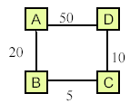
Optimal sub-structure
The principle of optimality holds in the case of problem of finding a shortest distance in a network, but it does not hold good for problem of finding the longest distance
Consider, for example, the network shown in the figure. The shortest distance A to D is A->B->C->D 35. Further, the shortest distance from A to C is A->B->C=25, and shortest distance from A to B is A->B=20. Thus, principle of optimality holds true for each of the sub paths of the shortest distance between A to D.
Now consider the longest distance from C to A. It is C->D->A=60. However, the sub path C->D=10 is not the longest distance, because the longest distance from C to D is C->B->A->D=75. Hence, the principle of optimality does not hold true.

