Slide 1
Artificial Intelligence
Lecture # 24
Session#27

Slide 2
Learning objectives
To enable students to
  Understand basic terminology for adversarial games
  Understand policy evaluation for adversarial games

Slide 3
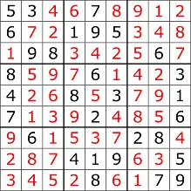
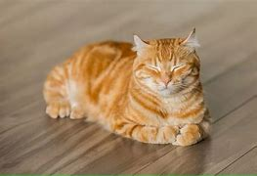
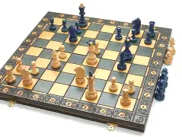
Model types
Four types in order of increasing generality:
  Simple reflex models
  State-based models
  Variable-based models
  Logic-based models
  Reflex State-based Variable Logic
  - Search-based - Constraint satisfaction
  - Markov decision - Bayesian networks
  - Adversarial

Slide 4
Games
Competitive environments, in which the agents' goals are in conflict, give rise to adversarial search problems often known as games
Games are interesting because they are hard to solve.
For example, chess has an average branching factor of about 35, and games often go to 50 moves by each player
Games, like the real world, therefore require the ability to make some decision even when calculating the optimal decision is infeasible
Games also penalize inefficiency severely
Game-playing research has therefore spawned a number of interesting ideas

Slide 5
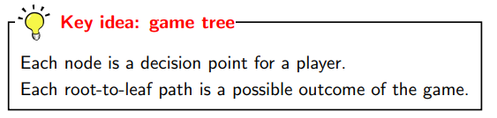
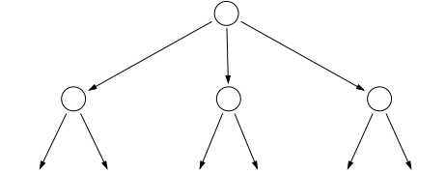
Game Tree
Represented as game trees- similar to a search tree

Slide 6
Games – Two-player zero-sum
In AI, games are usually of a rather specialized kind
  turn-taking, two-player, zero-sum games
This means
    two agents whose actions must alternate
    The utility values at the end of the game are always equal and opposite.
    For example, if one player wins a game of chess (+1), the other player necessarily loses (-1).

Slide 7
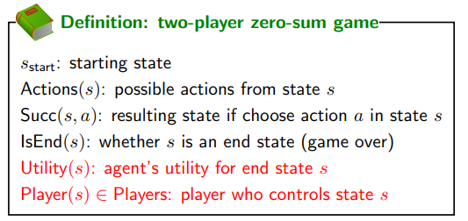
Players={agent, opponent}

Slide 8
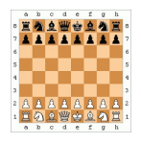
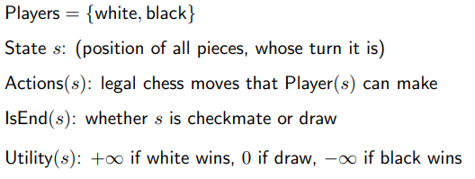
Chess

Slide 9
Characteristics of games
All the utility is at the end state
Different players in control at different states

Slide 10
Policies
Instead of having a single policy π, we have a policy π_{p} for each player p ∈ Players
We require that π_{p} only be defined when it’s p’s turn; that is, for states s such that Player(s) = p
Deterministic policies
  π_{p}(s) ∈ Actions(s)
  action that player p takes
Stochastic policies
  π_{p}(s, a) ∈ [0, 1]
  probability of player p taking action a in state s

Slide 11
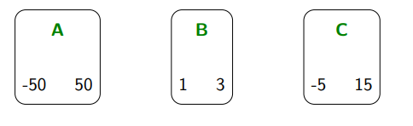
Simple Game 1
Agent picks a bucket
Opponent picks a number from the bucket
Number denotes Agent’s reward
Opponent gets – Agent’s reward
-100 100
2 6
-10 30

