Slide 1
Artificial Intelligence
Lecture # 24
Session#27

Slide 2
Learning objectives
To enable students to
  Understand basic terminology for adversarial games
  Understand policy evaluation for adversarial games

Slide 3
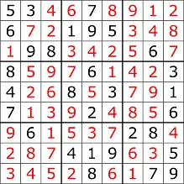

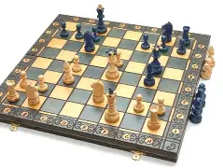
Model types
Four types in order of increasing generality:
  Simple reflex models
  State-based models
  Variable-based models
  Logic-based models
  Reflex State-based Variable Logic
  - Search-based - Constraint satisfaction
  - Markov decision - Bayesian networks
  - Adversarial

Slide 4
Games
Competitive environments, in which the agents' goals are in conflict, give rise to adversarial search problems often known as games
Games are interesting because they are hard to solve.
For example, chess has an average branching factor of about 35, and games often go to 50 moves by each player
Games, like the real world, therefore require the ability to make some decision even when calculating the optimal decision is infeasible
Games also penalize inefficiency severely
Game-playing research has therefore spawned a number of interesting ideas

Slide 5
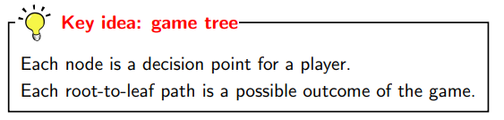
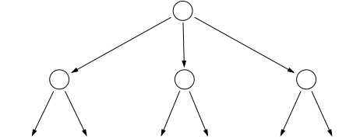
Game Tree
Represented as game trees- similar to a search tree

Slide 6
Games – Two-player zero-sum
In AI, games are usually of a rather specialized kind
  turn-taking, two-player, zero-sum games
This means
    two agents whose actions must alternate
    The utility values at the end of the game are always equal and opposite.
    For example, if one player wins a game of chess (+1), the other player necessarily loses (-1).

Slide 7
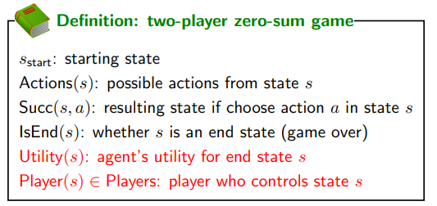
Players={agent, opponent}

Slide 8
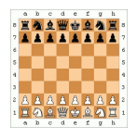
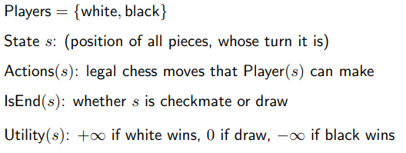
Chess

Slide 9
Characteristics of games
All the utility is at the end state
Different players in control at different states

Slide 10
Policies
Instead of having a single policy π, we have a policy π_{p} for each player p ∈ Players
We require that π_{p} only be defined when it’s p’s turn; that is, for states s such that Player(s) = p
Deterministic policies
  π_{p}(s) ∈ Actions(s)
  action that player p takes
Stochastic policies
  π_{p}(s, a) ∈ [0, 1]
  probability of player p taking action a in state s

Slide 11
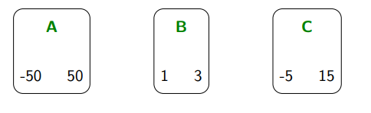
Simple Game 1
Agent picks a bucket
Opponent picks a number from the bucket
Number denotes Agent’s reward
Opponent gets – Agent’s reward
-100 100
2 6
-10 30

Slide 12
Artificial Intelligence
Lecture # 25
Session#28

Slide 13
Learning objectives
To enable students to
  Understand and apply expectimax and minimax for choosing best policy

Slide 14

Policies
Instead of having a single policy π, we have a policy π_{p} for each player p ∈ Players
We require that π_{p} only be defined when it’s p’s turn; that is, for states s such that Player(s) = p
Deterministic policies
  π_{p}(s) ∈ Actions(s)
  action that player p takes
Stochastic policies
  π_{p}(s, a) ∈ [0, 1]
  probability of player p taking action a in state s

Slide 15
Game policy evaluation
Given two policies π_{agent} and π_{opp}, what is the (agent’s) expected utility?
If the agent and the opponent were to play their (possibly stochastic) policies a large number of times, what would be the average utility
In zero-sum games, the opponent’s utility is the negative of the agent’s utility
Given the game tree, we can recursively compute the value (expected utility) of each node in the tree
The value of a node is the weighted average of the values of the children where the weights are given by the probabilities of taking various actions given by the policy at that node.

Slide 16
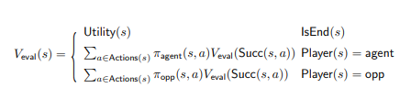
Game evaluation

Slide 17
Expectimax
We are trying to find the best policy - Expectimax
In the game tree, use an upward-pointing triangle to denote states where the player is maximizing over actions (max nodes)
At max nodes, instead of averaging with respect to a policy, we take the max of the values of the children
This computation produces the expectimax value V_{exptmax}(s) for a state s, which is the maximum expected utility of any agent policy when playing with respect to a fixed and known opponent policy π_{opp}

Slide 18
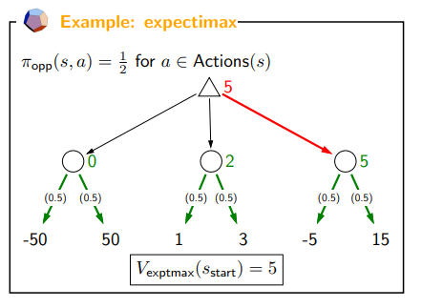
10
4
10
-100 100
2 6
-10 30
10

Slide 19



Slide 20
Problem: don’t know opponent’s policy
Approach: assume the worst case

Slide 21
Minimax
In practice, we don’t know the opponent’s policy
Our solution is to assume the worst case, that is, the opponent is doing everything to minimize the agent’s utility
In the game tree, we use an upside-down triangle to represent min nodes, in which the player minimizes the value over possible actions

Slide 22
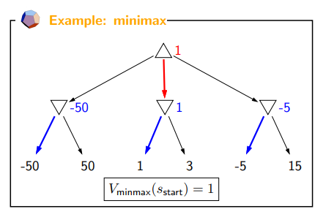
The policy for the agent changes from choosing the rightmost action (expectimax) to the middle action.
2
-100
2
-10
-100 100
2 6
-10 30
2

Slide 23
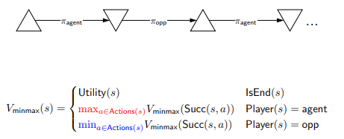
Minimax recurrence

Slide 24

Extracting minimax policies
2
-100
2
-10
-100 100
2 6
-10 30
2

