Slide 1
Artificial Intelligence
Lecture # 26
Session#29

Slide 2
Learning objectives
To enable students to
  Understand minimax properties
  Understand and apply alpha-beta pruning

Slide 3

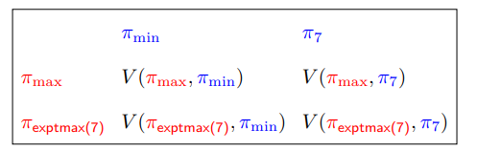
Minimax properties

Slide 4
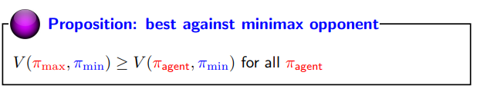
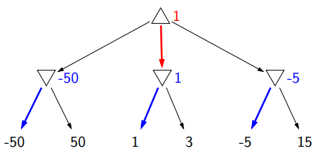
Minimax property 1
2
-100
2
-10
-100 100
2 6
-10 30

Slide 5
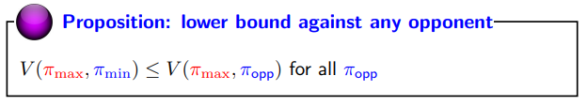
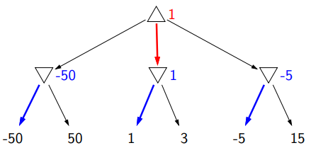
Minimax property 2
2
-100
2
-10
-100 100
2 6
-10 30

Slide 6
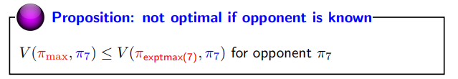
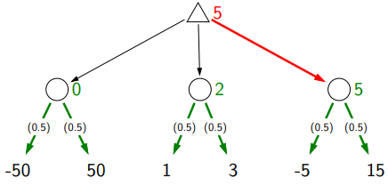
Minimax property 3
10
4
10
-100 100
2 6
-10 30

Slide 7
Computation
Complexity
  branching factor b, depth d (2d plies)
  O(d) space, O(b^{2d} ) time
  Chess: b approx. 35, d approx 50

Slide 8
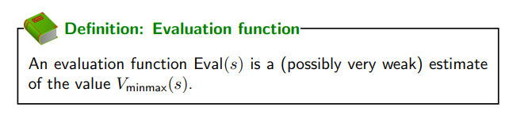
Improving speed
Evaluation functions
Alpha-beta pruning

Slide 9

Alpha-Beta pruning
Suppose you have to pick a maximum value from Buckets A and B
No overlap
Maintain upper bound and lower bound on values
If intervals don’t overlap, optimal choice is possible without going further (expanding a sub-tree)

Slide 10
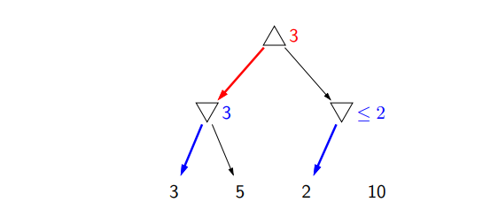

Slide 11
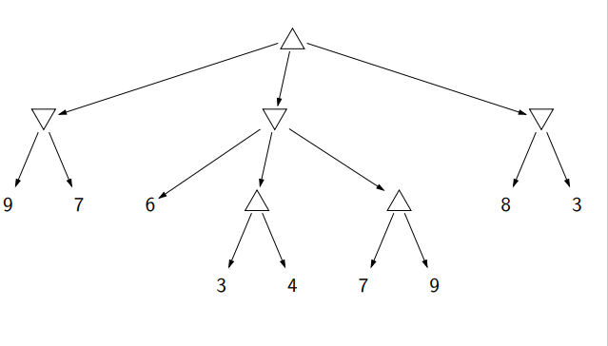

Slide 12
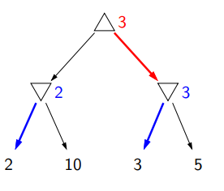
Pruning depends on order of actions.

Slide 13
Games (contd…)

Slide 14

Simple Game 2
Start with a number N
Players take turns either decrementing N or replacing it with N/2
The player that is left with 0 wins

