Slide 1
Artificial Intelligence
Lecture # 27
Session#30

Slide 2
Learning objectives
To enable students to
  Understand evaluation functions
  Understand TD learning

Slide 3
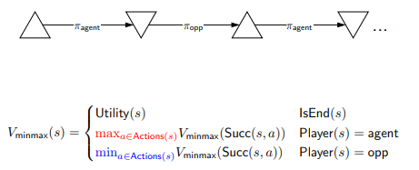
Minimax recurrence

Slide 4
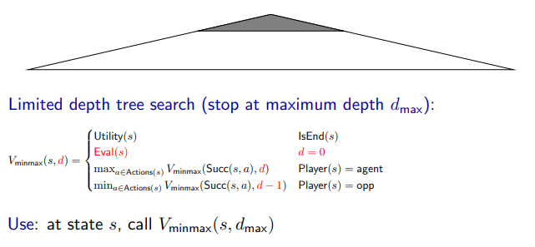
Speeding up
No guarantees (unlike A*) on the error from approximation

Slide 5
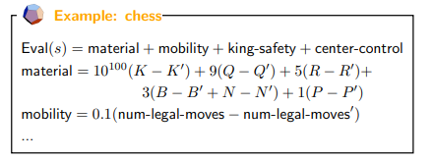

Evaluation function
Write the function yourself – Complicated
We can think of the components here as features that have weights
Features are easier to identify
Learn weights from data?

Slide 6


Model for evaluation functions
Linear
Neural network

Slide 7
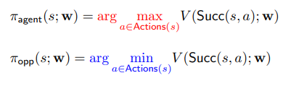
Generating data
Generate using policies based on current V (s; w)
Generate episode
Reward throughout is zero till the end

Slide 8


s, a, r, s’
Prediction
Target

Slide 9
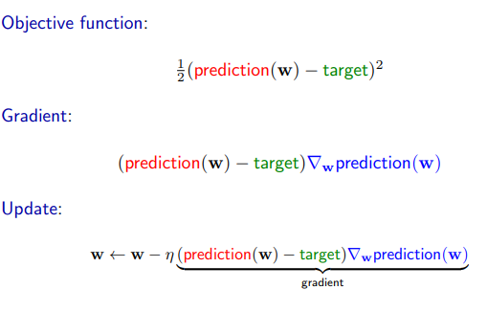
General framework

Slide 10
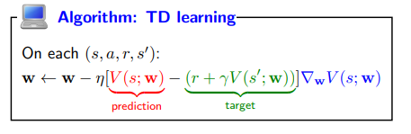
Temporal difference (TD) learning

Slide 11

Simple Game 2
Start with a number N
Players take turns either decrementing N or replacing it with N/2
The player that is left with 0 wins

