Slide 1
Artificial Intelligence
Lecture # 29
Session#31

Slide 2
Learning objectives
To enable students to
  Understand terminology related to logic and knowledge based systems

Slide 3
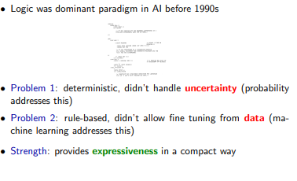

Slide 4
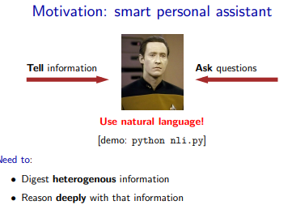


Slide 5
Languages
A mechanism for expression
Example:
  A Rs. hundred is better than Rs. fifty
  Rs. fifty is better than Rs. ten
  Therefore Rs. hundred is better than Rs. ten
Example:
  A rupee is better than nothing
  Nothing is better than peace
  Therefore a rupee is better than peace

Slide 6
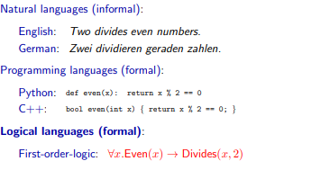

Slide 7
Logic language
Two goals of a logic language
  Represent knowledge about the world
  Reason with that knowledge

Slide 8
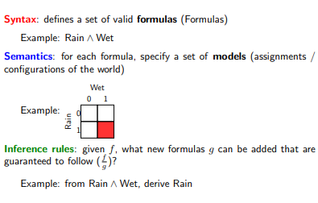
Syntax, Semantics and Rules

Slide 9
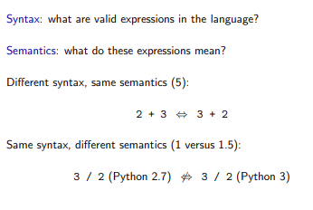
Syntax versus semantics

Slide 10
Logic
Propositional logic
First-order logic
Balance expressivity and computational efficiency
Syntax
Semantics
Inference rules
Develop general principles or algorithms to do the work

Slide 11
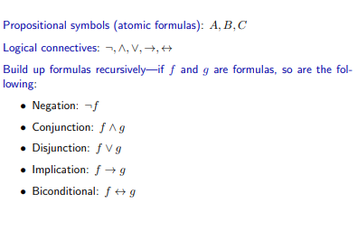
Syntax

Slide 12
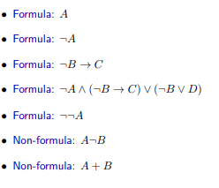
Syntax

Slide 13

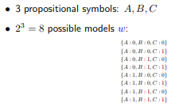
Semantics - Model
Formulas by themselves are just symbols (syntax)
No meaning yet (semantics)!

Slide 14
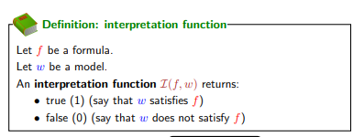
Semantics – Interpretation function

Slide 15
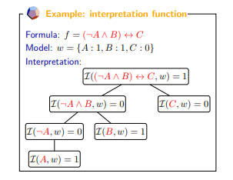

Slide 16
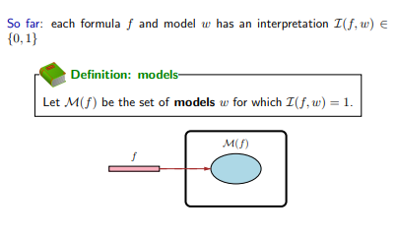

Slide 17
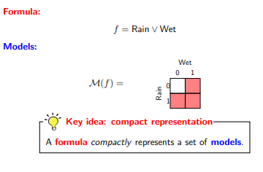

Slide 18
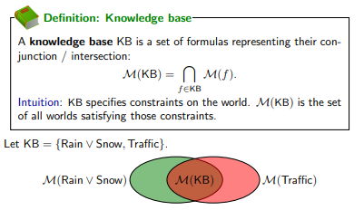
Knowledge base

Slide 19
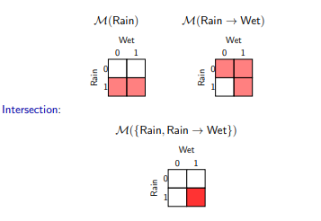

Slide 20
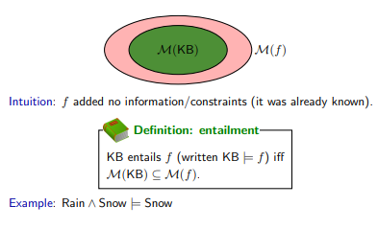
Entailment

Slide 21
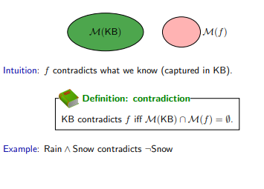
Contradiction

Slide 22
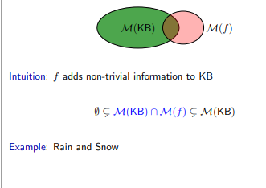
Contingency

Slide 23
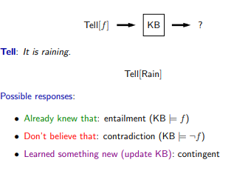
Tell operation

Slide 24
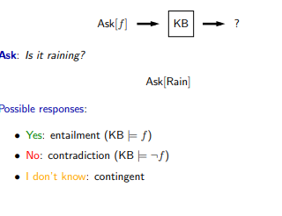
Ask operation

Slide 25
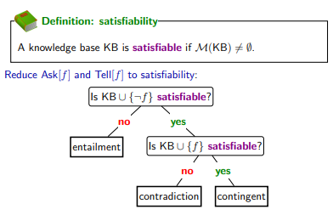
Satisfiability

Slide 26
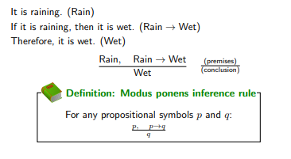
Inference rules

Slide 27
