Slide 1
Artificial Intelligence
Lecture # 3

Slide 2
Learning objectives
To introduce students to
  the Model-Inference-Learning paradigm
  basic linear prediction tasks (e.g. classification, regression)
  supervised learning, features and feature vector

Slide 3
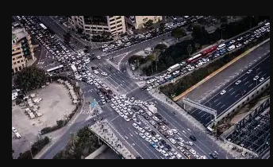

Agents and Environments
Task environment: Problems to which rational agents are solutions
Generally complex

Slide 4
Modelling Inference Learning Paradigm
Modelling
Inference Learning

Slide 5
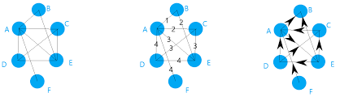
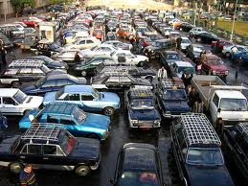
Real world Modelling Model without parameters
Modelling Inference +data – Learning
e.g. graph e.g. Shortest path e.g. learn edge weights

Slide 6
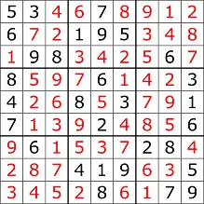

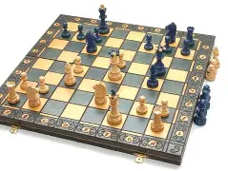
Model types
Machine learning allows shifting of information complexity of the model from the code to the data
By taking data and tuning parameters of the model
Will allow to produce good predictions beyond the dataset - Generalization
Four types in order of increasing generality:
  Simple reflex models
  Model-based models
  Variable-based models
  Logic-based models
  Machine learning
  Reflex State-based Variable Logic
  - Search-based - Constraint satisfaction
  - Markov decision - Bayesian networks
  - Adversarial

Slide 7
Roots
AI and Machine learning
  Philosophy
  Mathematics
  Statistics
  Economics
  Neuroscience
  Psychology
  Control theory
  Linguistics

Slide 8
Reflex models

Slide 9
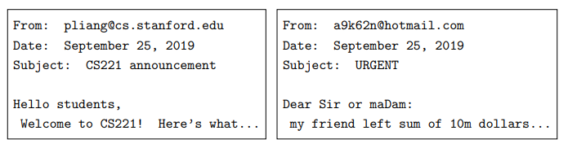
Linear predictors
Input x: Email message
Output y: {Spam, not spam}
Objective: Obtain a predictor f

Slide 10
Linear predictors
Types of prediction tasks
  Classification
    Binary
    Multiclass
    …..
  Regression
  Classification and Regression are examples of Supervised learning

Slide 11
Supervised Learning
The data has both inputs and outputs
An example (also called data point, instance, tuple etc) is in the form of (x,y) pairs
Training data is a set of examples, forming a partial specification
D_{train}=[“Good day from ….”, +1,
“AI course notes…..”, -1
………. ]

Slide 12
Modelling, learning and inference
Learner has to learn beyond the training examples – Can’t be a rote learner
This is generalization

