Slide 1
Artificial Intelligence
Lecture # 5

Slide 2
Learning objectives
To enable students to
  Understand loss minimization and 0-1 loss
  Learn basic concepts of linear regression

Slide 3
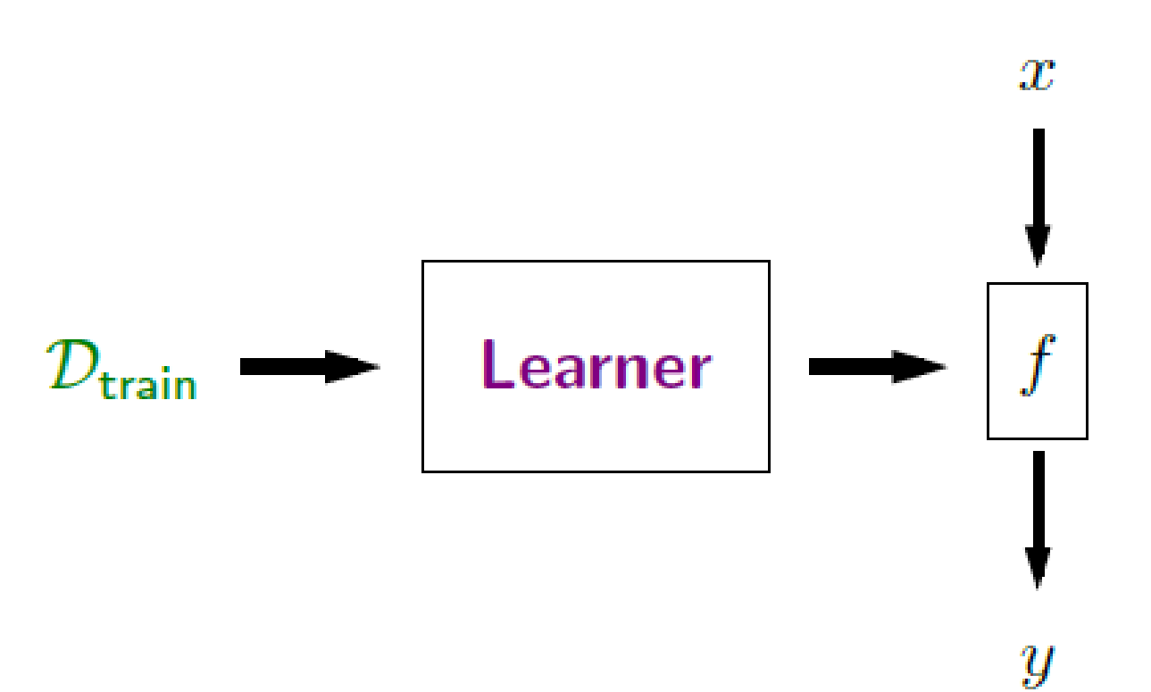
Loss Minimization
The learner in this framework is an algorithm, which is learning the weights of the function

Slide 4
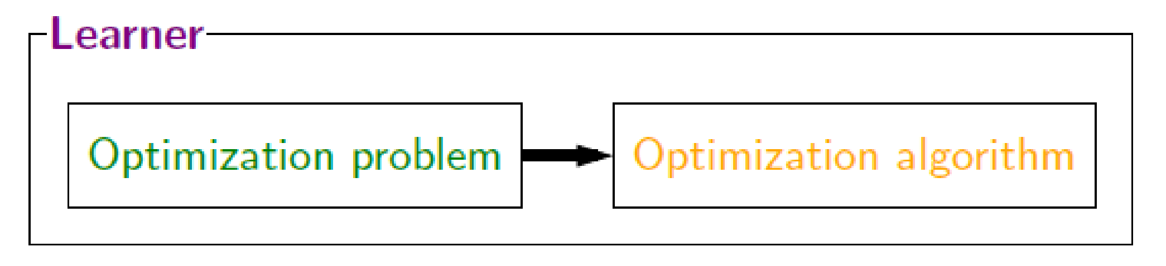
Role of Optimization
Through the loss minimization framework, learning is cast as an optimization problem
How to find weights to reduce (minimize) the loss
Why can’t we have zero loss?

Slide 5
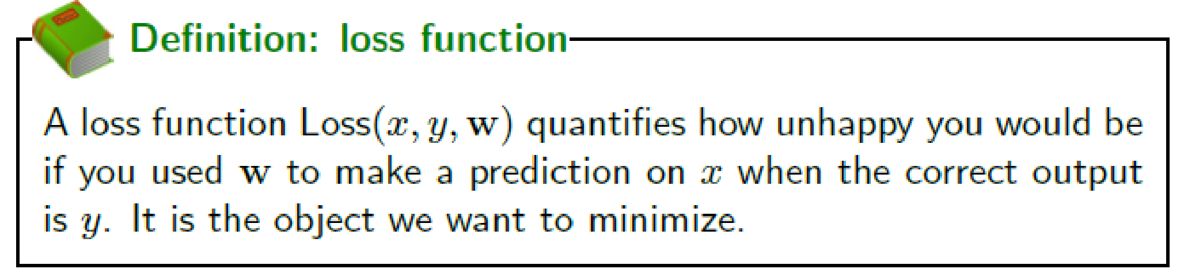
Defining loss – The Loss function

Slide 6
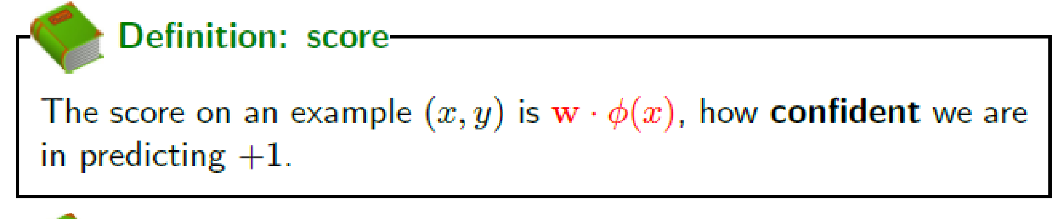
Score
Correct label y
Predicted label y`
Score can be both positive or negative, correct?
Which is better?

Slide 7
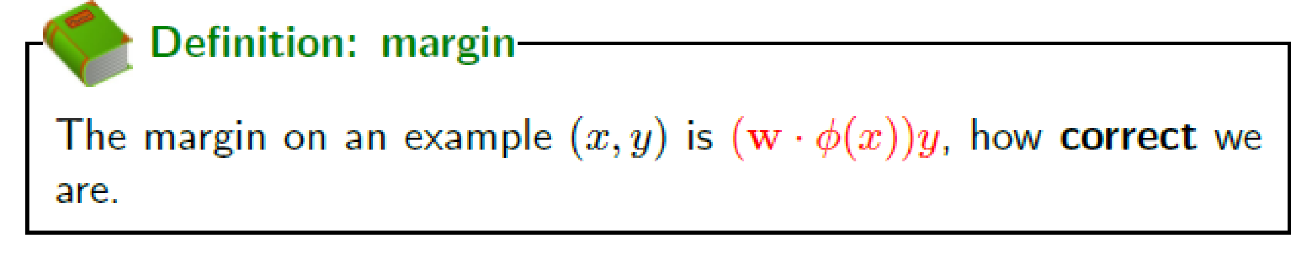
Margin
Margin can be both positive or negative, correct?
Which is better?

Slide 8
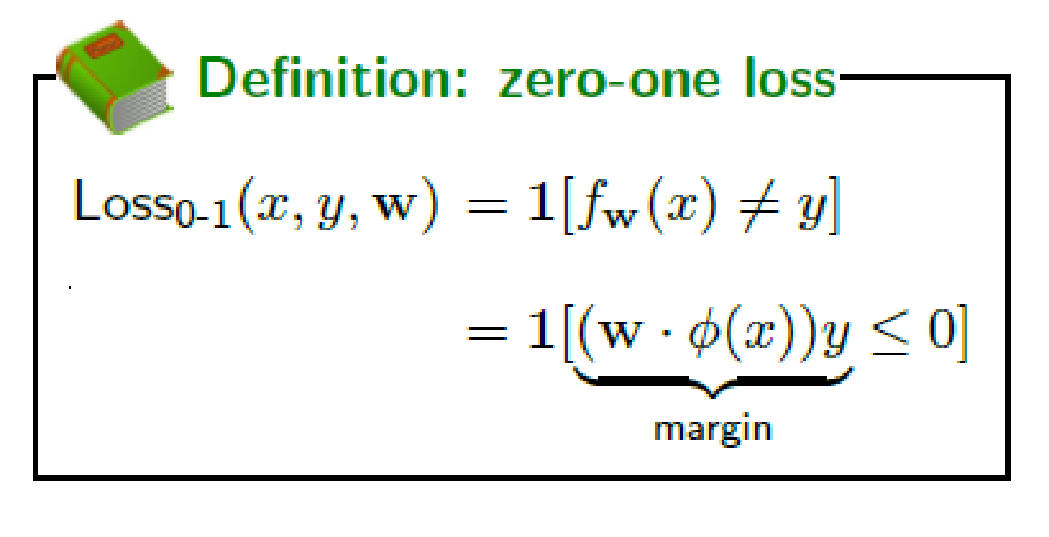
Zero-one Loss in Binary classification
Called zero-one because its zero if mistake was not made, and one if it was

Slide 9
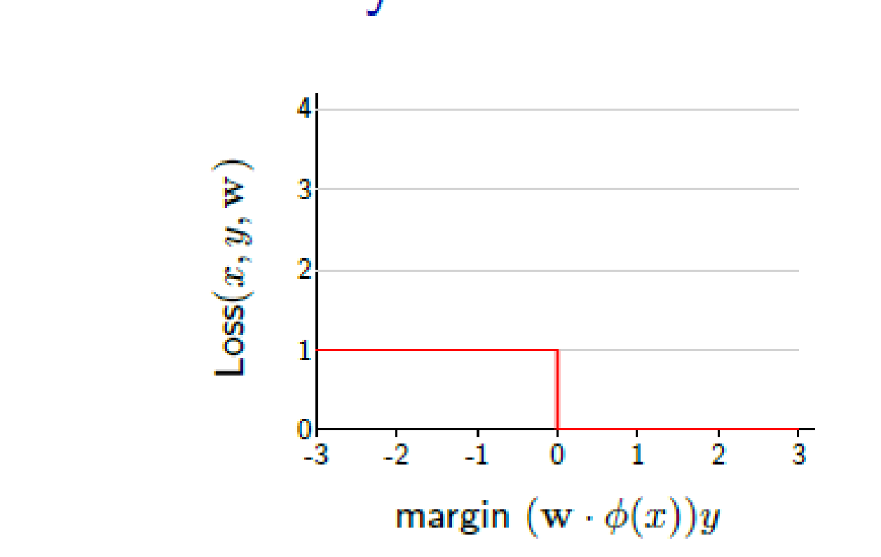
What would the zero-one loss function look like as a graph?

Slide 10
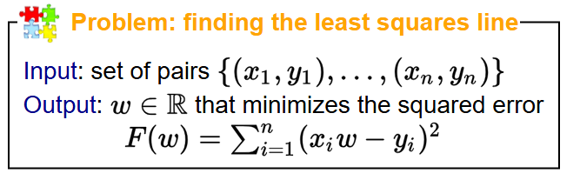
Linear Regression
Discovered in the early 1800s
Design decisions
  What is the predictor? (hypothesis class)
  How good is the predictor? (Loss)
  How do we find/compute the best predictor (optimization)

Slide 11
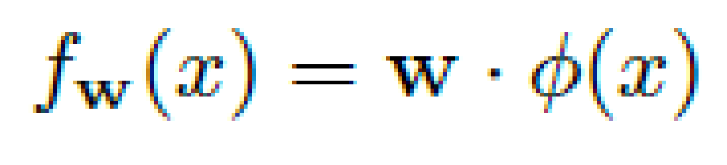
x y
1 1
2 3
4 3
Recall that y here is a real number
So represents the answer or prediction

Slide 12
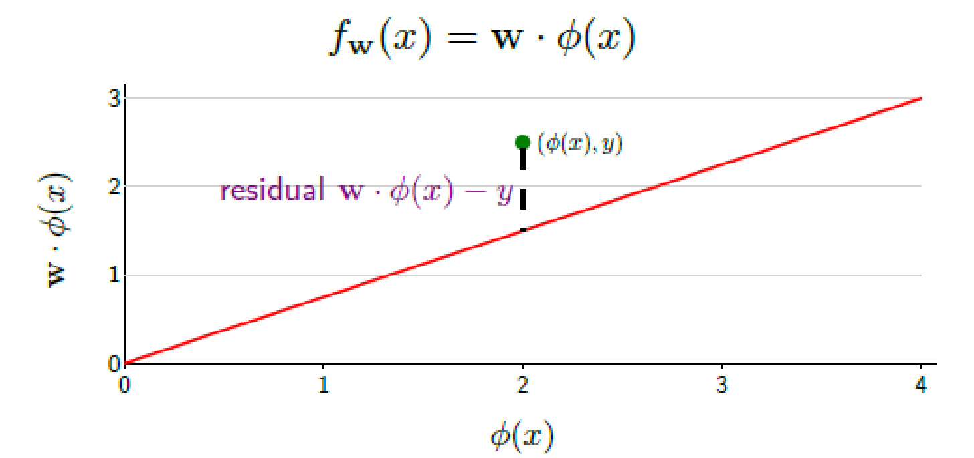
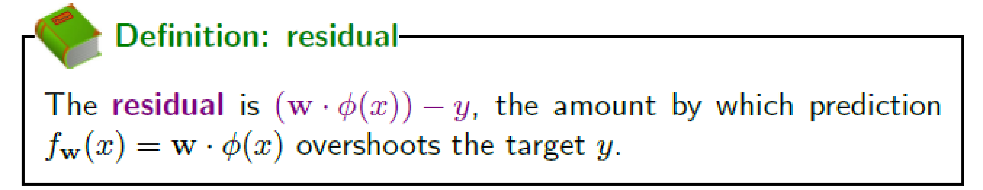
Residual

Slide 13
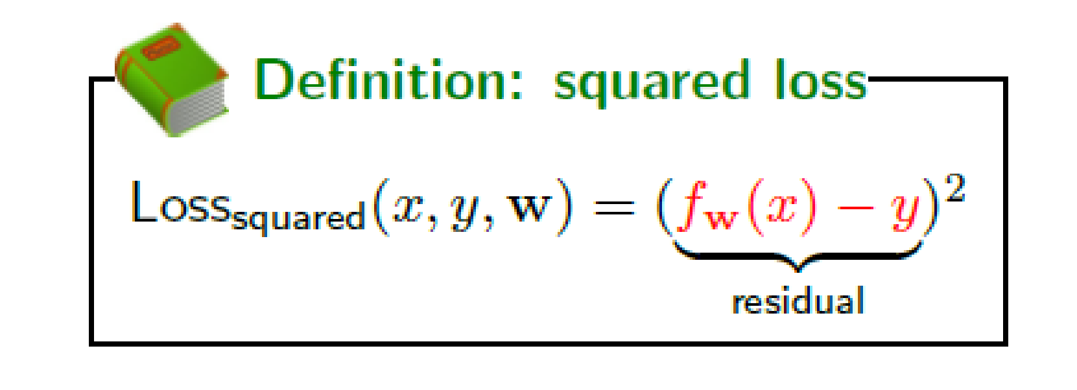
Squared Loss

