Slide 1
Artificial Intelligence
Lecture # 6

Slide 2
Learning objectives
To enable students to
  Understand loss minimization and various kinds of losses

Slide 3
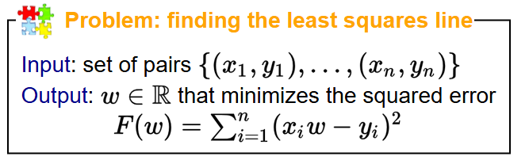
Linear Regression
Discovered in the early 1800s
Design decisions
  What is the predictor? (hypothesis class)
  How good is the predictor? (Loss)
  How do we find/compute the best predictor (optimization)

Slide 4
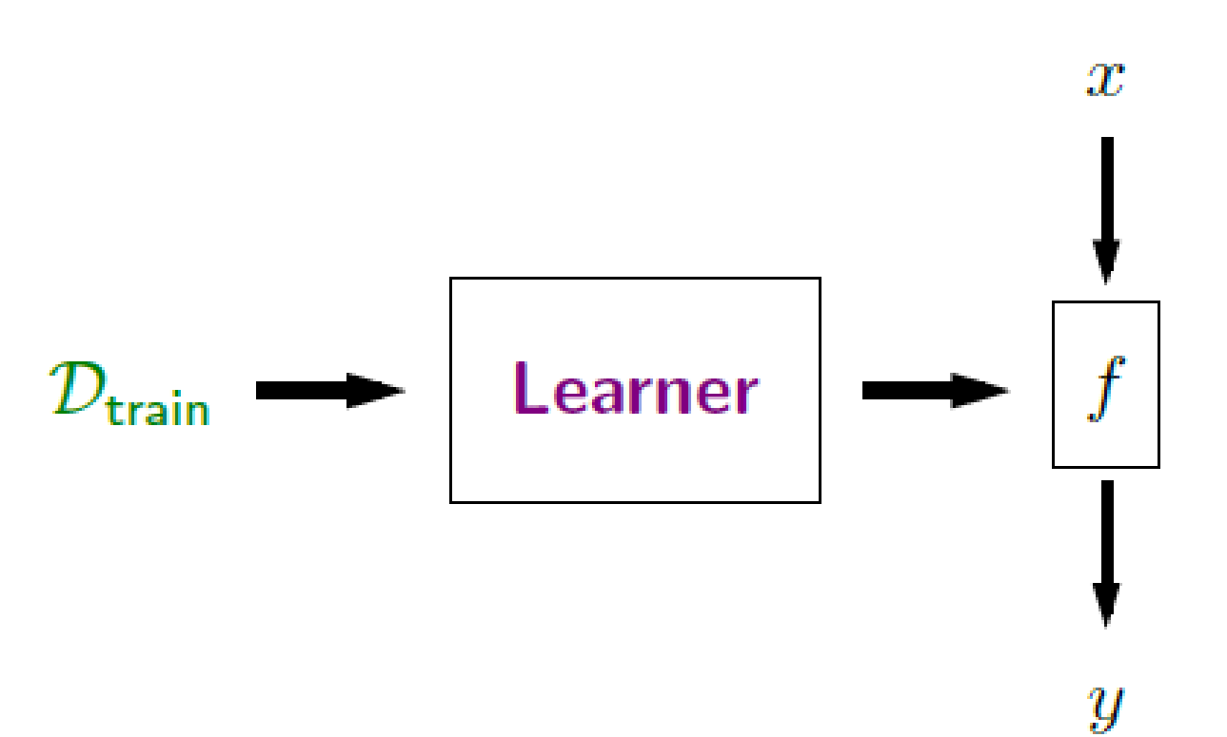
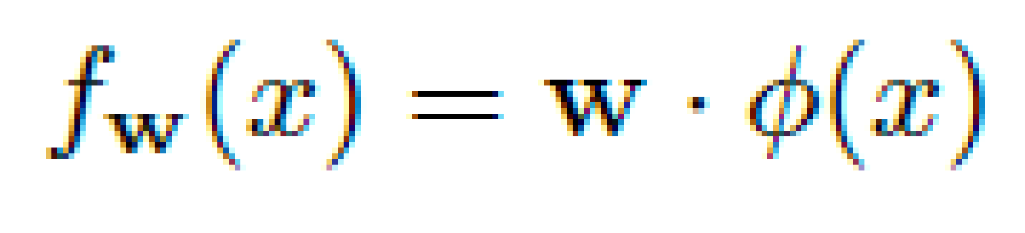
x y
1 1
2 3
4 3
Recall that y here is a real number
So represents the answer or prediction

Slide 5
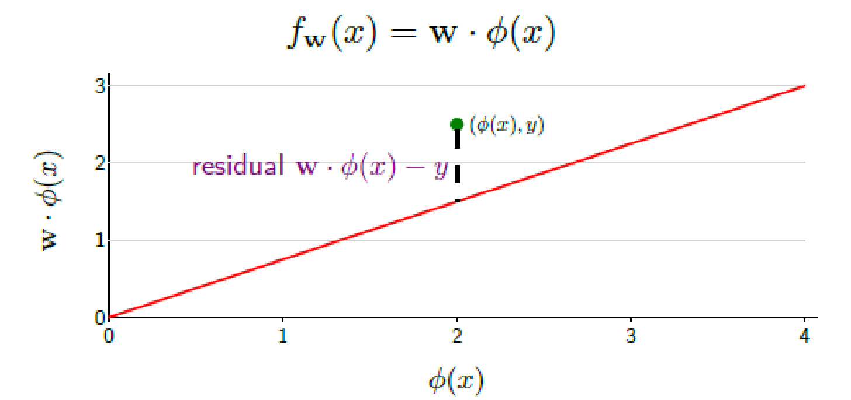
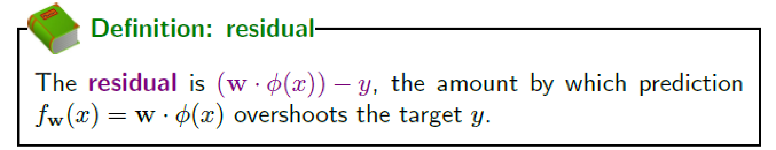
Residual

Slide 6
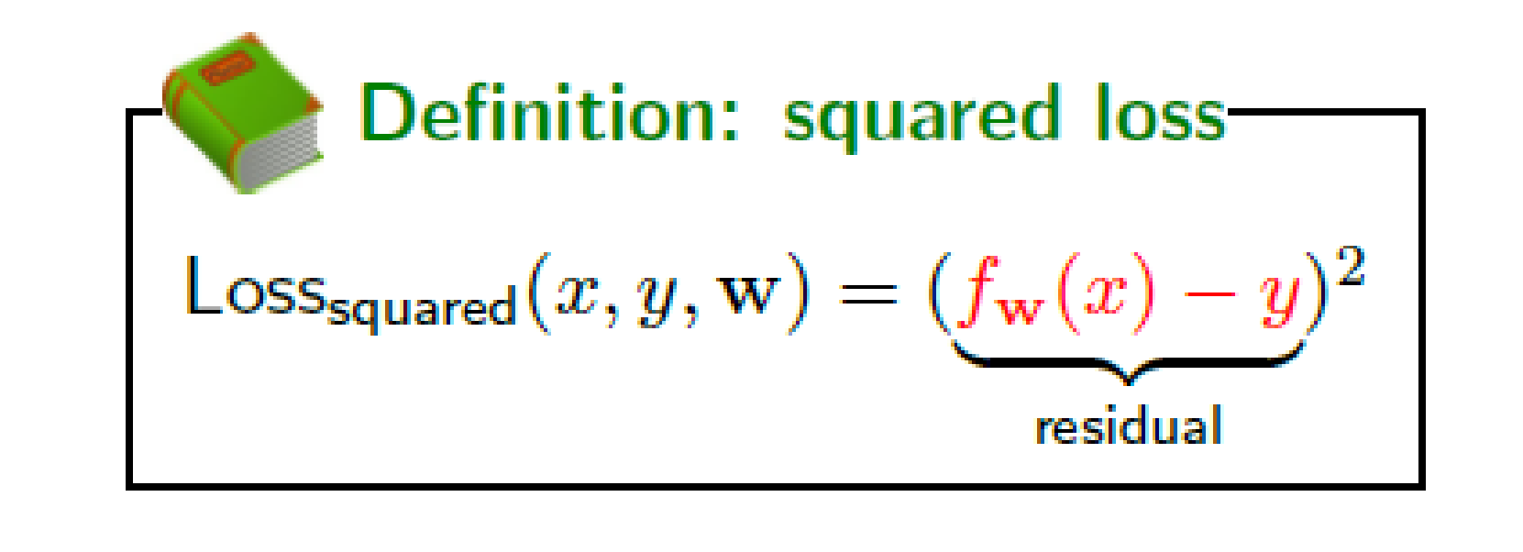
Squared Loss

Slide 7
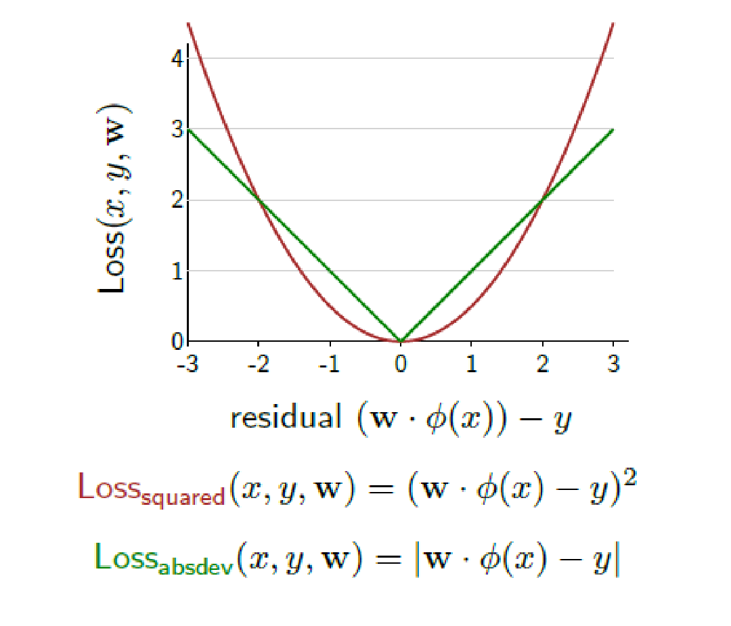
Regression Loss functions

Slide 8
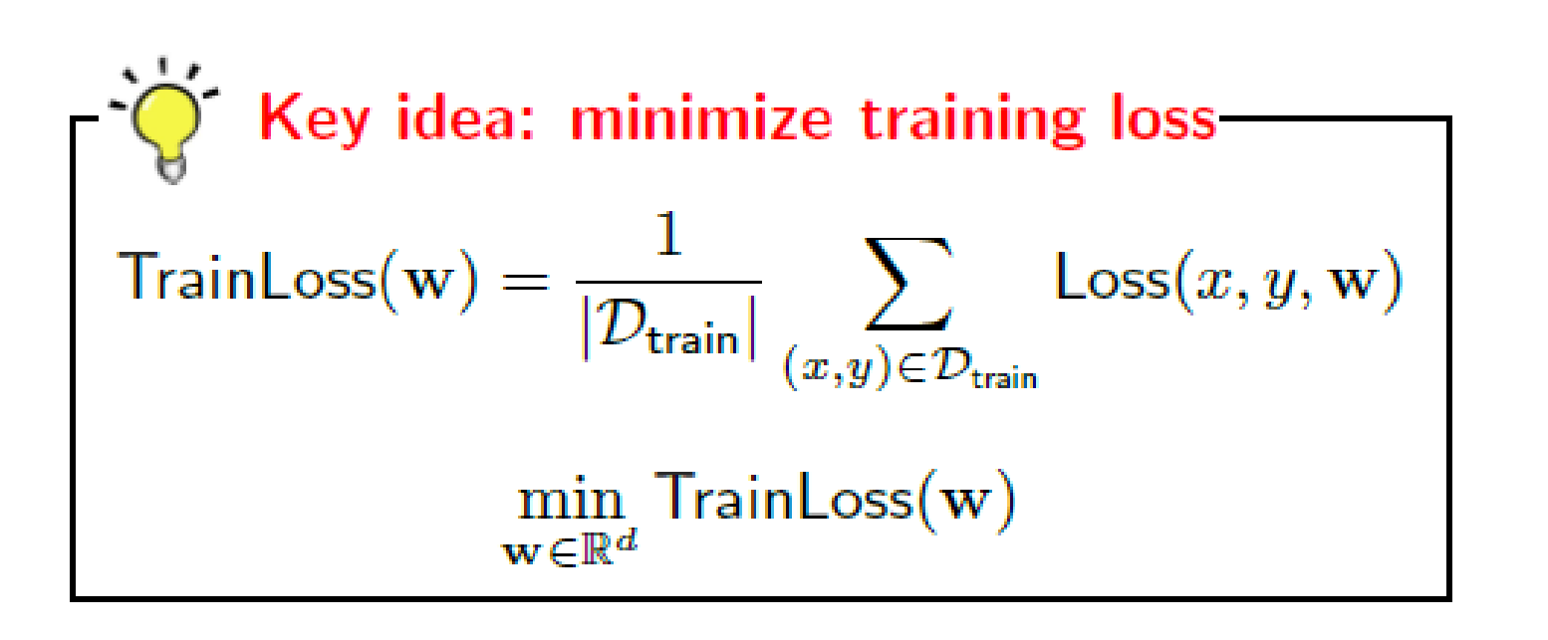
Loss minimization framework
For one example, loss may be easy to minimize
But we want an overall good solution – In general loss will not be zero.
Not every example can be happy…. Global tradeoffs
We try to minimize the average loss

Slide 9
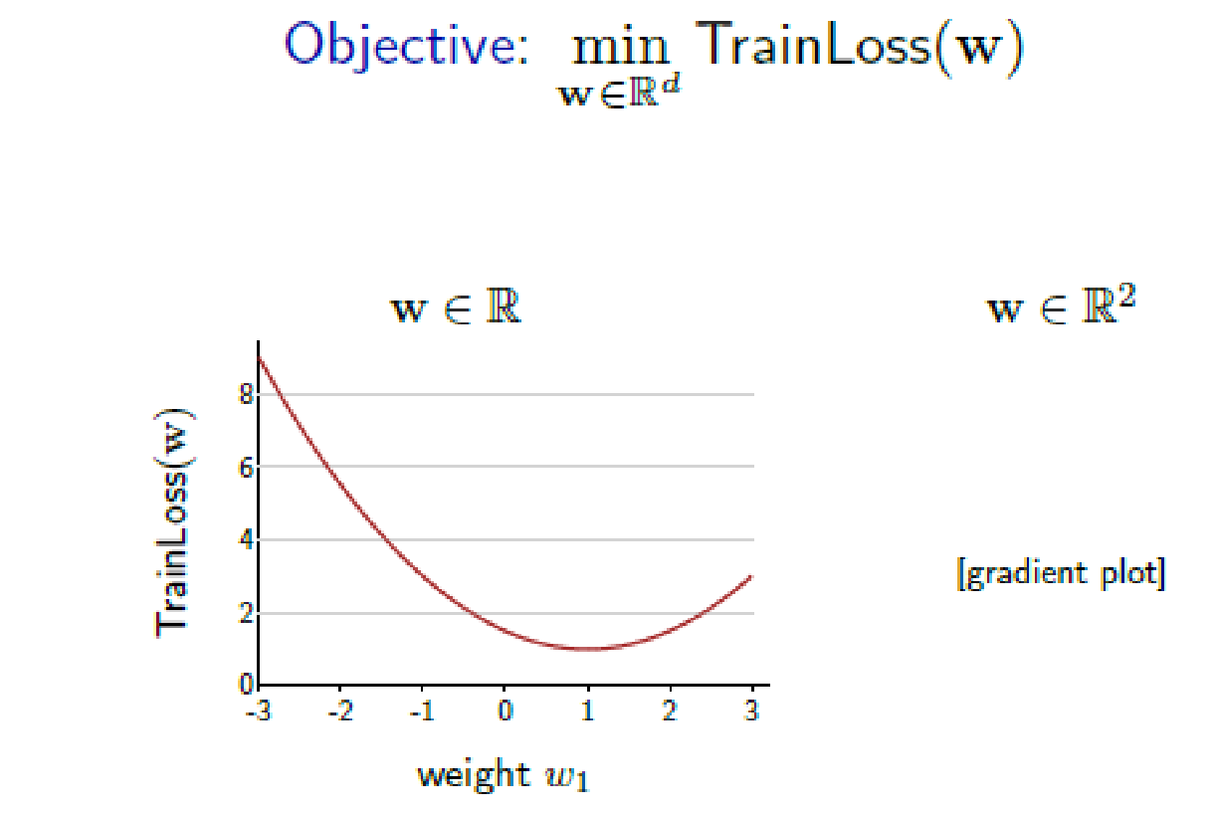
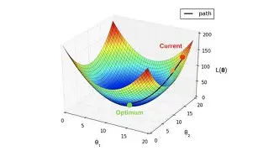
Optimization problem

Slide 10
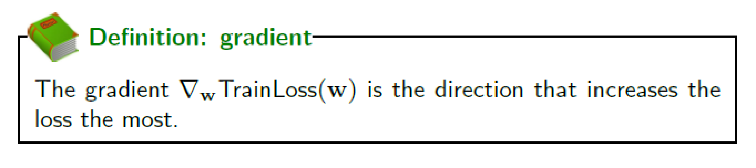
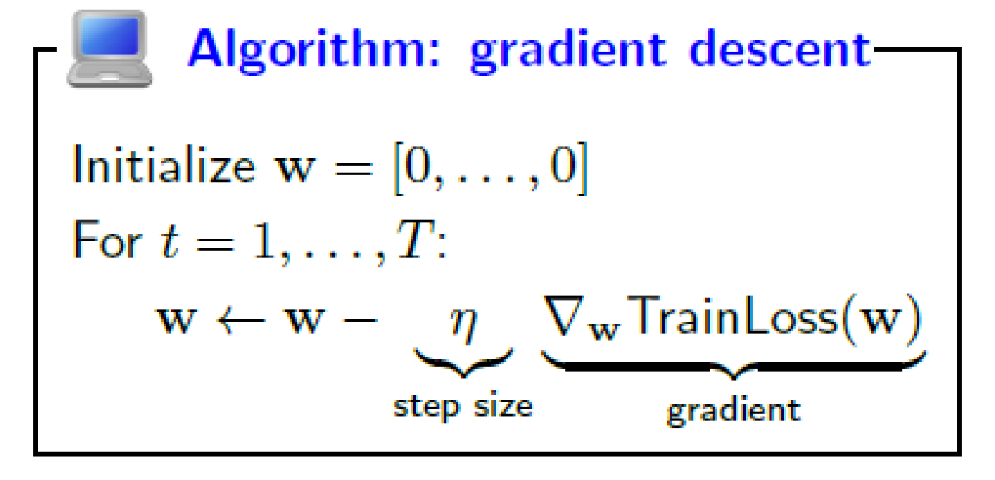
How to optimize?
Use gradient descent

Slide 11
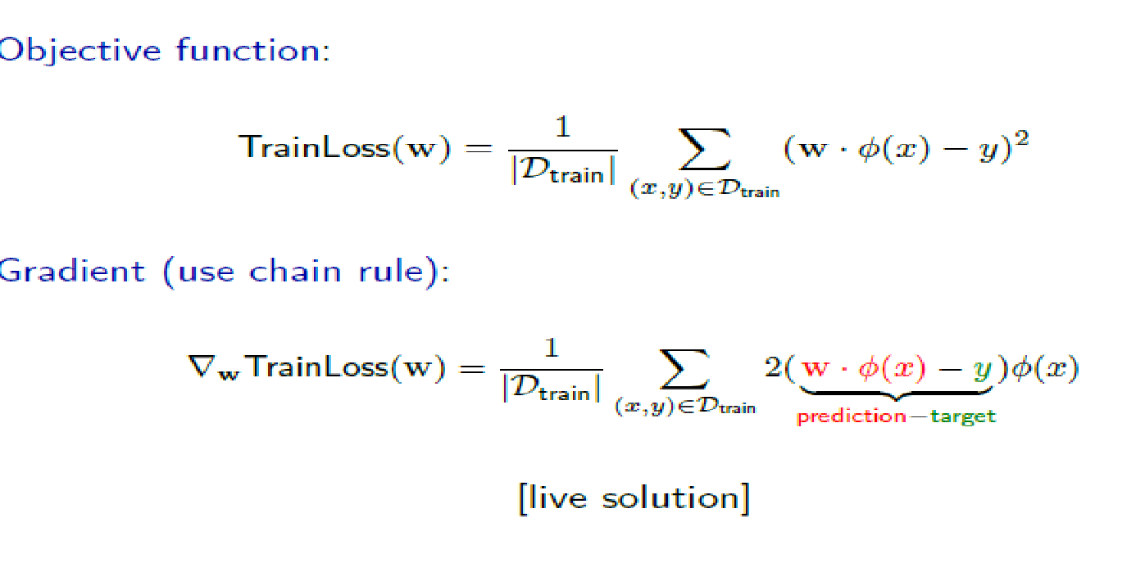
Least squares regression – Gradient descent

Slide 12
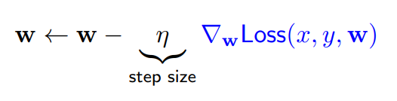
Implications of step size
Smaller size close to 0 is more stable
Larger is faster
Strategies
  Constant
  Decreasing

Slide 13
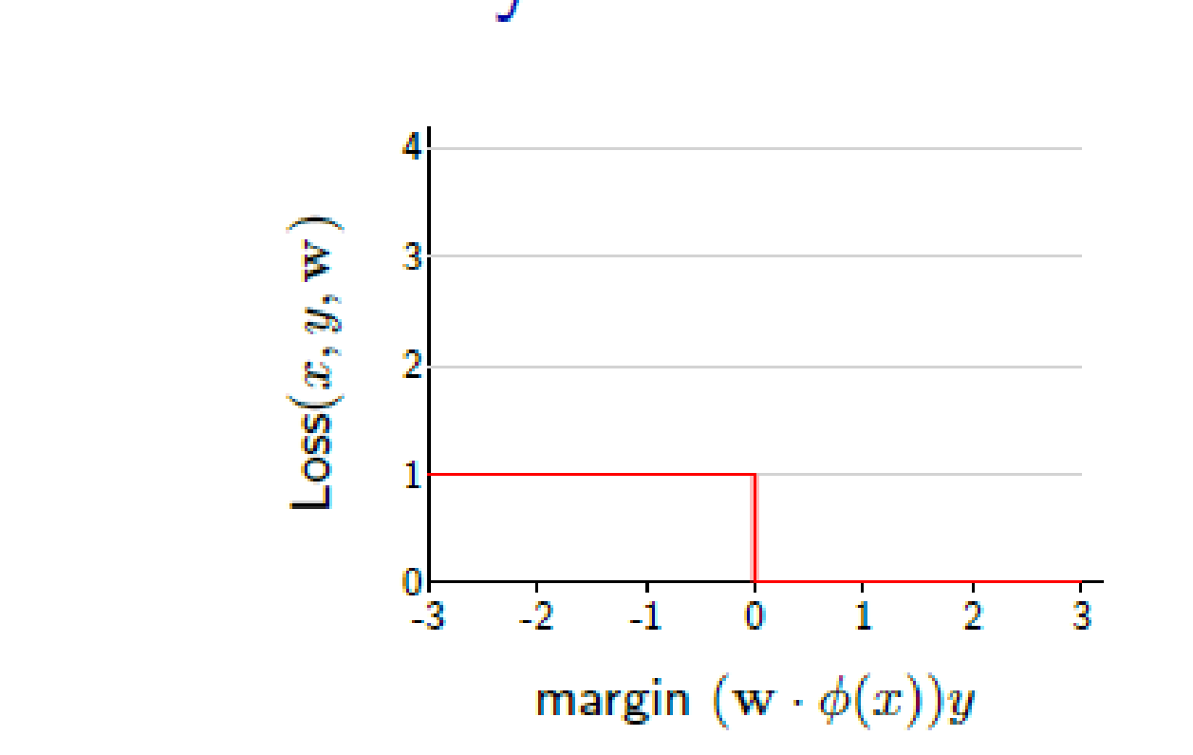
Loss minimization framework for binary classification
The zero-one loss function is not differentiable
The gradient is zero every where
Stochastic gradient descent won’t work

Slide 14
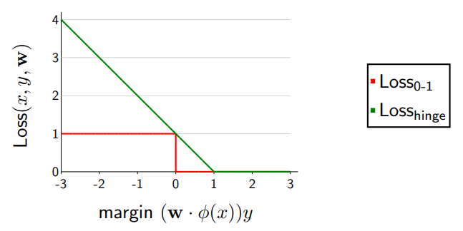
Hinge Loss

Slide 15
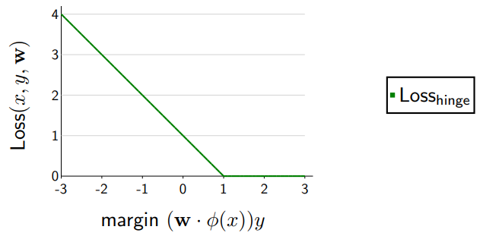
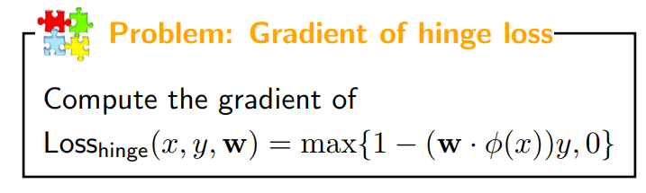
Gradient of Hinge Loss

Slide 16
