Slide 1
Artificial Intelligence
Lecture # 7

Slide 2
Learning objectives
To enable students to
  Understand stochastic gradient descent, logistic regression

Slide 3
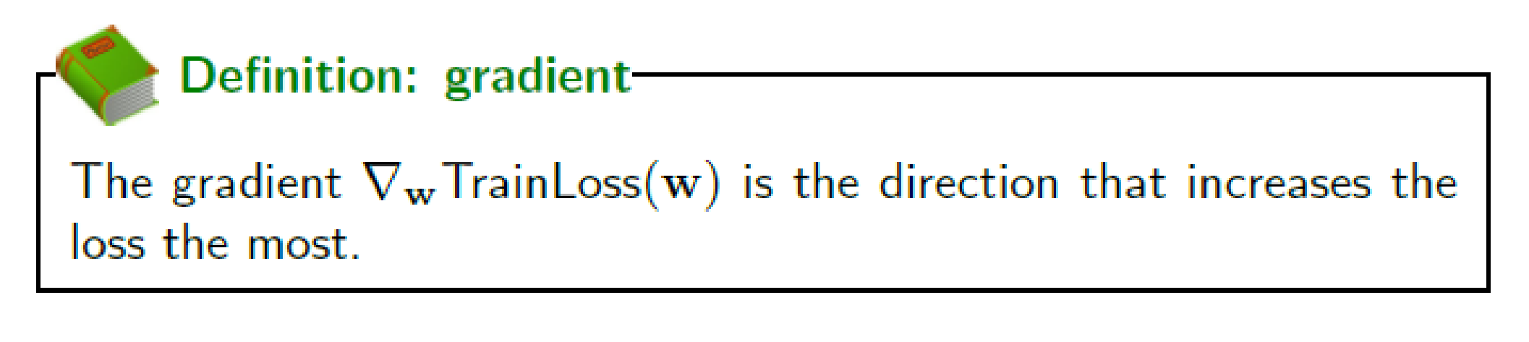
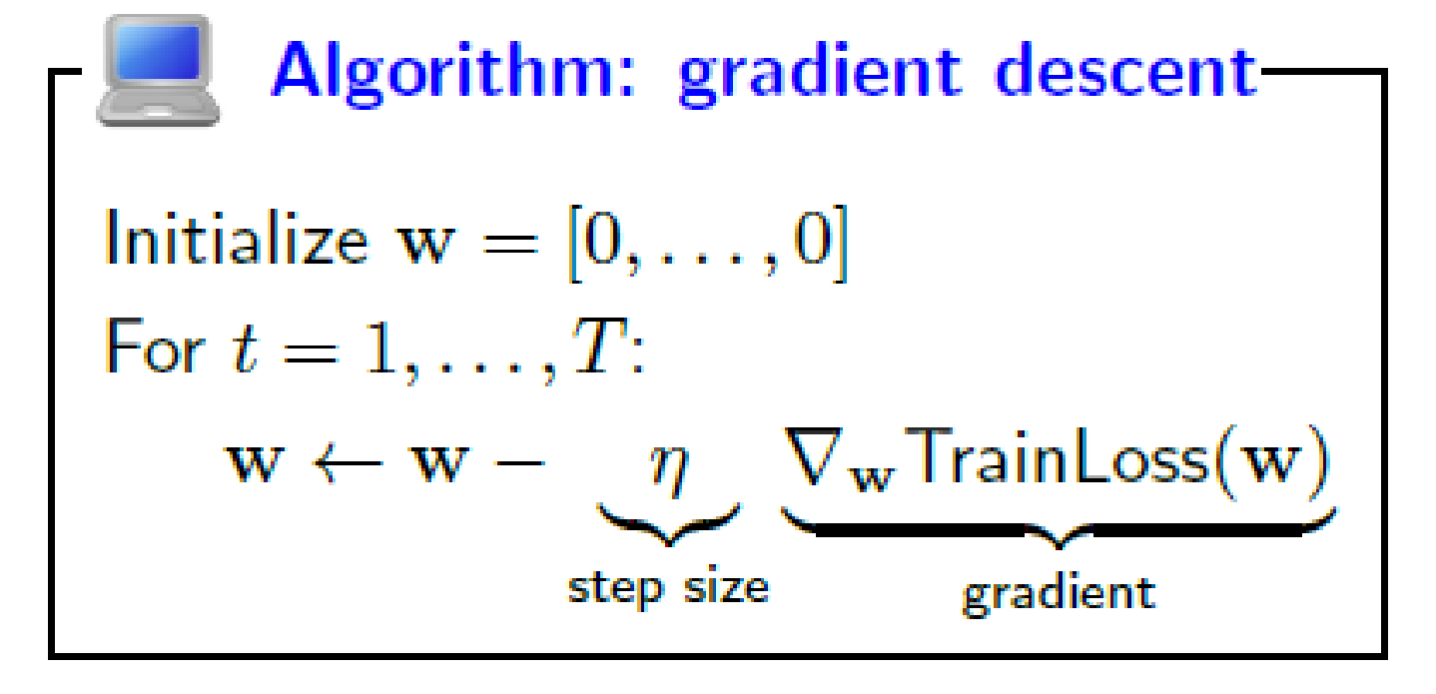
How to optimize?
Use gradient descent

Slide 4
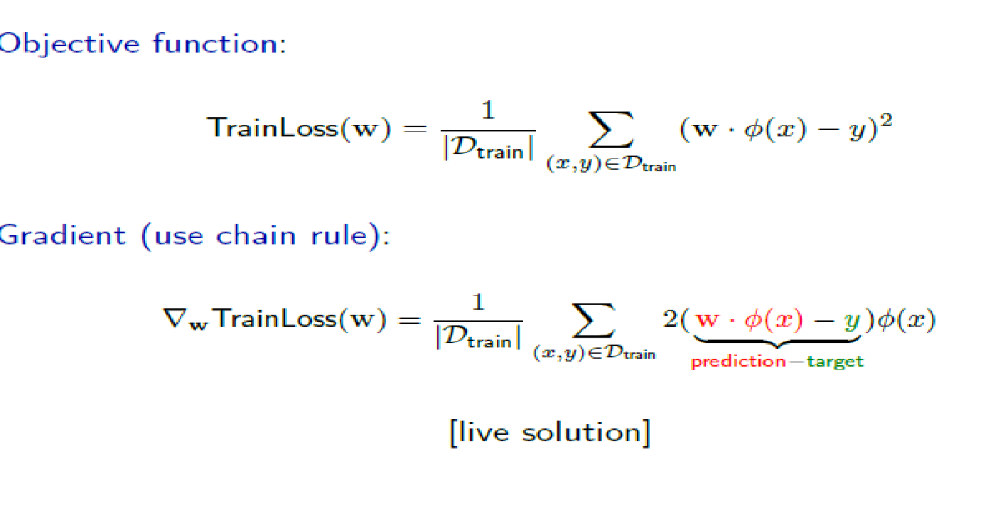
Least squares regression – Gradient descent

Slide 5
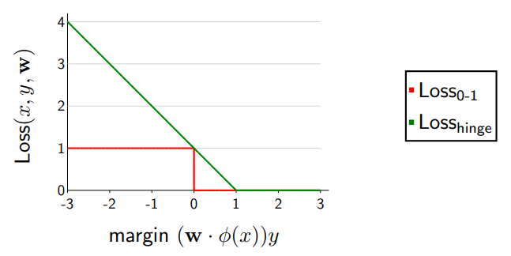
Hinge Loss

Slide 6
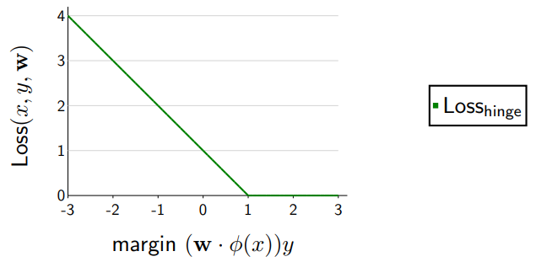
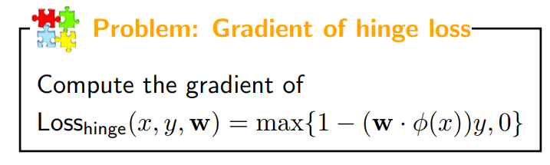
Gradient of Hinge Loss

Slide 7

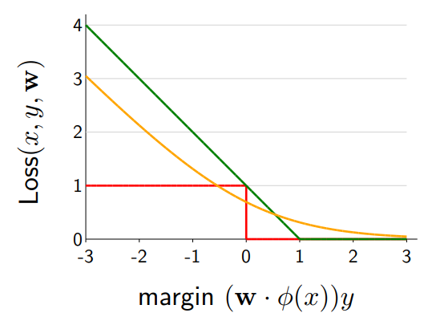
Logistic Regression

Slide 8
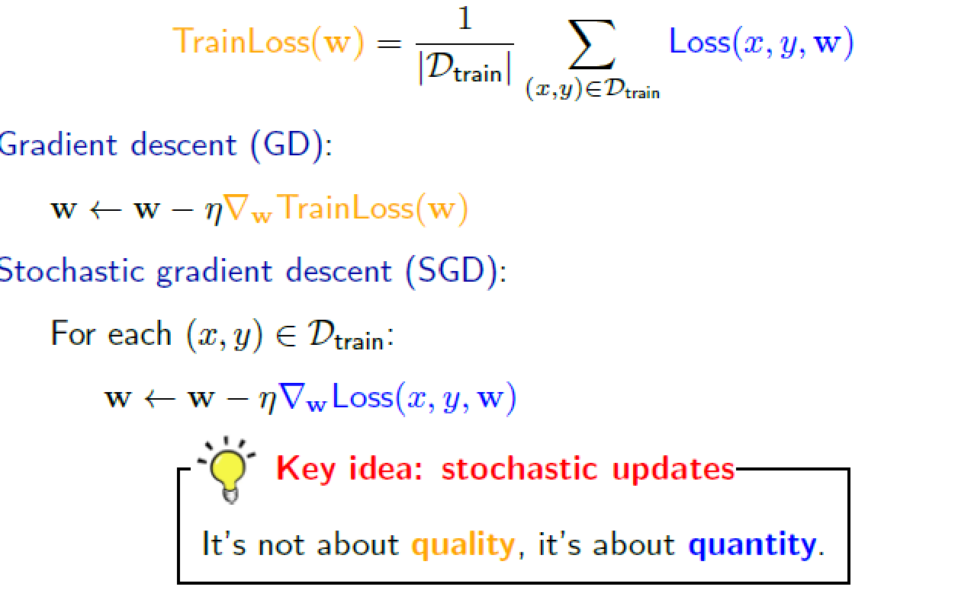
Stochastic gradient descent

Slide 9
