Slide 1
Artificial Intelligence
Lecture # 8

Slide 2
Learning objectives
To enable students to
  Understand the role and importance of features

Slide 3

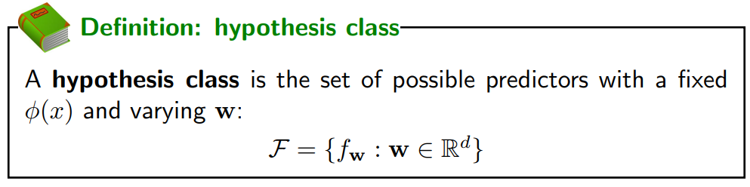
Hypothesis class
Predictor

Slide 4

Features
Score
Learning chooses ‘w’ via optimization
Feature extraction specifies ‘φ(x)’ depending on domain knowledge
Neural networks solve the problem to some extent but can’t do away with feature extraction

Slide 5
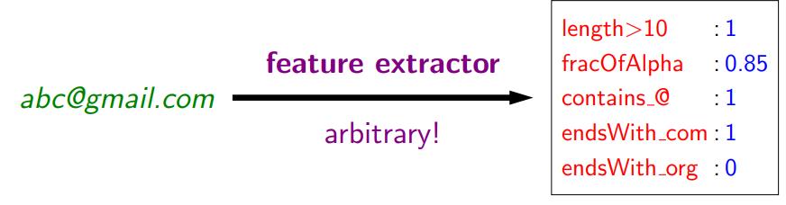
Feature extraction
Which features?
How many?

Slide 6
Feature representations
Feature vector
Feature map

Slide 7
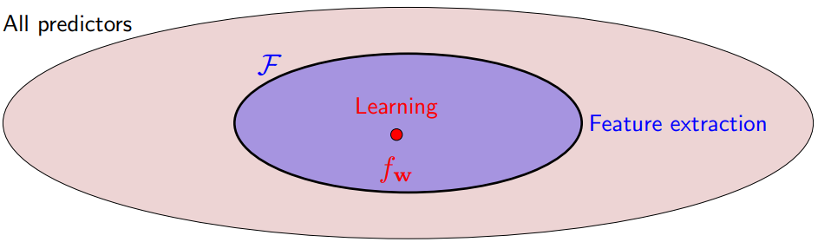
Features and Hypothesis class
Features may be used to form different functions e.g.

Slide 8
Feature extraction + learning
If the features are not relevant or enough, then no amount of learning will help to find the appropriate f_{w}
If you define the hypothesis class but do not optimize well, you won’t arrive at the appropriate f_{w}

Slide 9
Feature representations
Having irrelevant or less features will negatively effect learning
In general, having a larger set of relevant features leads to better results
You also need the right representation or hypothesis class

Slide 10
Feature types
Different types may require different pre-processing
For example: discretization or normalization
Example tasks

Slide 11


Prediction driven by Score:
Linear in w?
Linear in φ(x) ?
Linear in x?
Linearity leads to optimize the weights efficiently
Non-linearity leads to expressive features

Slide 12
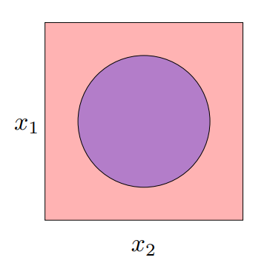
Geometric viewpoint
φ(x) =[1, x_{1,} x₂, x₁²+x₂²]
Feature vectors φ(x) include an extra dimension
In this 3D space, a linear predictor (defined by the hyperplane) actually corresponds to the non-linear predictor in the original 2D space

Slide 13
Neural Networks

Slide 14
Learning features
Sometimes we don’t know what features are good to use
Create algorithms that can take crude features and turn them into refined predictions
Shift the burden off feature extraction and move it to learning
In a sense, neural networks allow one to automatically learn the features

