Slide 1
Artificial Intelligence
Lecture # 9

Slide 2
Learning objectives
To enable students to
  Understand the basics of neural networks
  Understand how gradients are calculated through the chain rule

Slide 3
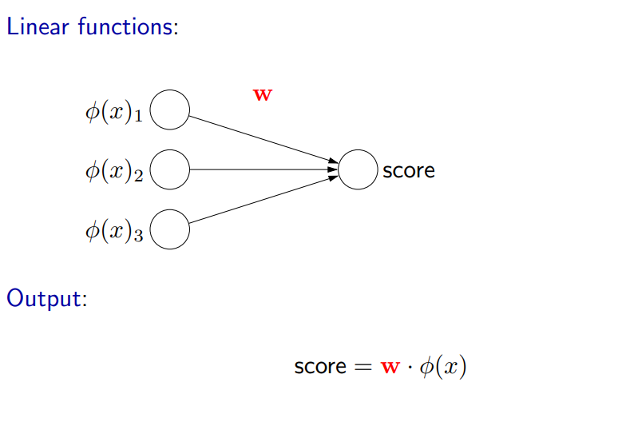
Linear functions

Slide 4
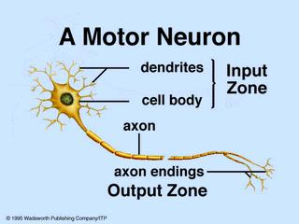
Neural Networks
Take their inspiration from the brain
In a sense, neural networks allow one to automatically learn the features
They also allow more complex decision boundaries

Slide 5
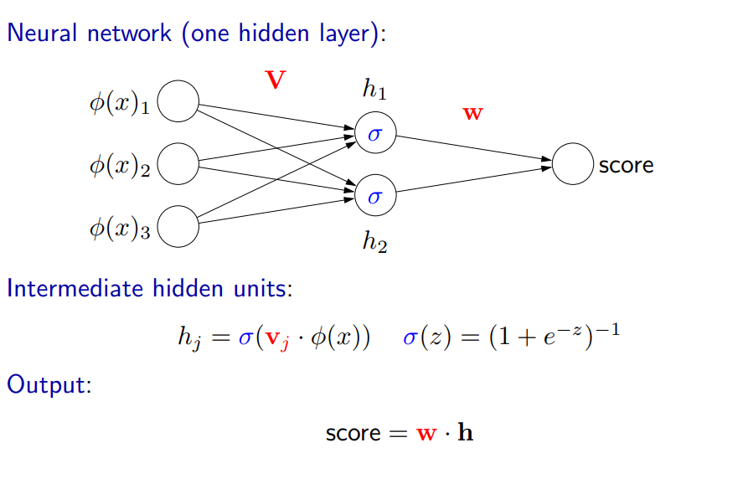
Neural Networks structure

Slide 6
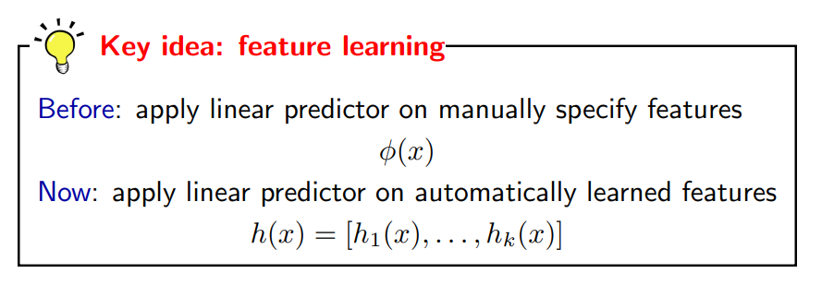
Interpretation: intermediate hidden units as learned features of a linear predictor

Slide 7
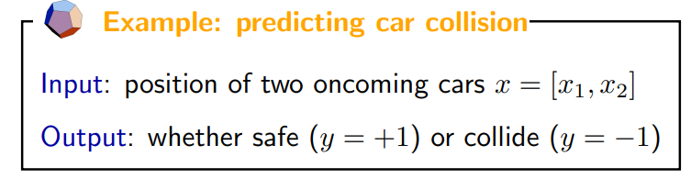

Example

Slide 8
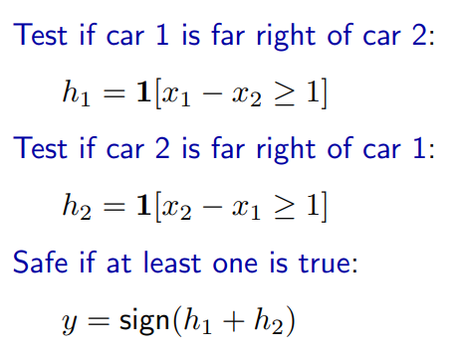
Decomposing the problem

Slide 9
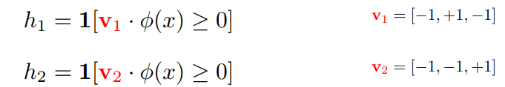
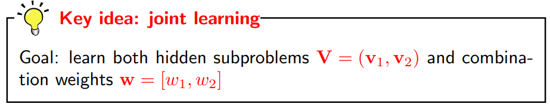
Intermediate sub-problems
  Define
    φ(x) =[1, x_{1,} x₂]

Slide 10
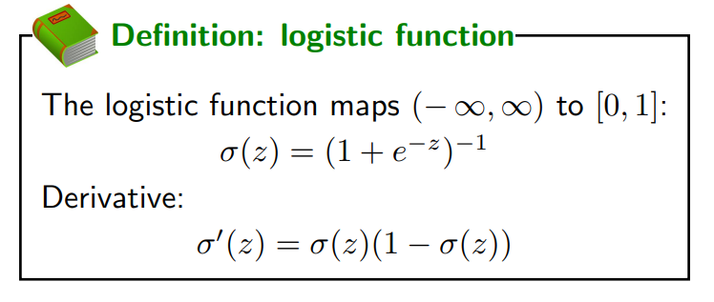
Gradient of h₁ w.r.t v₁ is zero
Gradient of h₂ w.r.t v₂ is zero

Slide 11
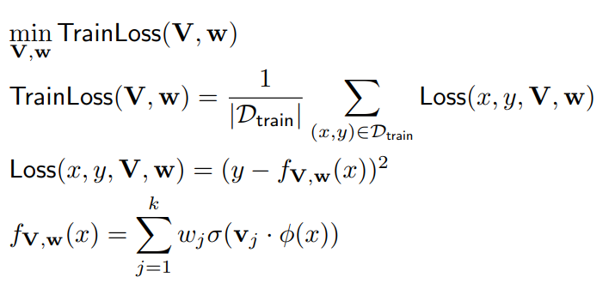

Loss Minimization
Optimization problem
Compute gradient

Slide 12
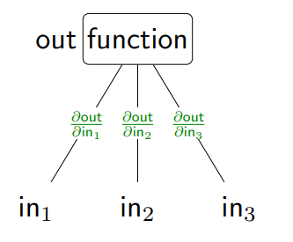
Functions
Partial derivatives (gradients): how much does the output change if an input changes?
2in1 + in2in3 = out
2in1 + (in2 + €)in3 = out + in3€

Slide 13
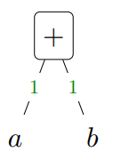
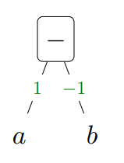
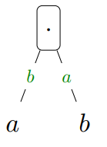
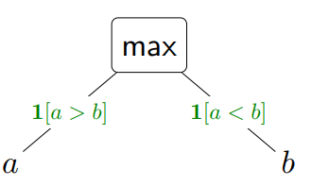
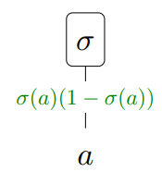
Computation graphs
A DAG whose root node represents the final mathematical expression, and each node represents intermediate expressions
Many function are made of subfunctions

