Slide 1
Laboratory Secure SoC for the
Internet-of-Things
Introduction
Thomas Schamberger, M.Sc.
Raum: 0101.01.007
t.schamberger@tum.de
Johanna Sepulveda, Ph.D
Raum: 0101.01.009
johanna.sepulveda@tum.de

Slide 2
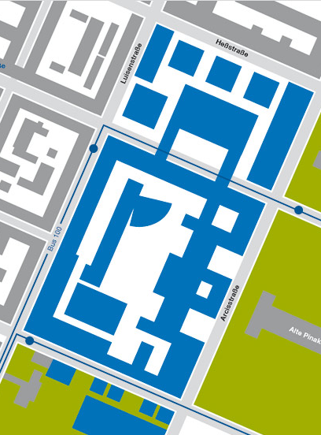
Contact
Lab Instructor
Thomas Schamberger, M.Sc.
Johanna Sepulveda, PhD
E-Mail
t.schamberger@tum.de
johanna.sepulveda@tum.de
Schedule an appointment
(Only if tutor was contacted before)
N1007
image source: http://www.clker.com/cliparts/d/L/P/X/z/i/no-image-icon-hi.png

Slide 3
Contact
Tutor
Tobias Tretschok
Email: tobias.tretschok@tum.de
Tutor-Times:
TBA:Will be released after second lecture
N1003
N1003
image source: http://www.clker.com/cliparts/d/L/P/X/z/i/no-image-icon-hi.png

Slide 4
Laboratory hours
The lab can be performed according to your own schedule.
The lab is open during:
Monday – Friday
7:00 – 21:00
You have access with your student card.
N1003
You wont be able to enter the lab after 21:00.
Doors of N1 will be closed, don’t use the emergency exit buttons of the doors!

Slide 5
Description of the laboratory
What is the Laboratory Secure SoC for the Internet-of-Things?
Practical
Programming of a
System-on-Chip
for IOT
Focus on IoT security, specifically secure communication
Work conducted in groups of 2 – 4
people

Slide 6
The course is designed to let you practice how to…
Design, implement and debug an application executed on a SoC operating in the IoT context
Integration of SECURITY
Evaluate cost/performance tradeoffs of security measures
Work effectively in a team

Slide 7
“The best instructor is practice.”
7

Slide 8
Overview
Motivation
Lab overview
Objectives + Software and tools
Organization of the laboratory
Project management / Working in groups
8

Slide 9
Motivation

Slide 10

Internet-of-Things
„Networked infrastructure for connectivity of heterogeneous devices, systems, and services “
IoT connects sensors, actuators and devices to a network
Enable sensing, controlling, exchange and analysis of data
M2M +Protocols+Applications
http://cdn2.business2community.com

Slide 11
Internet-of-Things: Why
Number of connected devices
28 billion connected devices by 2021*
*Ericsson
Economic Impact
Up to 11.1 trillion US Dollars by 2025*
*McKinsey
Broad spectrum of markets
Production
Mobility
Healthcare
Logistic
Energy

Slide 12
Internet-of-Things: Enabler technologies
Hardware innovations
SoC, RFID, NFC
Software effort (open source)
Operating systems and Middleware
Big Data (Apache Hadoop, Apache Cassandra)
Cloud (Open stack, Cloud Foundry)
Networking standards for low power (LoRaWAN, 6LoWPAN)
Standards for IoT use cases:
MQTT: Messaging
Improvement on data storage and analysis
Notes:
Hardware: Easier to develop and connect new devices

Slide 13
Internet-of-Things: Architecture
Devices
The thing interacts with the physical world
From sensors to Many-cores system-on-chip
Constrained in power and area
Software layer supports specific tasks
Eclipse.org

Slide 14
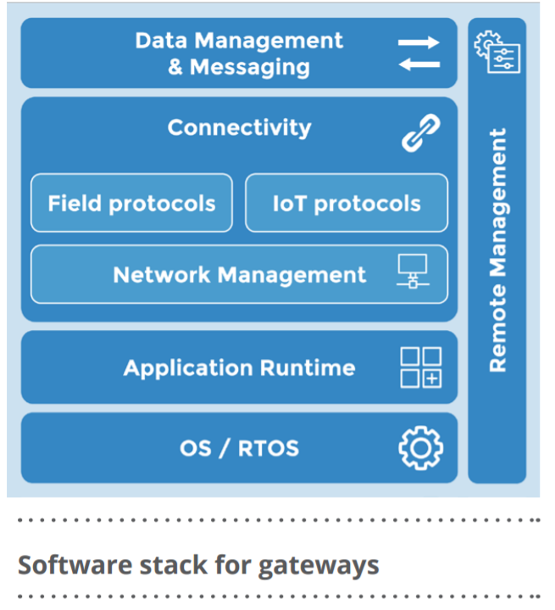
Internet-of-Things: Architecture
Devices
Gateways
Aggregation point for sensors and actuators
Coordinates connectivity
Among devices and devices to external networks
Implementation
Hardware /Software (additional functionality)
Offers processing data „at the edge“
Eclipse.org

Slide 15
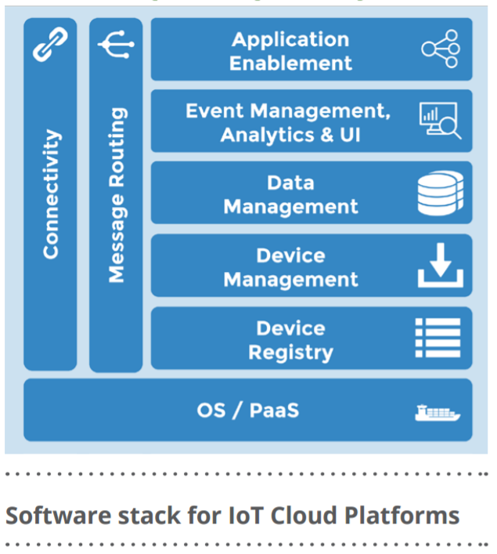
Internet-of-Things: Architecture
Devices
Gateways
Cloud
Hardware and software infrastructure and services required to enable an IoT solution
Microsoft Azure, Cloud Foundry, AWS
Facilitates the interoperabilability among IoT, applications and other IoT solutions
Eclipse.org

Slide 16
Internet-of-Things: Architecture
Devices
Gateways
Cloud
Applications
Which ones do you know?

Slide 17
Security
Security service:
Confidentiality
Authentication
Integrity
Availability
Non-repudiation
17

Slide 18
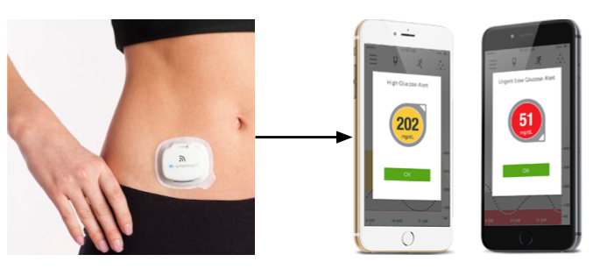
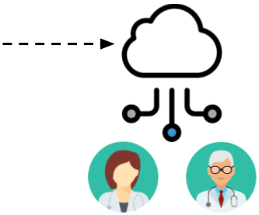
Security
Health monitoring example: Continuous Glucose Monitor
Bluetooth LE Continuous Glucouse Monitor [1]
Continuous Glucose Monitor App [2]
Privacy and integrity for medical data is a concern
18

Slide 19
Lab overview

Slide 20
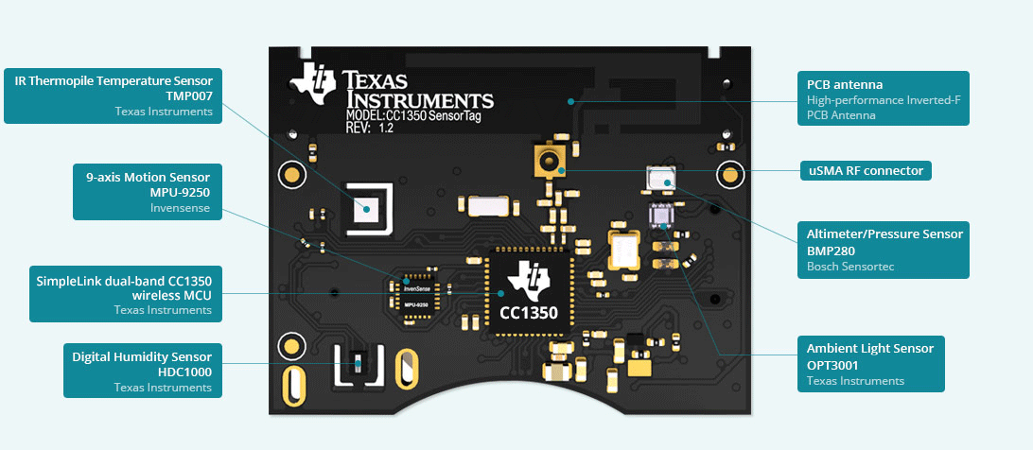
Lab overview
TI Sensortag

Slide 21
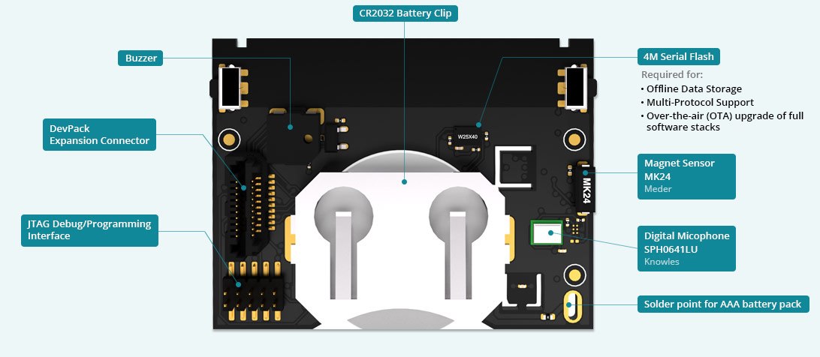
Lab overview

Slide 22
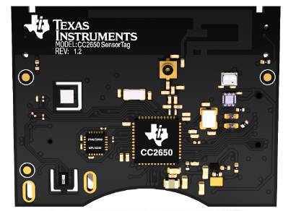

Lab overview
MQTT
Sensordata
6LowPAN
Router (VM)
TI SensorTag

Slide 23

Lab overview
Attacker can observe the communication

Slide 24

Lab overview
6LowPAN
Router (VM)
TI SensorTag
Your task: Secure the communication

Slide 25
Pre-requisites
What do I need for this course:
Experience with C programming
Basic knowledge of computer networks
Being able to use the linux command line
Ability to work in a team
Motivation to dig into existing code
What is nice to have:
Knowledge of a scripting language (e.g. Python)
Experience with Wireshark
Experience with microcontroller programming
Collaboration with Git

Slide 26
Objectives + Software and Tools

Slide 27
Setup

Slide 28
Sensortag
ARM Cortex-M3
128KB Flash, 20 KB RAM
Hardware crypto module (AES-128)
Random Number Generator
Debugger
Contiki operating system:
IOT operating system
Has support for:
6LoWPAN support
IPv6 communication
Drivers for sensors + peripherals

Slide 29
Setup

Slide 30
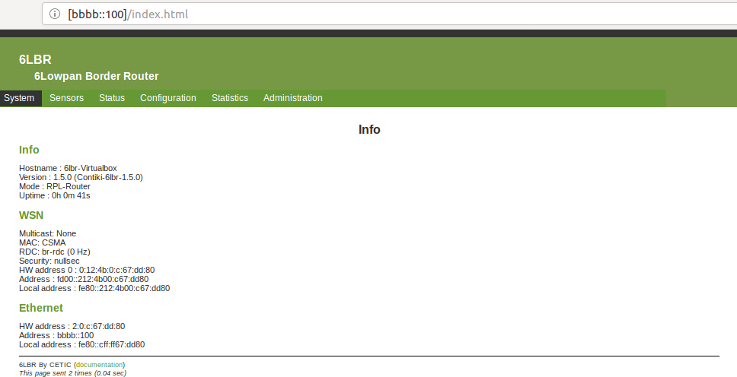
Router (6LBR)
Connects the WSN to the LAN or the Internet
Sensortags are reachable from arbitrary client connected to the router
Given for this lecture in a VM
WSN
LAN / Internet
6LoWPAN
IPv6
Router

Slide 31
Objectives
Lab split in two parts:
Part 1: Setup of infrastructure + Clone of existing sensortag
Part 2: Secure the communication

Slide 32
Part 1: Infrastructure setup + Clone of existing sensortag
What will be given:
Contiki operating system with running MQTT client
6LBR border router in Virtual machine
Compiled program of sensortag with authentication credentials
Makefile + Script for programming of the devices
Sniffer binary that can be used together with wireshark
Your task:
Analyse the connection packages with Wireshark to find out authentication credentials
Use the found credentials to program a sensortag to act as a clone
After part 1 you are:
Familiar with the code basis
Know how to compile programs and flash them onto a sensortag
Understanding the MQTT protocol
Able to use wireshark to inspect messages
The running setup + clone sensortag has to be shown on the 15.05!

Slide 33


Part 2: Secure communication
Pre-shared key
Mqtt-Header
Payload (Sensordata)
Use AES-GCM for authenticated encryption of the mqtt payload.

Slide 34
Collaboration Platform - GitLab
Version control with Git:
Index / Staging area
local
remote
checkout
Working copy
add
commit
push
pull

Slide 35
Organization

Slide 36
Organizational Matters: Important Dates
Lectures:
Presentations / Exam:
Date | Time | Place | Description
10.04.2018 | 09:45 am – 11:15 pm | N1005 | Introductory lecture
24.04.2018 | 09:45 am – 11:15 pm | N1005 | MQTT, Lab Hardware, Networking basics
Date | Time | Place | Description
15.05.2018 | 9:30 am – 12:00 pm | N1005 | Setup presentation
26.06.2018 | 9:00 am – 12:00 pm | N1005 | Final presentation
TBA | TBA | N1005 | Oral exam
36
Notes:
36

Slide 37
Organizational Matters: Grading
Practical Work (50%)
The lab work is performed and documented in groups
Quality of implementation
Final presentation of the results
The capability to realize a complex embedded system in practice is shown in an 30-minutes final presentation with subsequent discussion
Theoretical Knowledge (50%)
Each student must keep a lab diary in the wiki
The theoretical knowledge on treated topics (gained from the diary) is examined during a individual 10-minutes oral examination
37

Slide 38
Project Management

Slide 39
Teamwork
Work is to be carried out in groups of 2 - 4 people
Each student must keep a lab protocol (template will be given)
Suggestions for effective teamwork:
Share the workload in a fair manner
Contribute with ideas and listen to the opinions of others
Work on your task and be open to help others
Keep in touch with your team members (scheduled meetings)
Groups will be fixed this lecture
You have time until the next lecture to make changes to your group
39

Slide 40
Which qualities must a project have?
Definition taken from DIN 69901:
“Project is an undertaking characterized essentially through the uniqueness of the conditions, for instance,
goal,
time, money, personnel, and other restrictions,
the scope compared with other undertakings,
and project specific organization”
Notes:
Frage in die Runde
DIN: Deutschen Institutes fuer Normung
Zielvorgabe: Was soll erreicht werden
Begrenzungen: Jedes Projekt hat beschränkte Ressourcen
Abgrenzung: Ein Projekt hat immer gewisse Komplexität, neuartiges Vorhaben, Unsicherheiten
Organisation: Rollenverteilung, Vorgehensweisen, Prozesse

Slide 41
Project Phases
Definition
Planning
Realization
Conclusion
Collect Ideas
Define Goals
Create a Work Plan
Define the Architecture
Execute the work plan
Final Report
Presentation

Slide 42
Phase1: Definition
Requirements Specification
Requirements of the client
Common Problem: The client often does not know himself exactly what he wants
Feature Specification
First draft of the plan
Describes how the contractor will implement the requirements
Project Goals Definition
Goals must be “SMART”
(Specific, Measurable, Accepted, Realistic, Timely)
Definition
Planning
Realization
Conclusion
Notes:
S: Ziele müssen eindeutig definiert sein (nicht vage, sondern so präzise wie möglich).
M: Ziele müssen messbar sein (Messbarkeitskriterien).
A: Ziele müssen von den Empfängern akzeptiert werden/sein (auch: angemessen, attraktiv oder anspruchsvoll)
R: Ziele müssen erreichbar sein.
T: Zu jedem Ziel gehört eine klare Terminvorgabe, bis wann das Ziel erreicht sein muss.

Slide 43
Phase 2: Planning
Work-breakdown: Structure of subtasks, Tree structure
Process list:
[ID-Nr., Process description, Duration, Predecessors, Resources]
Gantt Charts
Milestones: Important events of the project
System architecture: Relationship between the different components
Interface definitions: Function calls between components
The first plan will still differ from reality, nevertheless, planning in the first stages is very important!
The first plan will still differ from reality, nevertheless, planning in the first stages is very important!
Definition
Conclusion
Realization
Planning
Notes:
Vorgangsliste: In der Vorgangsliste sind alle Vorgänge, die zur Durchführung des Projektes Notwendig sind
ID-Nr.: jeder Vorgang hat eine eindeutige Nummer
Vorgangbeschreibung: Was wird gemacht? (z.B. Implementierung AES Algorithmus)
Dauer: Grobe Abschätzung wie lange dieser Vorgang dauern wird
Vorgänger: Welche Vorgänge müssen abgeschlossen sein, damit dieser Vorgang starten kann
Ressourcen: Welche Personen werden benötigt?, Welche Hilfsmittel werden benötigt?
Meilensteine?
Gantt Chart aufzeichnen?
Netzplan aufzeichnen?
Meilensteine: Stehen auch in der Vorgangsliste

Slide 44
Phase 3: Realization
Perform the planned operations
Documentation
As much as needed, as little as possible
Architecture and steps
Project-Monitoring (Cycle)
Test
Check if what it is, is what it is supposed to be
Correct discrepancies
Adapt the plan
Definition
Planning
Realization
Conclusion

Slide 45
Phase 4: Conclusion
Final Report
Final Presentation, Demonstration
Client’s Approval
Evaluation - „Lessons Learned“
What has been achieved?
What problems where there?
What could be improved in the future?
Definition
Planning
Realization
Conclusion

Slide 46
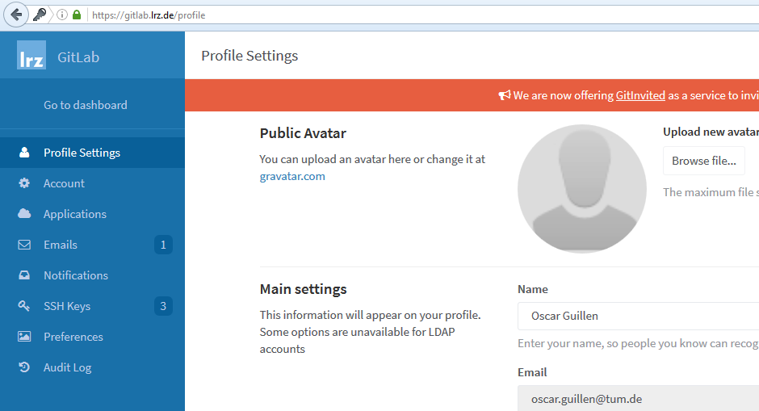
Homework
Setup GitLab access:
Log in GitLab (to activate your account) -> www.gitlab.lrz.de
Change your “Name” to your real name
Leave your “Username” unchanged (your LRZ account)
Change
46

Slide 47
Questions so far?

Slide 48
Create Groups

