Slide 1

Laboratory Secure SoC for the Internet-of-Things Second Introduction
Thomas Schamberger
24.04.2018
Institute for Security in Information Technology
Prof. Dr.-Ing. Georg Sigl

Slide 2
Agenda
Network Review
IPv6
WSN with 6LowPAN
MQTT
Securing the MQTT Connection
Lab Hardware/Software
Tasks
Organization

Slide 3
Network Review

Slide 4


TCP/IP Layers
Alice
APPLICATION
TRANSPORT
NETWORK
Bob
LINK/PHYSICAL

Slide 5





TCP/IP Layers: Application
APPLICATION
Data
Generate Data
TRANSPORT
NETWORK
(Internet)
LINK

Slide 6
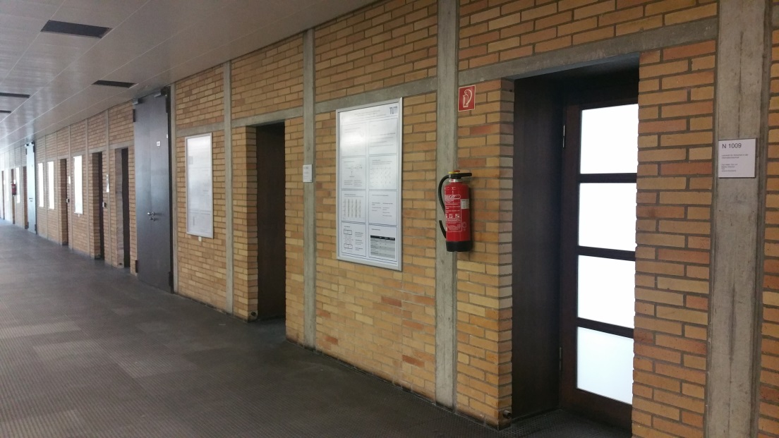





TCP/IP Layers: Transport
Source Ports, Destination Ports
(0 to 65535)
APPLICATION
Port
Port (16 bits)
TRANSPORT
Data
TCP/UDP

Slide 7
TCP/IP Layers: Network
APPLICATION
TRANSPORT
Source IP, Destination IP
IP Adress
Port
IP
NETWORK
(Internet)
Data
LINK/PHYSICAL

Slide 8
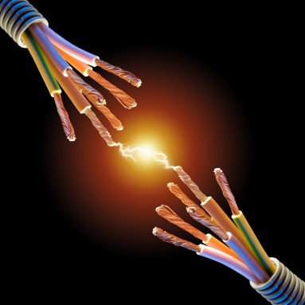
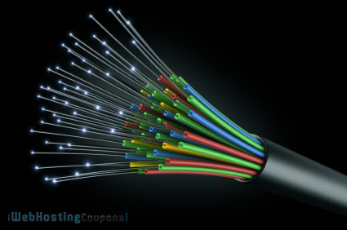
TCP/IP Layers: Link
APPLICATION
TRANSPORT
NETWORK
(Internet)
MAC
LINK/PHYSICAL
0 1 1 1 0 0 1 0
Media Access Control IEEE 802

Slide 9
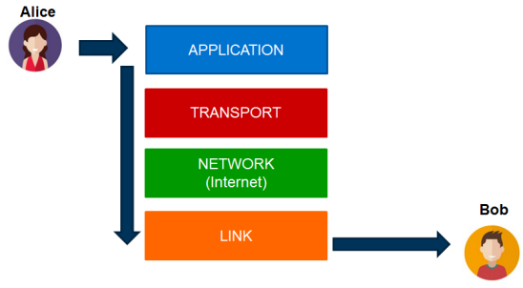
TCP: Transport
Connection: 3 way handshake
Alice
Bob
Alice
Start communication
SYN
SYN,ACK
ACK
Connection
DATA
DATA
DATA
End communication
FIN
ACK
FIN
ACK

Slide 10
Comparison TCP/UDP
TCP | UDP
Connection oriented | Connectionless
Rearrangement of packet order | No reordering available
Acknowledgement of messages | Faster then TCP
Reliable | Less Overhead

Slide 11
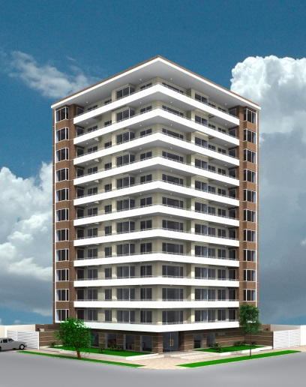
IP-Adresses
IPv4
94.31.94.96
Example: Are those Hosts in the same network?
192 . 168 . 0 . 1
192 . 168 . 0 . 190
Routing
Same network
Gateway/Router

Slide 12
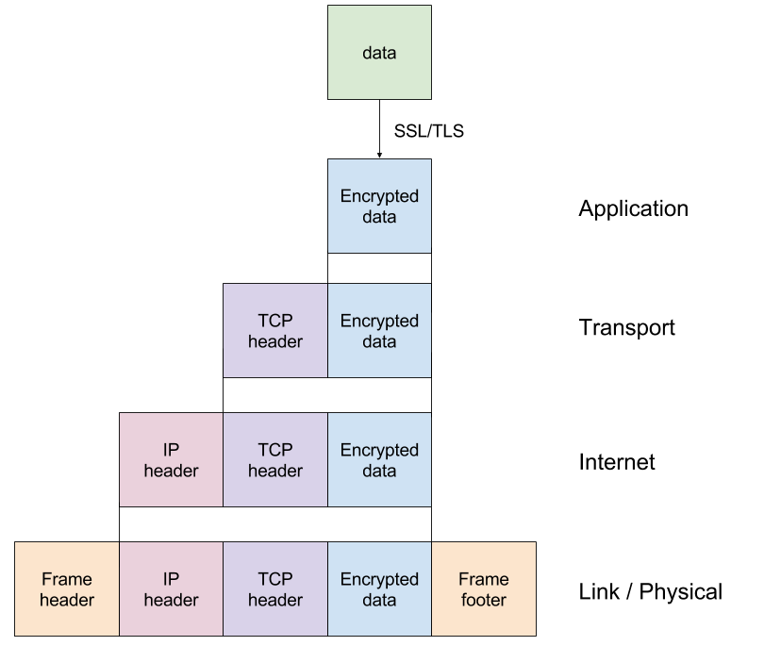
TCP/IP Internet Protocol Suite
Breakdown of TCP/IP layers

Slide 13
IPv6

Slide 14
IPv6 - Overview
Addresses of size 128 bit compared to 32 bit for IPv4
Different notation:
Trailing zeros can be eliminated:
Zero groups can be substituted by “::”
2001:0db8:4004:0010:0000:0000:6543:0ffd
2001:db8:4004:10:0:0:6543:ffd
2001:db8:4004:10::6543:ffd
Network ID
Interface ID
64 bits
64 bits

Slide 15
IPv6 - Prefixes
There are different types of addresses:
Link-local addresses:
Can only be used to communicate with hosts on the same network
Start with FE80::
Global addresses:
Prefix given by router
2001:4ca0:2fff:11::94

Slide 16
IPv6 - Quiz
Which of the following are correct IPv6 addresses:
2001:db8:A:B:C:D::1
2001:db8:000A:B00::1:3:2:F
2001:0db8::F:A::B
Notes:
1.) Correct
2.) Falsch (zu viele Adressen)
3.) Falsch zwei mal ::

Slide 17
WSN with 6LoWPAN

Slide 18

6LoWPAN
IPv6 over Low-Power Wireless Personal Area Networks

Slide 19
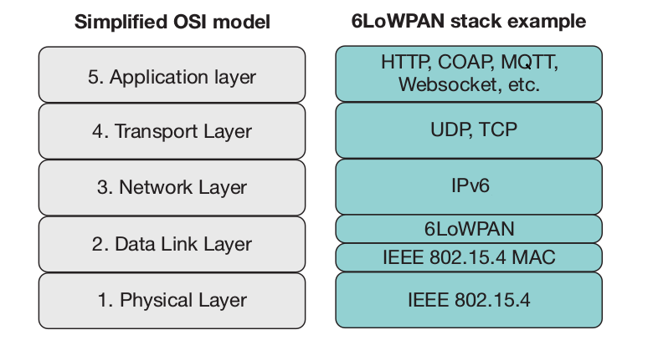
6LoWPAN – Stack
Source: http://www.ti.com/lit/wp/swry013/swry013.pdf

Slide 20

IEEE 802.15.4
Defines Physical and Data Link layer
2,4 GHz or Sub-1 GHz band
Designed for low-cost and ultra-low power design
Throughput is limited to 250 kbps
Frame length is limited to 127 bytes:
Low packet and bit error rates
Reduced power
Source: http://www.ti.com/lit/wp/swry013/swry013.pdf

Slide 21
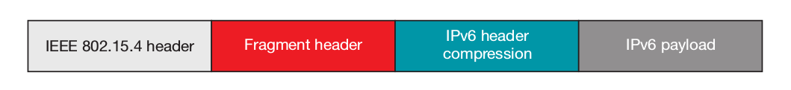
6LoWPAN: IEEE 802.15.4
Adaption layer to enable the efficient transport of IPv6 packets over a 802.15.4
Protocol describes:
Fragmentation/reassembly (RFC4944)
IPv6 requires an MTU of 1280 bytes but 802.15.4 only has a frame length of 127 bytes
Header compression methods (RFC4944,RFC6282,RFC7400)
40 byte IPv6 header takes large part of packet
Autoconfiguration (RFC4944)
http://www.9tut.com/ipv6-questions

Slide 22
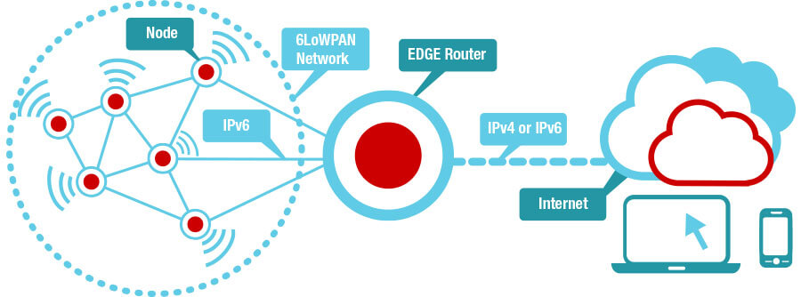
6LoWPAN – Network Overview
Source: http://www.ti.com/lsds/ti_de/wireless-connectivity/6lowpan/overview.page

Slide 23
MQTT

Slide 24
MQTT Overview
A publish–subscribe based protocol used on top of the TCP protocol
Managed by a central entity called the MQTT-Broker
Messages are grouped under topics
Clients can subscribe / publish to certain topics of the broker
Publish
B
Publish
MQTT Client
MQTT Broker
MQTT Clients

Slide 25
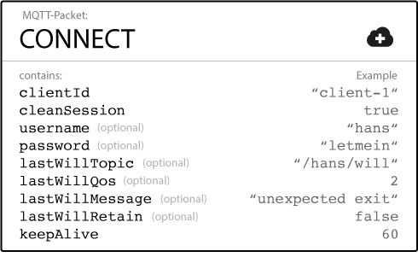
MQTT - Connect
CONNECT
B
CONNACK
Source: https://www.hivemq.com/blog/mqtt-essentials-part-3-client-broker-connection-establishment

Slide 26
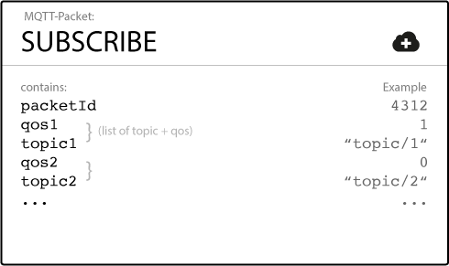
MQTT - Subscribe
1.) SUBSCRIBE
B
2.) SUBACK
3.) PUBLISH
4.) PUBLISH
MQTT Client
MQTT Broker
Source: https://www.hivemq.com/blog/mqtt-essentials-part-4-mqtt-publish-subscribe-unsubscribe

Slide 27
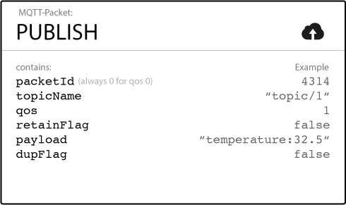
MQTT - Publish
Publish
Publish
B
MQTT Client
MQTT Broker
https://www.hivemq.com/blog/mqtt-essentials-part-4-mqtt-publish-subscribe-unsubscribe

Slide 28
MQTT - Example
MQTT Subscriber
Publish:
Topic = pulse
Message = “100 bpm”
Subscribe to “pulse”
B
Publish: “100 bpm”
Subscribe to “pulse”
MQTT Publisher
MQTT Broker
Publish: “100 bpm”
MQTT Subscriber

Slide 29
Securing the MQTT Connection

Slide 30
Problem
Authentication with MQTT is optional
Credentials transferred in plaintext with the connect packet
Solution: Use Transport Layer Security (TLS) to secure the whole TCP packet
TLS

Slide 31


TLS (Transportation Layer Security)
Handshake: Algorithms and keys are negotiated
Record layer: Data is encrypted
Client HELLO
ACK
Server HELLO
ACK
SHARED KEY EXCHANGE
ENCRYPTED HANDSHAKE

Slide 32
TLS (Transportation Layer Security)
Cryptographic protocols that provides communication security over a network
Security: e.g. symmetric cryptography
Authenticity: e.g. public-key cryptography
Data integrity: e.g. MAC (message authentication code)
TLS cipher suites supports different methods for:
Key exchange: RSA, PSK, ECDH-RSA, ...
Data encryption: AES CCM, AES GCM, Camellia GCM, ...
Data integrity: HMAC-MD5, HMAC-SHA1/SHA256, ….
Commonly used in securing web browsing, email, Internet, etc.

Slide 33
Problem with Sensortag
The sensortag has not enough resources to use TLS
Alternatives have to be found
CAUTION:
If possible established cryptographic algorithms or techniques have to be used in practice. Use proven libraries like mbedTLS if possible!

Slide 34
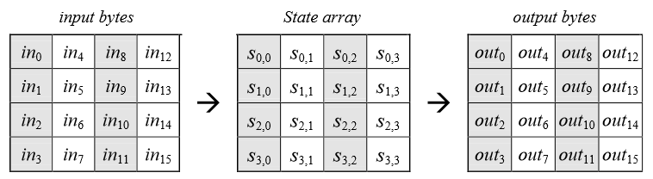
AES – Encryption of the payload
AES-128
Input size = 128 bit
Output size = 128 bit
Key size = 128 bit
10 Rounds
AddRoundKey
Round 0
SubBytes
ShiftRows
Rounds 1- 9
MixColumns
AddRoundKey
SubBytes
Round 10
ShiftRows
AddRoundKey

Slide 35
AES – Encryption of the payload
What if someone manipulates the encrypted data??
Solution: Authenticated encryption with AES-GCM

Slide 36
AES-GCM
Authenticated encryption with AES-128
IV has to be different for each encryption
Input:
Plaintext (P)
Additional authenticated data (A)
Initialization Vector (IV)
AES-GCM
Output:
Ciphertext (C)
Authentication tag (T)

Slide 37
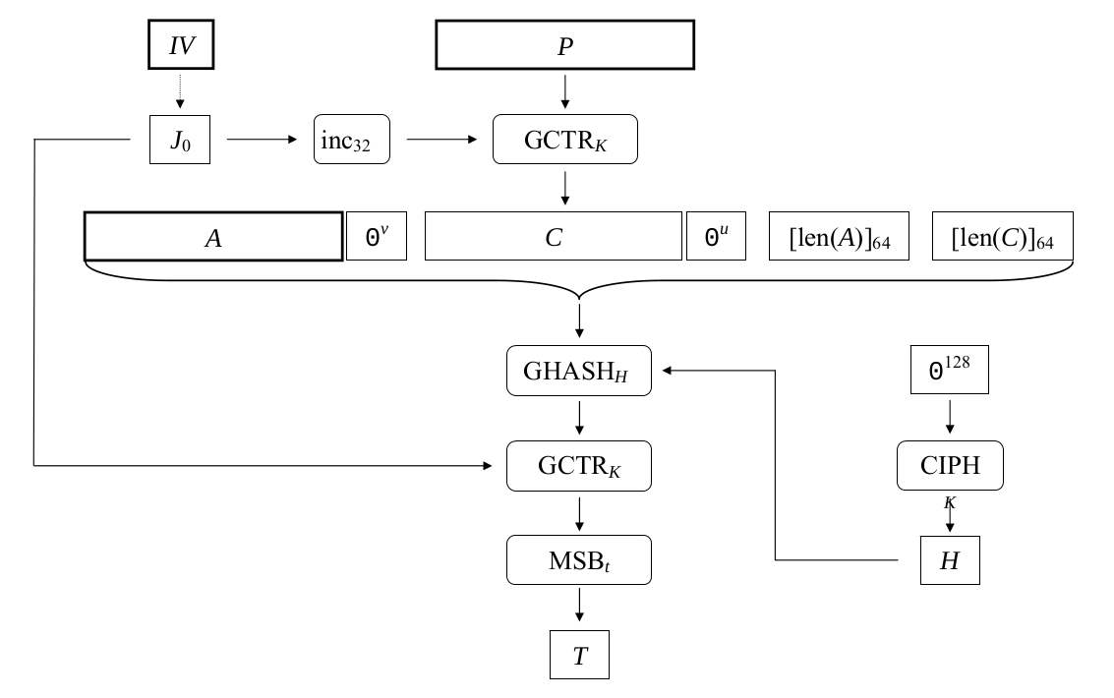
GCM-Encryption

Slide 38
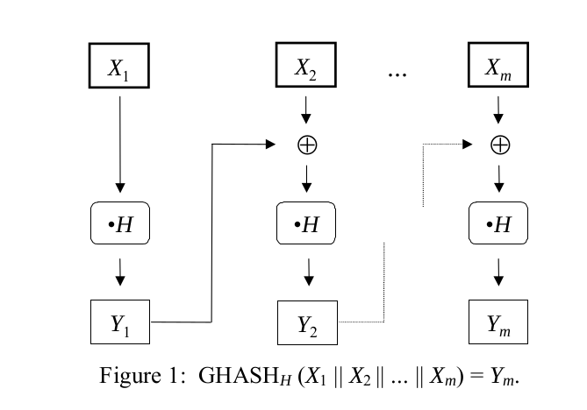
GCM-GHASH

Slide 39
GCM-Encryption

Slide 40
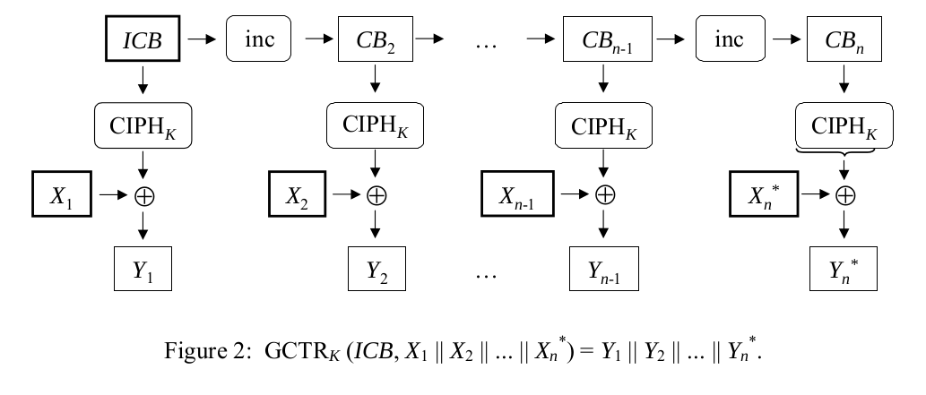
GCM-GCTR

Slide 41
MQTT Security
Mqtt-Header
Payload
Message
Nonce
AES-GCM
Ciphertext
AAD
Tag
IV

Slide 42
Lab Hardware/Software

Slide 43
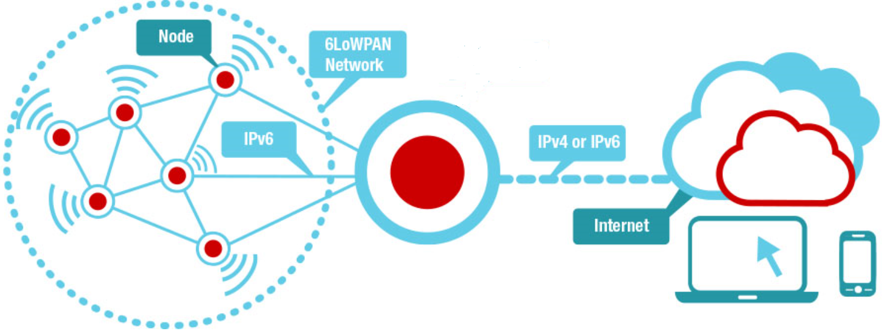
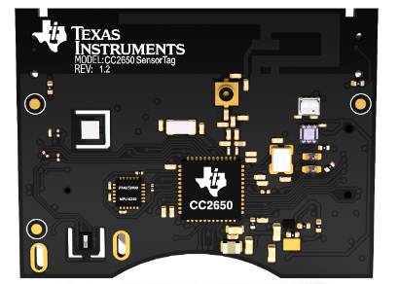
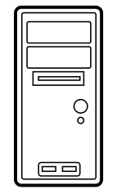

Lab Hardware
VM on Lab PC:
Acts as edge router
MQTT broker
Nodes consist of TI Sensortags
Connected trough USB

Slide 44
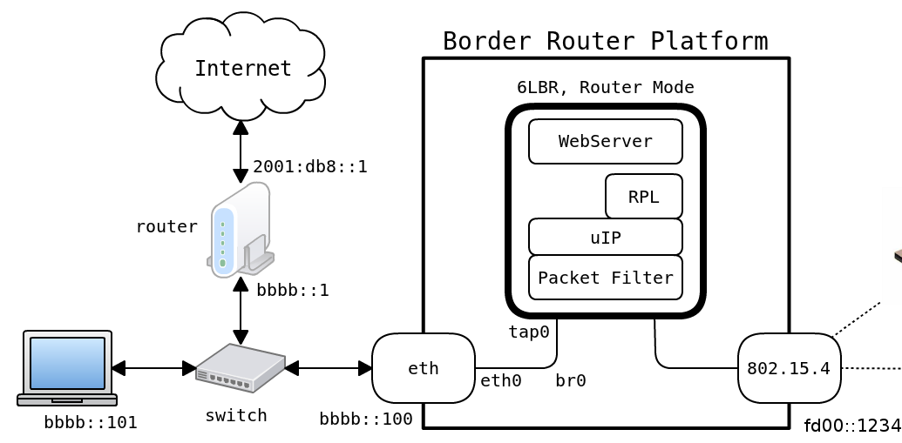


Overview – Edge router
Source: https://github.com/cetic/6lbr/wiki/6LBR-Modes

Slide 45
Contiki OS
Operating system for the TI Sensortag
Provides the following features:
Memory allocation
Full IP networking
6LoWPAN networking support with the Sensortag hardware
TI drivers for the hardware of the sensortag:
Sensors
AES
Random number generation
Timers
Use of protothreads for control flow

Slide 46
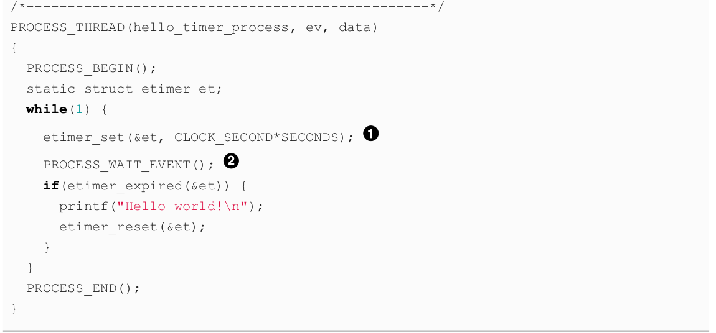
Contiki - Example
Documentation:
https://github.com/contiki-os/contiki/wiki
http://contiki.sourceforge.net/docs/2.6/

Slide 47
Conikti – Given application
You are given an application for the Sensortag
Consists of the following:
Sensor values can be read from Contiki
Features a http server that can be contacted from the edge router
Change settings
Show sensor values in HTML site
MQTT-broker
Library for Sensortag peripherals

Slide 48
Tasks

Slide 49
Part 1: Infrastructure setup + Clone of existing sensortag
What will be given:
Contiki operating system with running MQTT client
Edge router in Virtual machine
Compiled program of sensortag with authentication credentials
Makefile + Script for programming of the devices
Sniffer binary that can be used together with wireshark
Your task:
Analyse the connection packages with Wireshark to find out authentication credentials
Use the found credentials to program a sensortag to act as a clone
After part 1 you are:
Familiar with the code basis
Know how to compile programs and flash them onto a sensortag
Understanding the MQTT protocol
Able to use wireshark to inspect messages
The running setup + clone sensortag has to be shown on the 15.05!

Slide 50


Part 2: Secure communication
Pre-shared key
Mqtt-Header
Payload (Sensordata)
Use AES-GCM for authenticated encryption of the mqtt payload.

Slide 51
Part2: Tasks
MQTT is already implemented in Sensortag application → Only change to payload function needed
Tasks for AES-GCM:
Implementation of AES (Or usage of AES hardware on Sensortag)
Implementation of RNG for the creation of the IV for GCM
TRNG on Sensortag
Implementation of PRNG
Implementation of AES-GCM:
Multiplication in GF(128)
GHASH Function
GCTR Function

Slide 52
Organization

Slide 53

Material on Gitlab
Lab material will be on Gitlab:
Scripts to flash the sensortag
Sensniff script to use with wireshark
Contiki source
Documentation of the Sensortag
AES + GCM Standards
https://gitlab.lrz.de/

Slide 54
Organizational Matters: Important Dates
Lectures:
Presentations / Exam:
Date | Time | Place | Description
10.04.2018 | 09:45 am – 11:15 pm | N1005 | Introductory lecture
24.04.2018 | 09:45 am – 11:15 pm | N1005 | MQTT, Lab Hardware, Networking basics
Date | Time | Place | Description
15.05.2018 | 9:30 am – 12:00 pm | N1005 | Setup presentation
26.06.2018 | 9:00 am – 12:00 pm | N1005 | Final presentation
TBA | TBA | N1005 | Oral exam
54
Notes:
54

Slide 55
Tutor hours
 | Monday | Tuesday | Wednesday | Thursday | Friday
10.00 – 13.00
14.00 – 17.00 |  | X

Slide 56
Lab Hardware / Groups

