Slide 1
FORMAL VERIFICATION Of OpenRISC 1200 (OR1200)
Saqib Khan (sak2454)

Slide 2
OUTLINE
Brief Overview of OR1200 Architecture
Specific modules covered in this verification attempt
Results
Fault Injection and Debug
Summary

Slide 3
OR1200 CORE
32-bit Reduced Instruction Set Computer (RISC)
Five stage pipeline
Instruction Fetch (IF)
Instruction Decode (ID)
Execution (EX)
Memory Access (MA)
Writeback (WB)

Slide 4
ASSERTIONS AND COVER PROPERTIES
Assertion for OR1200 Core
genPC
IF
Ctrl
OperandMUX
Except

Slide 5
Exception Unit
Three main properties under tests for the exception module:
Save Program Counter (PC)
Flush pipeline
Exception priority

Slide 6
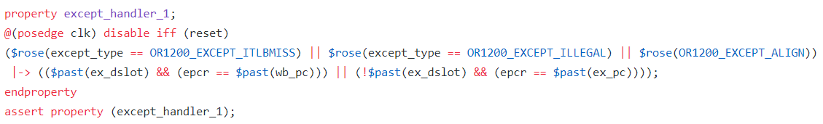
Exception Unit – PART 1
No branch prediction in OR1200
Steps for exception handling
Exception detected
Save Register Files
Save Program Counter (PC) in Exception Program Counter Register (EPCR)
Notes:
Whenever an exception occurs, the current/next PC is saved to the current EPCR. If the CPU implements delay-slot execution (CPUCFGR[ND] is not set) and the PC points to the delay-slot instruction, PC-4 is saved to the current EPCR and SR[DSX] is set. Table 6-3 defines what are current/next PC and effective address.

Slide 7
Exception Unit – PART 2
Finite State Machine (FSM) for pipeline flush
IDLE
FLU1
FLU2
FLU3
FLU4
FLU5
start
IDLE
FLU5
FLU1
FLU4
FLU2
FLU3

Slide 8

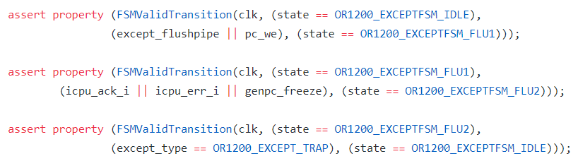
Exception Unit – PART 2 Continued
Finite State Machine

Slide 9


Exception Unit – PART 3
Exception | Priority
Reset | 1
Bus Error | 2
Data Page Fault | 8
Instruction Page Fault | 3
Alignment | 6
Illegal Instruction | 5
External Interrupt | 12
I-TLB Miss | 2
Range | 10
System Call / Trap | 7
Floating Point | 11
Tick Timer | 13
Notes:
13 has the highest priority and 1 has the lowest priority

Slide 10

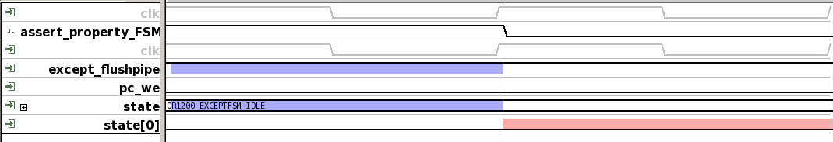
FAULT INJECTION AND DEBUG
or1200_except.v

Slide 11
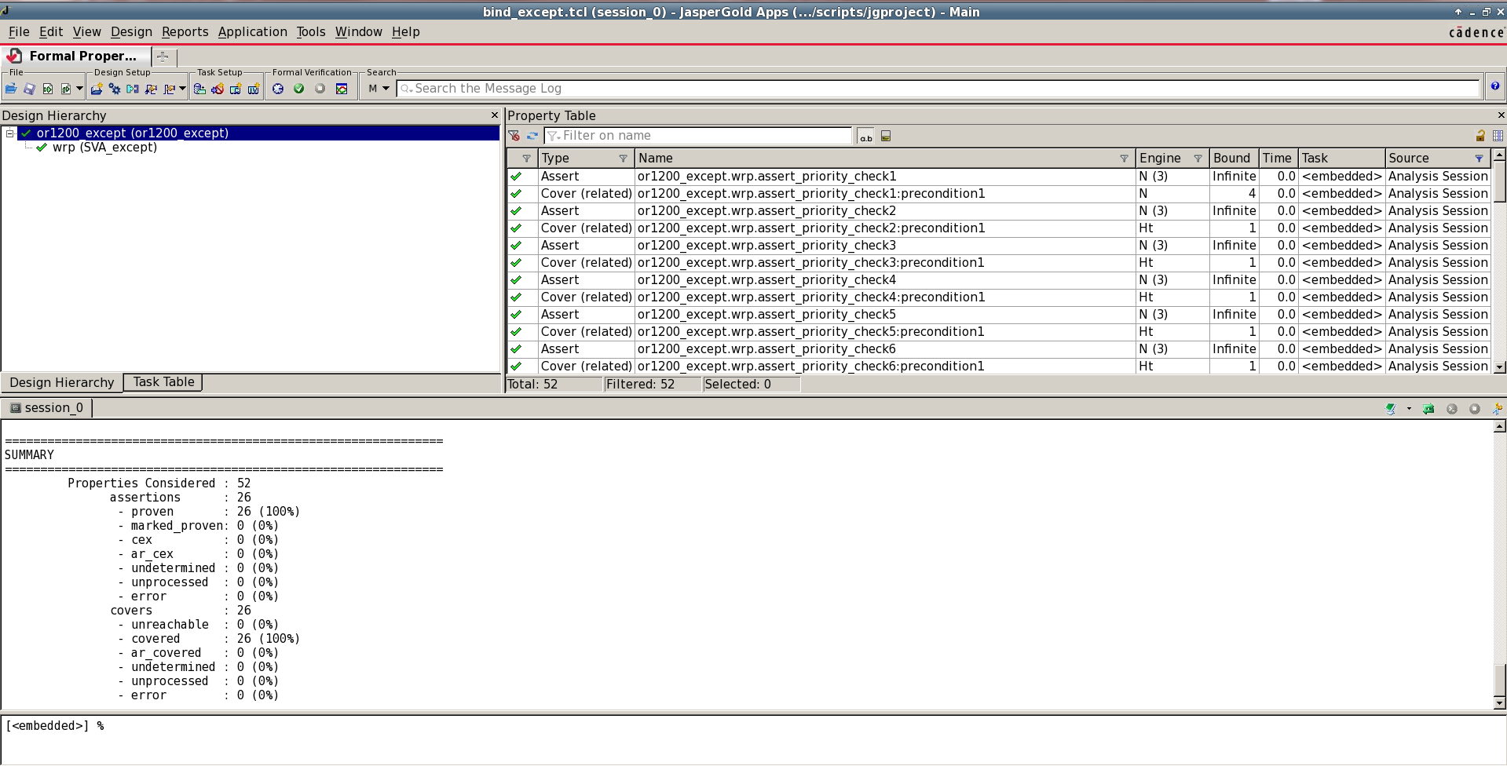
RESULTS – PART 1
Each module is set as the top module

Slide 12
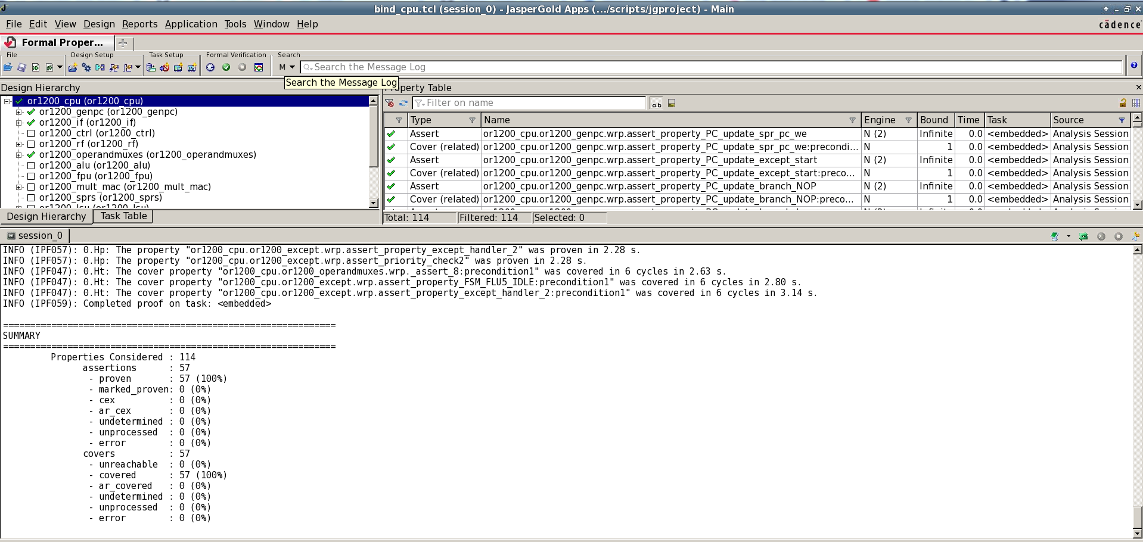
RESULTS – PART 2
We set or1200_cpu as the op module and all other modules comes under this.

Slide 13
CONCLUSION
Gives us a good understanding of how formal verification works for complex architecture.
Learned how to use Instruction Set Architecture (ISA) and golden model to test the functionality of the design.
Gives us an experience to work with mainstream verification tools, such as Cadence Jaspergold.
Future Work
Add verification for all other modules, not covered in this project, such as ALU, FPU etc.
Test code coverage.

