Slide 1
Automotive Sales Performance & Strategic Recommendations
Prepared by: Shanzeh Butt

Slide 2

Business Question
How do automotive sales vary by vehicle category, market segment, fuel type, price, and season—and how can these insights be used to guide inventory, pricing, and marketing strategies?

Slide 3
Data Overview
Data Categories | Description
Vehicle Category | Sedan, SUV, Truck, EV
Market Segment | Standard, Luxury / Performance
Region | Geographic sales region
Time Period | Quarterly (Q1–Q4)
Fuel Type | Gasoline, Electric, Hybrid, Hydrogen
Sales Metric | Count of Sales Price/ Sales Total

Slide 4
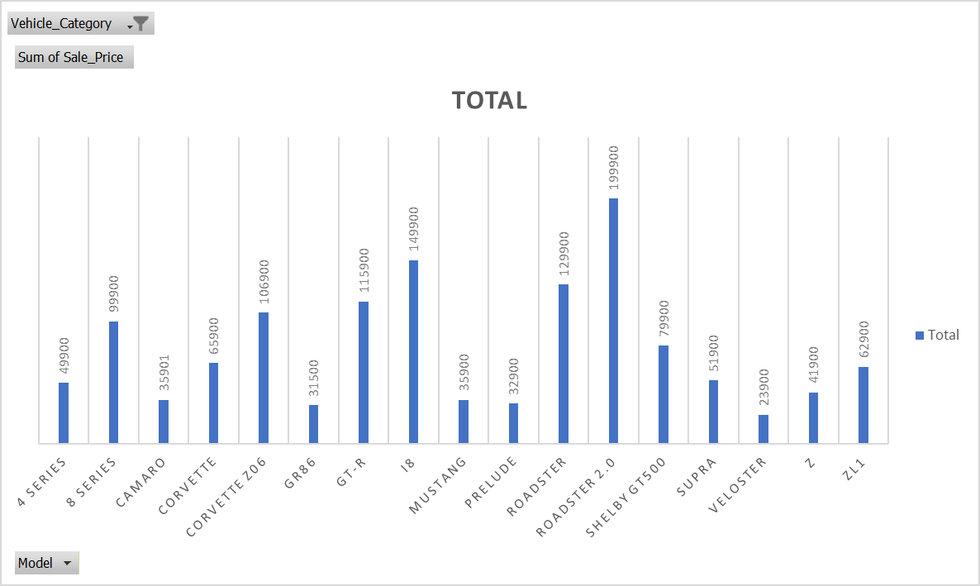
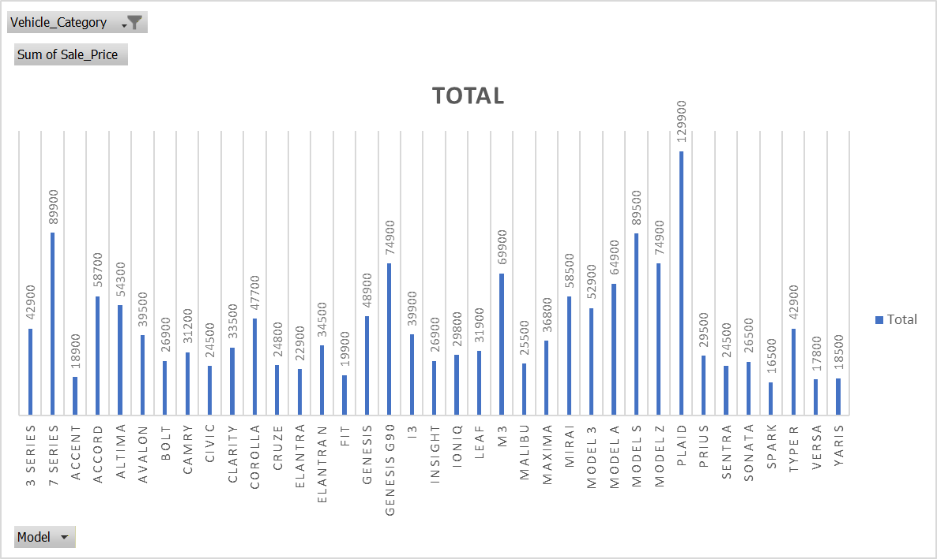
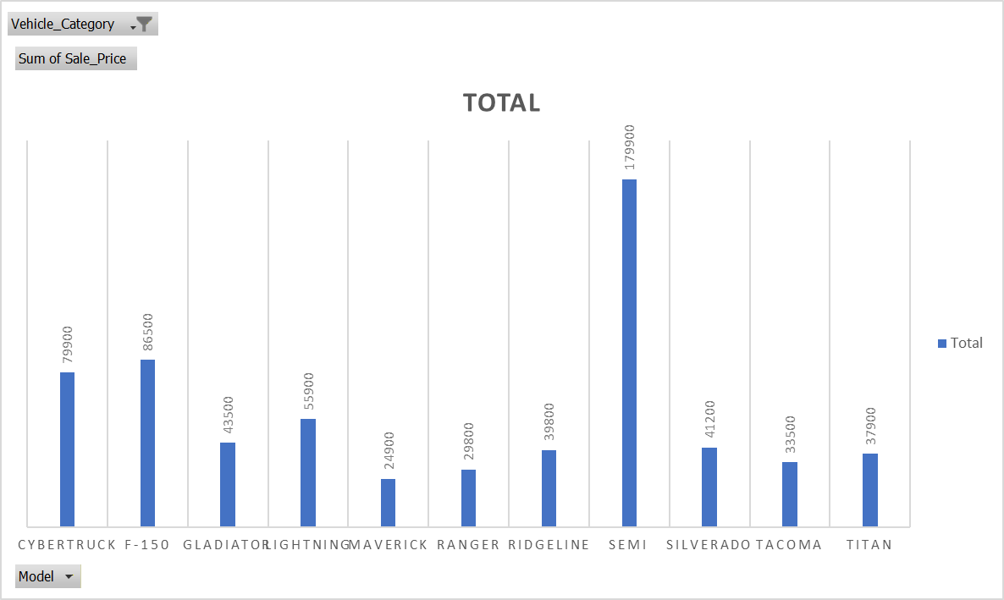
Best Performing Models by Sales Price
These models generate the highest revenue per sale, driven by premium pricing and performance positioning:
Top contributors include:
Tesla Roadster 2.0 ($199.9K)
Tesla Semi ($179.9K)
BMW i8 ($149.9K)
Tesla Plaid / Roadster ($129.9K)
Nissan GT-R ($115.9K)

Slide 5
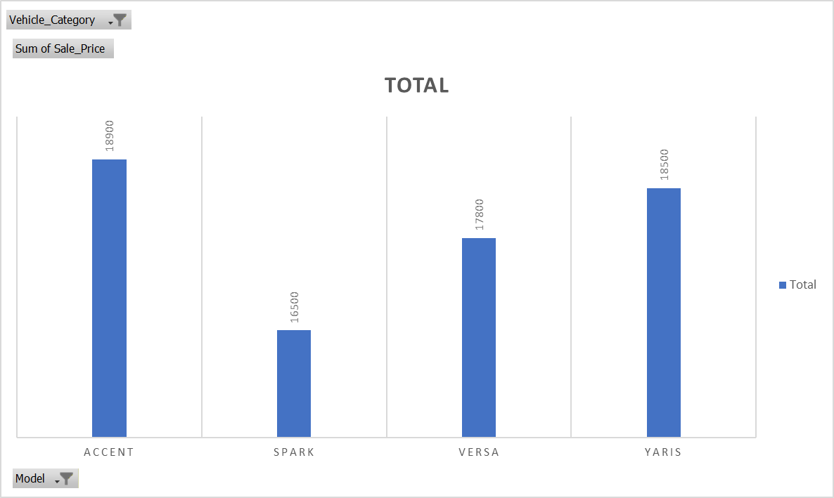
Worst Performing Models by Sales Price
Lowest revenue comes from entry-level economy vehicles
Lowest contributors include:
  Chevrolet Spark ($16.5K)
  Nissan Versa ($17.8K)
  Toyota Yaris ($18.5K)
  Hyundai Accent ($18.9K)

Slide 6
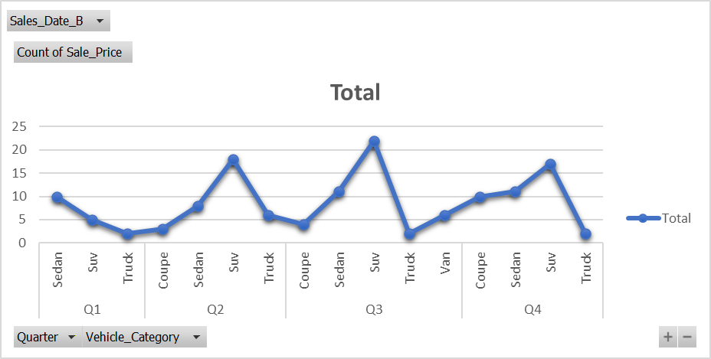
Seasonal Patterns in Buying Behavior
Clear Seasonal Trends
Q1: Strong demand for budget sedans and practical vehicles
Q2: Growth in SUVs and trucks (spring/summer utility demand)
Q3: Increased family vehicles (SUVs, vans) and EV launches
Q4: Peak sales for:
  Luxury vehicles
  EVs
  Performance models
➡️ Q4 is the strongest revenue quarter, driven by incentives, tax planning, and new model-year releases.

Slide 7
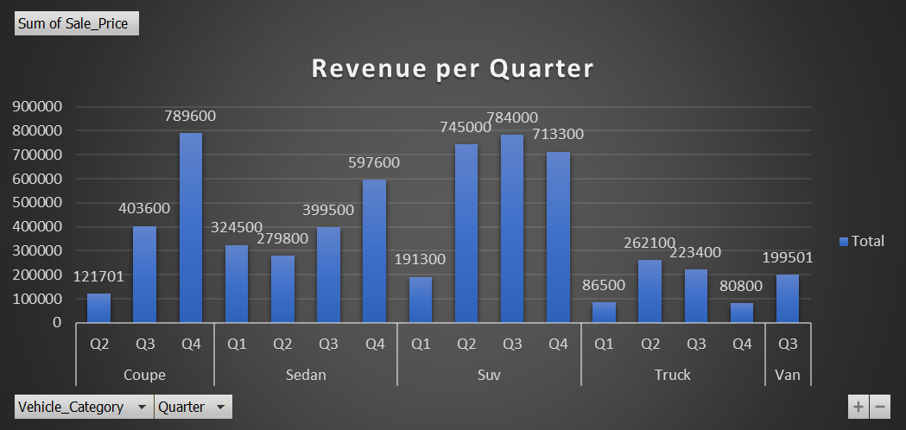
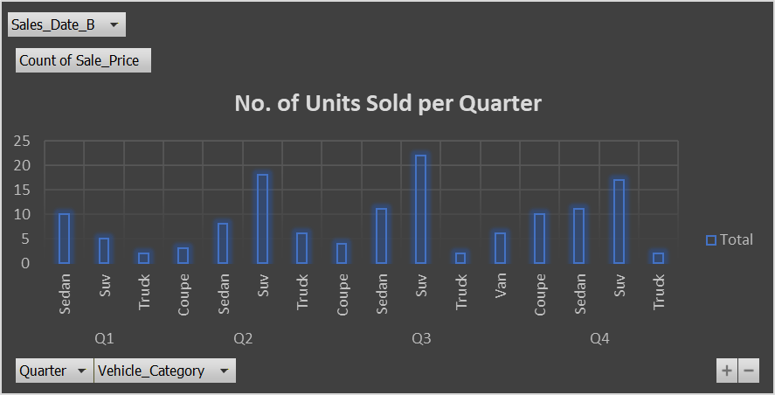
Patterns Across Vehicle Categories
Vehicle Category | No. of Units Sold | Revenue | Peak Quarter
SUV’s | 62 | $2,433,600 | Peak Q3, core revenue driver
Sedans | 40 | $1,601,400 | Stable sales, Q4 revenue jump → luxury shift
Coupes | 17 | $1,314,901 | No Q1 sales → surge in Q4
Trucks | 12 | $652,800 | Peak Q2, slow afterward
Vans | 6 |  | Likely seasonal

Slide 8
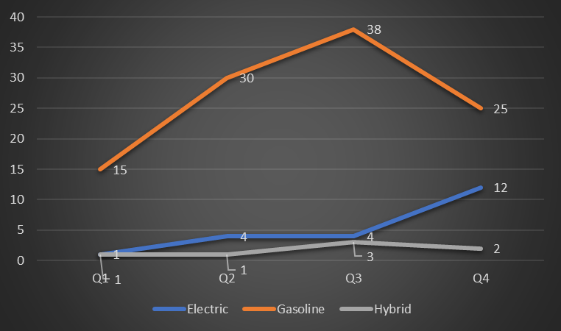
Sales Trends by Fuel Type
Gasoline
Highest sales each quarter
Strong growth Q1 → Q3, slight drop in Q4 (38 → 25)
Remains preferred fuel, Q4 momentum slows
Electric
Very low Q1 adoption (1)
Gradual growth Q2–Q3 (4 each)
Sharp Q4 jump (12) → clear sign of shifting preference
Hybrid
Low but steady sales
Slight increase in Q3
No major trend shifts

Slide 9
Seasonal Trends by Vehicle Category
SUVs: Peak Q2 → Q4 → summer/fall preference
Sedans: Stable across quarters → consistent commuter demand
Trucks: Moderate Q2 spike → fleet/construction activity
EVs: Mostly Q4 → year-end incentives & new launches
Vans: Peak Q3 → back-to-school/family trips
Coupes: Low volume, luxury-oriented → minimal seasonality

Slide 10
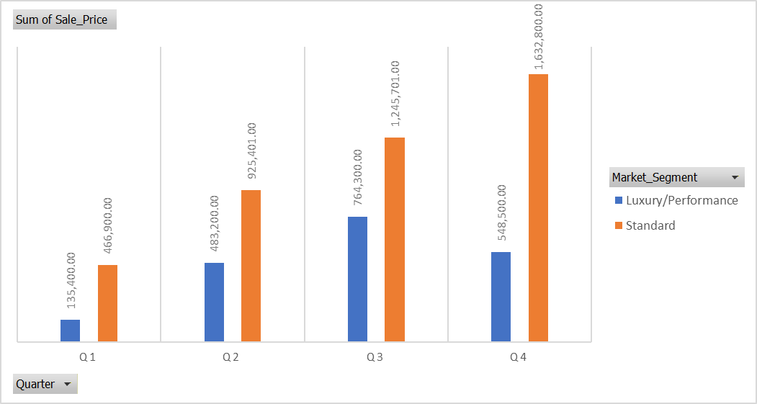
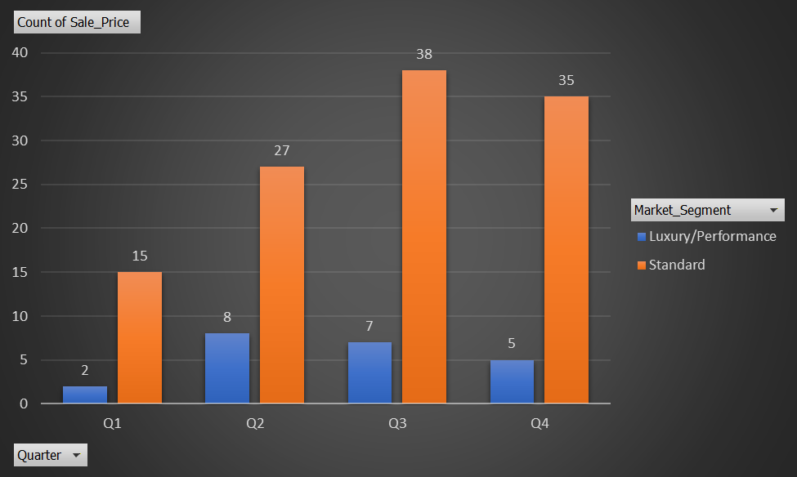
Premium vs Economy Model Performance
Economy Models | Premium Models
Dominate total sales → high volume, consistent demand | Lower volume but higher prices
Low seasonal variation → reliable year-round cash flow | Strong seasonality → mostly sold in Q4
Examples: Toyota Corolla, Honda Civic, Hyundai Elantra, Ford Escape | Examples: Tesla Roadster, Model X, i8, iX → align with launches & holiday promotions

Slide 11
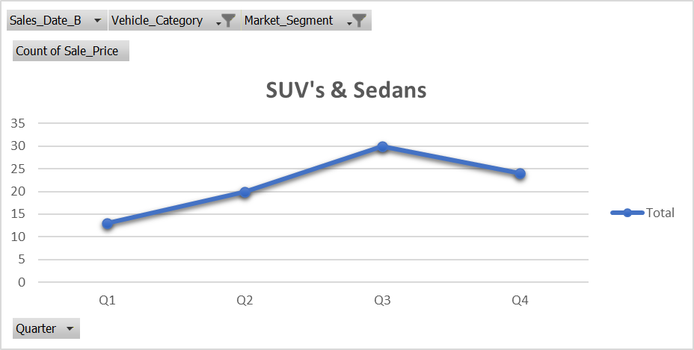
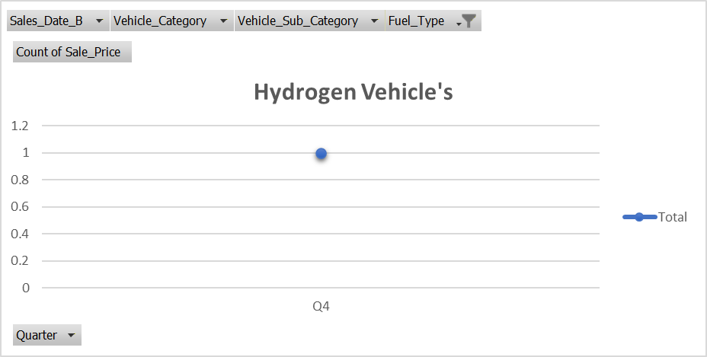
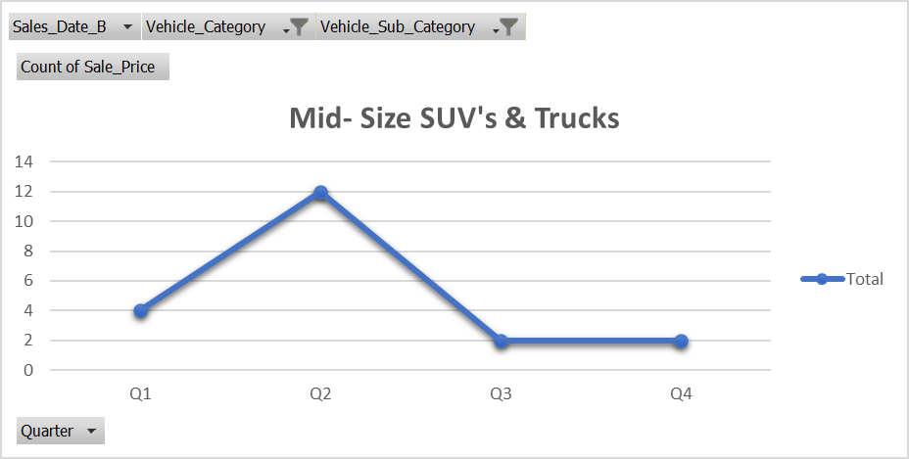
Inventory Optimization Based on Sales Patterns
Key Insights
Economy Sedans & SUVs (Standard segment) sell consistently Q1–Q4
Reliable, high-volume demand
SUVs average 25–30 units per quarter
Premium EVs & Luxury models show strong Q4 concentration
Very limited sales earlier in the year
Examples: Tesla Model X, Tesla Roadster, BMW iX
Mid-size SUVs & Pickup Trucks perform best in Q2–Q3
Driven by summer travel, outdoor activities
Hydrogen vehicles show minimal demand
Only 1 unit sold in Q4
Inventory Strategy
Maintain high year-round inventory of economy Sedans & SUVs
Stock Premium EVs & Luxury models primarily in Q3–Q4
Increase SUV & Truck inventory in Q2–Q3
Limit Hydrogen & niche vehicles to minimal stock

Slide 12
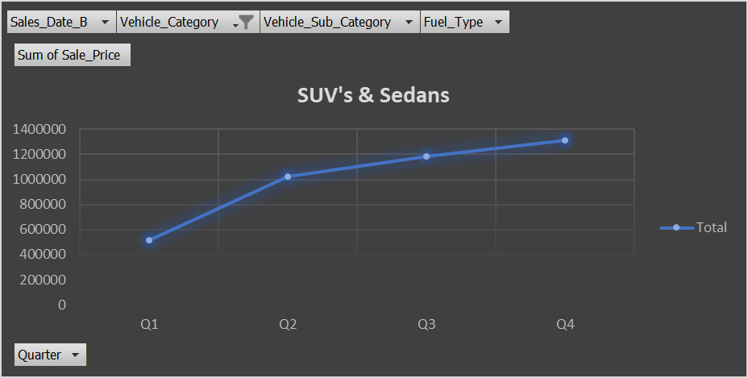
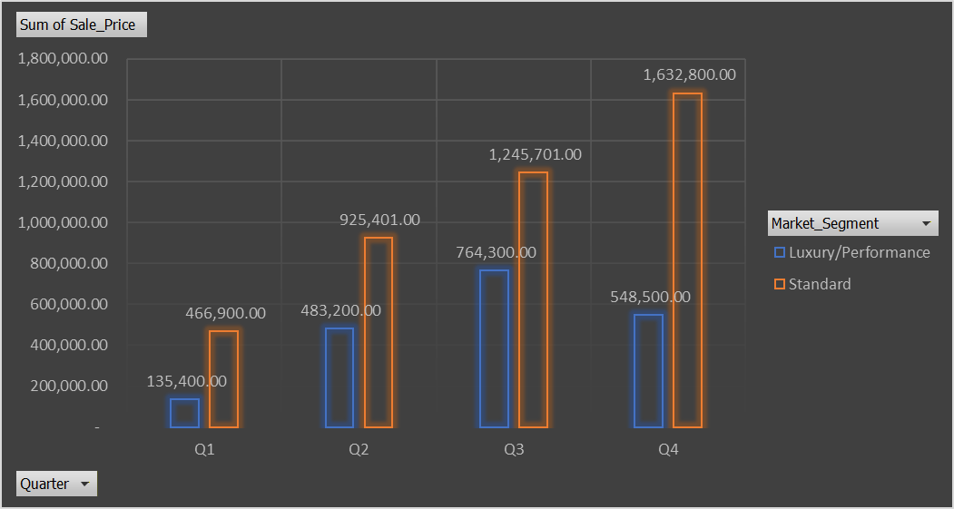
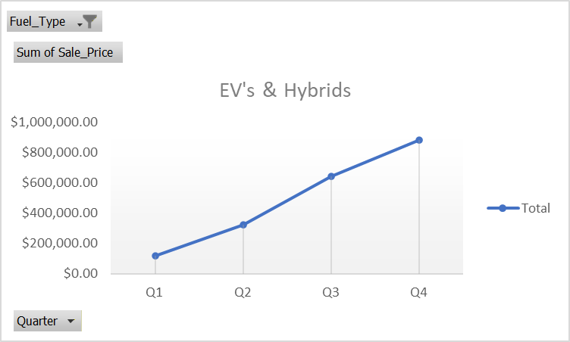
Pricing Recommendations by Vehicle Segment
Economy Sedans & SUVs | Premium & Luxury Vehicles | EVs & Hybrids (Growth Segment)
Maintain competitive pricing as it is price-sensitive, high-volume segment | Use dynamic pricing, especially in Q4 when demand peaks | Offer selective incentives in Q2–Q3 to encourage trial
Small price changes can significantly impact demand | Preserve premium margins during year-end promotions | Avoid heavy discounting in Q4 when demand is naturally higher
Introduce discounts in Q2 to stimulate mid-year sales | Examples: Tesla Model X, Roadster, BMW iX Price Range: $64,900 – $179,900 | Position incentives against dominant economy models
Examples: Toyota Corolla, Honda Civic. Price Range: $18,500 – $35,000

Slide 13
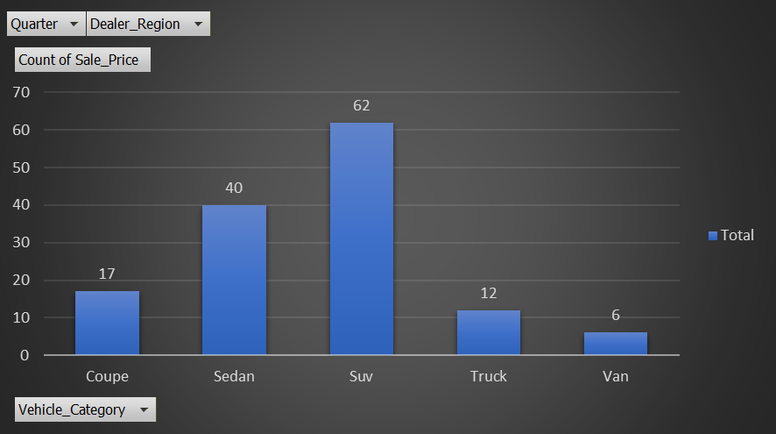
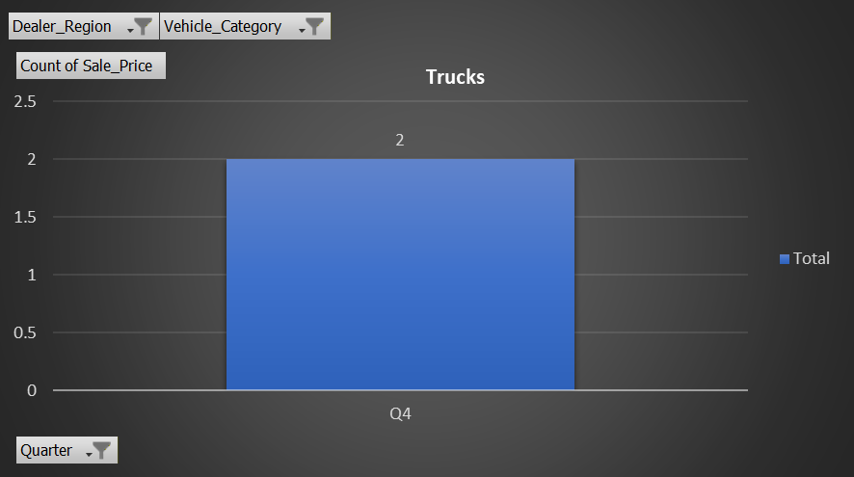
Marketing Campaign Focus Areas
Key Recommendations
Prioritize SUVs (Mid-Size & Full-Size) across Standard and Luxury segments, as they lead sales volume year-round.
Amplify EV & Hybrid marketing in Q4, aligning with year-end incentives and sustainability campaigns.
Target Truck promotions regionally, focusing on the Midwest and South, where pickup demand is strongest.
Therefore, Maximizes marketing ROI by aligning campaigns with high-demand categories, seasonal buying behavior, and regional preferences.

Slide 14
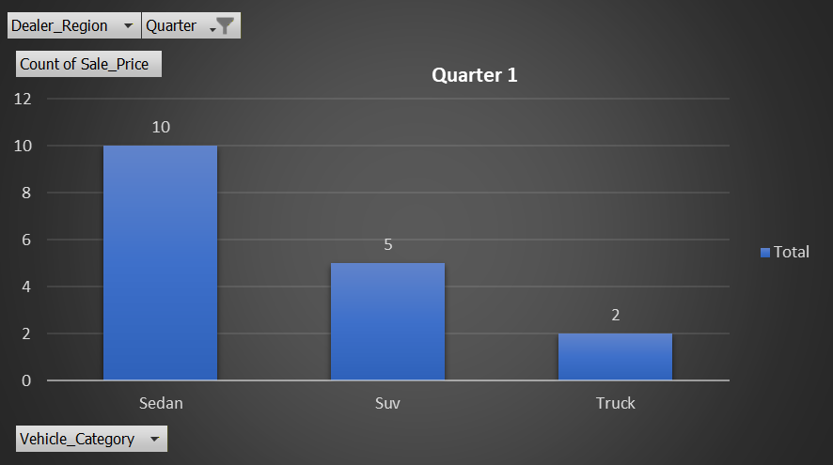
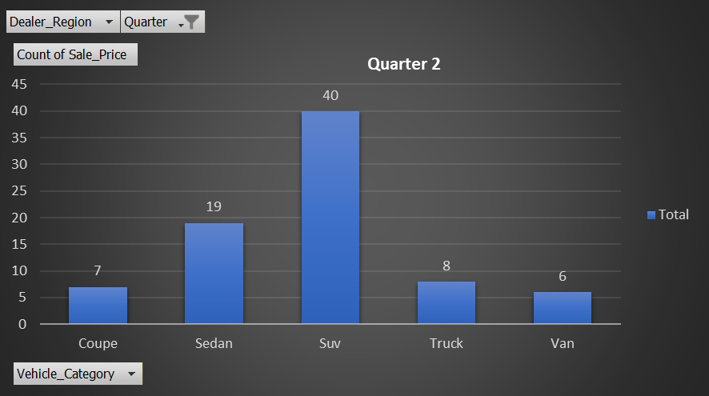
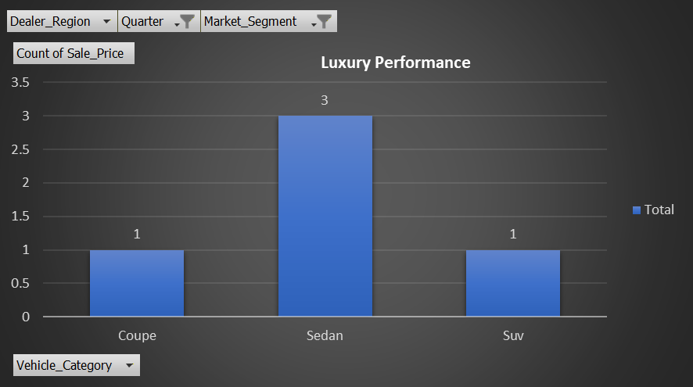
Seasonal Promotion Strategies
Q1 | Q2- Q3 | Q4
Promote Economy Sedans & Compact SUVs to attract new-year and budget-conscious buyers. | Emphasize Mid-Size SUVs, Family Vehicles & Trucks, aligning with summer travel and outdoor demand. | Launch Premium & EV campaigns (Luxury/Performance models), supported by holiday financing and bundled incentives.
Standard models sell consistently year-round, making Q1 an ideal period to drive early-year volume. |  | Luxury EVs and premium SUVs peak in Q4, driven by incentives and year-end purchasing.

Slide 15
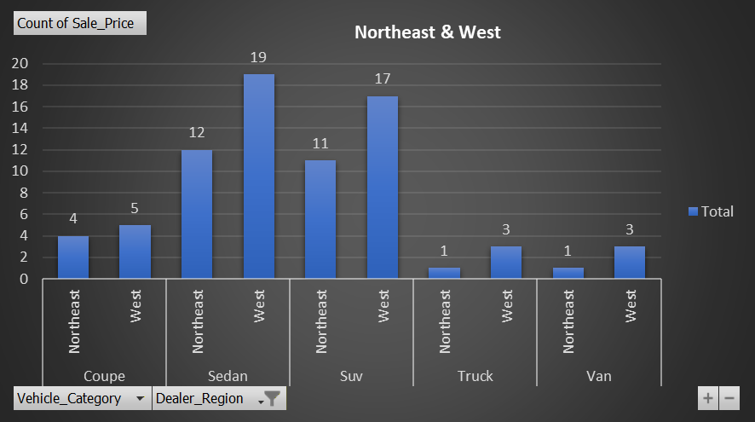
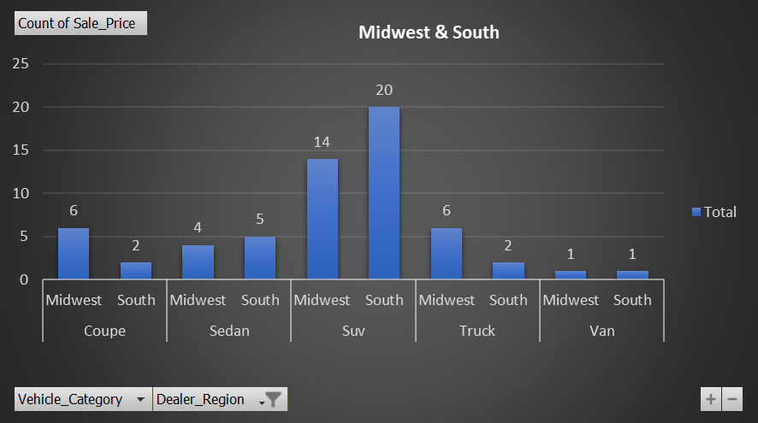
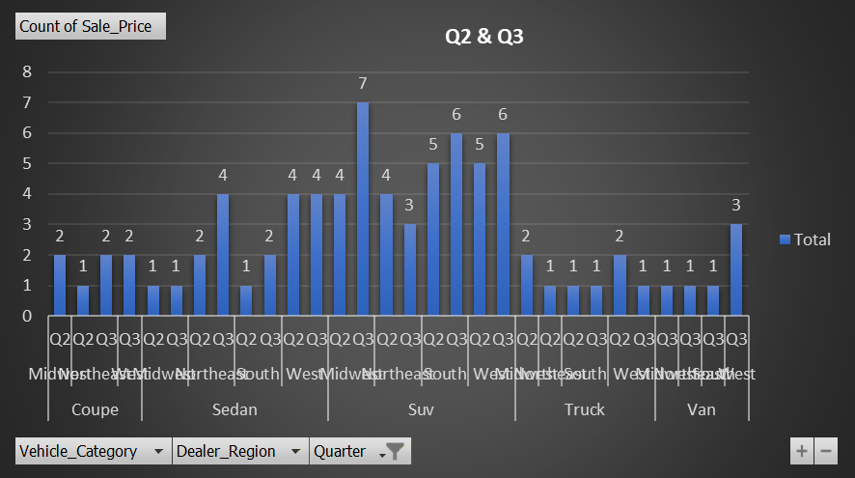
Sales Team Resource Allocation by Region
Northeast & West | Midwest & South: | All Regions (Q2–Q3)
Deploy senior sales reps and EV specialists to drive Premium and EV sales, where Tesla and BMW demand is strongest. | Focus sales teams on Trucks and Standard SUVs, aligning with regional preferences and high-volume demand. | Train teams to cross-sell Economy SUVs and Hybrids during peak summer buying periods.

