Slide 1
Saqlain's Tech Portfolio: A Glimpse into Innovation

Slide 2

About Me
Highly motivated Computer Science student at PES University, Bangalore.
Passionate about problem-solving, building smart solutions, and AI/Data.
Proven ability to transform ideas into tangible results through coding and analysis.
Experienced in diverse technologies, from machine learning to cloud deployment.
A well-rounded individual with interests in sports (cricket) and martial arts (Black Belt Dan 1).

Slide 3

Core Programming Skills
Proficient in Python, a versatile language for various applications.
Experienced in C and Java, providing a strong foundation in programming paradigms.
Skilled in R, a powerful tool for statistical computing and data analysis.
Adaptable to new languages and frameworks based on project requirements.
Committed to continuous learning and expanding programming expertise.

Slide 4
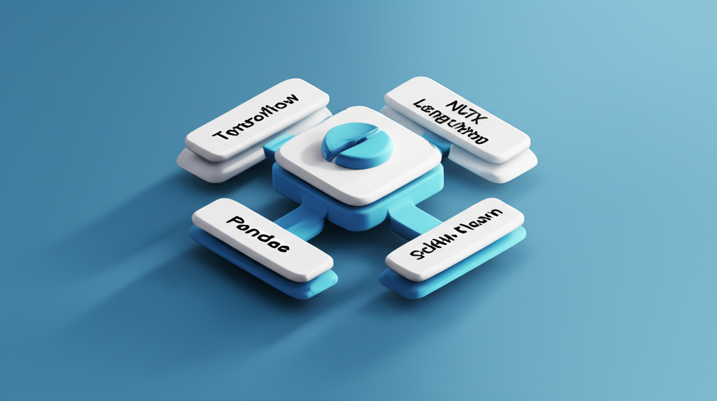
Machine Learning Expertise
Extensive experience with TensorFlow and PyTorch, leading deep learning frameworks.
Proficient in data manipulation and analysis using Pandas and NumPy.
Skilled in model building and evaluation using Scikit-learn.
Familiar with Hugging Face's ecosystem for pre-trained models and efficient development.
Expertise in Natural Language Processing (NLP) using NLTK, Keras, and Langchain.

Slide 5
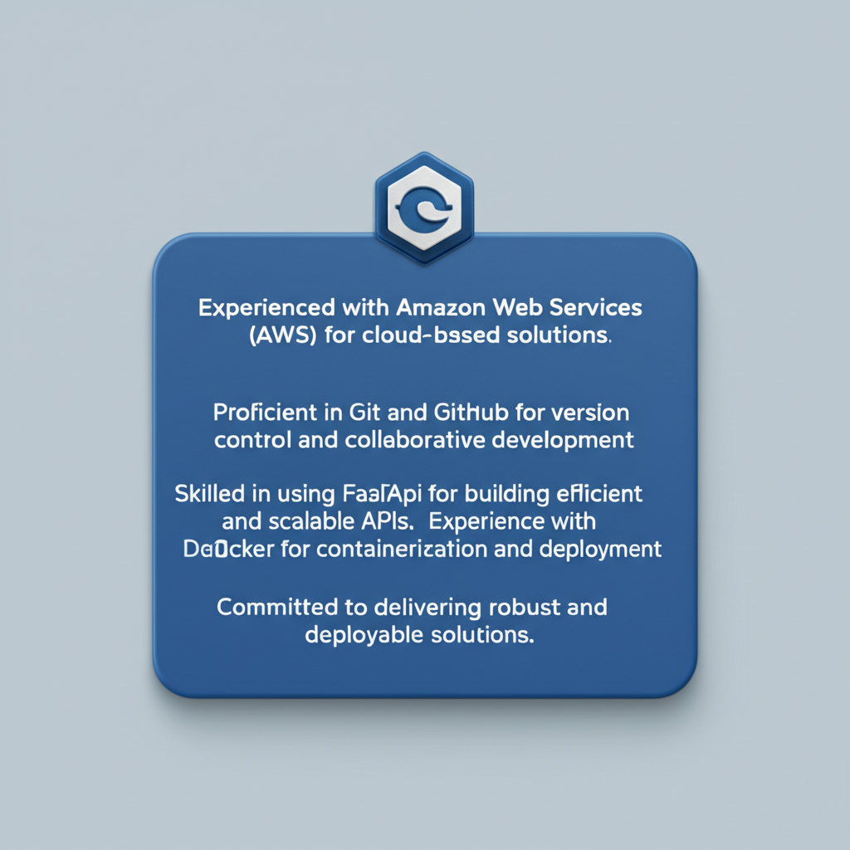
Cloud & Deployment Capabilities
Experienced with Amazon Web Services (AWS) for cloud-based solutions.
Proficient in Git and GitHub for version control and collaborative development.
Skilled in using FastAPI for building efficient and scalable APIs.
Experience with Docker for containerization and deployment.
Committed to delivering robust and deployable solutions.

Slide 6
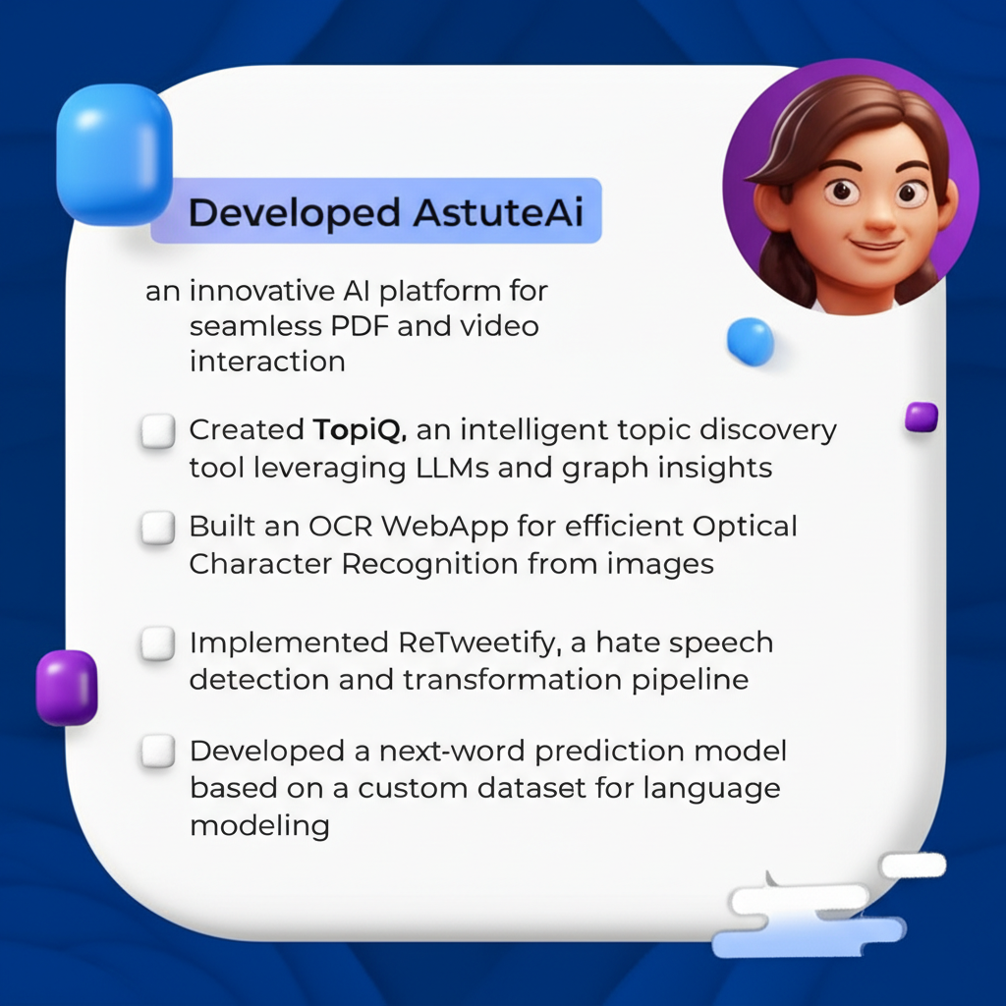
Key Projects Overview
Developed AstuteAI, an innovative AI platform for seamless PDF and video interaction.
Created TopiQ, an intelligent topic discovery tool leveraging LLMs and graph insights.
Built an OCR WebApp for efficient Optical Character Recognition from images.
Implemented ReTweetify, a hate speech detection and transformation pipeline.
Developed a next-word prediction model based on a custom dataset for language modeling.

Slide 7
Thank You

