Slide 1
DevOps as a Career Path
BY 19SW81

Slide 2
Contents
My Introduction
My current Field of interest
How I get there?
My achievements
Why I’ve chosen DevOps?
What pathways I followed?
How I guide others?
About DevOps
Pros & Cons of Field

Slide 3

My Introduction
My name is “Saqlain Mustafa”. I’m from district Naushahro Feroze. I’m currently studying in final year of BE Software Engineering at Mehran University of Engineering and Technology, Jamshoro.

Slide 4

My current Field of Interest
Here I’m mentioning my field of Interest which is DevOps.
Being an student of Software Engineering, I studied DevOps and I felt this field very interesting to learn.

Slide 5
How I get there?
In the start of 3rd year we studied “DevOps” as a Subject and it was very exciting and interesting to learn.
After that I did a research regarding the field and found this rapidly evolving field that requires professionals to constantly learn new skills and stay up to date with the latest technologies and practices. For individuals who enjoy working with technology and are passionate about software development, DevOps can be an exciting and rewarding career path.
Another factor that lead me to pursue a career in DevOps is the demand for professionals in this field. As more and more organizations adopt DevOps practices, the demand for skilled DevOps professionals has been steadily increasing. This demand has resulted in competitive salaries and benefits packages for DevOps professionals, making it an attractive career option for many.
That’s how I get there and chose this as my career path.

Slide 6

My Achievements
3. Implemented automated testing processes that reduced the number of bugs and defects by 75%.
4. Improved incident response times by 80% through the implementation of automated monitoring and alerting systems.
5. Developed a disaster recovery plan that ensured business continuity in the event of a major outage or system failure.
6. Contributed to open-source DevOps projects, such as Kubernetes or Jenkins, that have been widely adopted by the industry.
7. Received recognition for contributions to the DevOps community, such as speaking at conferences or writing articles or blog posts on DevOps topics.
8. Implemented DevOps practices and processes that led to significant cost savings for the organization.
1. Designed and implemented a continuous integration and continuous delivery (CI/CD) pipeline that reduced deployment times by 50%.
2. Led a team of DevOps engineers to successfully migrate a legacy application to the cloud, resulting in improved scalability and reliability.

Slide 7
Why I’ve chosen DevOps?
Passion for technology: DevOps is a field that involves working with cutting-edge technology and requires a deep understanding of software development and IT operations. For individuals who are passionate about technology and enjoy working with complex systems, DevOps can be an exciting and fulfilling career path.
Desire for collaboration: DevOps is a collaborative field that brings together developers, operations professionals, and other stakeholders to work towards a common goal. For individuals who enjoy working as part of a team and value open communication and transparency, DevOps can be an ideal career path.
Opportunities for growth: DevOps is a rapidly growing field, and there is a high demand for skilled professionals. This demand has resulted in competitive salaries, benefits, and opportunities for career growth and advancement.
These are some of the reasons behind choosing DevOps as my career Path.

Slide 8
What pathways I followed?
Starting from class learning in my 3rd year to different courses and certifications in the field till now, I learned DevOps and now working on real time projects and freelancing that also leads me towards extra learning regarding the field.
I will like to mention some courses that I followed, the first one is a YouTube playlist that I felt very feasible and worth watching to learn DevOps. Here is the link:
https://youtube.com/playlist?list=PLBGx66SQNZ8aPsFDwb79JrS2KQBTIZo10
After that I entered the DevOps field through formal training and certification programs. There are numerous courses and certifications available, such as the Certified DevOps Engineer certification from AWS or the DevOps Foundation certification from the DevOps Institute.
Ultimately, the specific pathway you follow will depend on your personal interests, skills, and career goals. Many DevOps professionals have diverse backgrounds and bring a wide range of skills and experience to the field.

Slide 9
How I guide others?
Learn about DevOps principles and practices: DevOps is a discipline that emphasizes collaboration between software development and IT operations teams. To be successful in DevOps, it is important to have a deep understanding of DevOps principles and practices, such as continuous integration, continuous delivery, infrastructure as code, and automation.
Develop your technical skills: DevOps is a technical field, so it is important to have strong technical skills in areas such as programming, system administration, cloud computing, and automation tools. You can develop your technical skills by taking online courses, attending workshops, or working on personal projects.
Build a strong foundation in software development: While DevOps is not solely focused on software development, it is important to have a strong foundation in software development practices and methodologies. This includes understanding programming languages, software testing, and software development lifecycles.
Gain practical experience: To be successful in DevOps, it is important to have practical experience working with DevOps tools and technologies. You can gain practical experience by working on personal projects, contributing to open-source projects, or taking on DevOps-related projects at your current job.

Slide 10
How I guide others?
5. Network and participate in the DevOps community: Networking and participating in the DevOps community can help you learn about the latest trends and best practices in the field. You can participate in the DevOps community by attending meetups, conferences, or joining online forums and social media groups.
6. Consider pursuing certifications: There are a variety of DevOps certifications available, such as the Certified DevOps Engineer certification from AWS or the DevOps Foundation certification from the DevOps Institute. Pursuing certifications can help you demonstrate your expertise in DevOps and can also help you stand out in a competitive job market.
Remember, DevOps is a rapidly growing field with many opportunities for growth and career advancement. By developing your skills, gaining practical experience, and participating in the DevOps community, you can position yourself for a successful career in DevOps.

Slide 11
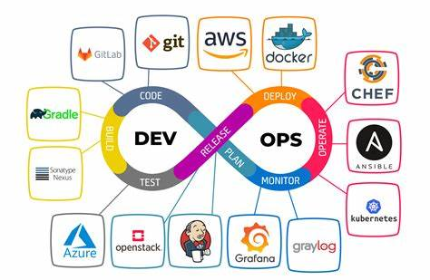
About DevOps

Slide 12
About DevOps
DevOps is a software development methodology that emphasizes collaboration and communication between software developers and IT operations teams to deliver high-quality software products more quickly and efficiently. The DevOps approach involves automating processes, such as code testing, deployment, and infrastructure management, to reduce manual errors and improve efficiency. DevOps also emphasizes continuous feedback and improvement, with teams constantly monitoring and optimizing the software development process. DevOps has become increasingly popular in recent years, with many organizations adopting DevOps practices to improve their software development processes and accelerate their time-to-market.

Slide 13
DevOps cycle
The DevOps cycle typically includes the following stages:
Plan: In this stage, development teams plan and define the scope and objectives of a project, as well as the features and requirements needed to achieve these objectives.
Develop: In this stage, development teams create the code and software components needed to meet the project's objectives. This stage involves testing and continuous integration, with the goal of catching and addressing issues early in the development process.
Test: In this stage, the software is tested to ensure that it meets the project's objectives and requirements. This stage includes both automated and manual testing, with the goal of identifying and resolving any issues before the software is released.
Deploy: In this stage, the software is deployed to production environments, either through automated or manual processes. The goal is to ensure that the software is deployed quickly and efficiently, without causing any disruption to users or systems.
Operate: In this stage, the software is monitored and maintained in production environments. This includes tasks such as monitoring system performance, identifying and resolving issues, and optimizing the system for efficiency and scalability.

Slide 14
DevOps Tools
Some common DevOps tools include:
Source code management tools, such as Git or SVN, which are used to manage and version control code changes.
Continuous integration and continuous delivery (CI/CD) tools, such as Jenkins or CircleCI, which automate build, test, and deployment processes.
Configuration management tools, such as Ansible or Chef, which automate infrastructure provisioning and management.
Containerization tools, such as Docker or Kubernetes, which enable developers to create and manage lightweight, portable software containers.
Monitoring and analytics tools, such as New Relic or Splunk, which enable teams to monitor and analyze system performance and user behavior.

Slide 15
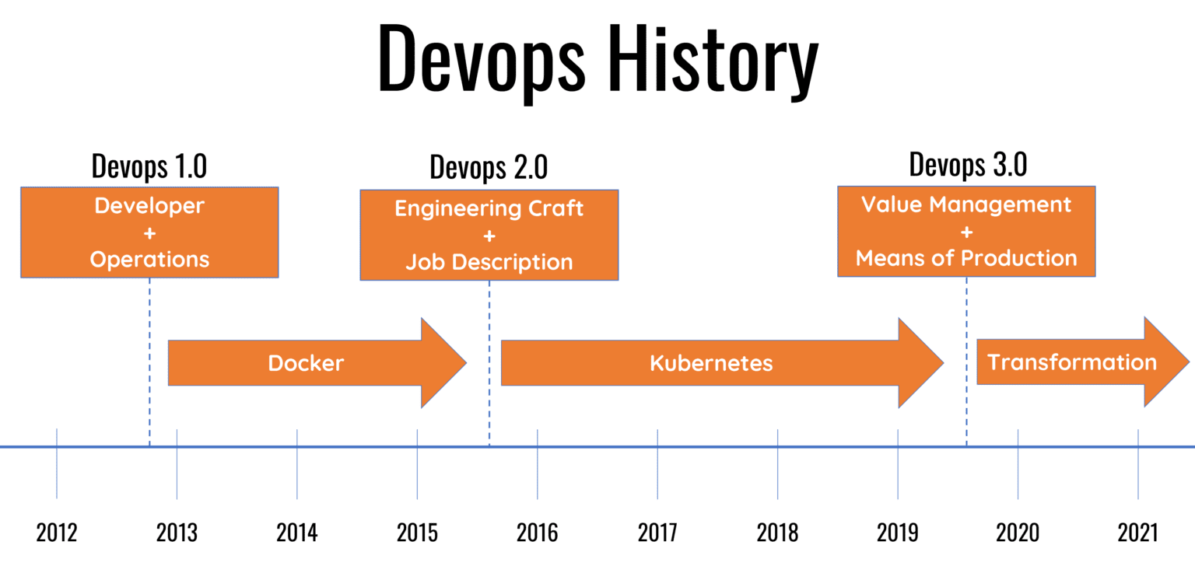
History Of DevOps

Slide 16
Pros & Cons of DevOps
Pros:
Faster time-to-market: DevOps allows organizations to release software faster and more frequently, with faster feedback cycles.
Increased collaboration and communication: DevOps encourages collaboration and communication between development and operations teams, which can lead to more effective problem-solving and better outcomes.
Improved efficiency and productivity: By automating processes and eliminating manual errors, DevOps can improve efficiency and productivity for development teams.
Increased reliability and quality: DevOps emphasizes continuous testing and monitoring, which can help ensure that software is of high quality and reliable.
Greater agility and adaptability: DevOps can enable organizations to respond more quickly to changing market conditions and customer needs.

Slide 17
Pros & Cons of DevOps
Cons:
Increased complexity: DevOps can introduce more complexity to the development process, particularly if there are multiple teams and technologies involved.
Greater reliance on automation: DevOps relies heavily on automation tools and processes, which can be a challenge to implement and maintain.
Cultural challenges: DevOps requires a cultural shift towards greater collaboration and communication, which can be a challenge to implement in organizations with a more traditional culture.
Security concerns: DevOps can introduce security risks if security measures are not adequately integrated into the development process.
Cost: Implementing DevOps can require significant investments in tools, infrastructure, and training.

Slide 18
Thank You!

