Slide 1
Data Analyst Internship — Task Submission
Beginner & Intermediate Levels
Saqueeb Akhtar Ansari · ShadowFox · 2026 · SF-PID-2026-W6751
LEARN · CREATE · LEAD
1

Slide 2
What I'll Walk You Through
▸ Beginner — Retail Sales Dashboard
cleaned a messy year of sales data, built a one-page spreadsheet dashboard
▸ Intermediate — Customer & Revenue Analysis
repeat behaviour, revenue concentration, channel quality, returns
▸ How it's organised
GitHub repo: data → code → notebooks → reports for every level
A quick note on approach
Every number you'll see comes from actually running the analysis — where an early hypothesis didn't survive contact with the data, I'll show that too.
2

Slide 3
Beginner — The Data & the Mess
601 orders · Jan–Dec 2025 · 4 categories · 4 regions
▸ What I started with
a typical small-business export — usable, but not clean
▸ Blank regions — 8 rows
filled with that month's most common region
▸ Negative prices — 5 rows
refund entries keyed in wrong → converted to positive
▸ Inconsistent categories — 4 rows
'ELECTRONICS' → 'Electronics'
Why keep the messy file at all?
The raw CSV stays untouched in the repo so the cleaning is auditable — anyone can diff raw vs cleaned and check every fix. That's how analysis should be handed over.
3

Slide 4
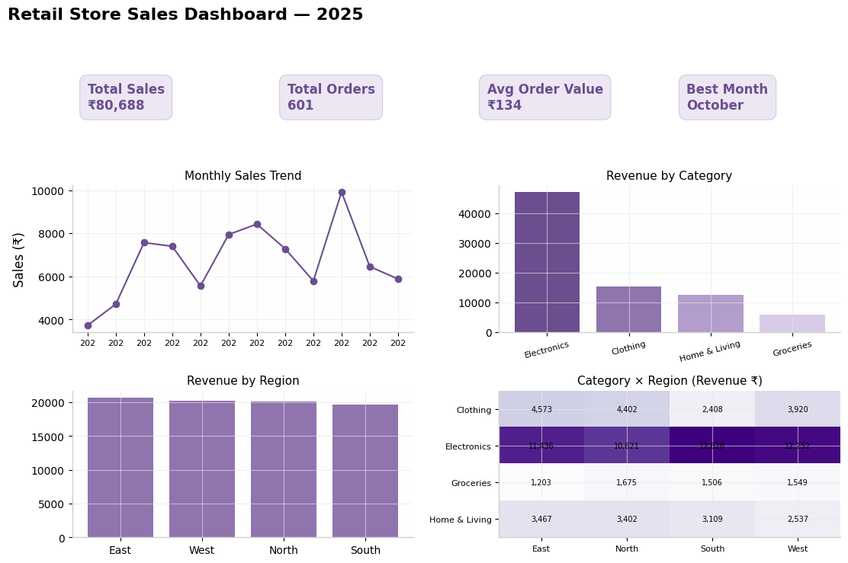
Beginner — The Dashboard
one screen, no scrolling — KPIs first, detail after
▸ KPI cards
sales · orders · AOV · best month
▸ Charts
monthly trend, category & region bars, category × region matrix
▸ Built in
Google Sheets / Excel — pivots + native charts
5

Slide 5
Beginner — What the Numbers Said
▸ Electronics carries the store
58% of revenue from just 25% of orders — Groceries is the mirror: 31% of orders, 7% of revenue
▸ October spikes, February dips
₹9,916 vs ₹4,718 — October is 2.1× February; Oct–Dec = 28% of the year
▸ Regions are evenly matched (~2% apart)
so the lever isn't 'fix a weak region' — it's lifting all four together
▸ What I'd recommend
protect Electronics stock into October · use Groceries as a cross-sell engine · February = clearance/planning month
6

Slide 6
Intermediate — From 'What' to 'Why'
939 transactions · 380 customers · Jan 2023 – Dec 2024 · ₹5.7L revenue
▸ The business question
who are our customers, do they come back, and where is money leaking?
▸ Why this dataset
you need customer identity across transactions for behavioural analysis — a plain sales log can't answer these questions
▸ Prep work
fixed impossible dates, dropped 15 rows with missing values (2%), built repeat flags & frequency per customer
Honesty check
My going-in hypothesis was 'Instagram customers don't repeat.' The data disagreed — Google Ads was the actual laggard. The report says it that way.
7

Slide 7
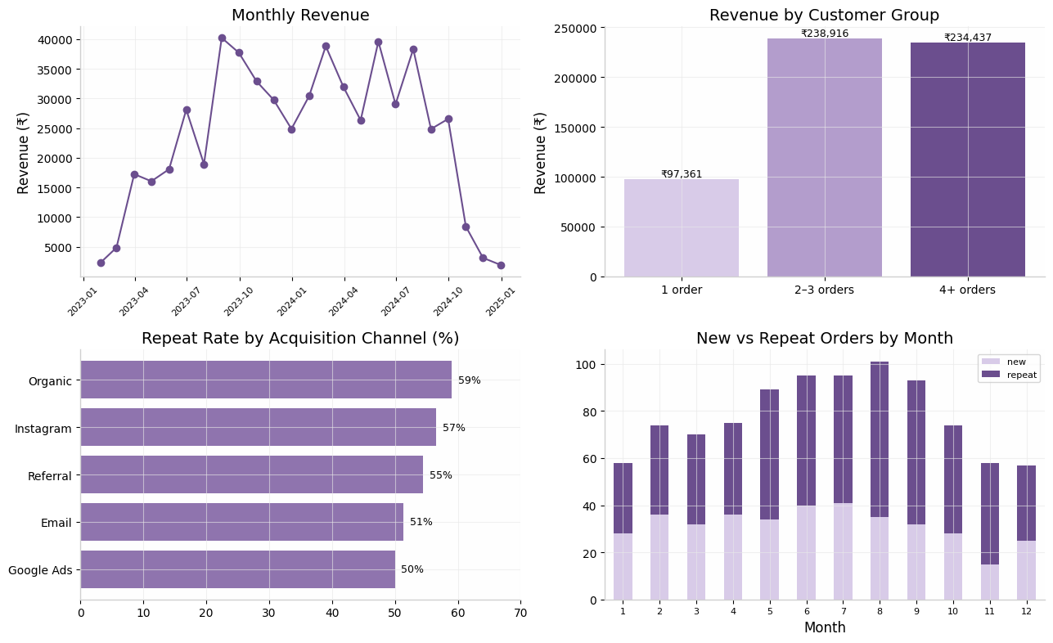
Intermediate — The Analysis at a Glance
8

Slide 8
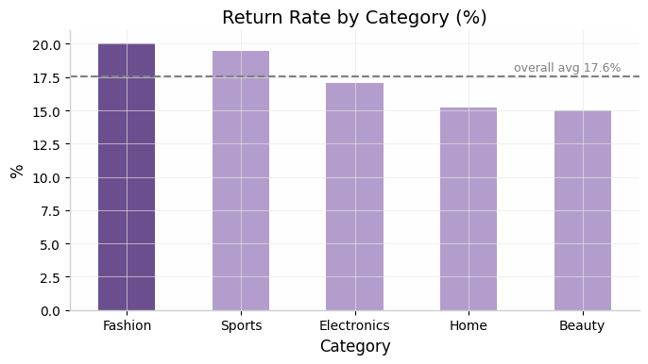
Intermediate — Returns: A Store-wide Problem
worst in Fashion, but high everywhere
▸ 17.6% overall
of transactions are returned — steep for any store
▸ Fashion 20% · Sports 19.5%
the two worst categories
▸ Fix
sizing info & product photos first; target <12% store-wide
9

Slide 9
Intermediate — Findings & Recommendations
▸ 45% of customers buy once, never return
the 2–3 order group (152 people) is the cheapest revenue available — nudge them ~30 days after last order
▸ Revenue is concentrated
loyal 15% = 41% of revenue; top 20% by frequency = 68% — build an early-warning list for at-risk loyal customers
▸ Google Ads is the weak channel (50% repeat)
audit the post-click journey — or reallocate toward Referral-style incentives
▸ May–Sep peak is repeat-driven
time campaigns to it; run re-activation pushes in the Nov–Jan dip
10

Slide 10
Where Everything Lives
GitHub repo structure
beginner-level/ data · dashboard · report · code
intermediate-level/ data · notebooks · visuals · report
advanced-level/ data · powerbi guide · report
video/ walkthrough link
Every claim traces back to a file: raw data,
cleaned data, executed notebook, then report.
▸ 3–5 min video
narrated walkthrough of both levels
▸ Reproducible
seeded data + scripts — anyone can re-run
▸ Auditable
raw kept messy on purpose
11

Slide 11
Thank you!
Questions & feedback welcome — that's the point of the exercise.
[GitHub repo link] · [Email]
12

