Slide 1
Numpy, Pandas & Visualization Ramen Ratings Dataset
Batch 8
Saquib Rafeeq, Suma Danappa & Ghanshyam Ji

Slide 2
Project Statement
To analyze the popularity of Ramen based on the star ratings, brand & style across the continents from the given data.
Preliminary Analysis
Variable Identification
Missing Value Treatment
Outlier Treatment
Data Cleaning
Univariate / Bi-variate Analysis
Variable Creation
Data Visualization

Slide 3
Detailed Analysis:
Types of variables:
Predictor Variables: Review #, Brand, Variety, Style, Country, Stars, Top Ten
Target Variables: Variables based on Style, Popular Brand, Star ratings
Data Type:
Character: Brand, Variety, Style & Country
Numeric: Review#, Stars, Top Ten
Variable Category:
Categorical: Style
Continous: Review #, Brand, Variety, Country, Stars, Top Ten
Initial Explorations:
Dataframe.describe()
Data Cleaning:
Drop.(columns)
Drop_Duplicates()
Dataframe. Replace()
Outlier Treatment:
Seaborn : Plotly:
Countplot() Bar
Swarmplot()
Distplot()

Slide 4
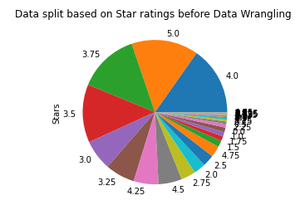
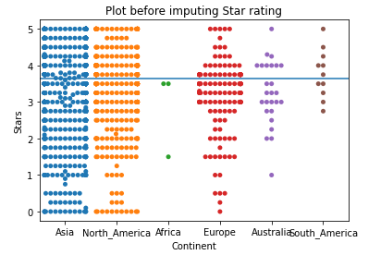
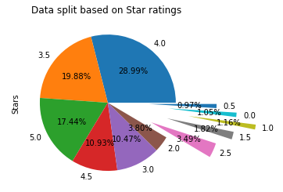
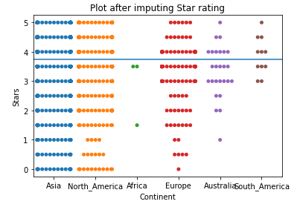
Data Analysis

Slide 5
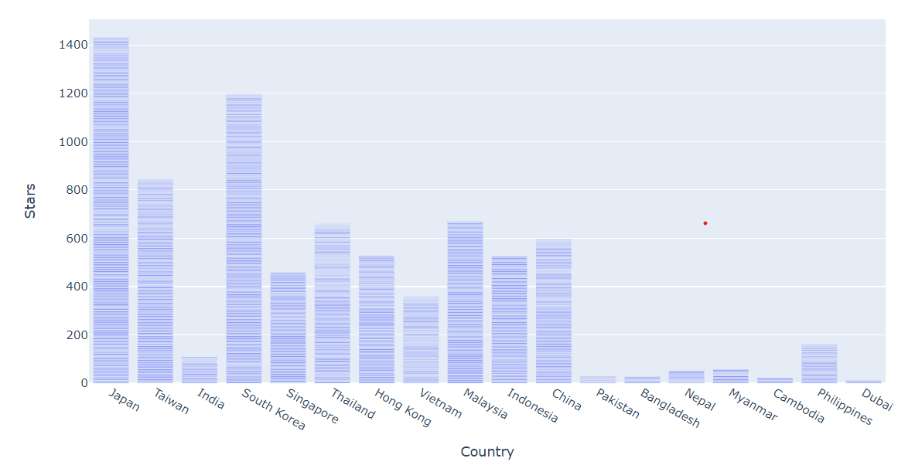
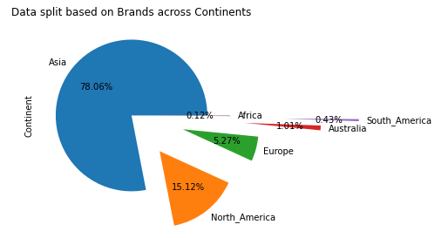
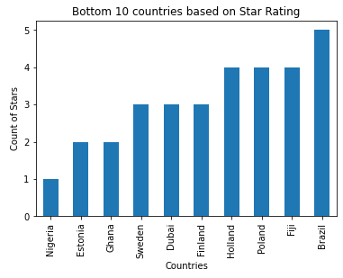
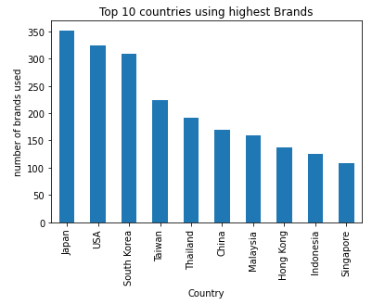
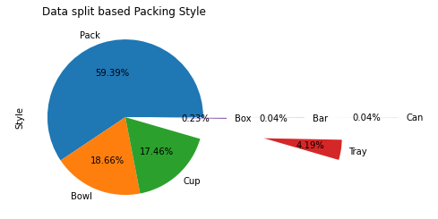
Data Analysis Contd.

Slide 6
Findings from the Analysis
Highest consumers of Ramen products : Asian Countries
Most preferred Ramen’s packing style : Pack
Most brands used in country: Japan (352)
Least brands used in country: Nigeria (1)
Revised Project Statement
To improve Ramen business:
In Africa and South America continents
By Recommending the packing style: Pack, Bowl & Cup
Link to the project presentation:
https://github.com/saquib3012/NPV/blob/main/Ramen-Ratings%20Dataset%20-%20NPV%20-%20Batch%208.ipynb

Slide 7
THANK YOU

