Slide 1
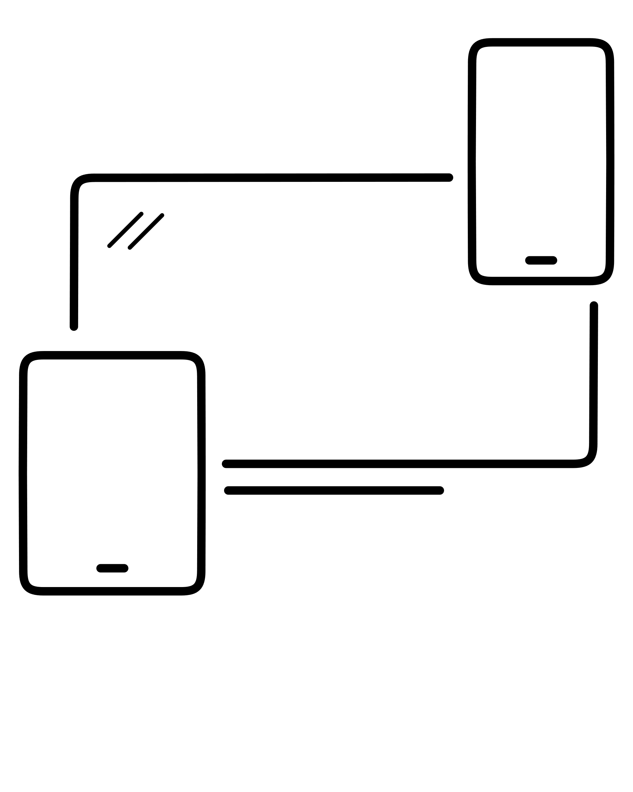

A Seminar by Saquib Akhtar on
Cross-Platform Development With Flutter
What is Flutter?
Flutter is an open-source UI software development kit created by Google. It is used to develop cross platform applications for Android, iOS, Linux, Mac, Windows, Google Fuchsia, and the web from a single codebase.
Original author(s) | Google
Developer(s) | Google and community
Initial release | Alpha (v0.0.6) / May 2017; 4 years ago
Stable release | 2.2.0 / 19 May 2021; 25 days ago
Written in | C, C++, Dart
Platform | Android, iOS, Google Fuchsia, Web platform, Linux, macOS and Windows
Website | flutter.dev

Slide 2
What is Flutter?
Flutter is an open-source UI software development kit created by Google. It is used to develop cross platform applications for Android, iOS, Linux, Mac, Windows, Google Fuchsia, and the web from a single codebase.
Original author(s) | Google
Developer(s) | Google and community
Initial release | Alpha (v0.0.6) / May 2017; 4 years ago
Stable release | 2.2.0 / 19 May 2021; 25 days ago
Written in | C, C++, Dart
Platform | Android, iOS, Google Fuchsia, Web platform, Linux, macOS and Windows
Website | flutter.dev

Slide 3
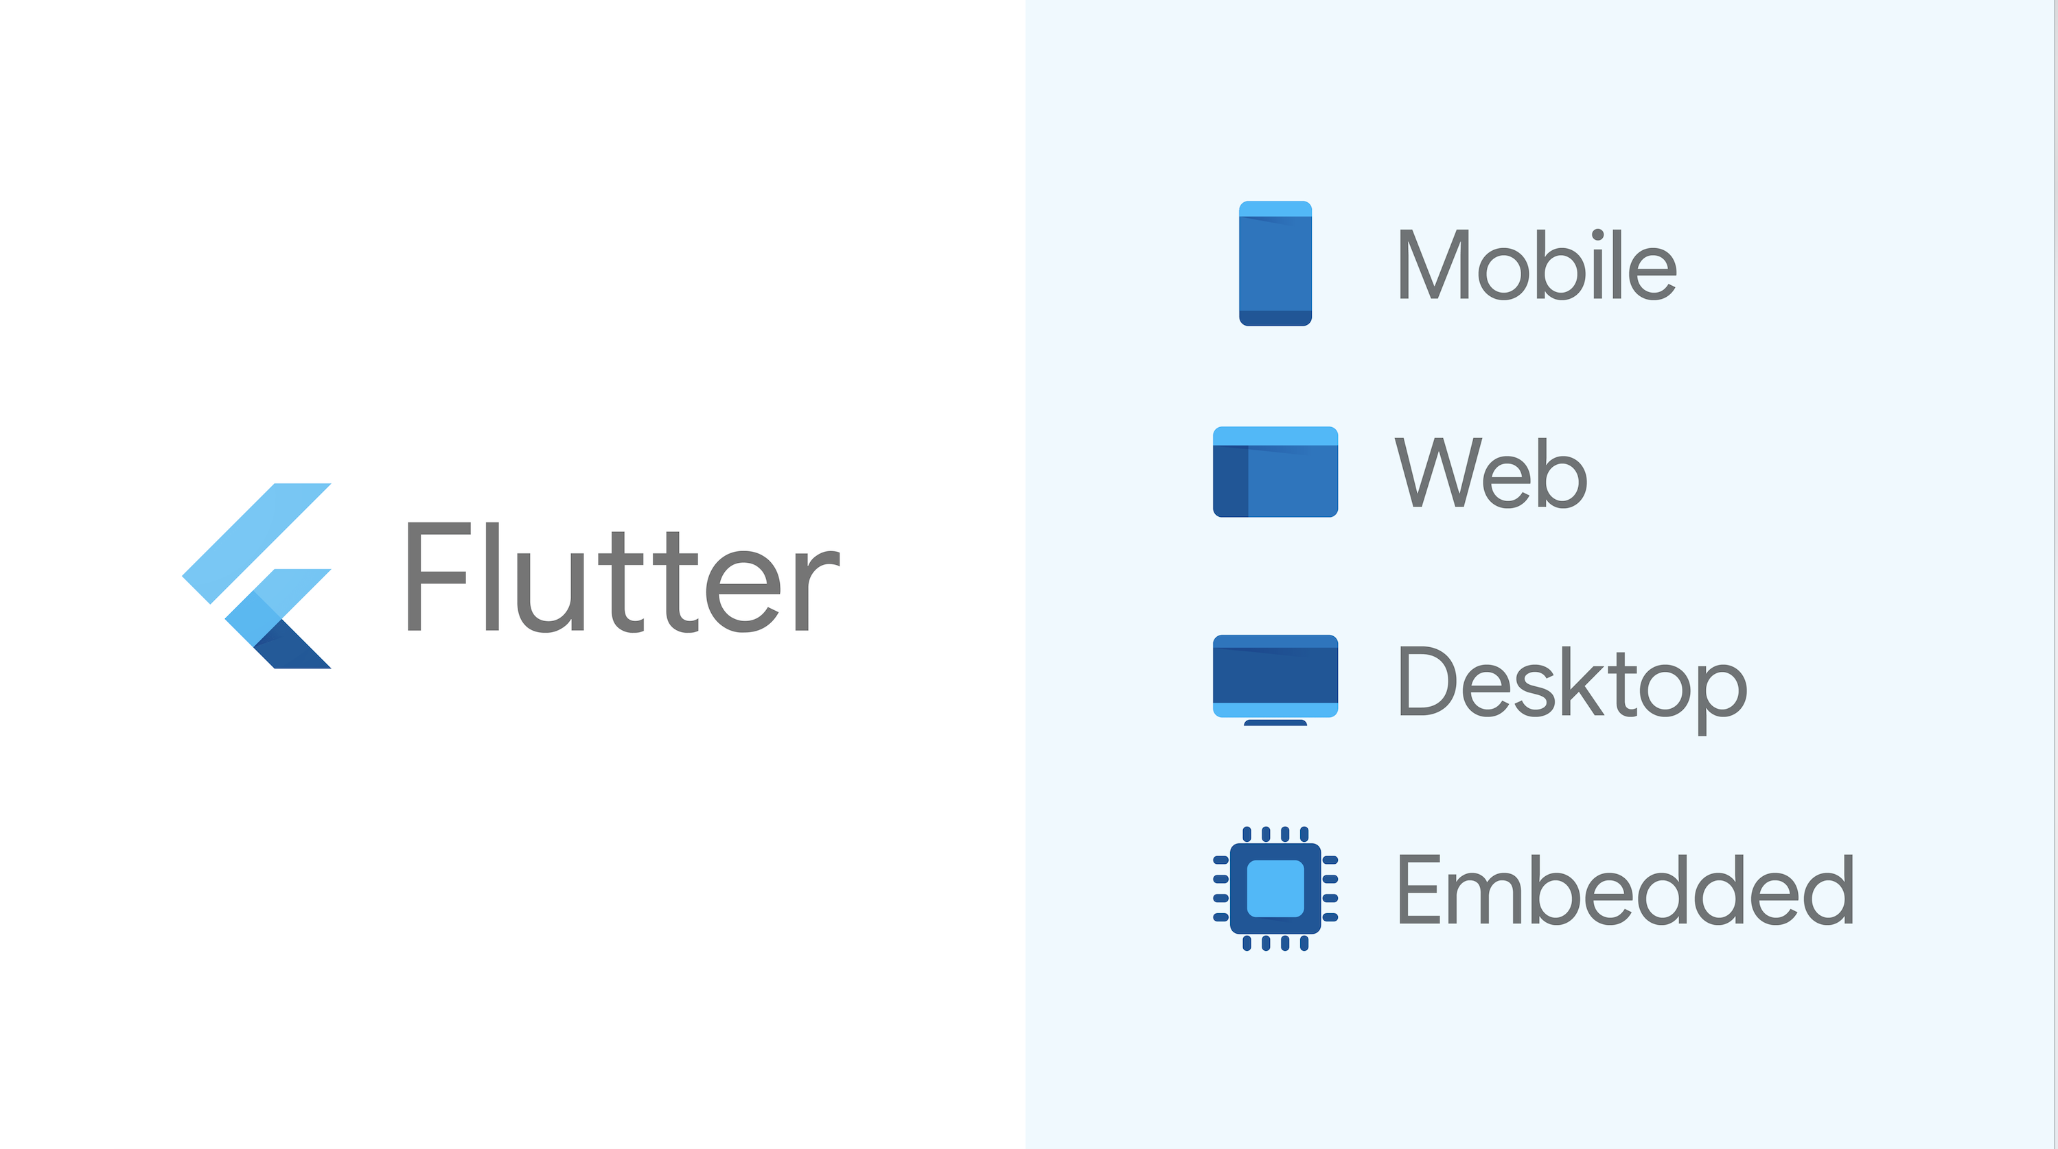
Solution For All

Slide 4
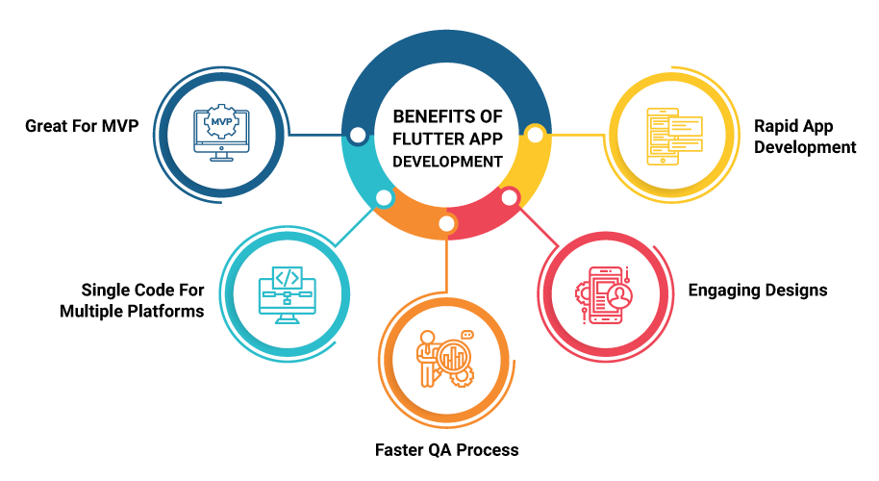
Flutter is Next Step in Cross-Platform Development

Slide 5
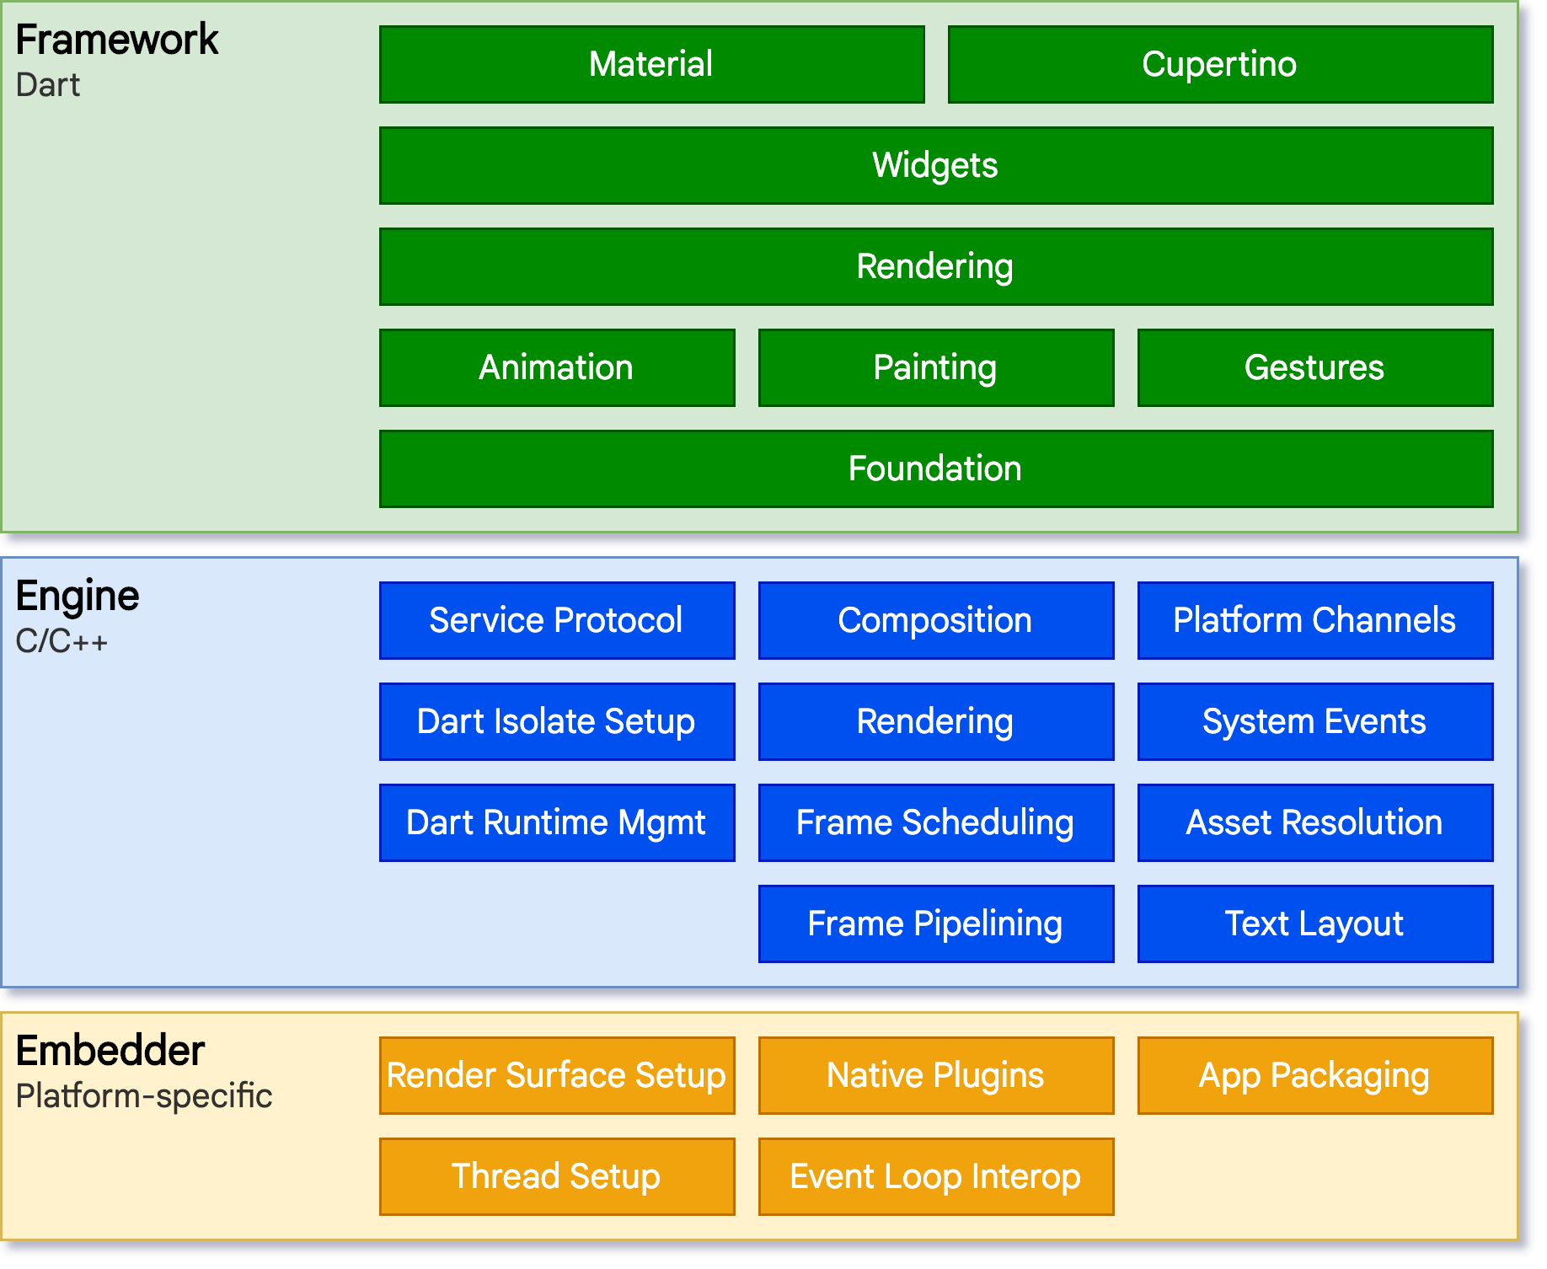
Flutter Architecture
Developers interact with Flutter through the Flutter framework, which provides a modern, reactive framework written in the Dart language. It includes a rich set of platform, layout, and foundational libraries, composed of a series of layers.
At the core of Flutter is the Flutter engine, which is mostly written in C++ and supports the primitives necessary to support all Flutter applications. The engine is responsible for rasterizing composited scenes whenever a new frame needs to be painted
Flutter code can be integrated into an existing application as a module, or the code may be the entire content of the application.

Slide 6


Why Flutter is in Dart?
OOP style language
High performance and avoids frame drop
Highly productive language, accelerates the coding process and makes the framework more attractive
Strongly typed language
Has many built in features like hot reload, code doc generation tool, tree shaking optimization etc.
Both flutter and dart are developed by google

Slide 7
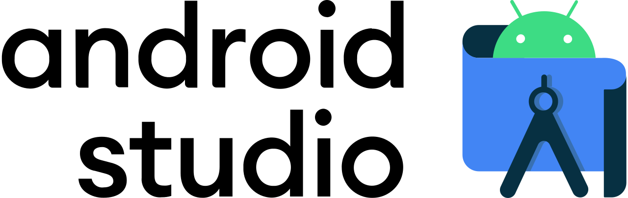
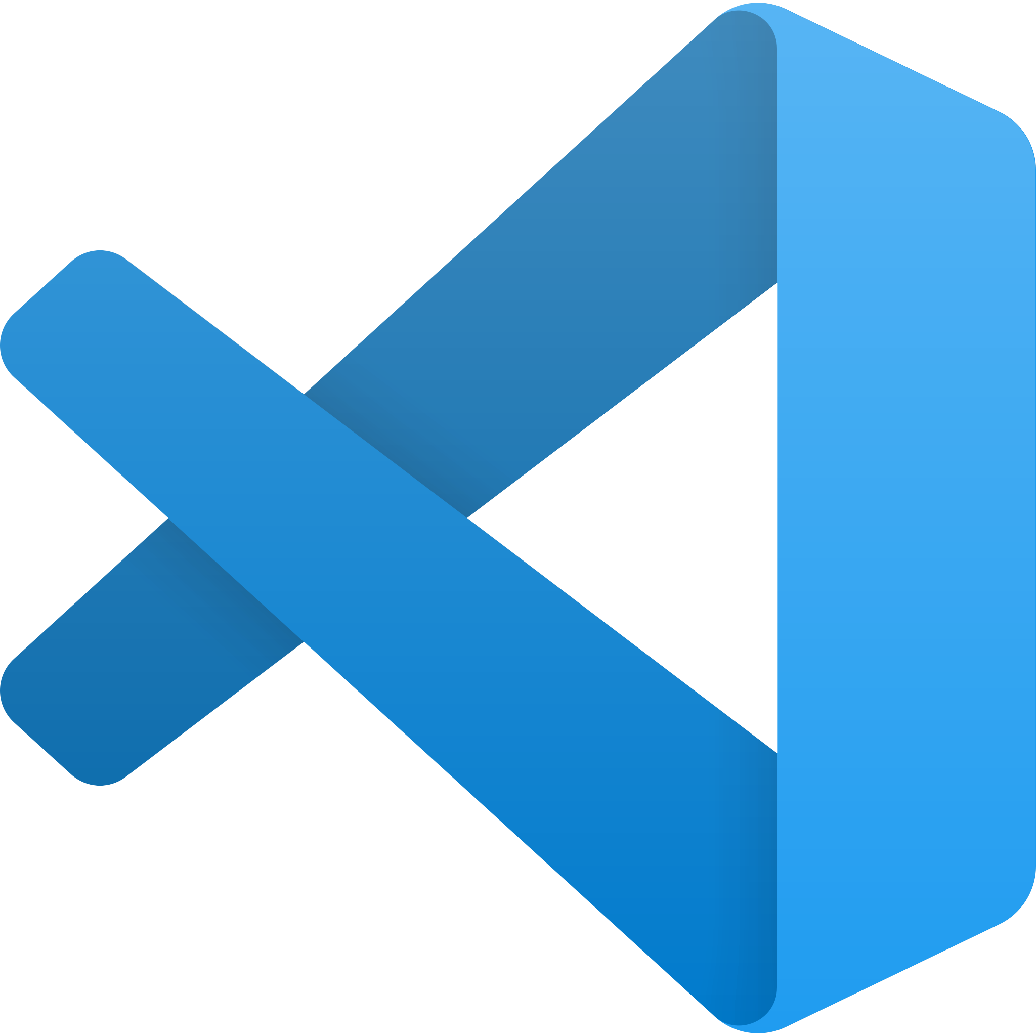
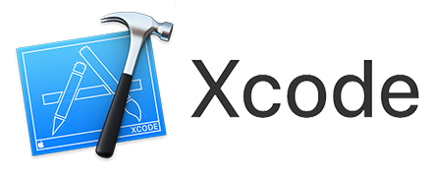
IDEs to use flutter
Visual Studio Code
Lets see a Cross-Platform Application

