Slide 1
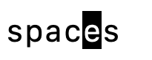

Slide 2


Slide 3


Slide 4


Slide 5
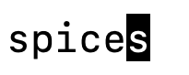

Slide 6
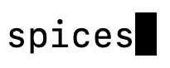

Slide 7


Slide 8


Slide 9
(hit the right arrow key to move the cursor forward…)
(hit the right arrow key to move the cursor forward…)
(hit the right arrow key to move the cursor forward…)
(hit the backspace key…)
(type “d”…)

