Slide 1

5 BEST MOVIES OF ALL TIME

Slide 2
What Makes Movies Great
Movies stand the test of time through multiple elements
Best films create indelible images
Great movies evoke powerful emotions
Top films tell unforgettable stories
Classic movies feature believable characters

Slide 3
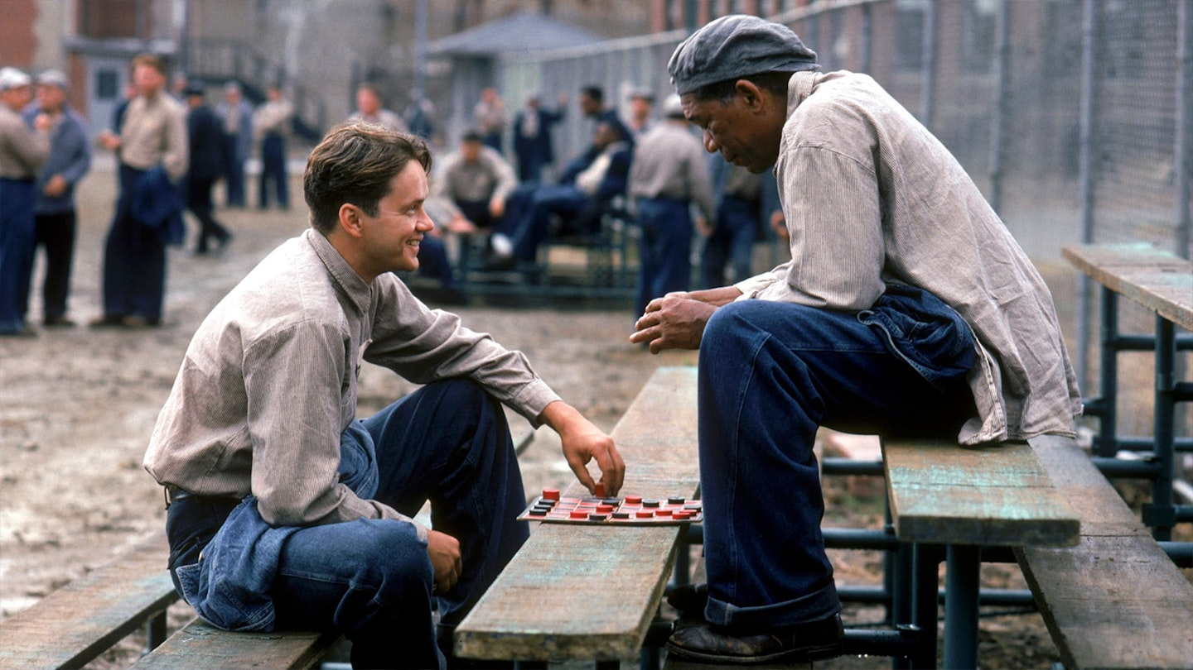
The Shawshank Redemption
Released in 1994
Prison drama film
Based on Stephen King's novella
Award-winning performance by Morgan Freeman

Slide 4
Director
Frank Darabont

Slide 5
Cast
Tim Robbins plays lead role
Morgan Freeman features in film
William Sadler part of cast

Slide 6
Shawshank Redemption Overview
Morgan Freeman's distinctive narration sets warm tone
Tim Robbins' performance evokes Gary Cooper-like qualities
Initially failed at box office despite later becoming beloved
Frank Darabont's directorial debut showcases masterful construction

Slide 7
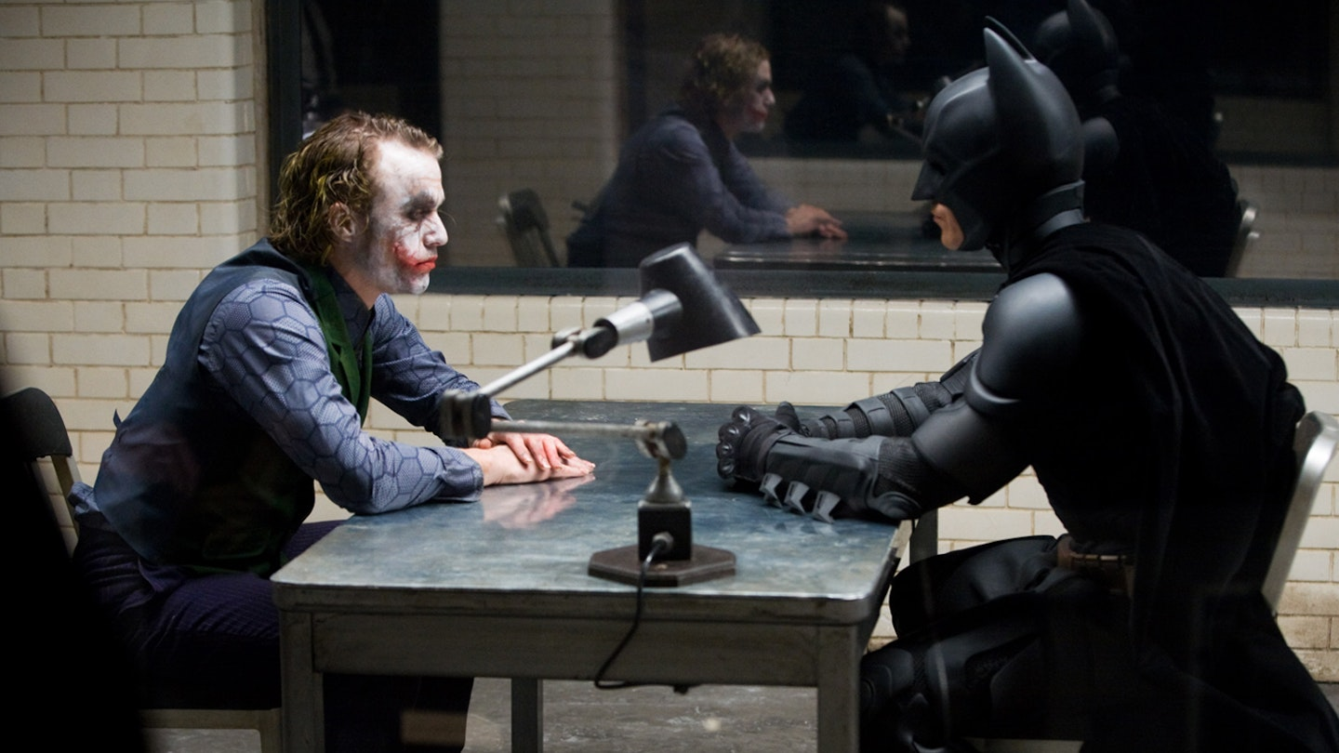
The Dark Knight (2008)
Second film in Christopher Nolan's Batman trilogy
Features Heath Ledger's iconic portrayal of The Joker
Released in 2008 to critical and commercial success
Stars Christian Bale as Batman/Bruce Wayne

Slide 8
Christopher Nolan - Director
Film director and screenwriter
Renowned for complex, non-linear storytelling
Known for directing major blockbuster films
Combines artistic vision with commercial success

Slide 9
Cast
Christian Bale
Heath Ledger
Aaron Eckhart
Maggie Gyllenhaal
Gary Oldman

Slide 10
The Dark Knight Overview
First Batman film without 'Batman' in title
Heath Ledger delivers transformative performance as The Joker
Reimagines Joker as chaos-driven terrorist in post-9/11 context
Opens with masterful clown-mask bank heist sequence
Combines crime saga elements with superhero genre
Directed by Christopher Nolan with no-holds-barred approach

Slide 11
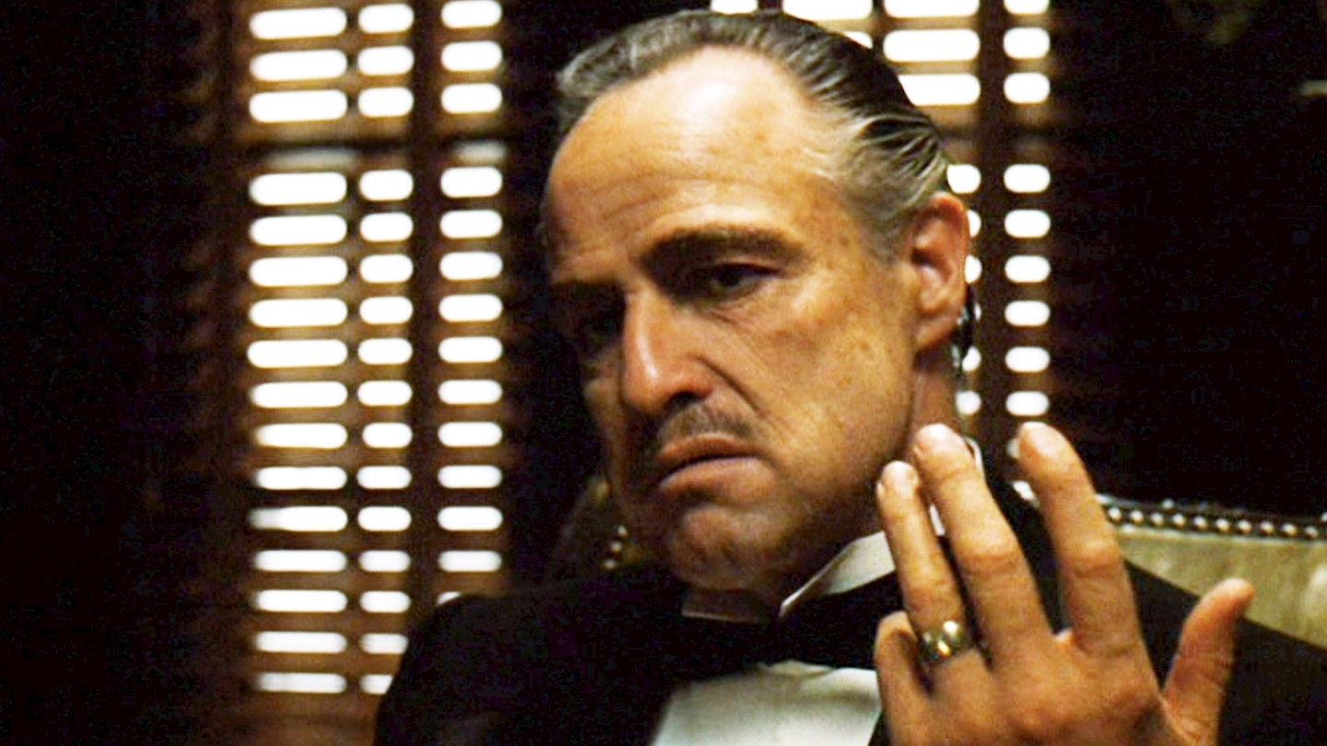
The Godfather (1972)
American crime film released in 1972
Directed by Francis Ford Coppola
Adapted from Mario Puzo's novel
Chronicles the Corleone crime family

Slide 12
Director Biography
Francis Ford Coppola
Acclaimed American filmmaker
Professional film director
Member of the New Hollywood wave of filmmaking

Slide 13
Cast Members
Marlon Brando leads the cast
Al Pacino in starring role
James Caan features prominently
John Cazale among key performers
Talia Shire completes main cast

Slide 14
The Godfather's Legacy
Praised by Stanley Kubrick as "best film ever made"
Successfully bridged arthouse drama and commercial blockbuster
Launched the era of mega-movies
Broke box office records while maintaining artistic merit
**Film's Cultural Impact**
Created iconic phrases like "Luca Brasi sleeps with the fishes"

Slide 15

Star Wars: The Empire Strikes Back (1980)
Second film in the Star Wars saga
Released in 1980
Sequel to Star Wars: A New Hope
Often considered the darkest entry in the original trilogy

Slide 16
Director
Irvin Kershner directed the film

Slide 17
Cast
Mark Hamill
Harrison Ford
Carrie Fisher
Billy Dee Williams
David Prowse

Slide 18
Star Wars: The Empire Strikes Back
Expanded and deepened the Star Wars galaxy universe
Directed by Irvin Kershner in collaboration with George Lucas
Features Luke's training with Master Yoda
Includes iconic "I am your father" revelation
Showcases advanced model work and visual effects
**Key Action Sequences**

Slide 19
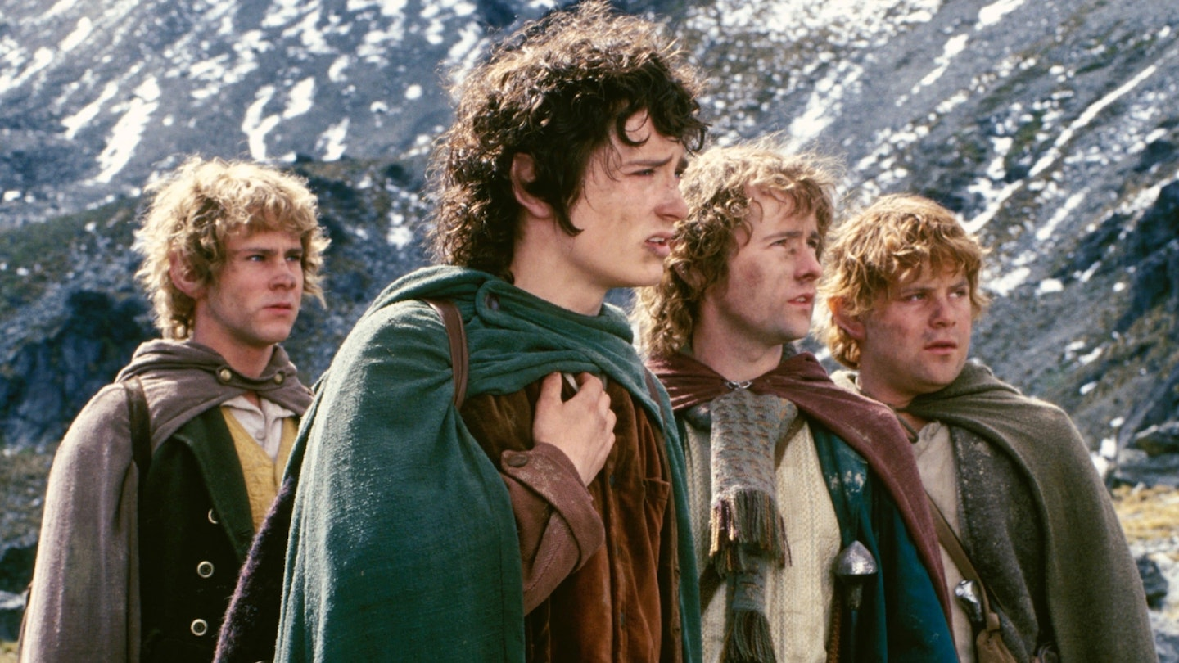
The Lord of the Rings: The Fellowship of the Ring
Released in 2001
First film in The Lord of the Rings trilogy
Directed by Peter Jackson
Based on J.R.R. Tolkien's novel

Slide 20
Director Peter Jackson
Film director from New Zealand
Directed The Lord of the Rings trilogy
Known for epic fantasy adaptations
Award-winning filmmaker

Slide 21
Cast of The Lord of the Rings
Elijah Wood
Sean Astin
Ian McKellen
Viggo Mortensen
Orlando Bloom
Sean Bean

Slide 22
The Fellowship of the Ring's Impact
Peter Jackson's fantasy film took 20 years to reach top position in movie rankings
Film delivers exceptional amount of content even by midpoint at Rivendell
Combines multiple elements: thrills, suspense, jollity, and ethereal beauty
Surpasses standard film expectations in scope and content
Story continues to expand beyond already rich midpoint

Slide 23
Fellowship's Enduring Legacy
Masterwork featuring ornate detail and emotional depth
Perfect reflection of modern times with focus on perseverance
Heroes defined by determination rather than strength
Celebrates those who continue despite adversity
Sets gold standard for cinematic storytelling and filmmaking

