Slide 1
Lending Club Case Study
by Saquib Shaikh & Abhilash Radhakrishnaru
February 2023

Slide 2
Problem Statement
When the company receives a loan application, the company has to make a decision for loan approval based on the applicant’s profile.
Two types of risks are associated with the bank’s decision:
If the applicant is likely to repay the loan, then not approving the loan results in a loss of business to the company
If the applicant is not likely to repay the loan, i.e. he/she is likely to default, then approving the loan may lead to a financial loss for the company

Slide 3
Approach
Data Sourcing (loan.csv)
Data cleaning
Perform Univariate Analysis
Perform Bivariate Analysis
Perform Multivariate Analysis
Consolidate Observations & Recommendations

Slide 4
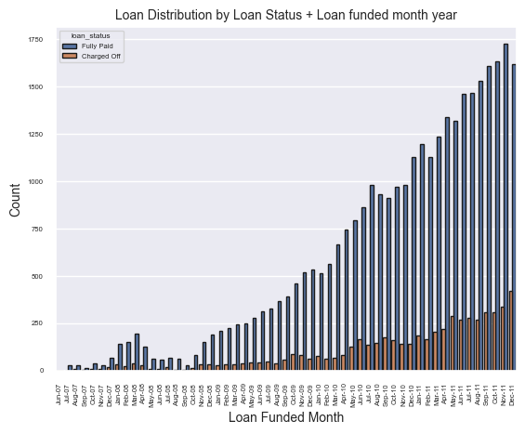
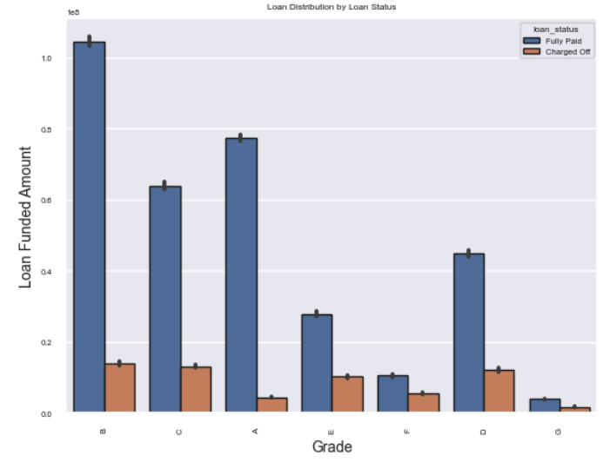
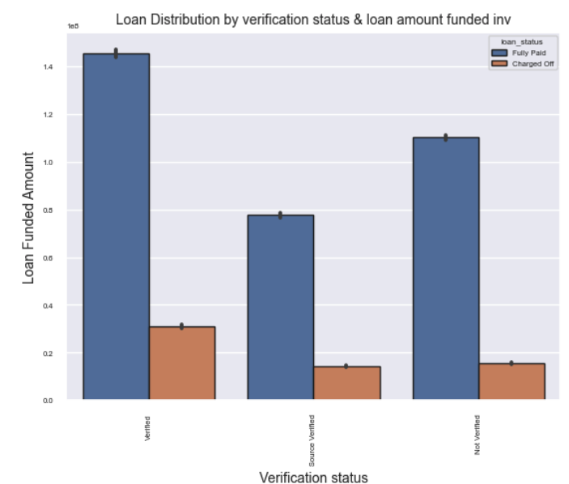
Keep Doing… Positive signs!
Loan amount and number of loans are
increasing month over month
More loans have been given in the A, B & C grades which are relatively better grades with respect to risk & volatility
Income Source verified by LC has the highest number of loans

Slide 5
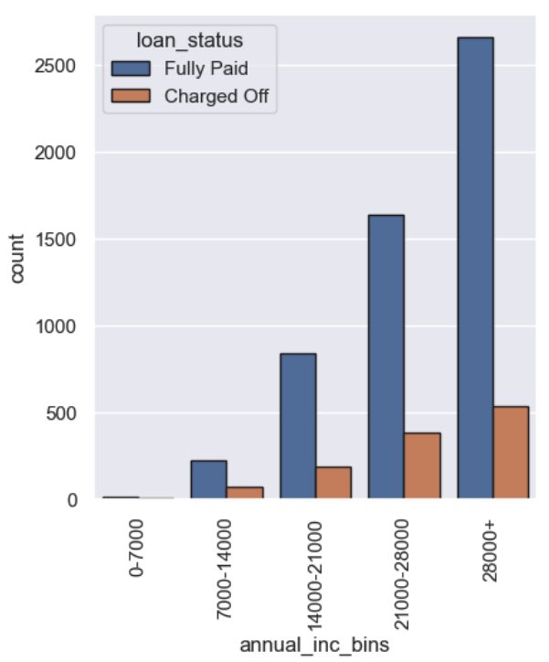
Keep Doing… Positive Signs!
More loans are given to the highest income group( more than 28000)

Slide 6
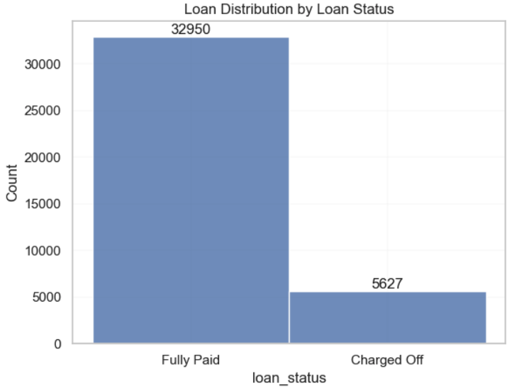
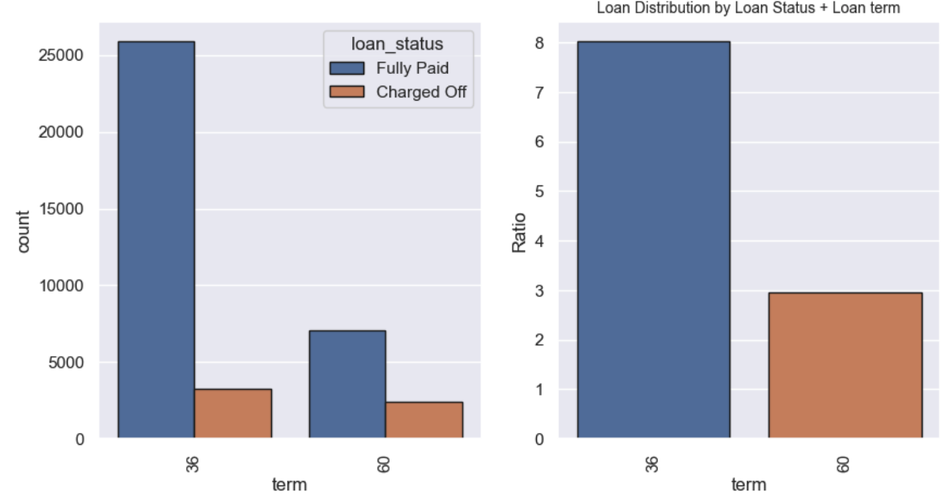
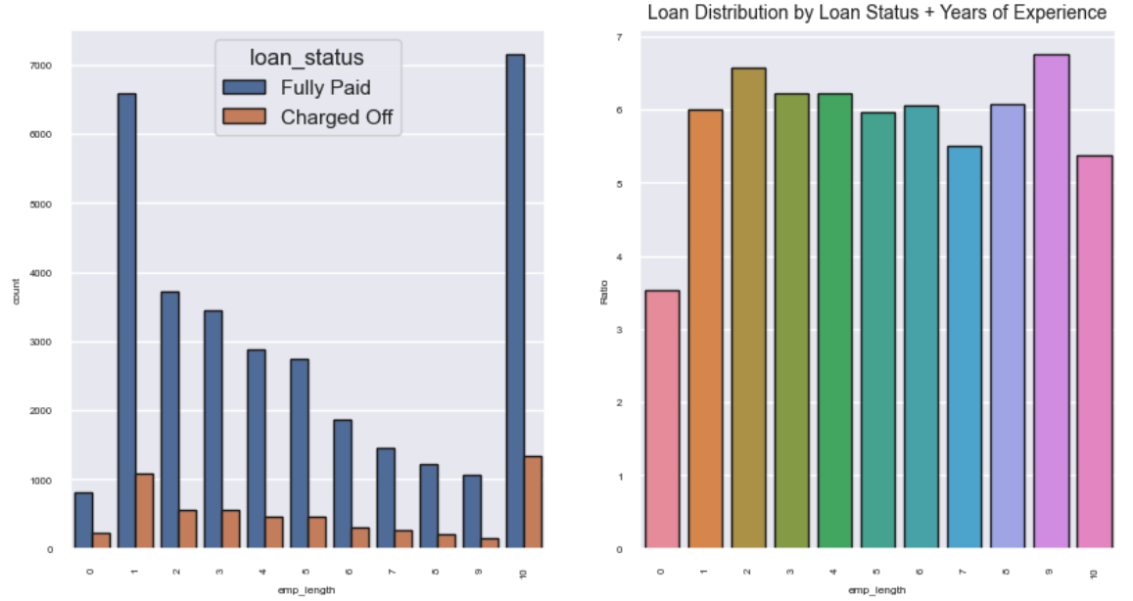
Concerns / Scope for Improvement
Around 15% loans disbursed are Charged Off.
High rate of default for 60 month term loans
Loans given to borrowers with less than 1yr experience shows highest percentage of ChargedOff

Slide 7
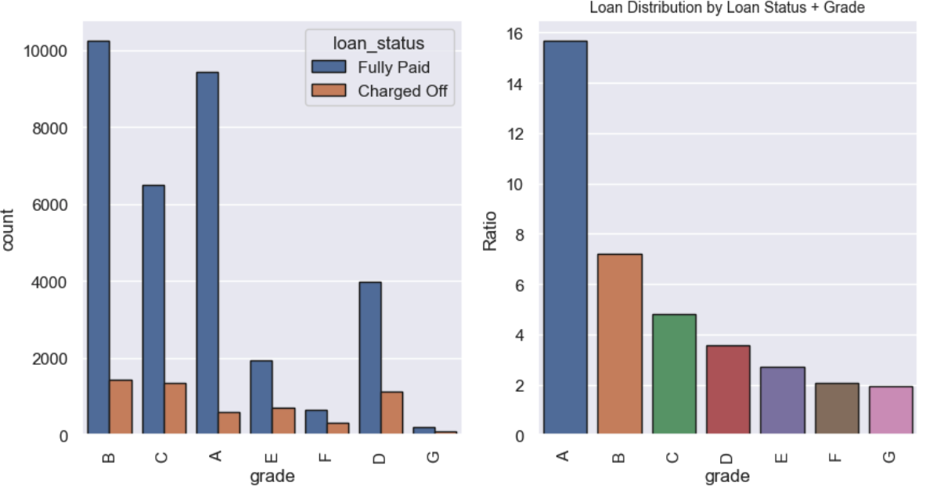
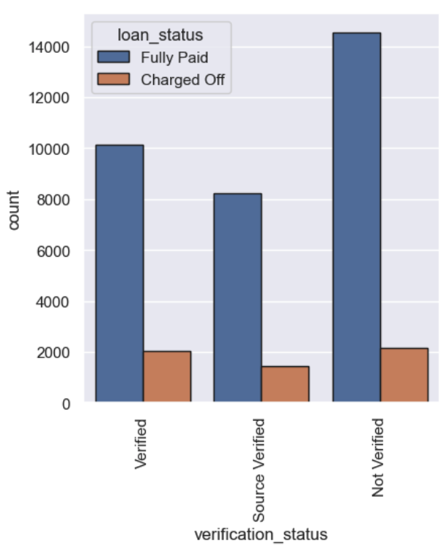
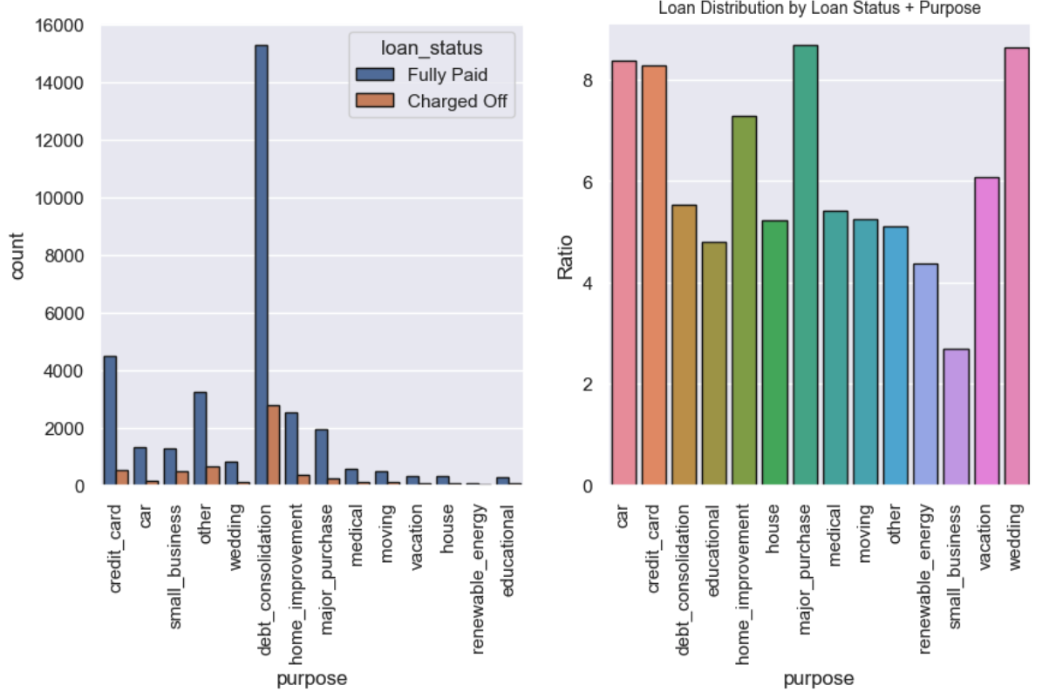
Concerns / Scope for Improvement
Loans given to E, F, & G grades shows highest rate of Charged Off
More number of loans are given to ‘income source not verified’ category
High rate of ChargedOff for loans given to ‘small business’ category (though the total loans given is less)

Slide 8
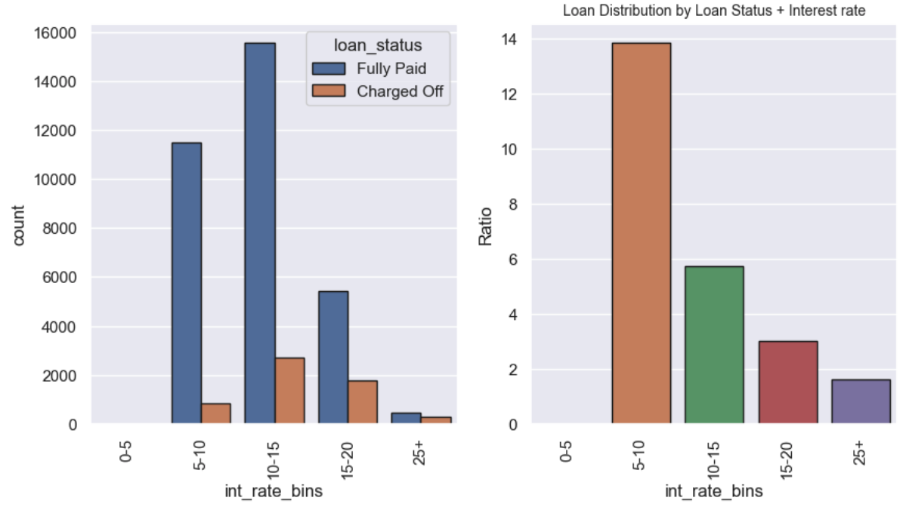
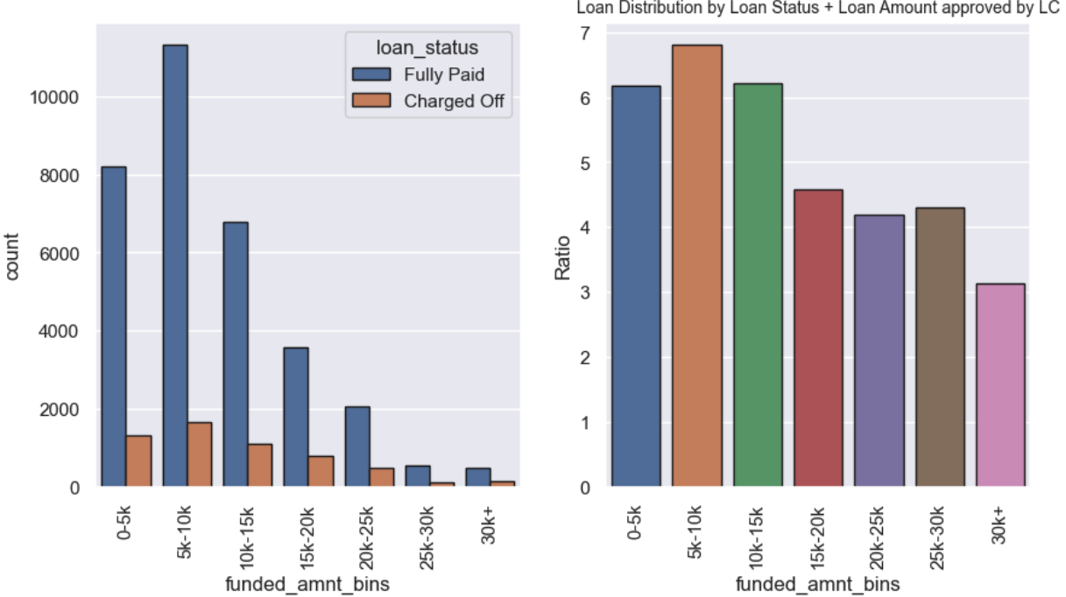
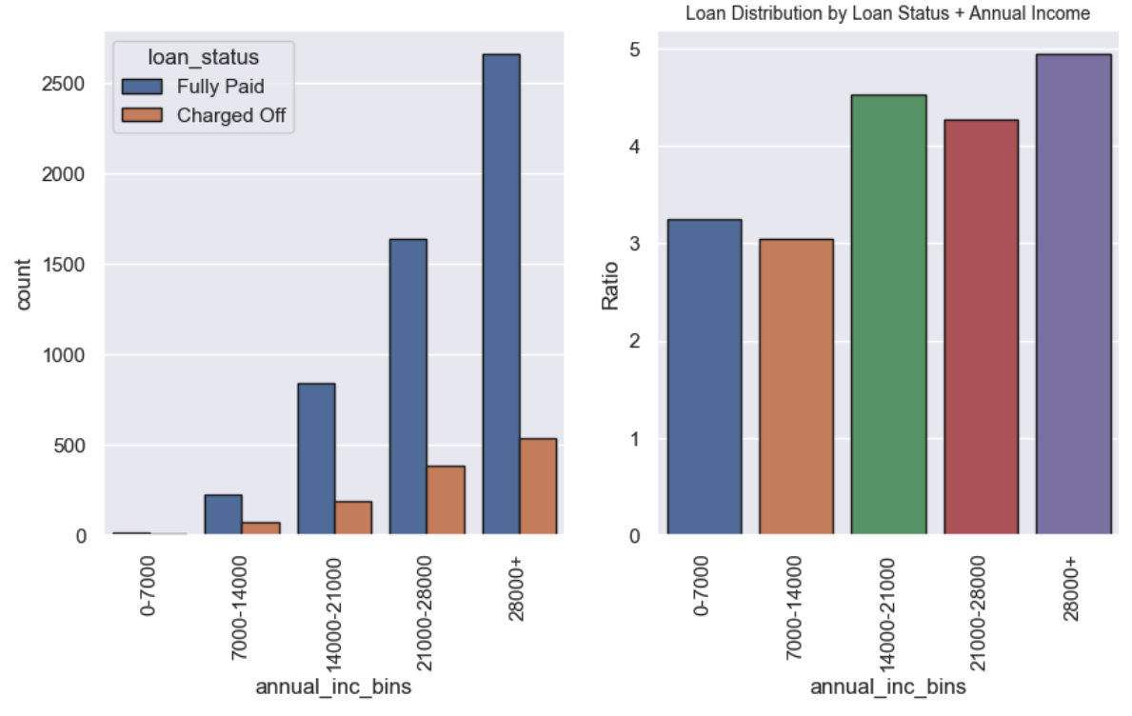
Concerns / Scope for Improvement
High interest rate has high chance of ChargedOff
Borrowers with amounts more than 30000 has the highest percentage of default
Borrowers with lower income has the highest ChargedOff ratio.

Slide 9
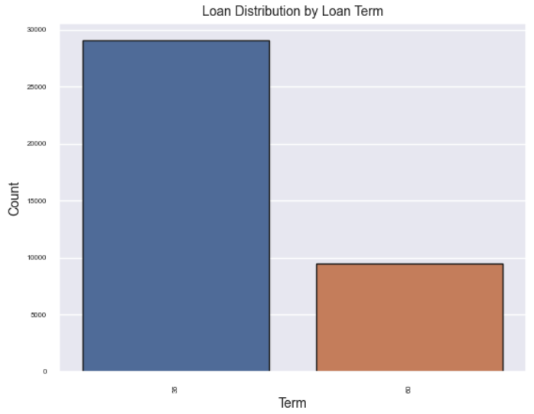
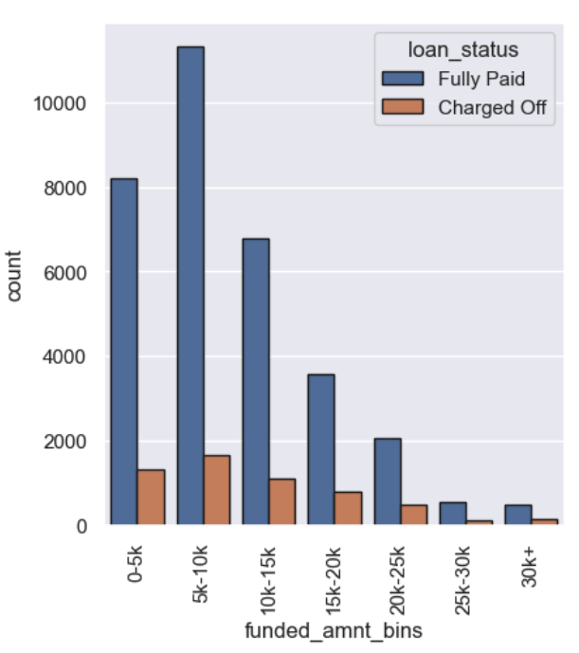
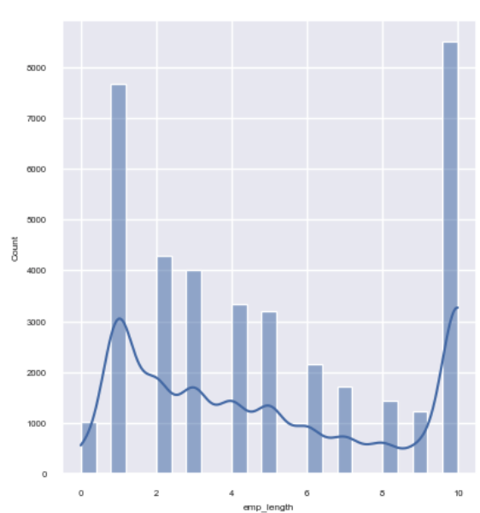
Observations
More loans are given for 36 month term(compared to 60 month term)
More demand for loan amounts in the 0 – $15000 range
Borrowers with 1yr experience and 10+ years of experience has high demand for loans

Slide 10
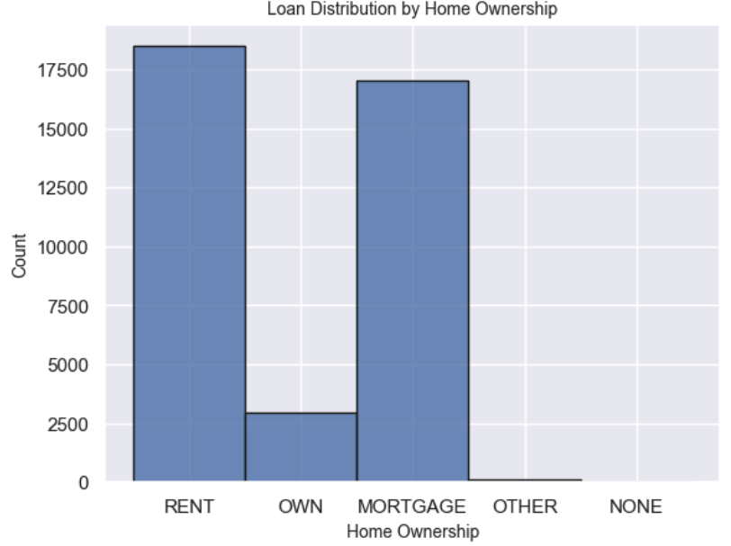
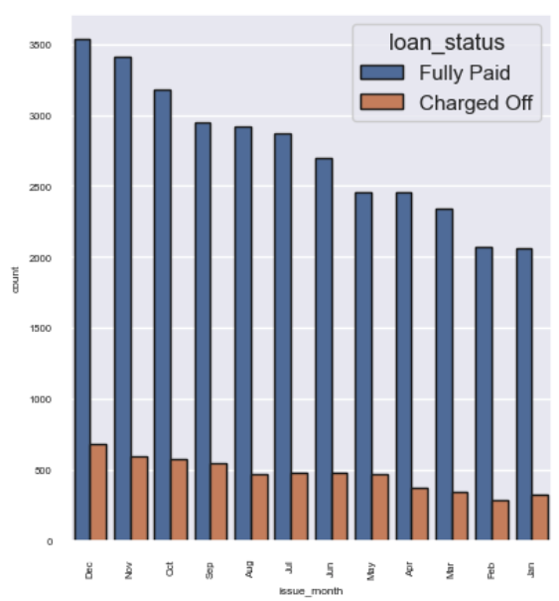
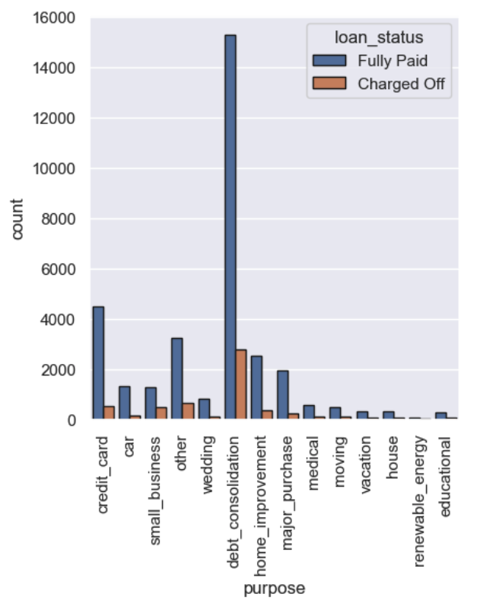
Observations
Borrowers staying for RENT or having mortgage are the highest takers of loan
More loans are given in the month of December. There is an increasing trend in loan from Jan to Dec
More loans given for ‘ debt consolidation’ purpose, followed by credit card

Slide 11
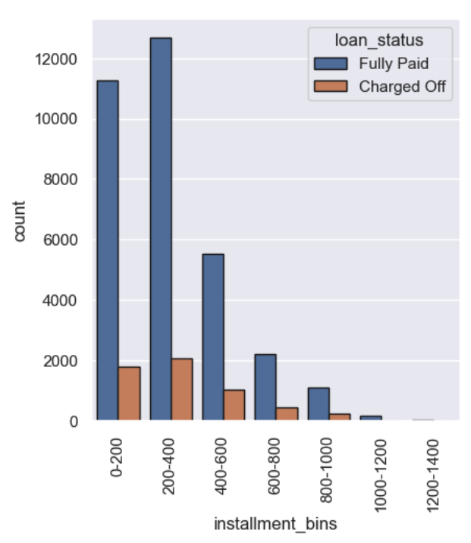
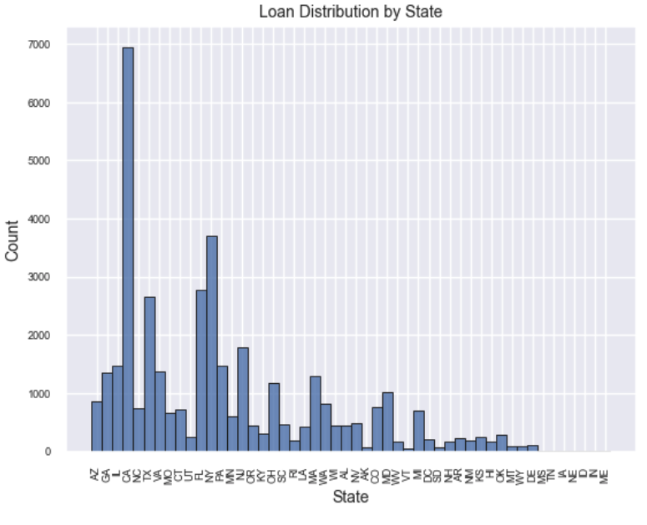
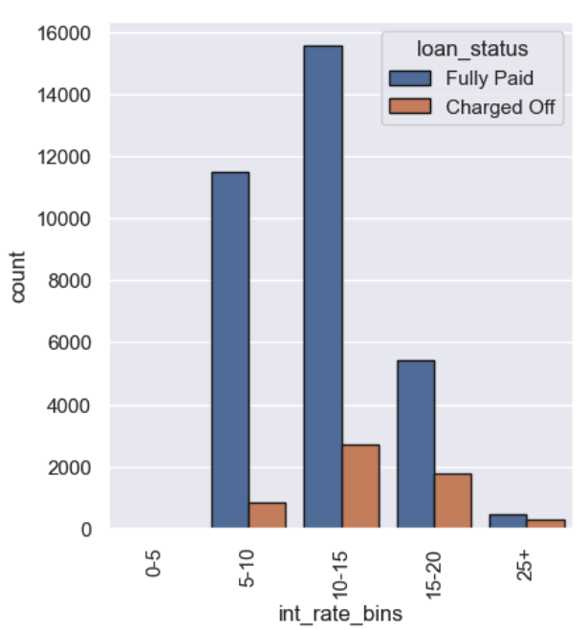
Observations
Number of instalments ranging from 0-400 has the highest demand
State of California having the highest number of loans
Interest in the 5-15% range has the number of highest takers

Slide 12
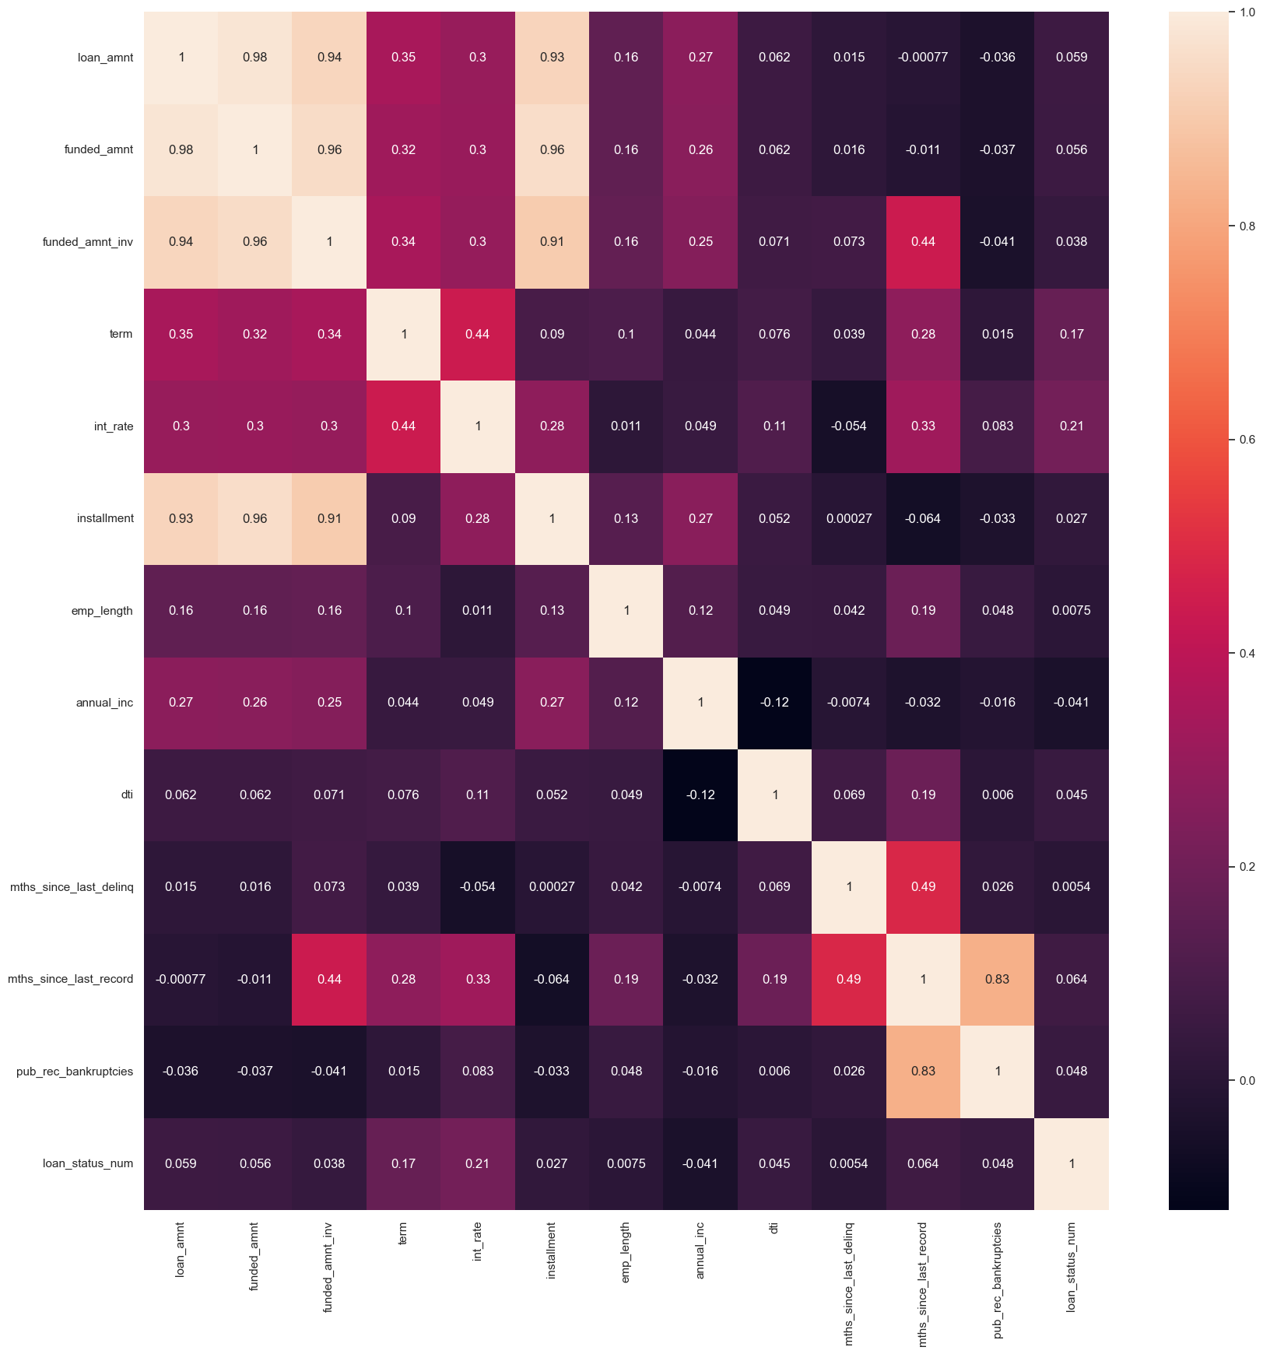
Observations
loan amount, funded amount & funded amount invoiced has a strong correlation
loan amount also has positive correlation with instalments, loan term, years of experience and annual income
term has correlation with years of experience and loan status
interest rate has correlation with term, instalments, dti and loan status
instalment has correlation with years of experience, annual income
Annual income has positive correlation with dti

Slide 13
Recommendations
At the time of approving/rejecting loan, consider below points
High repayment term has highest risk
Applicants with less than 1 year of experience are risky
Consider Grade of applicants. A, B & C grades are comparatively safer
Applications with purpose ‘Small Business’ are riskier than others
Higher the rate of interest higher the chance of ChargedOff
Loan amounts more than 30000 has high rate of ChargedOff
Giving loan to lower income group(below 14000) is risky

Slide 14
Thank You

