Slide 1
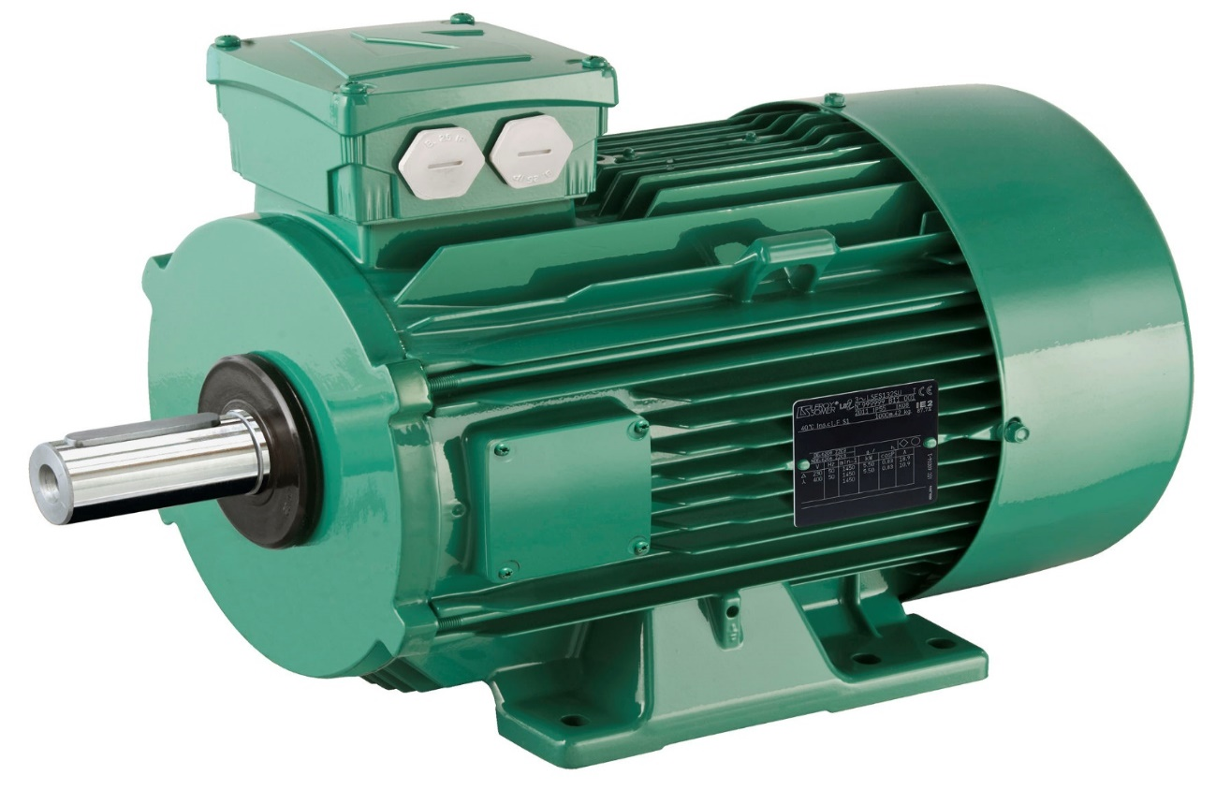
Electric Motors
Written By Sarthak Nadkarni

Slide 2
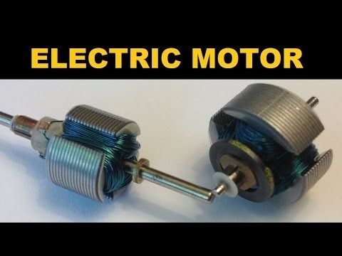

Slide 3
What Is An Electric Motor ?
Converts electrical energy into mechanical energy
They are powered from batteries
Produce Linear or Rotary Force
They operate between motor’s magnetic field
Are classified as power source type
Can be distinguished from magnetic solenoids

Slide 4

Who would use this product?
Engineers
Device builders
Furnace builders

Slide 5
Why would someone use this product and why someone wouldn’t
It has an excellent speed control
A great efficiency in operation
It is a bit expensive
Sometimes hard to control the system

Slide 6
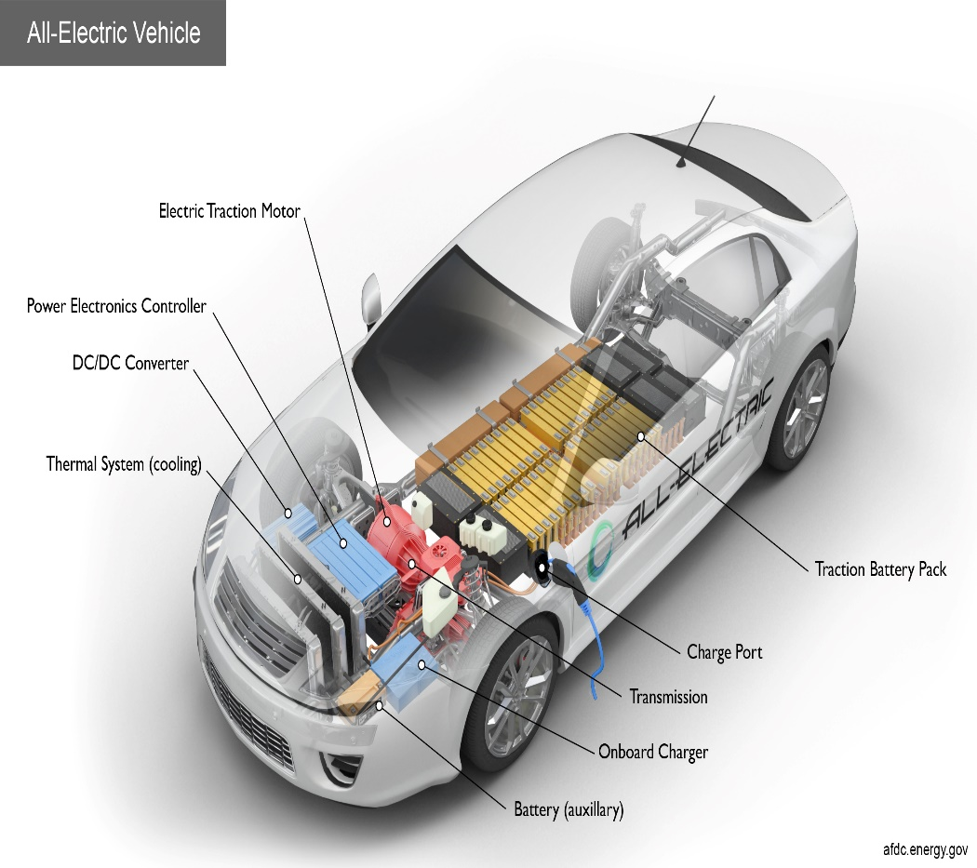
How are electric motors useful in society?
Use it for cars, trucks, etc
Use it for household appliances
Use it for electrical appliances
Use it for Robots

Slide 7
Why I chose this product?
It felt really interesting
It was something I didn’t know
Something that not many people know

Slide 8
Questions
1. In what year were electric motors invented and who invented it?
Thomas Davenport invented
It in 1832-1834

Slide 9
Questions:
2. How much do electric motors cost
About $70,000
In total

