Slide 1
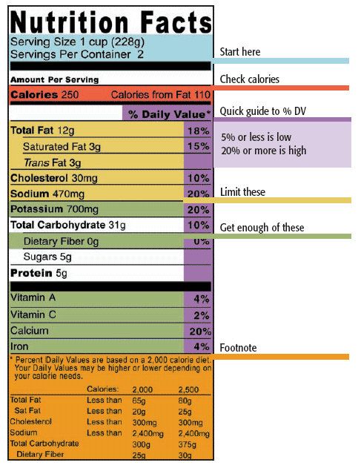
Food Labels
Ms. Wheeler
Career Life Education 10

Slide 2
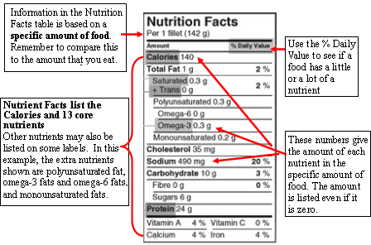
How to read a food label

Slide 3
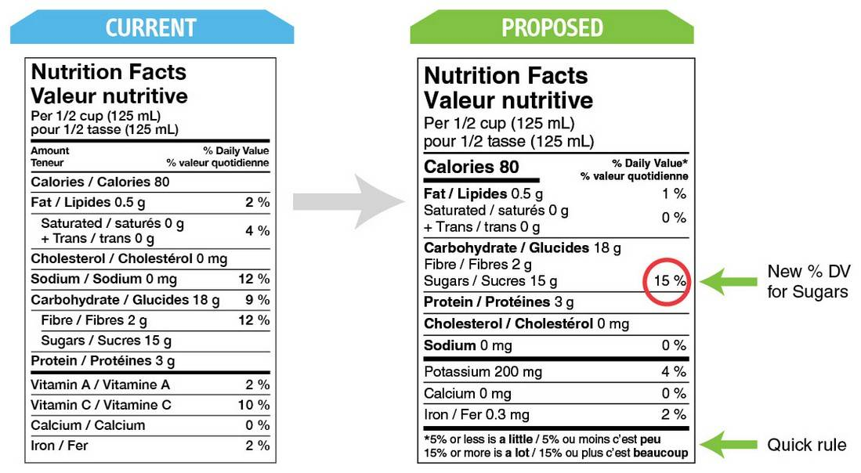
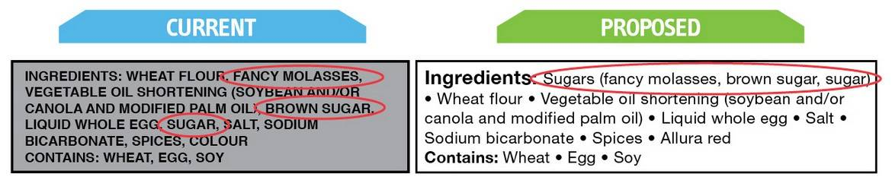
Current and Proposed Food labels
http://globalnews.ca/news/2048822/new-proposed-nutrition-labels-give-food-industry-a-free-pass-doctor/

Slide 4
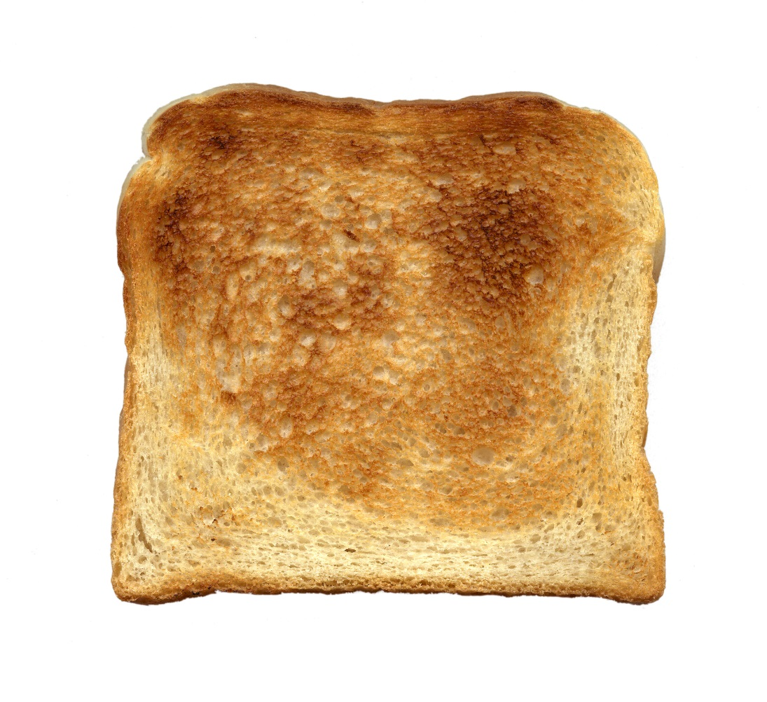
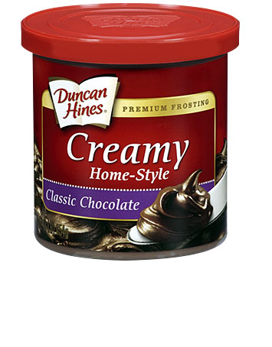
Anyone eat icing on their toast?

Slide 5
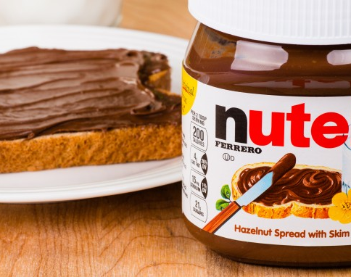
Nutella
1 serving is a tablespoon
2 ½ hazelnuts
3 tsp of sugar
¼ tsp of cocao
1/8 tsp of milk powder

Slide 6
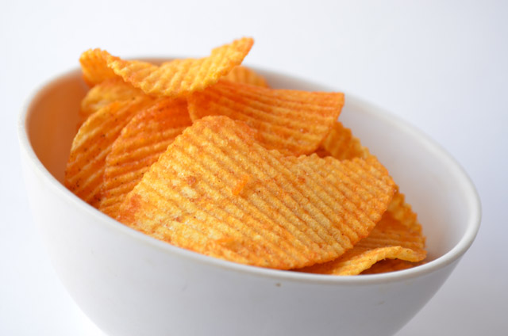
How about some potato chips for lunch?

Slide 7
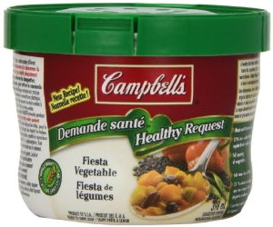
Campbell’s Healthy Request
Has the same amount of salt as a large bowl of potato chips
Label shows nutritional information for half the serving size of this can of soup
Would you only eat half of this can in one sitting?

Slide 8
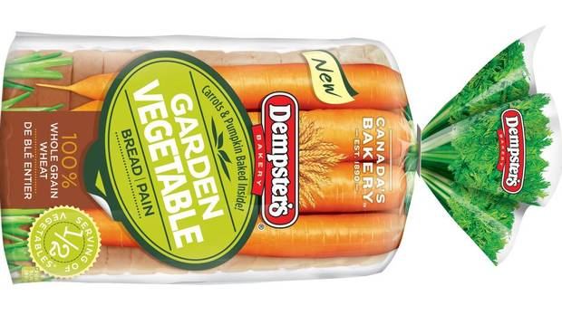
Do your vegetable servings come from bread?

Slide 9

Dempster’s Garden Vegetable Bread
Claims ½ a serving of vegetables in 2 slices of bread
You would need to eat the entire loaf of bread to get the same amount of vitamin A in a finger sized carrot.
Notes:
There may very well be an entire carrot in two slices of this bread but by the time the carrot is mashed up and baked in, the vitamins and nutrients you would get from a raw carrot are gone.

Slide 10
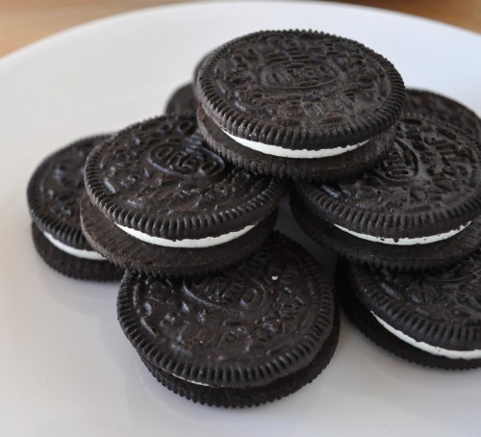
Healthy snack?

Slide 11
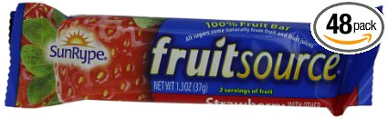
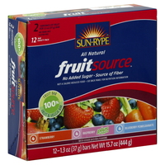
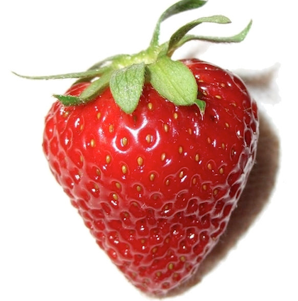
SunRype Fruit Bars
Contain the same amount of sugar as 6 ½ oreo cookies
You would have to eat 6 bars to get the same Vitamin C as 1 strawberry!
Notes:
The processing of fruit changes its nutrition!

Slide 12
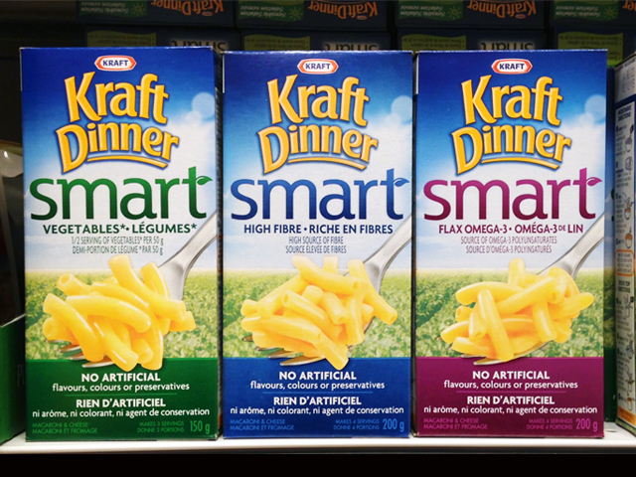
Healthy Dinner?

Slide 13
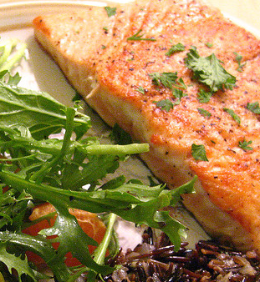
Kraft Smart Dinner
Would need to eat 44 boxes of Kraft Dinner to get the same amount of Omega 3 as a piece of salmon

