Slide 1

Mental Health:

Slide 2
What comes to mind when you hear the words, “Mental Health”?
Notes:
Crazy
Stupid
Suicidal
Good mental health – means we can cope with stress and adversity in a healthy way

Slide 3
What movies, TV programs, public awareness campaigns have you seen that are related to mental illness?
http://en.wikipedia.org/wiki/List_of_films_featuring_mental_disorders
http://www.youtube.com/watch?v=MyaTzth71bQ

Slide 4
Mental Health
A state of well-being in which the individual realizes his or her own abilities, copes with the normal stresses of life, works productively and contributes to his or her communities.

Slide 5
About mental health
About one in five individuals in BC will experience significant mental health and/or substance use problems leading to personal suffering and interference with life goals.

Slide 6
Children’s mental health disorders
Serious behavior & emotional problems
Bullying, violence, fire-setting
Depression, suicide attempts, self-harm
Defiance, disruptive behaviour
Anxiety, post-traumatic stress (e.g. related to violence or abuse), obsessive-compulsive
ADD/ADHD and related school problems
Substance abuse & addictions
Other Child & Adolescent Psychiatric disorders
Schizophrenia
Bi-polar (manic-depressive)
Anorexia & bulimia
Autism spectrum … etc.

Slide 7
Suicide
Suicide is the 2nd leading cause of death among 10-24 year olds (24% of all deaths)
Hospitalization rates for suicide attempts by 15-19 year old Canadians are 73% above the average for all age groups
In a study of adolescent suicide, at least 78% of subjects saw a physician in the year before their suicide, but only 12% received medical intervention for a psychiatric issue⁷

Slide 8
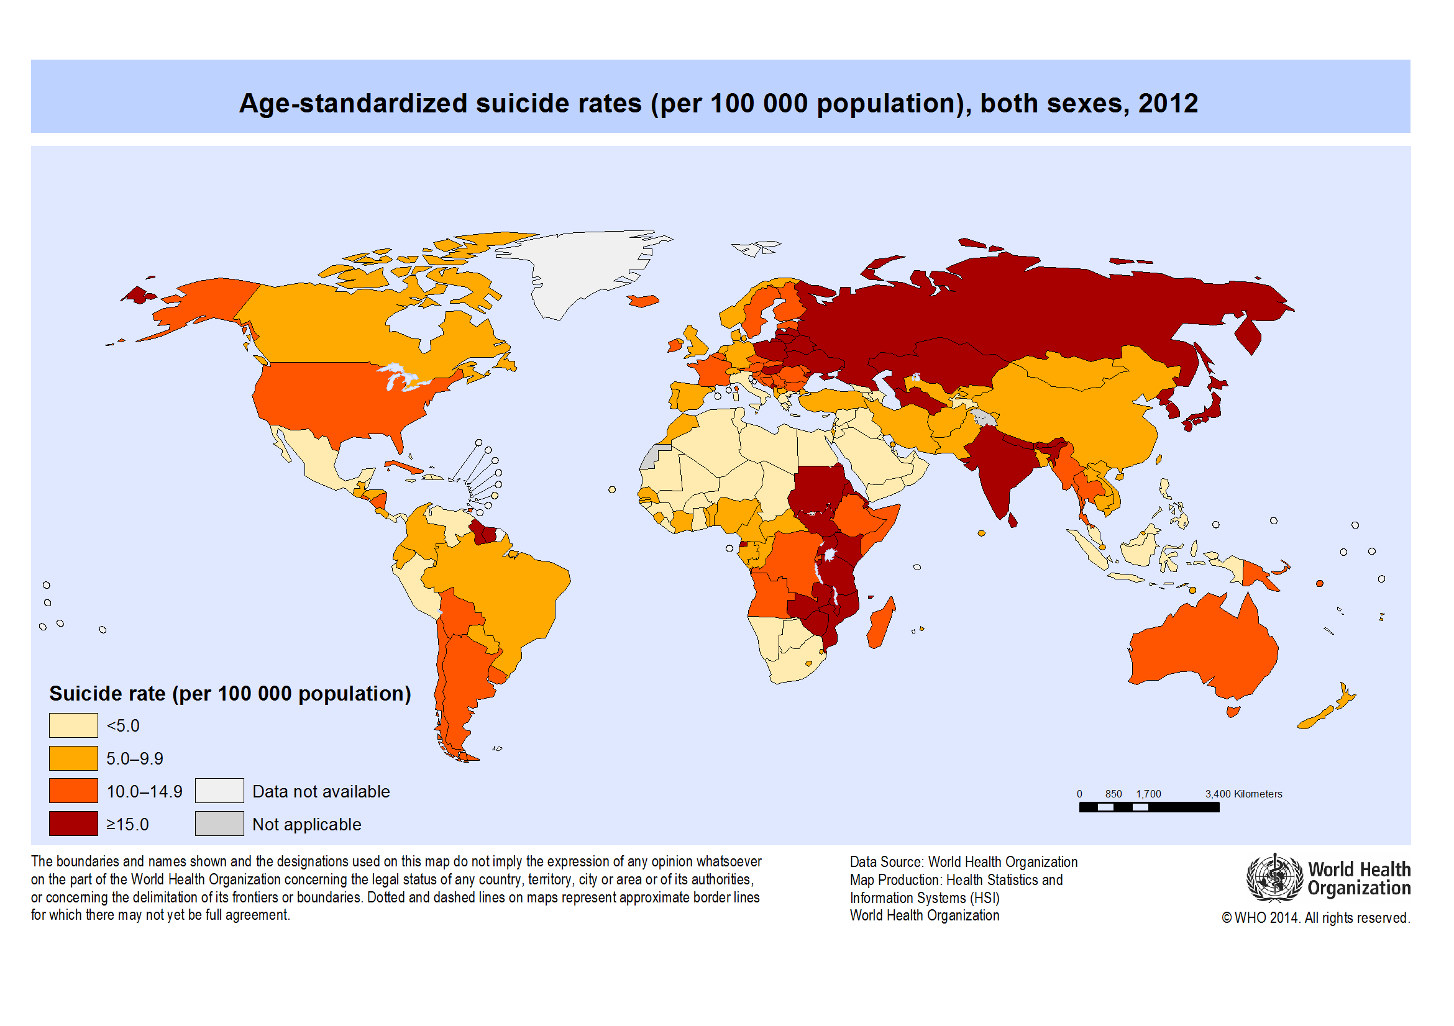
Age- Standardized Suicide Rates (Per 100,000 population), both sexes 2012 images

Slide 9
Mental health & education
Children whose mental health problems are untreated disrupt classes, bully other students, abuse drugs & alcohol, engage in vandalism, etc.
Boards have cut back special education, social workers and counselors
Poor grades and dropping out are strongly correlated with mental health problems¹⁰

Slide 10
Early treatment is an investment
75% of 21 year olds with mental health problems had prior problems¹⁶
“When children with disorders are not effectively treated, they do not shed problems as they grow, but become more vulnerable and less resilient as they approach adulthood – a pathway that can result in adult mental ill-health, involvement with the law, and homelessness.”¹⁷
For half of Canadians affected by depression, symptoms start before age 20; the average age for onset of anxiety disorders among Canadians is 1218

Slide 11
Signs of Poor Mental Health
Loss of interest in activities previously enjoyed
No longer wanting to be around family and friends
Feeling worried or stressed

Slide 12
Experiences that can knock a person “off balance”
Worrying about schoolwork
Losing a friend
Getting a poor mark
Family problems
Being bullied
Physical accident
Alcohol or drug use
Money problems

Slide 13
Summary
We all experience feelings as part of our daily lives and these feelings can range from mild to intense
Its important to be able to identify what we’re feeling
There are times when feelings can overwhelm us
It’s okay to talk about how were feeling – it can help us feel better and understand why we’re feeling this way.

Slide 14
Notes
Ontario Child Health Study, 1989/Statistics Canada, 2003
Ontario Provincial Auditor, 2003
Health Canada, 1998
Ministry of Children and Youth Services estimates, vote 3702 (2004-05); CMHO member survey, 2003; Children’s Hospital of Eastern Ontario, 2003-04 Annual Report
World Health Organization
UNICEF
Adolescent Suicide in Quebec and Prior Utilization of Medical Services, Canadian Journal of Public Health, September-October 2004
Canadian Council for Social Development, 2002
Wright, 1996
Stein Hauer, 1998
Ministry of Public Safety & Security, 2000
Stein Hauer, 1998
Stein Hauer, 1998
Ontario Association of Children’s Aid Societies, December 2003
Leached, Chiodo, Whitehead & Hurley, 2003

Slide 15
Notes (2)
16. Canadian Mental Health Association, 2003
17. B. Wattie, 2003
18. Global Business & Economic Roundtable on Addiction & Mental Health, 2005
19. Ontario Provincial Auditor, 2003
20. Standard Client Information System, 1999
21. US Surgeon General, Children and Mental Health, 1999
22. Network, Canadian Mental Health Assn, Fall 2003
23. CMHO member survey, 2003
24. Statistics Canada, 2003
25. Kates, Fugere, Farrar, CPA Bulletin, April 2004
26. Ontario Provincial Auditor, 2003
CMHO member survey, 2003
http://www.health.gov.bc.ca/library/publications/year/2010/healthy_minds_healthy_people.pdf

