Slide 1

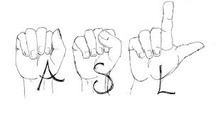
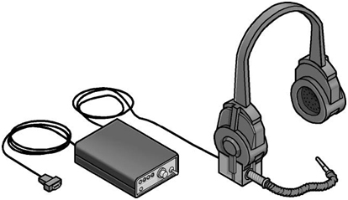
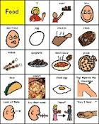
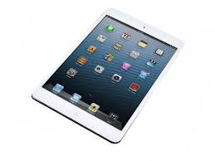
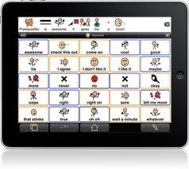
ALTERNATIVE AND AUGMENTATIVE COMMUNICATION

Slide 2
Communication
Kurzweil
PECS
Dragon Naturally
AbleNet
fingerspelling
Boardmaker
ASL
JAWS
Clicker
DynaVox
IPAD
Inspiration
Notes:
l

Slide 3
What is Communication
⦁ to send or receive messages to at least one
other person through verbal, non verbal or
visualization methods
⦁ Those with access to communication:
- develop language skills
- decrease frustration
- increase socialization
- increase participation
- have control over what happens to them

Slide 4

What is Alternative & Augmentative Communication?
Alternative - a choice or substitute method
using it to speak by pointing to
symbols, signing or by spelling
⦁ Augment - to add to or enhance using
gestures, eye pointing and body
language
⦁ Communication - facilitating spoken language

Slide 5
The Evolution of AAC
5th Century – documentation of sign language
19th Century – fingerspelling, sign language
each country has their own version
ASL (Canada, US) is derived from France
Sign Language ( Britain, Australia, New Zealand)
has a different dialect
1950’s – modern AAC
1960’s – 1970’s – Sign Language, graphic symbols ( Bliss)
1980’s - advent of technology, AAC emerges as a field of
its own, speech generating devices (DynaVox), switches,
eyetracking, PECS, switch access scanning
1990’ -2000 - voice output, boadmaker, language strips,
graphics
2000-2015 - TECHNOLOGY, I PHONES, IPADS, APPS

Slide 6
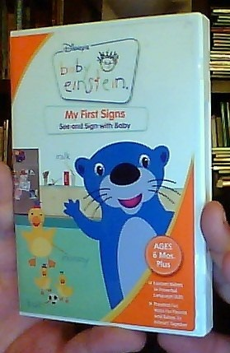
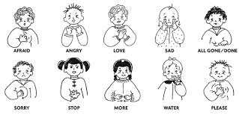
ACTIVITY

Slide 7
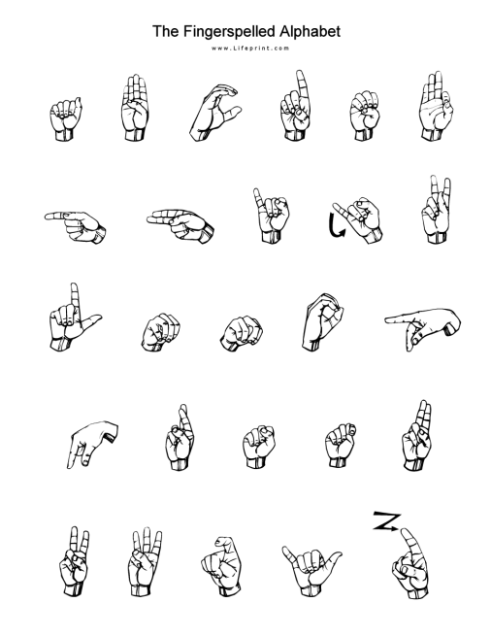
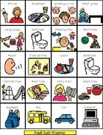
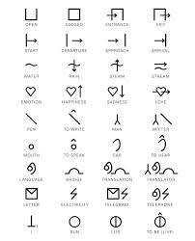
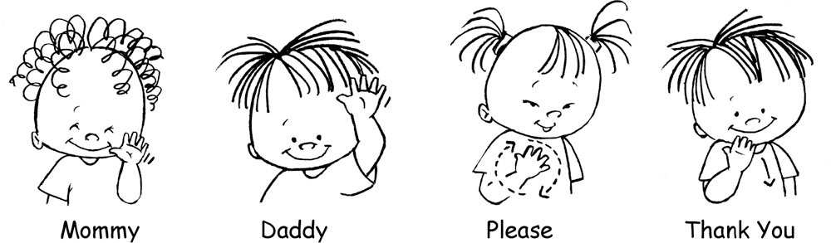
Activity

Slide 8

Sharing
Students share a sample of their communication systems using BLISS Symbols, sign language, Boardmaker, PECS, fingerspelling

