Slide 1
Making Inferences
0

Slide 2
Inference
0
Sometimes a writer will leave certain details out of a story to make it more dramatic or humorous. In these cases, it is up to the reader to draw his/her own conclusion based on the information given. These conclusions are known as inferences.

Slide 3
How to Make an Inference
Use
  what you read about the characters and plot details
  common sense
  Your own experience
  to fill in the missing details.

Slide 4

Make an Inference!
0
What does this image tell me?

Slide 5
Question…
0
What did I already know that helped me make that inference?
Did I use picture or written clues?

Slide 6
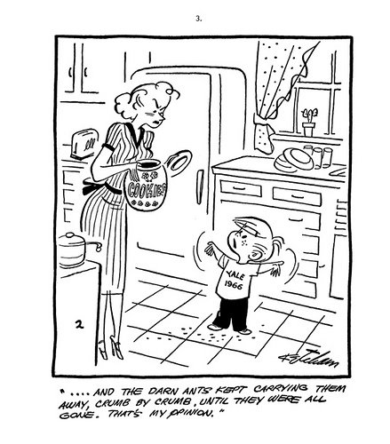
Help Me Make an Inference!
0

Slide 7
More Questions…
0
Did you use words, graphs, or picture clues to help you make a guess about what that cartoon meant?

Slide 8
How Do Good Readers Make Inferences?
0
They use:
Word/text clues
Picture clues
Define unknown words
Look for emotion (feelings)
Use what they already know
Look for explanations for events
ASK themselves questions!

Slide 9
Make Another Inference
0
Miss White has recess duty. Jacob finds a frog, picks it up, and runs over to show it to Miss White. Miss White screams, jumps, and runs as fast as she can into the school.
What can you infer from this passage?
What are the “clues” in this passage?

Slide 10
Game Time!
0
Let’s play a game to find out how good we are at making inferences:
What Can You Infer?

Slide 11
Authors vs. Readers
0
Authors Imply, Readers Infer.
Authors make implications that readers have to infer.
What do I mean by these statements?
Good readers are detectives who are always looking out for clues to help them better understand stories and pictures.

