Slide 1

Flight Delays and Cancellations 2015

Slide 2
Introduction: The Bureau of Transportation Statistics of the U.S. Department of Transportation (DOT) keeps tabs on how well big airlines do in terms of on-time domestic flights. DOT's monthly Air Travel Consumer Report and this dataset of flight delays and cancellations from 2015 provide summary data on the number of flights that were on time, delayed, canceled, and diverted.

Slide 3
Data overview:
data contains 3 files:
Flights: 5819078 rows, 31 columns
Airports: 322 rows, 7 columns
Airlines: 14 rows, 2 columns

Slide 4
Airports
322
Total flights overall
222119
Canceled flights
2735
Delayed flights
92540
Diverted flights
628

Slide 5
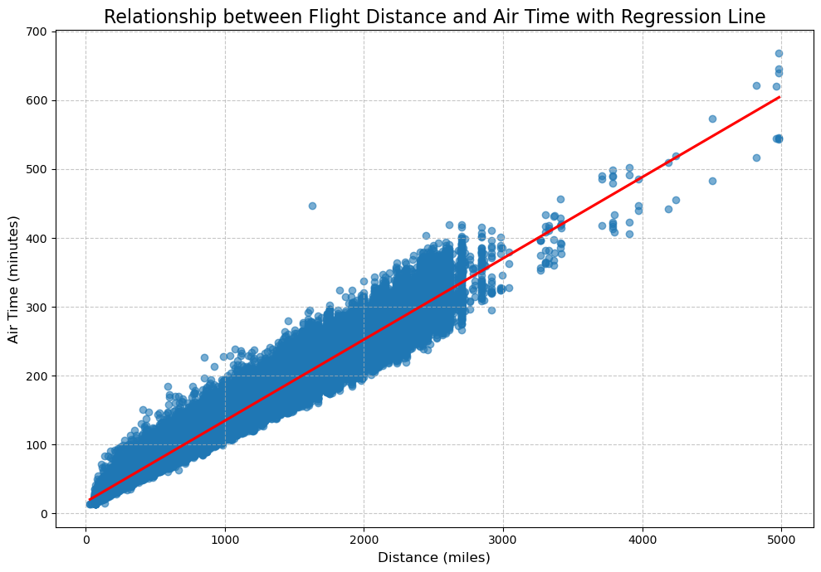

Slide 6
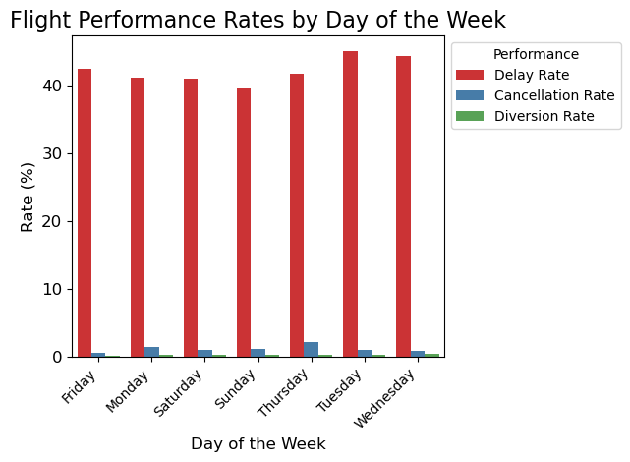

Slide 7
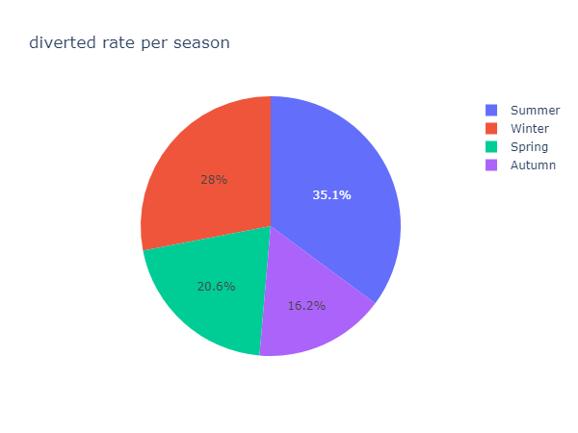
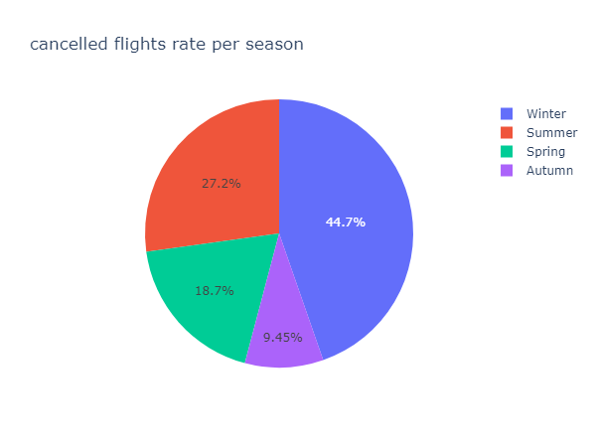
Airlines' performance per season

Slide 8
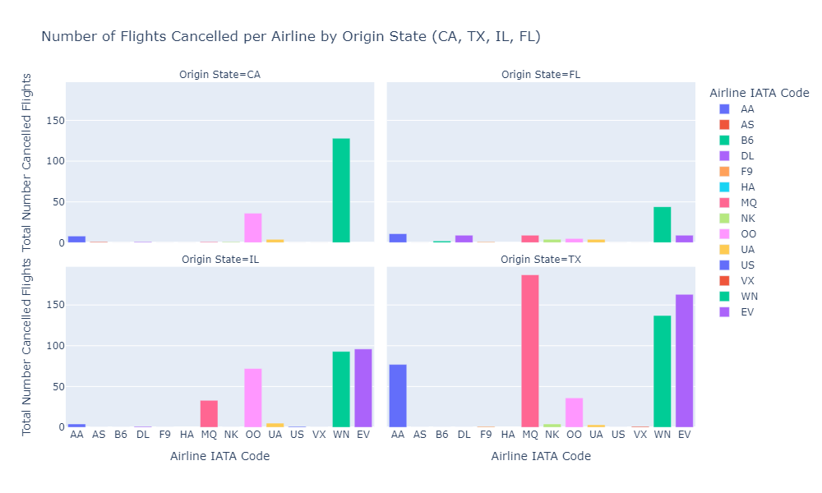
Airlines' performance in the states with the most flights

Slide 9
Data analysis
There is strong relation between flight time and distance
Data show height cancelation and diverted rate in winter season
Airline WN has the highest number in cancelation flights in the states CA and FL.
Airline MQ has highest number in cancelation flights in TX.

Slide 10
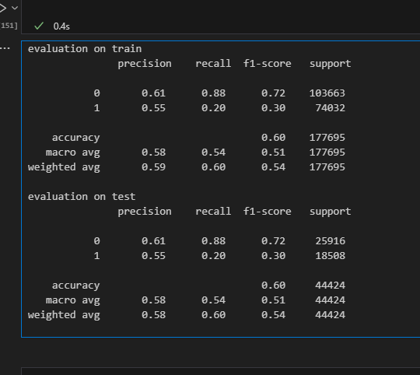
Module for Classification Problems

Slide 11
Conclusions
The model is very weak at predicting delayed flights (which is likely the most important class for you). The overall Accuracy (60%) seems reasonable, but it's misleading because it primarily stems from the model's ability to predict the majority class (non-delayed flights).
Data was imbalance and we need to set another module to predict the canceled flights

