Slide 1

Sokoban project in Java
Advanced Object Oriented Programming

Slide 2
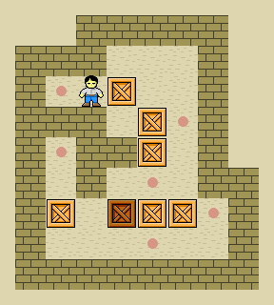


Sokoban in Java

Slide 3
Java MVC Pattern Explanation
Controller
User action
Notifies
Model
View
Update
Update

Slide 4
Code Structure Overview
Model
+levelDataSetting(String[][] s, int r) void
+sokobanPosition() Point
-isBoxAt(int row, int col) boolean
+winCase() boolean
+loseCase() boolean
-update() void

Slide 5
Code Structure Overview
View
+View(Model model, String name)
+getTimerLabel() JLabel
Model
+levelDataSetting(String[][] s, int r) void
+sokobanPosition() Point
-isBoxAt(int row, int col) boolean
+winCase() boolean
+loseCase() boolean
-update() void

Slide 6
Code Structure Overview
View
+View(Model model, String name)
+getTimerLabel() JLabel
Controller
+getDataSaver()
-canPushCrateVertically(int row, int col) boolean
-canPushCrateHoeizontally(int row, int col) boolean
#paintComponent(Graphics g) void
Model
+levelDataSetting(String[][] s, int r) void
+sokobanPosition() Point
-isBoxAt(int row, int col) boolean
+winCase() boolean
+loseCase() boolean
-update() void

Slide 7

