Slide 1

The importance of programming and the importance of learning it

Slide 2

The importance of programming
and the importance of learning it
2

Slide 3
The importance of programming and the importance of learning it
1️⃣ The Importance of Learning Programming the Right Way
🟩 Main Concept: Programming is one of the highest-paying professions and requires proper study and progression.
🟩 Key point: You can't expect to reach a professional level in just a few months.
💡 Example : A doctor studies for nine years to earn a high salary, and the same goes for engineers and lawyers.
2️⃣ Why People Fail to Learn Programming
🟩 Main Concept: Lack of a Progressive and Interconnected Programming Learning Methodology
🟩 Key Point: Most courses focus on a specific language or single skill without building a foundation.
💡 Example : : A student starts programming directly with advanced techniques and skips the basics, becoming a limited programmer.

Slide 4
3️⃣ Foundations of Learning Programming
🟩 Definition: Any profession requires a solid foundation, and programming is no exception.
🟩 Main Concept: Learning programming requires time, effort, and a gradual approach.
🟩 Key Point: Focus on developing analytical and problem-solving skills before learning programming languages.
💡 Example : : Solve addition and subtraction problems on paper before moving on to differential and integral calculus.
4️⃣ Roadmap for Learning Programming
🟩 Definition: A roadmap consists of progressive and interconnected courses, starting with the fundamentals and culminating in specialization.
🟩 Main Concept:
1️⃣ Blue Section: General Foundations of Programming
🟨 Learning Computer Science from Scratch
🟨 Developing Analytical and Logical Thinking
🟨 Gradual Problem Solving (Divide and Conquer, LEGO Method)
🟨 Building Problem-Solving Skills Before Learning Languages
2️⃣ Yellow Section: Beginning Specialization
🟨 Specializes in various fields such as web, mobile, or backend development.
🟨 Intersects with most other specializations.
💡 Example : After completing course 13, you can begin C# and database courses simultaneously.

Slide 5
5️⃣ Sequence of Learning Languages ​​and Tools
🟩Main Concept: Learning programming is not limited to one language, but rather focuses on the principles of problem-solving and logical thinking.
🟩 Key Point: Start with C++ because it requires learning fundamental concepts. 🟩 Later, move on to C# to develop web and mobile applications.
💡 Example: Courses include small projects that gradually increase in difficulty, with an emphasis on applying practical experience.
6️⃣ Practical vs. Theoretical Learning
🟩 Definition: Programming is an applied profession, not a theoretical one.
💡 Example : Remote logic exercises focus on the applied solution, not just observing the code.
7️⃣ Tips for Success in Learning Programming
🟩 Main Concept: Gradual progress and patience are the keys to success.
🟩 Key Point: Don't believe advertisements promising to learn programming in months and earn a high salary immediately.
💡 Example : Completing courses in order accelerates the learning of advanced skills later on and makes any new language easier to learn.

Slide 6
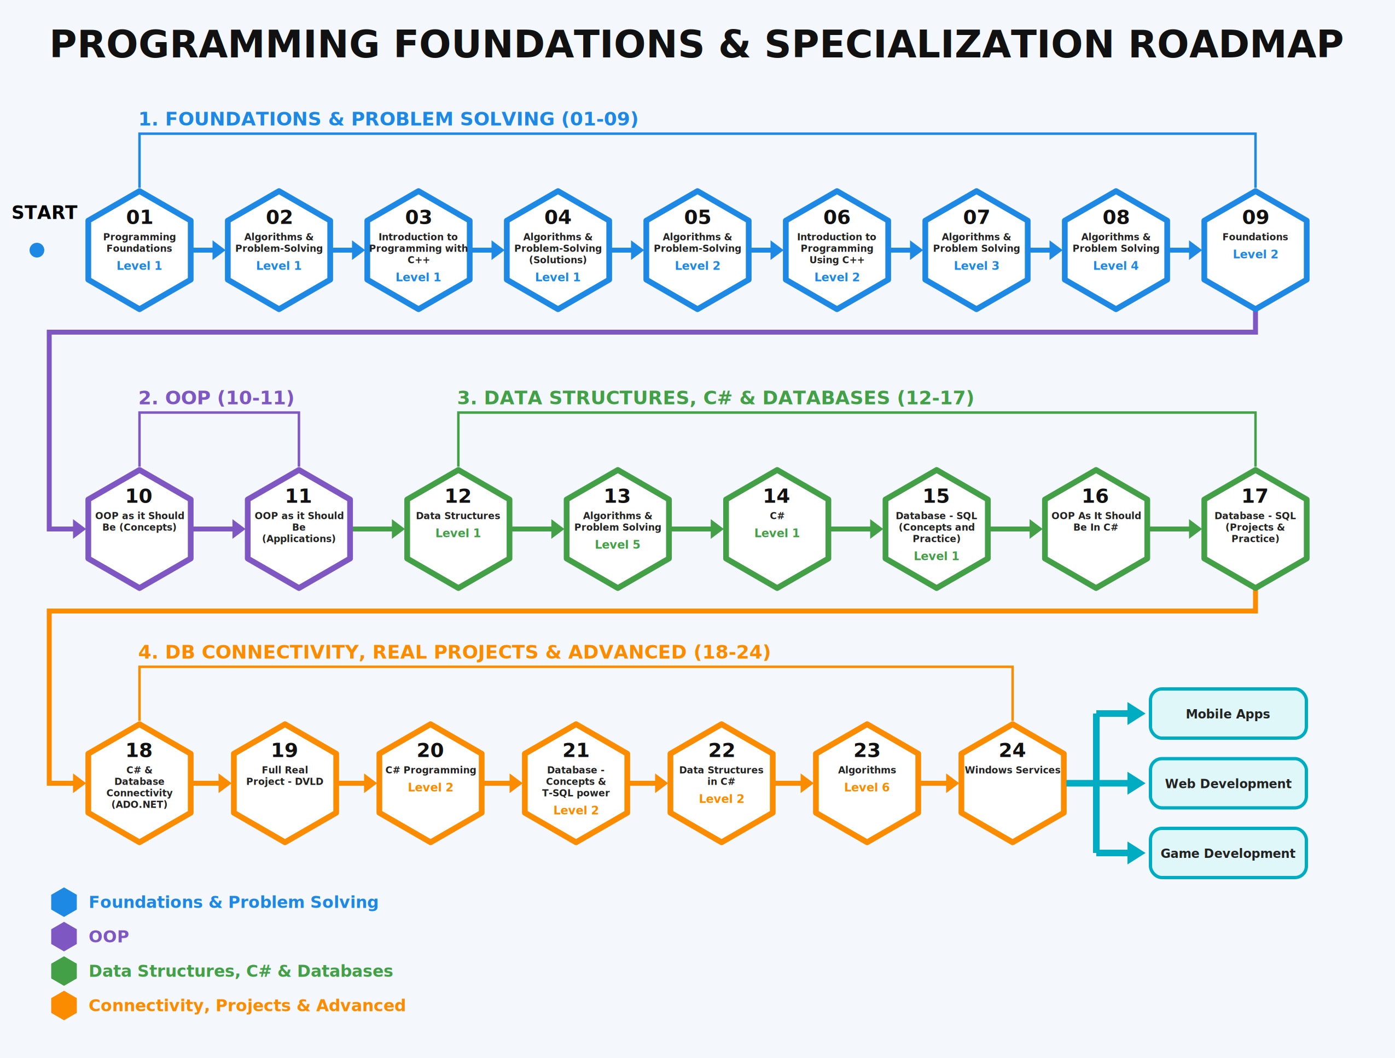

Slide 7
Thank you ☺

