Slide 1

OOP as it Should Be
Level 1

Slide 2

OOP
Level 1
What is
OOP and Why??
2

Slide 3

Functional (FP) vs Object Oriented (OOP)
University System Example (FP)
AddStudent
UpdateStudent
DeleteStudent
CalculateAverage
AddCourse
UpdateCourse
DeleteCouse
EnrollStudentInCourse
UnEnrollStudentFromCoruse
HowManyStudentsInCourse
Doctor (Add, Edit, Delete)
AssignCourse ToDoctor
SendEmail ToStudent
Send TextMessage ToStudent
SendEmailToDoctor
Send TextMessage ToDoctor
CallStudent
CallDoctor
AddEmployee
UpdateEmployee
DeleteEmployee
CalculateSalary
PaySalary
………………….
Simply
You can have thousands of functions in your System!!!!

Slide 4
The problem is not with number of functions at all ☺
The problem is with organizing them and the way you look
at them ☺

Slide 5



  To make it simple for you ☺
  What if you have thousands of contacts and phone numbers and all
  these contacts and numbers are not organized!
  You will have a nightmare ☺

Slide 6
  OOP will solve this Problem for you
  OOP Makes Programming and the Way you look at programming near to the way you look at your lite

Slide 7
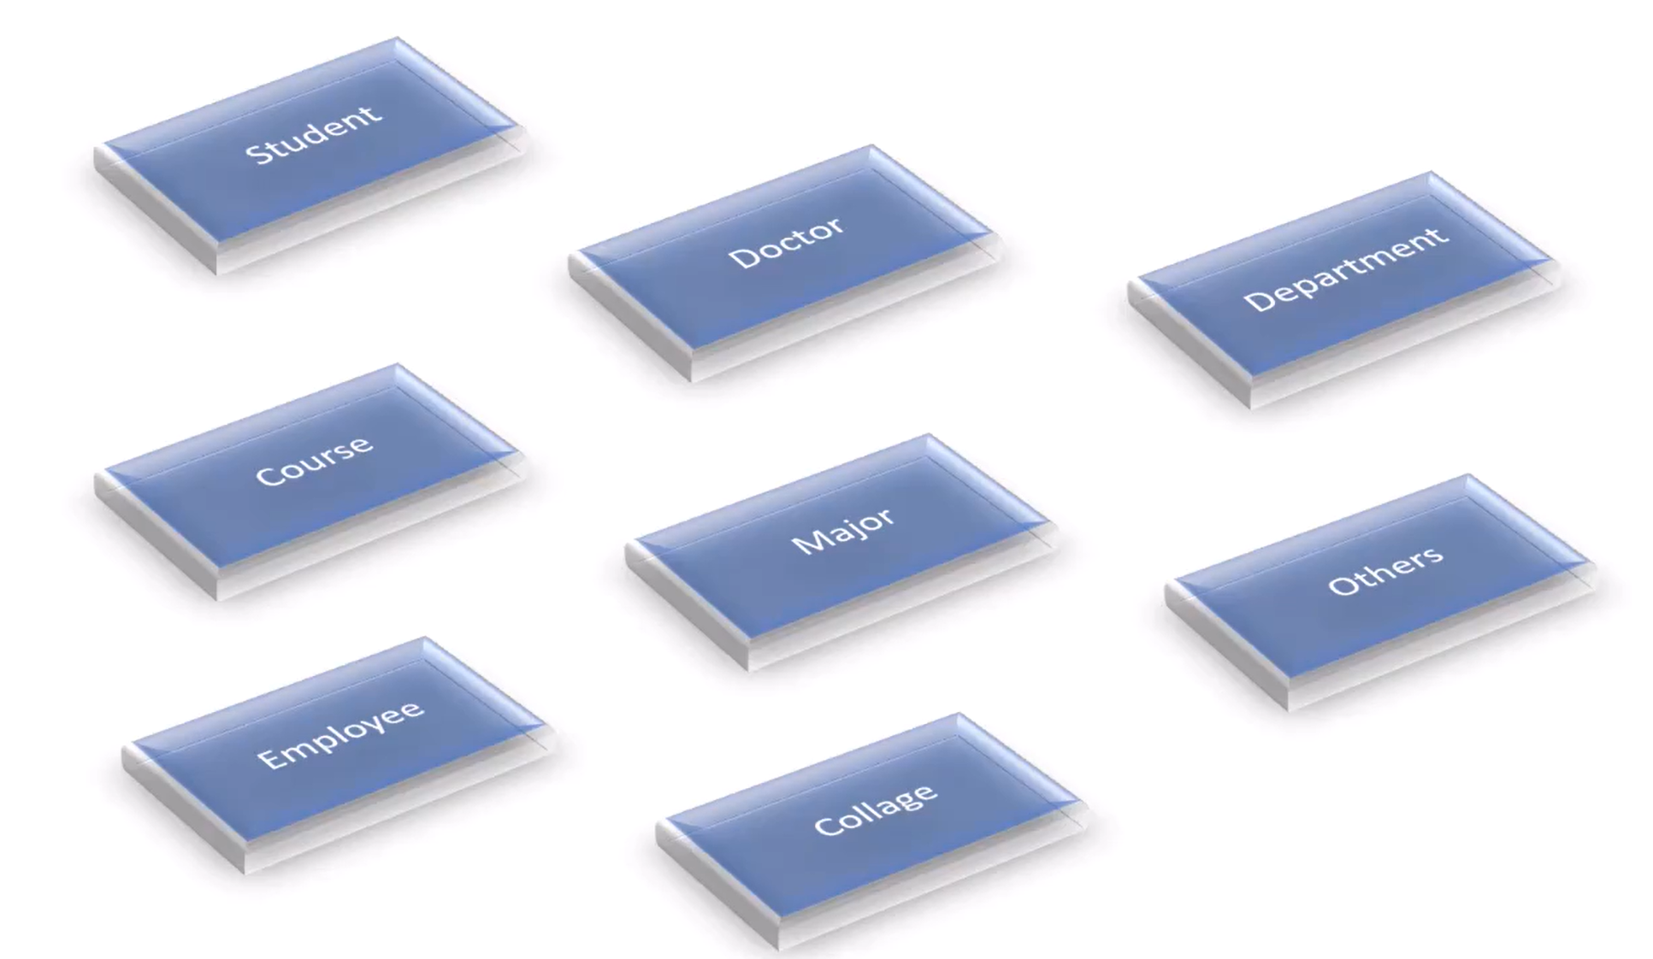
Functional (FP) vs Object Oriented (OOP)
University System Example (OOP)
Simply
Group Members and Functions Inside Related Objects

Slide 8
Functional (FP) vs Object Oriented (OOP)
Student Object
Student1.Name
Student1.Email
Student1.GetEnrolledCourses()
Student1.CalcuateAverage()
Student1.SendEmail(Subject, Body)
Student1.EnrollInCourse(10)
Student1.PayFees
Student1.UnEnrolFromCourse(10)
You can do whatever you want with a certain student through its object

Slide 9
Thank you ☺

