Slide 1

OOP as it Should Be
Level 1

Slide 2

OOP as it Should Be
Level 1
Classes and Objects
2

Slide 3

Functional (FP) vs Object Oriented (OOP)
University System Example (FP)
AddStudent
UpdateStudent
DeleteStudent
CalculateAverage
AddCourse
UpdateCourse
DeleteCouse
EnrollStudentInCourse
UnEnrollStudentFromCoruse
HowManyStudentsInCourse
Doctor (Add, Edit, Delete)
AssignCourse ToDoctor
SendEmail ToStudent
Send TextMessage ToStudent
SendEmailToDoctor
Send TextMessage ToDoctor
CallStudent
CallDoctor
AddEmployee
UpdateEmployee
DeleteEmployee
CalculateSalary
PaySalary
………………….
Simply
You can have thousands of functions in your System!!!!

Slide 4
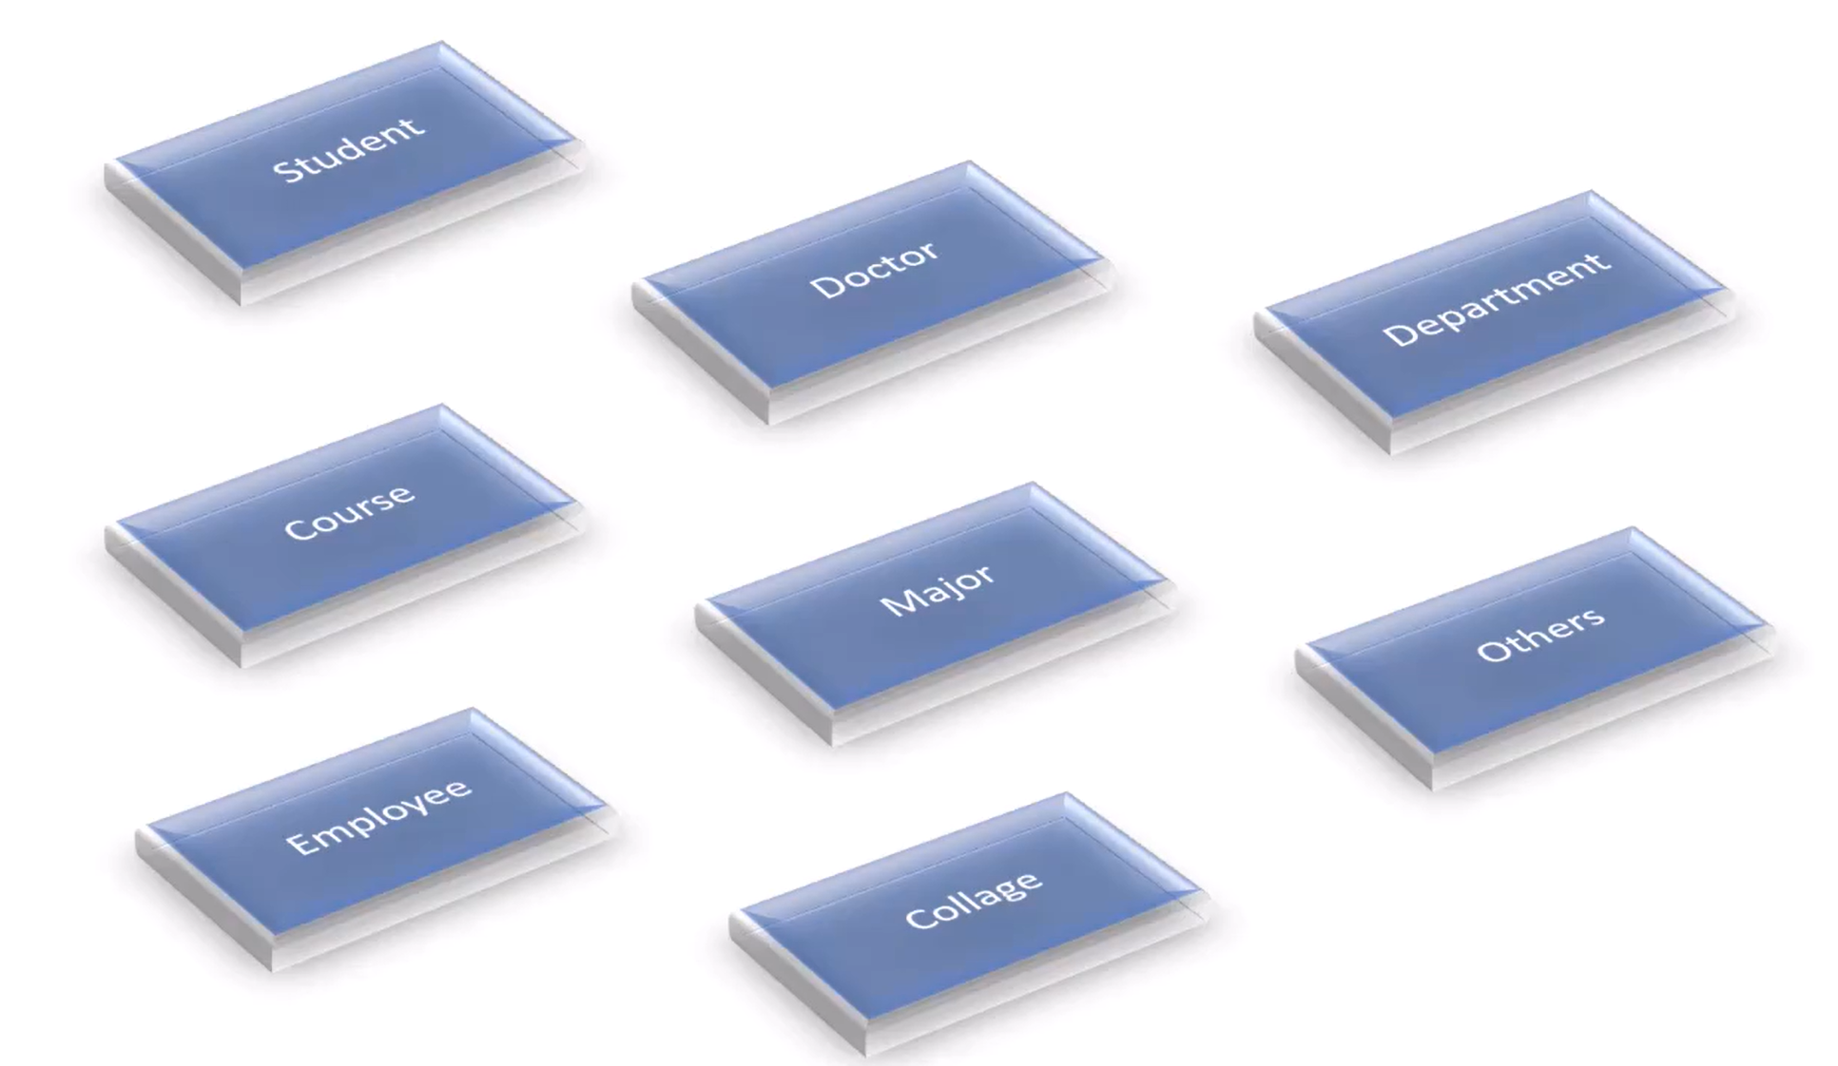

What is Class? Why we call it Class?
University System Example (OOP)
Class
Class
Class
Class
Class
Class
Class
Class
Simply
Class came from Classification

Slide 5
OOP as it Should Be
Level 1
Let us code now….
2

Slide 6
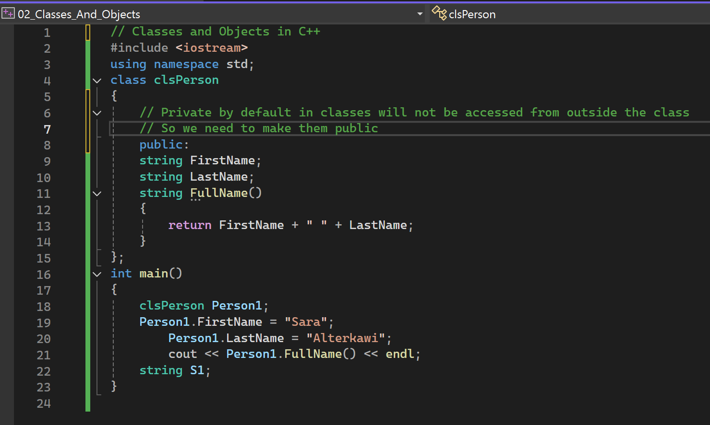

Slide 7
OOP as it Should Be
Level 1
Class Members
2

Slide 8
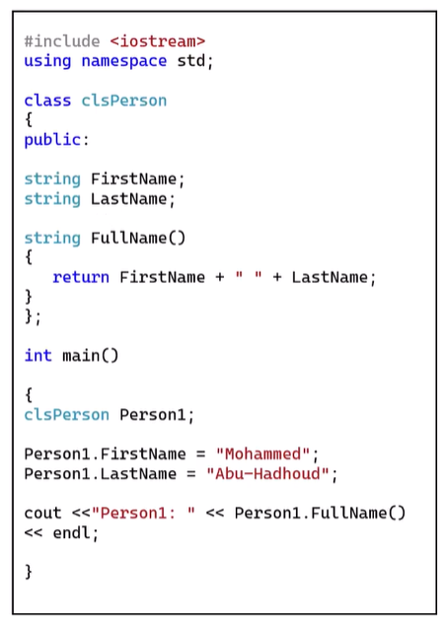
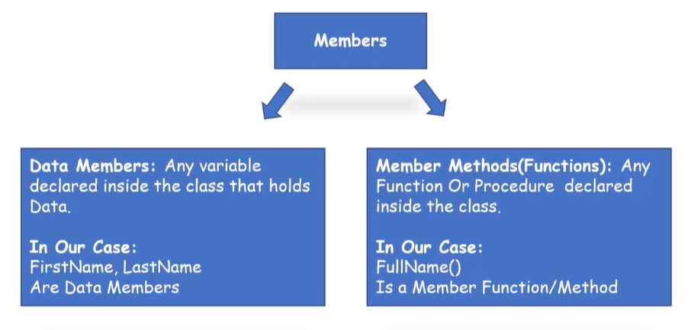
Class Members

Slide 9
OOP as it Should Be
Level 1
Objects In Memory
2

Slide 10
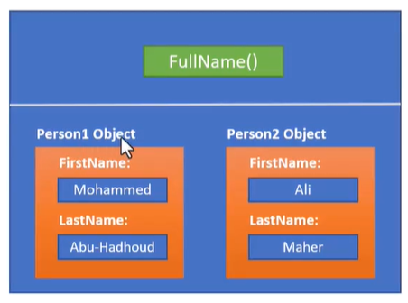
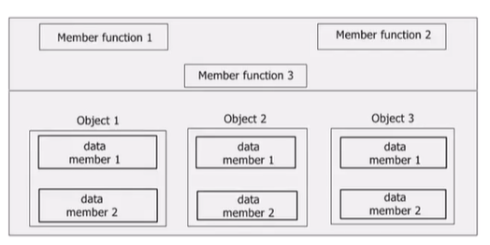
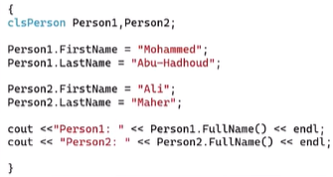
Each instance has its own space in memory, Only Member functions are shared among all objects

Slide 11
Thank you ☺

