Slide 1

OOP as it Should Be
Level 1

Slide 2

OOP as it Should Be
Level 1
Classes and Objects
2

Slide 3
OOP as it Should Be
Level 1
Access Specifiers/Modifiers
2

Slide 4
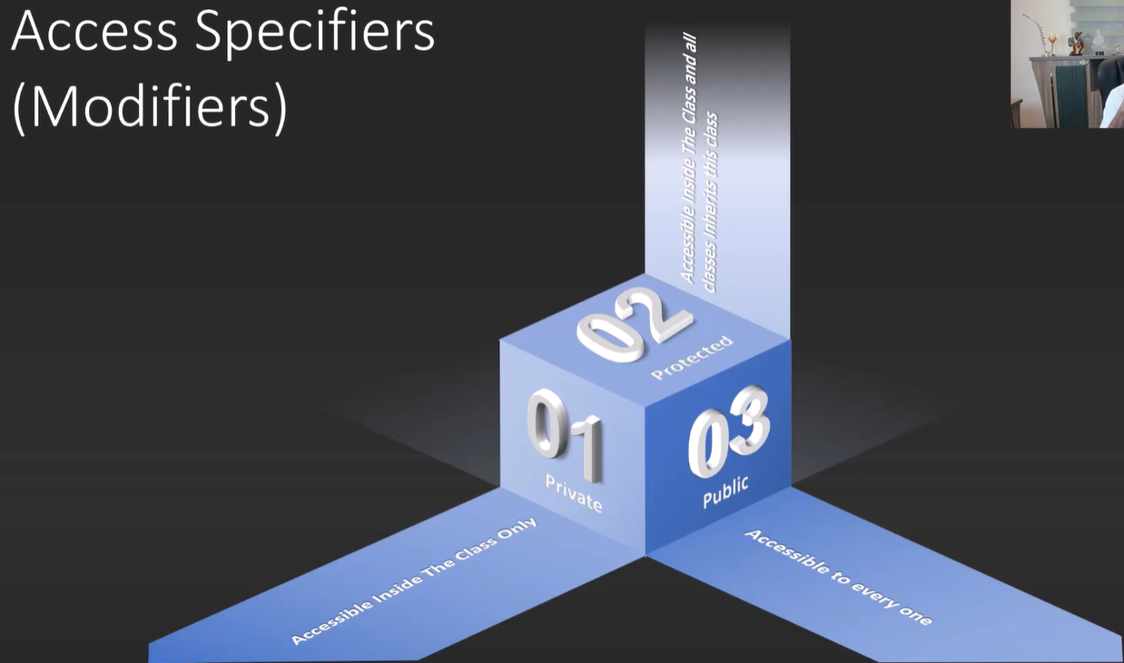
Access Specifiers/Modifiers

Slide 5
Thank you ☺

