Slide 1

OOP as it Should Be
Level 1
First Principle Concept Of OOP Encapsulation

Slide 2

OOP as it Should Be
Level 1
First Principle Concept Of OOP Encapsulation
2

Slide 3

Functional (FP) vs Object Oriented (OOP)
University System Example (FP)
AddStudent
UpdateStudent
DeleteStudent
CalculateAverage
AddCourse
UpdateCourse
DeleteCouse
EnrollStudentInCourse
UnEnrollStudentFromCoruse
HowManyStudentsInCourse
Doctor (Add, Edit, Delete)
AssignCourse ToDoctor
SendEmail ToStudent
Send TextMessage ToStudent
SendEmailToDoctor
Send TextMessage ToDoctor
CallStudent
CallDoctor
AddEmployee
UpdateEmployee
DeleteEmployee
CalculateSalary
PaySalary
………………….
Simply
You can have thousands of functions in your System!!!!

Slide 4
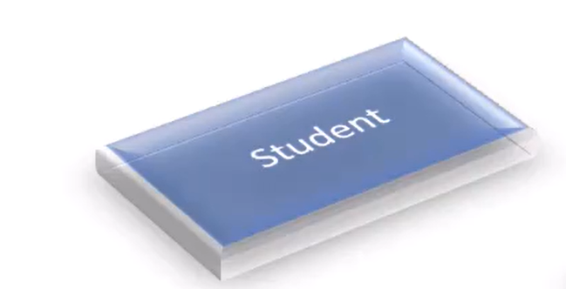
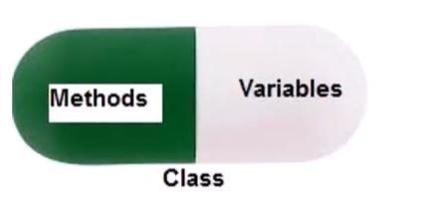

Encapsulation in Object Oriented (OOP)
Student1.Name
Student1.Email
Student1.GetEnrolledCourses()
Student1.CalcuateAverage()
Student1.SendEmail(Subject, Body)
Student1.EnrollInCourse(10)
Student1.PayFees
Student1.UnEnrolFromCourse(10)
You can do whatever you want with a certain student through its object

Slide 5
🔎 Definition
Encapsulation is an OOP principle that bundles data with its methods and restricts direct access to an object’s internal state.

Slide 6
Thank you ☺

