Slide 1

OOP as it Should Be
Level 1
Multi Level Inheritance

Slide 2

OOP as it Should Be
Level 1
Multi Level Inheritance
2

Slide 3
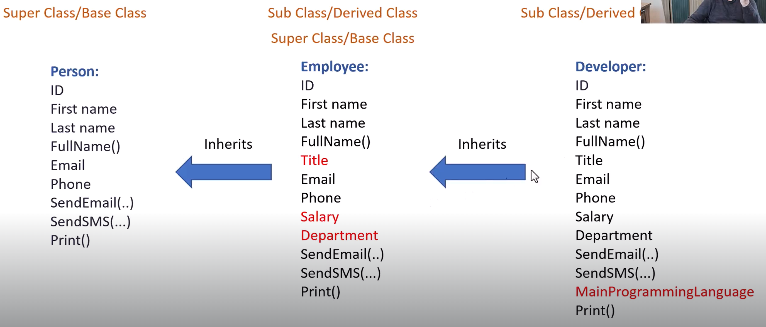

Slide 4
🔎 Definition
Multi-level inheritance occurs when a class derives from a derived class, forming a chain of inheritance..

Slide 5
📖 Explanation
🔹 clsPerson → base class (person info)
🔹 clsEmployee → derived from clsPerson (job info)
🔹clsDeveloper → derived from clsEmployee (programming language info)

Slide 6
🟨 Base Class clsPerson Structure
🔹 Holds personal attributes
🟨 Private members
🟩 _ID
🟩 _FirstName
🟩 _LastName
🟩 _Email
🟩 _Phone
🟨 Public functionality
🟩 Accessors (get/set)
🟩 FullName() → concatenates first + last
🟩 Print() → prints formatted personal info
🟩 SendEmail()
🟩 SendSMS()

Slide 7
🟨 Derived Class clsEmployee Structure
🔹 Extends clsPerson
🟨 Additional private members
🟩 _Title
🟩 _Department
🟩 _Salary
🟨 Constructor responsibilities
🟩 Pass personal fields to parent class constructor
🟩 Initialize additional employee fields
🟨 Public methods
🟩 setter + getter pairs for:
🟩 Title()
🟩 Department()
🟩 Salary()

Slide 8
🟨 Derived Class clsDeveloper Structure
🔹 Extends clsEmployee
🟨 Additional private members
🟩 _ MainProgrammingLanguage
🟨 Constructor responsibilities
🟩 Pass personal fields to parent class constructor
🟩 Initialize additional employee fields
🟨 Public methods
🟩 setter + getter pairs for:
🟩 MainProgrammingLanguage

Slide 9
🟦 Steps in main()
1️⃣ Create a clsDeveloper object
2️⃣ Constructor chain initializes clsPerson → clsEmployee → clsDeveloper
3️⃣ Call Print() → shows all personal, job, and programming info
4️⃣ Call SendEmail() inherited from clsPerson
5️⃣ Call Print() again

Slide 10
➡️ Expected Output
Employee Info:
------------------------------------------
ID : 10
Name : Sara Alterkawi
Email : sara.omar.alterkawi@gmail.com
Phone : 0706357155
Title : Software Engineer
Department : IT
Salary : 6500$
Main Programming Language : Java
------------------------------------------
The following message sent successfully to email : sara.omar.alterkawi@gmail.com
Subject :Hi Developer
Body :How are you?

Slide 11
📌 Note
All messaging methods are simulated. Real sending requires external services.

Slide 12
⚖️ Comparison
🟩 Employee class (derived)
✔️ Extends the Person class
✔️ Adds job-related fields (Title/Department/Salary)
✔️ Uses constructor chaining to initialize both parts
⬜ Person class (base)
✔️ Holds personal identity and contact info
✔️ Provides messaging utilities (email/SMS)
✔️ Print shows only personal data (unless overridden)

Slide 13
🚫 Warning
Salary is stored as string, which is not suitable for calculations without conversion.

Slide 14
✨ Summary
✅ Developer object contains personal, job, and programming info
✅ Constructor chaining ensures fields are initialized correctly
✅ Getters/setters protect private data
✅ Unified messaging behavior via inheritance

Slide 15
Thank you ☺

