Slide 1

OOP as it Should Be
Level 1
Inheritance Visibility Modes

Slide 2

OOP as it Should Be
Level 1
Inheritance Visibility Modes
2

Slide 3
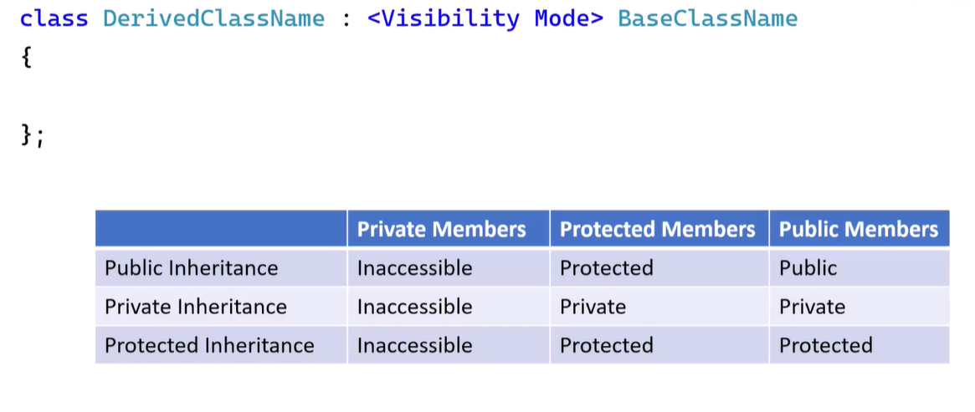
Syntax

Slide 4
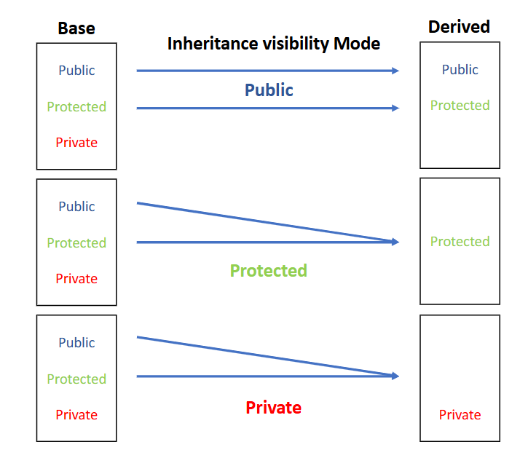
Visibility Modes

Slide 5
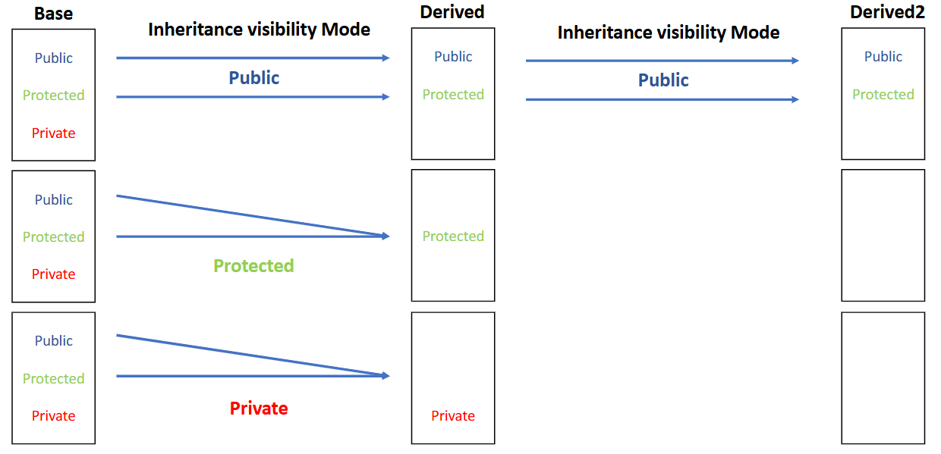
Visibility Modes

Slide 6
🔎 Definition
Multi-level inheritance occurs when a class is derived from another derived class, forming an inheritance chain.

Slide 7
📖 Explanation
🔹 The example demonstrates how private, protected, and public members behave across multiple inheritance levels
🔹 It also shows how inheritance mode (public / protected / private) affects accessibility from objects and derived classes

Slide 8
🟨 Base Class: clsA
🔹 Represents the base class with all three visibility types
🟨 Member Visibility
🟩 Private members
🟨 V1
🟨 Fun1()
❌ Not accessible outside clsA
🟩 Protected members
🟨 V2
🟨 Fun2()
✔️ Accessible in derived classes
❌ Not accessible through objects
🟩 Public members
🟨 V3
🟨 Fun3()
✔️ Accessible everywhere

Slide 9
🟨 Derived Class: clsB : private clsA
🔹 clsB privately inherits from clsA
🟨 Effect of private inheritance
🟩 public members of clsA
🟨 Become private inside clsB
🟩 protected members of clsA
🟨 Become private inside clsB
🟩 private members of clsA
❌ Still inaccessible
🔹 clsB adds its own public method:
🟩 Fun4()

Slide 10
🟨 Derived Class: clsC : public clsB
🔹 clsC publicly inherits from clsB
🟨 Important consequence
🟩 Members inherited from clsA
🟨 Were already private inside clsB
❌ Cannot be accessed in clsC
🟩 Only members visible to clsC
🟨 Public members of clsB
🟨 Fun4()
🔹 clsC adds:
🟨 Fun5()

Slide 11
🟦 Steps in main()
1️⃣ Create object of clsB
2️⃣ Try accessing members through B1
🟩 Allowed:
🟨 Fun4()
🟥 Not allowed:
🟨 V3, Fun3() (became private due to private inheritance)
3️⃣ Create object of clsC
4️⃣ Try accessing members through C1
🟩 Allowed:
🟨 Fun5()
🟨 Fun4()
🟥 Not allowed:
🟨 Any members originally from clsA

Slide 12
➡️ Expected Output
🔹 Private inheritance blocks access to base class members from outside
🔹 Visibility reduction is permanent and affects further derived classes
🔹 Multi-level inheritance amplifies visibility restrictions

Slide 13
⚖️ Comparison
🟩 Public inheritance
✔️ Preserves visibility
✔️ Models “is-a” relationships
🟨 Protected inheritance
✔️ Hides members from objects
✔️ Keeps access for derived classes
🟥 Private inheritance (used here)
✔️ Completely hides base class interface
✔️ Breaks access for further inheritance levels

Slide 14
🚫 Warning
🔹 Using private inheritance:
🟨 Makes base class members inaccessible to objects
🟨 Prevents reuse in further derived classes
🟨 Is rarely recommended unless intentional encapsulation is needed

Slide 15
✨ Summary
✅ Demonstrates multi-level inheritance
✅ Shows visibility transformation
✅ Explains why private inheritance is restrictive
✅ Reinforces access rules through objects vs classes
✅ Ideal for understanding C++ inheritance mechanics

Slide 16
Thank you ☺

