Slide 1

OOP as it Should Be
Level 1
Inheritance Types

Slide 2

OOP as it Should Be
Level 1
Inheritance Types
2

Slide 3
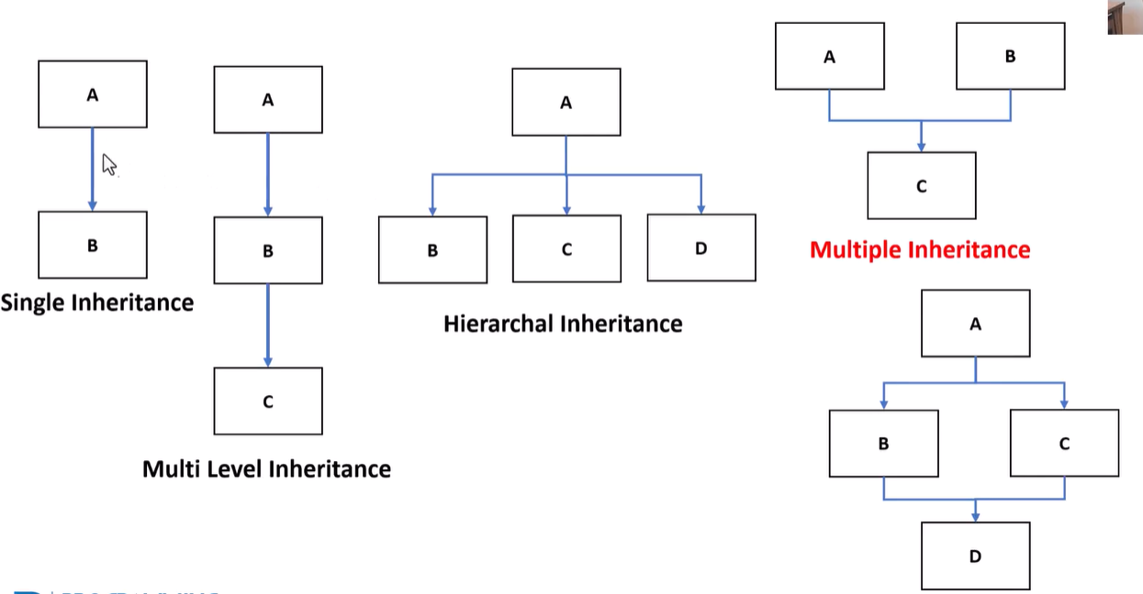
Inheritance Types

Slide 4
Thank you ☺

